Slide 1




Thursday 11th March 2021
L.O. To investigate places.
C: Continents and countries.

Slide 2
Our New Topic!
Today we are going to begin exploring our new topic: Binfield!
We are going to begin our topic by using a variety of maps and atlases to explore Binfield’s location.

Slide 3
Starter:
On your desks there are some Atlases. Please explore them.
While exploring them, think about these questions:
What are they for?
What information do they give us?
What special features can you find?

Slide 4
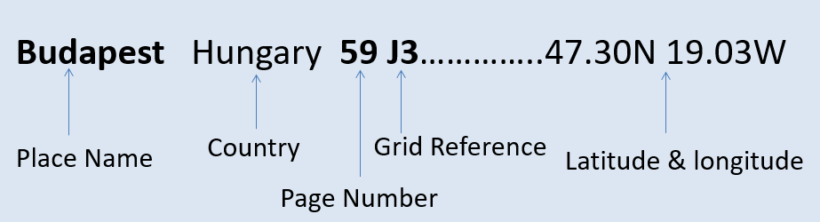
An Atlas has lots of features:
These include:
A contents page with gives us an overview of the Continents and the World
An index page which helps us to find specific areas
Maps with lots of symbols, keys and scales
Demographics (facts about different countries around the world)

Slide 5
First, I would like you to explore the world!
What do you notice?
Let’s look at Google Earth too!

Slide 6
First, I would like you to explore the world!
What do you notice?
Let’s look at Google Earth too!
The earth is split into 7 continents.
Let’s watch this song to learn more…
https://www.youtube.com/watch?v=35V2dm7JIwE

Slide 7
Each continent is made up of lots of countries!
Do you know what country we live in?
Can you name any more?

Slide 8
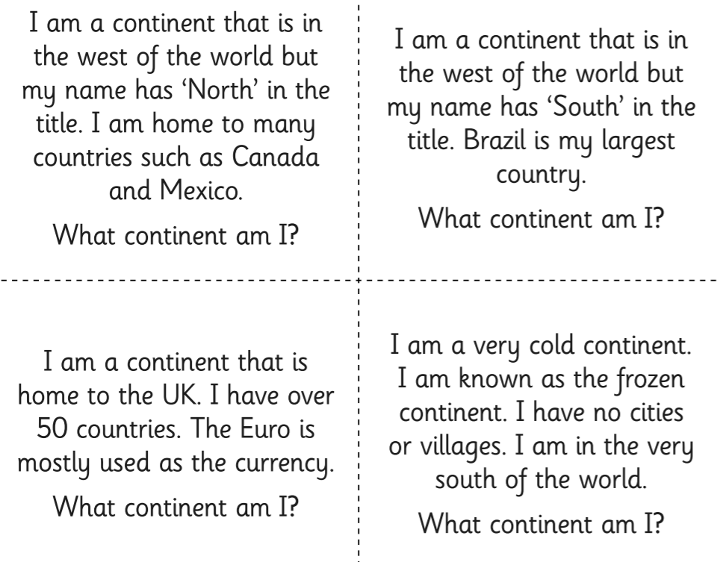
Now we are experts let’s try these riddles…

Slide 9
Our task!
Now we have built our understanding let’s begin exploring Binfield.
First, can you circle which continent Binfield is in?

Slide 10
Our task!
Now we have built our understanding let’s begin exploring Binfield.
Next, can you circle which country Binfield is in?

Slide 11
Our task!
Now we have built our understanding let’s begin exploring Binfield.
Next, can you circle which county Binfield is in?

Slide 12
Our task!
Now we have built our understanding let’s begin exploring Binfield.
Next, can you find Binfield in Berkshire?

Slide 13
Our task!
Lastly, let’s try to write a paragraph including some geographical facts about Binfield…

Slide 14
Our task!
Binfield is a ? West of London. The nearest town is ?. Binfield is in ? which is part of the UK. Binfield is a rural/urban location and is surrounded by fields. There is a ? running through it.

Slide 15
Our task!
Binfield is a village West of London. The nearest town is Bracknell. Binfield is in England which is part of the UK. Binfield is a rural location and is surrounded by fields. There is a river running through it.

