Slide 1
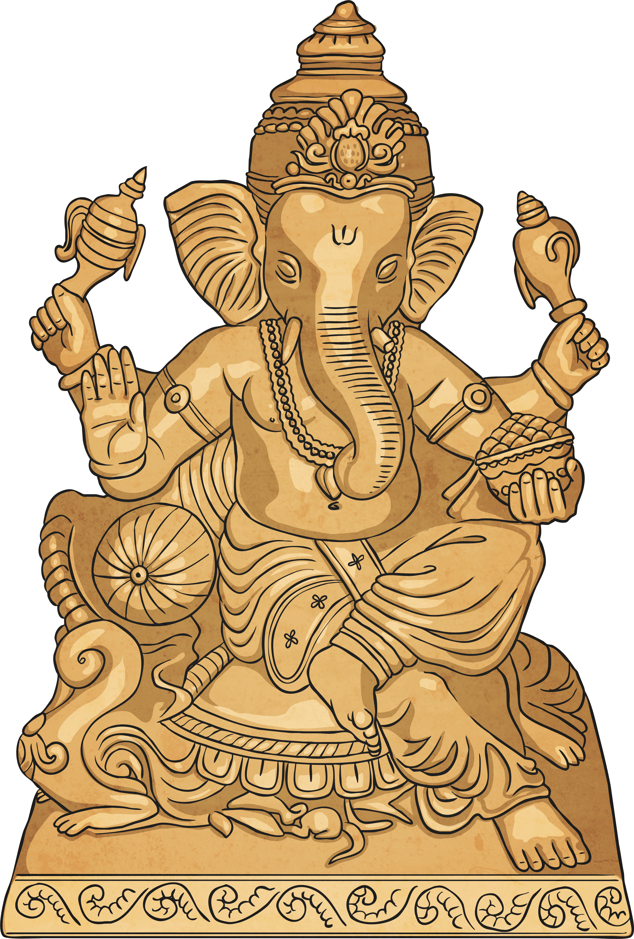
Hinduism
Hinduism is a religion which has fused many different traditions and practices. There is no one way to be a Hindu, nevertheless, there are certain fundamental principles that all Hindus share.

Slide 2
Moksha
Moksha - each person has a soul. Hindus believe the soul can be released to be with Brahman. So if a person dies they do not have to go through rebirth and be born again. This can be done through Yoga, meditation and devotion to god and by working selflessly.

Slide 3
Moksha
Moksha is…
Liberation – from samsara: the cycle of birth, death and rebirth.
Salvation – of the soul which is rescued from the material world and delivered into the spiritual world.
The Goal – of Hindus who eventually hope to achieve moksha. Though many accept this might not happen for their next rebirth they aim to produce positive karma in the hope of a good rebirth that might be a little closer to moksha

Slide 4
Karma
Karma – to be pure and good. To have knowledge and show devotion. If you achieve this you will be reborn to a higher level, when you die.

Slide 5

Karma
Karma refers to the law of cause and effect i.e. actions have consequences.
Hindus believe this is a law of the universe -> Every single action has an affect on something else.
Karma decides where you come back and what you come back as.
If your actions are good you will get a good rebirth into pleasant circumstances; if they are bad you will get a bad one.
Notes:
In a lifetime people build up karma, both good and bad, based on their actions within that lifetime. This karma affects their future lives and existences. People must take responsibility for their actions either within this life time or the next

Slide 6
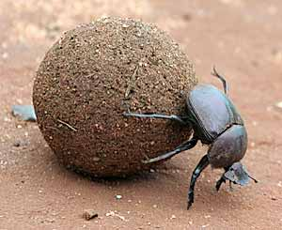
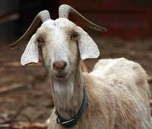
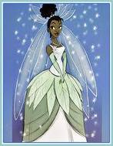
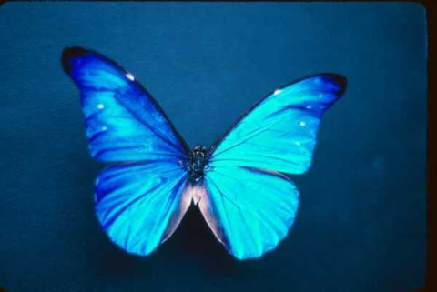
Karma
In a lifetime people build up karma, both good and bad, based on their actions within that lifetime.
Influences circumstances of future lives.
There are lots of different types of rebirth in samsara, e.g. human or a pig; a prince or a homeless person, in India or Ireland.
It all depends on what you deserve.

Slide 7
Summary
SAMSARA IS THE CYCLE OF LIFE
REINCARNATION IS A RESULT OF PREVIOUS KARMA
KARMA RELATES TO ACTIONS AND THEIR CONSEQUENCES
MOKSHA IS LIBERATION FROM SAMSARA

