Slide 1


Slide 4
39 ÷ 3 =
13
42 ÷ 3 =
14
39
42
30
30
9
40
2
12
÷ 3
÷ 3
÷ 3
÷ 3
10
3
10
4
10 + 3 =
13
10 + 4 =
14

Slide 5

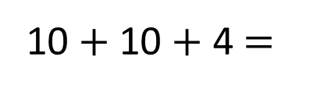
51 ÷ 3 =
17
96 ÷ 4 =
24
Have a think
51
96
96
40
16
1
40
30
21
16
50
11
80
40
÷ 4
÷ 4
÷ 3
÷ 3
÷ 4
÷ 4
÷ 4
10
4
10
7
20
10
4
10 + 7 =
17
24
10 $+$ 10 + 4 =
24
20 + 4 =

Slide 7
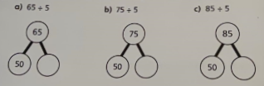

Slide 8
Now try these:
78 ÷ 6 = 84 ÷ 3 =
70 ÷ 5 = 96 ÷ 4 =

