Slide 1

Thursday 11th March 2021
L.O: To understand texts- inference skills
C: Boy

Slide 2
Starter:
Thinking Question:
What do you think children did for fun in 1918?

Slide 3
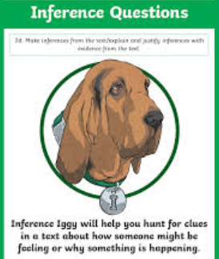
We are going to continue reading the story today.
We will be using our Inference Iggy skills today!

Slide 4
Class Read: p.11-14

Slide 5
Question 1:
Using evidence from the text, can you draw a labelled picture of the house at Radyr and its grounds?

Slide 6
Question 2
Imagine you are two year old Roald Dahl, living in the house at Radyr.
Write a paragraph explaining something you would have explored or played with.
I will model this for you…

Slide 7
Live Teacher Modelling
If I was two year old Roald Dahl...

Slide 8

Red Pen Challenge:
Would you rather be a child in today’s times or back in 1918? Why?

