Slide 1
Wednesday 2nd December 2020
L.O: To order processes.
C: Explanation Text
Today we are going to learn all about the mummification process!

Slide 2
Your task is to order the processes as we go along!
You need to stick in the pictures in order and write a detailed sentence to explain each step!

Slide 3
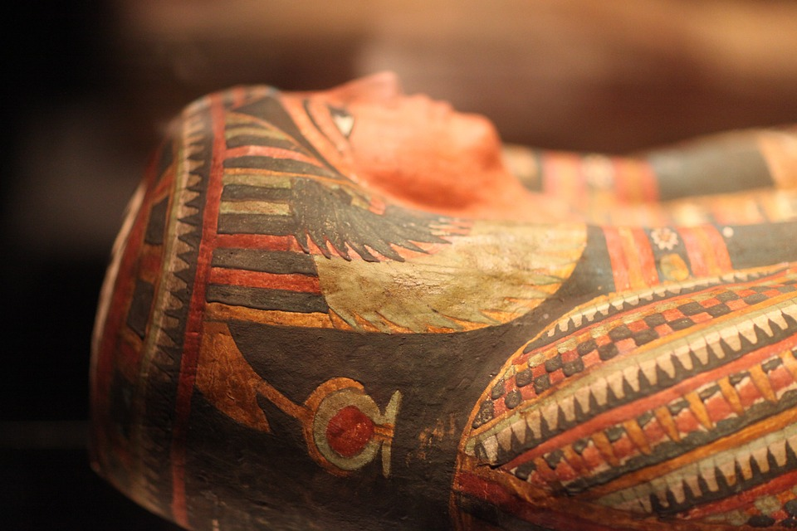
What is a Mummy?
A mummy is a body that has been preserved after death, it could be a human or an animal.

Slide 4
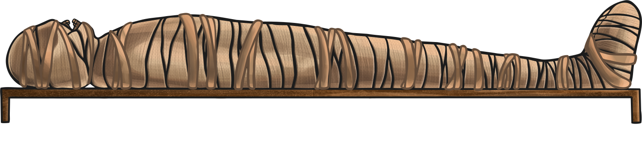
Why did the Egyptians preserve bodies?
The Egyptians believed that when they died their soul left their bodies. After they were buried their soul would return and together with the body would live forever in the afterlife when the world had ended. Unless their body was preserved, it would be no good in the afterlife.
Did all Egyptians preserve bodies?
Not everyone could afford to, it was a very expensive process that took around 70 days to complete.

Slide 5
How did the mummification process start?
The first ancient Egyptians didn’t go through the long mummification process, they just buried people in small pits in the sand. The bodies dehydrated in the dry heat of the desert, preserving them naturally.
The downside to this was the risk of the bodies being eaten by wild animals. You didn’t want to enter the afterlife with a half-eaten body after all. To stop this happening they started using coffins, but when the bodies weren’t lying on the sand they didn’t dehydrate so they decayed.
By 3400BC they had developed the method they are famous for today.

Slide 6
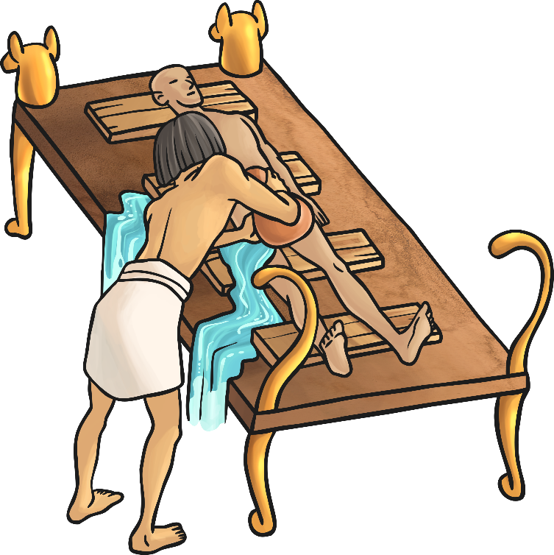
What was the process?
The body was taken to a place called the Beautiful House. It wasn’t as beautiful as the name suggests!
The body was cleansed with palm wine and rinsed with water from the River Nile.
Sometimes they would use a slatted bed on a slant. This would let fluids drain off and out of the body, and allow them to wrap the strips of linen around the body.

Slide 7
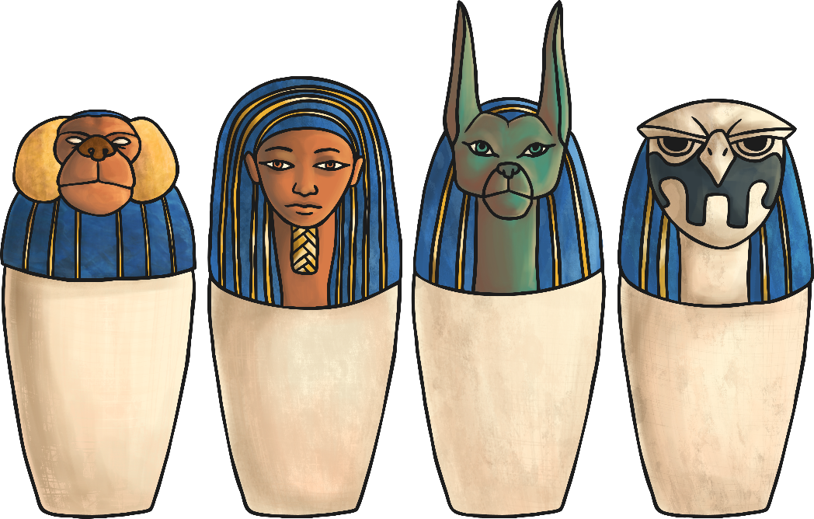
Organs
A cut was made on the left side of the body and the organs removed to stop the body decomposing.
The liver, lungs, intestines and stomach were washed, dried in natron and either wrapped in cloth to place in the body later or stored in canopic jars.
The heart, responsible for intelligence and emotion, was left in the body as it was needed in the afterlife.
Natron is a natural salt.

Slide 8

Canopic Jars
The canopic jars had four different heads representing the four
sons of Horus.
Hapi
Baboon headed God. Looked after the lungs.
Imsety
Huma headed
God. Looked
after the liver.
Duamutee
Jackal headed
God. Looked
after the stomach.
Qebehsenuef
Falcon headed God. Looked after
the intestines.

Slide 9
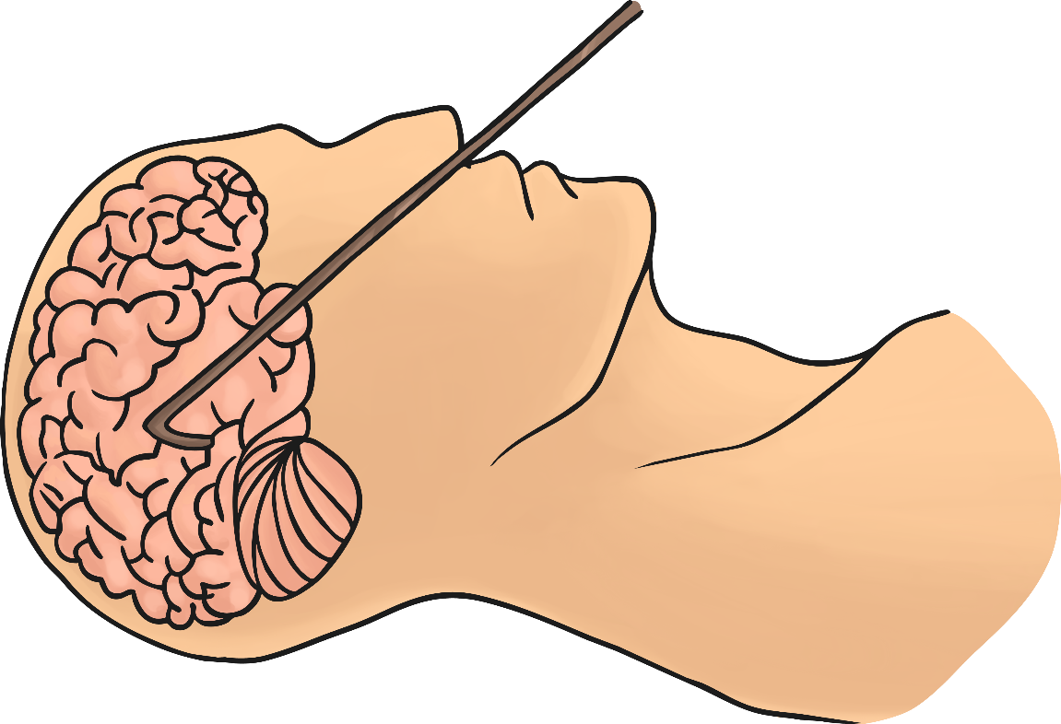
The Brain
The brain wasn’t thought to be important! A long hook was pushed up through the nose to smash the brain to pieces, then either pull it out or lift the body so the liquefied brain would drain out through the nose.
This prevented them having to damage the head or the skull.

Slide 10
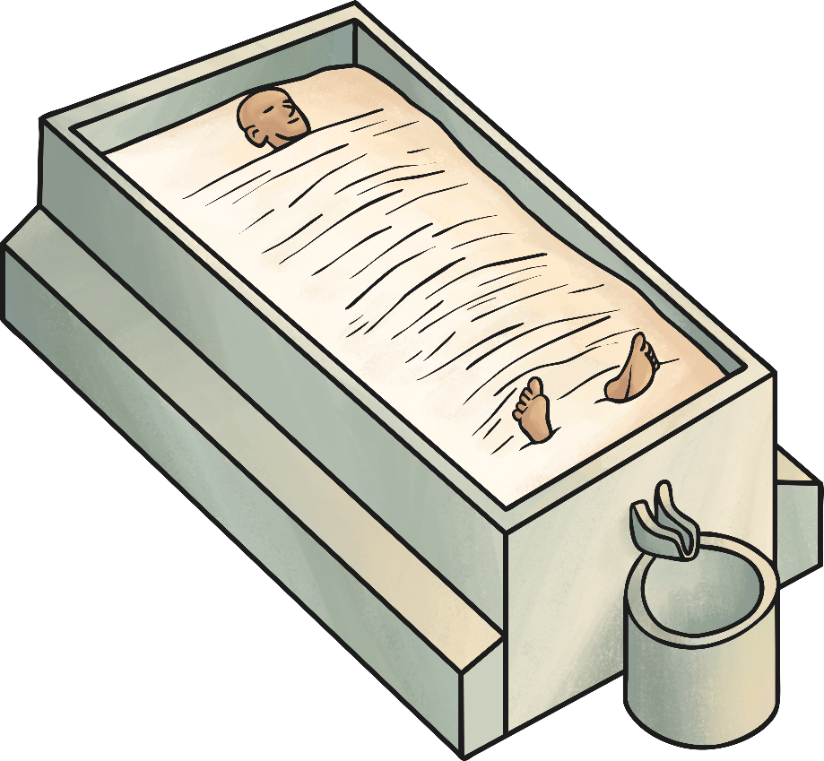
Natron
75% of the body is water.
Wet things rot very quickly so the body was dried inside and out with natron.
Natron absorbed the moisture but it could take 40-50 days.

Slide 11

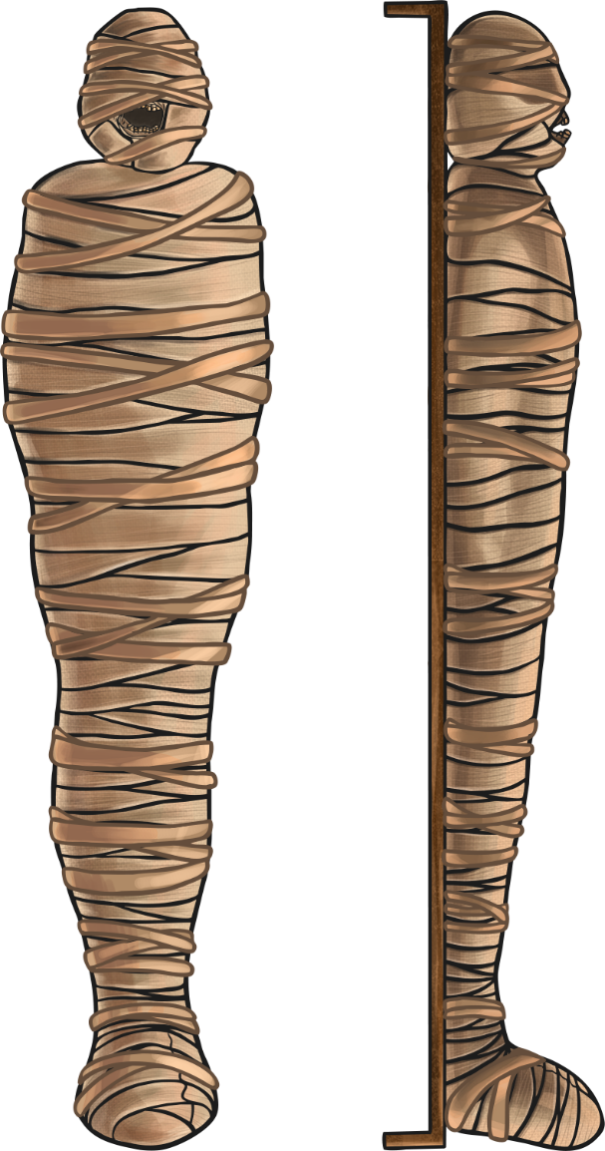
Further Preservation
Unless they were put in canopic jars, the dried organs would be replaced, or the body filled with sawdust, rags or leaves so it kept it’s shape.
In order to preserve the skin it was coated in a resin made from plants.
The body was now wrapped in strips of linen, hundreds of metres of it, up to twenty layers thick. This was an elaborate process.

Slide 12
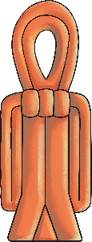
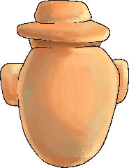
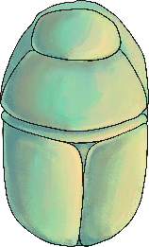
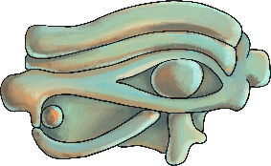
Wrapping
The head and neck would be wrapped first, then the fingers and toes wrapped individually.
The arms and legs were wrapped separately.
Between the layers of linen they would place amulets, which would protect the dead person in the afterlife.
As well as amulets, inscribed pieces of papyrus were placed between the layers. Words from the book of the dead were placed between the hands.

Slide 13

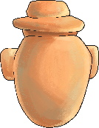


Amulets
The isis knot or tyet would be placed at the neck to protect
the body.
The heart amulet was placed over the heart to protect it.
The scarab was placed over
the upper abdomen. It was a dung beetle which represented rebirth and the rising and setting of the sun.
The Udjat or Eye of Horus was placed on the abdomen, over the cut to remove the organs. It was a symbol of good health that was shaped like the eye of the falcon God Horus.

Slide 14
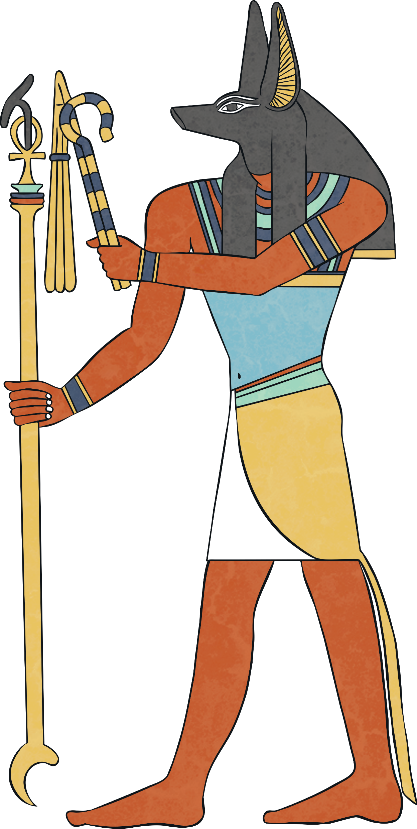
The Mask of Anubis
While the wrapping took place, a priest wearing a mask of Anubis would read out spells to ward off evil spirits and help the journey to the afterlife. Anubis was the jackal headed God of the dead.

Slide 15
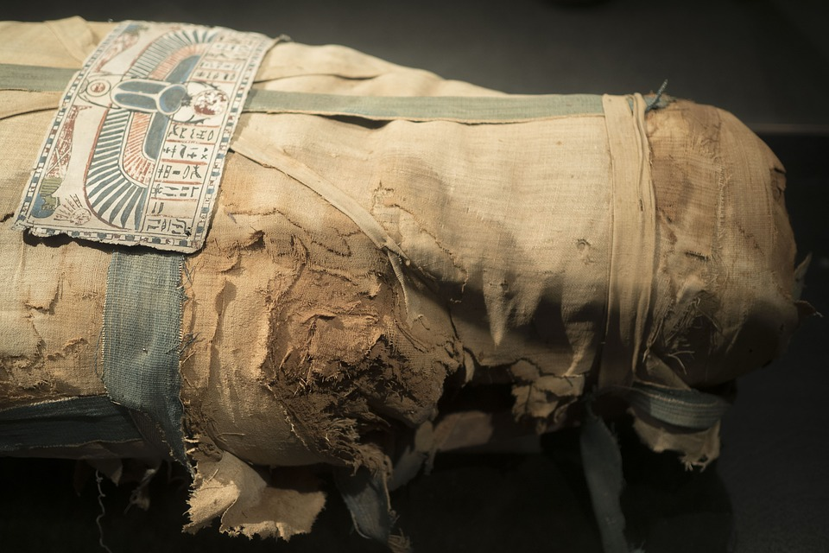
Mummia
Mummia, a tar like paste, was used to ‘glue’ the wraps of linen together. This is where the term ‘mummy’ came from.
A final piece of linen, the shroud, was placed over the body.

Slide 16
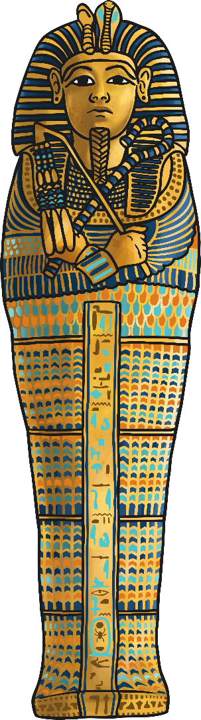
Egyptian Coffins
A death mask, that looked like the person when they were alive, was made and put on top of the mummy so that their soul (Ba) could find them.
The mummy is put in a wooden coffin. This wooden coffin might be put into another wooden coffin. Perhaps even another wooden coffin.
These coffins would be elaborately decorated. The first coffin might be shaped and painted like a body. The box shaped outer coffin might have eyes painted on it so the person could see, a false door on the inside so the person could step out, and hieroglyphics on the outside.

Slide 17
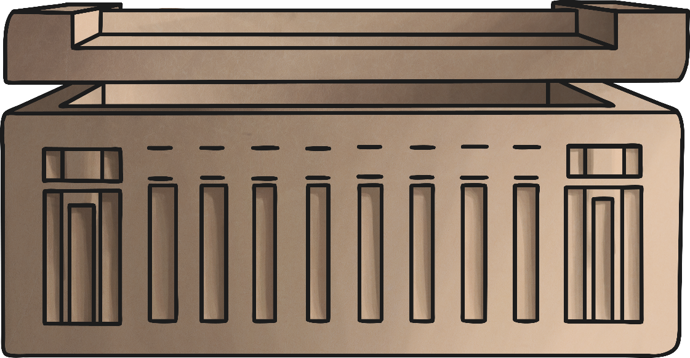
Funeral and Sarcophagus
A funeral was held, and funeral songs sung. A ritual called the ‘Opening of the Mouth’ was performed so that the dead person would be able to eat, drink and speak in the afterlife.
The final stage was to put the coffins into a sarcophagus (stone coffin) and place it in a tomb with valuable objects, food and drink for the journey to the afterlife.

Slide 18
Funeral and Sarcophagus
The Mummy was placed in an elaborate coffin (sometimes even several) and then placed inside a sarcophagus. This was placed in the tomb with the provisions for the afterlife.

