Slide 1
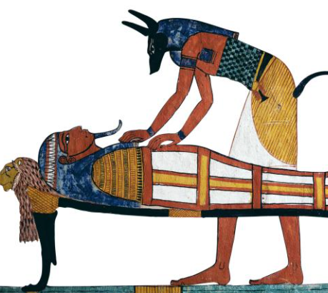
Thursday 7th and Friday 8th January 2021
L.O: To edit and improve.
C: Explanation Text
We are going to edit and improve an explanation text of how to make a mummy!

Slide 2
Let’s recap the key features of an explanation text….
Try your best to remember the features because we are going to try and spot them in a minute!

Slide 3
These are our key features of an explanation text.
Title​
Opening Paragraph​
Chronological order​
Clear Stages
Technical vocabulary​
Diagrams​
Conclusion​
Time conjunctions​
Cause and effect conjunctions​
Present tense​
​
Are you confident that your work includes these features?

Slide 4
Editing and Improving – Live Modelling

Slide 5
Your Turn!
Please use Book on Book to edit and improve your explanation text!
You can use:
Checklist
Dictionaries
Previous work
Marking Codes on your desks

Slide 6
The final step!
Can you stick your detailed labelled diagrams in the correct place to finish off your incredible explanation texts?

