Slide 1
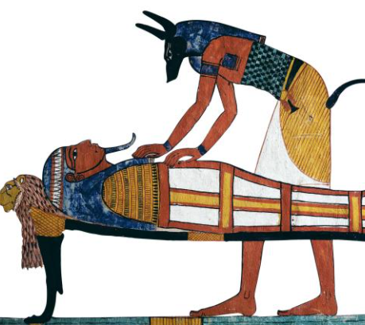
Wednesday 6th January 2021
L.O: To apply key features.
C: Explanation Text
We are going to finish writing an explanation text of how to make a mummy!

Slide 2
Let’s recap the key features of an explanation text….
Try your best to remember the features because we are going to try and spot them in a minute!

Slide 3
These are our key features of an explanation text.
Title​
Opening Paragraph​
Chronological order​
Technical vocabulary​
Diagrams?​
Conclusion​
Time conjunctions​
Cause and effect conjunctions​
Present tense​
​

Slide 4
Let’s look at our model text!
Egyptian Coffins
A death mask, which looked like the person when they were alive, was made and put on top of the mummy so that their soul could find them.
The mummy was then placed inside a wooden coffin and this coffin may be placed inside another coffin. The coffins were elaborately decorated. The inside coffin would be painted and shaped like a body. The outer coffin would sometimes have eyes painted on it so that the person could see out and a false door on the inside so that the person could step out. The outside was often decorated with hieroglyphics.
The final stage of the process was to put the coffins into a sarcophagus and place it in a tomb with valuable objects, food and drink for the journey to the afterlife.
If all of these procedures were completed correctly, the soul and body have the best chance of reuniting and reaching the Field of Rushes in the afterlife.

Slide 5
We are going to finish writing the last few sections today! Let’s look back at your plans…
Coffin
Conclusion
Remember you can use your plan, conjunction work and model text to help you all lesson!

Slide 6
Let’s start with Coffin- Live Modelling/ Sentence Starters….

Slide 7
Now it is your turn!
Can you write your own coffin section?
We will pause to hear a few in a few minutes so try your best to impress everyone and move your name up!

Slide 8
Let’s move to the Conclusion Live Modelling/ Sentence Starters….

Slide 9
Now it is your turn!
Can you write your own conclusion?
We will pause to hear a few in a few minutes so try your best to impress everyone and move your name up!

Slide 10
Now it is your turn!
Make sure you read what you have written to check:
You have used the correct features
Your work makes sense
Your work matches your audience and purpose.

