Slide 1
L.O- To understand and interpret the past
L.O- To investigate places
C: what were the challenges facing the Anglo-Saxons?

Slide 2
Let’s take a tour around an Anglo-Saxon village…
https://www.bbc.co.uk/bitesize/clips/znjqxnb

Slide 3
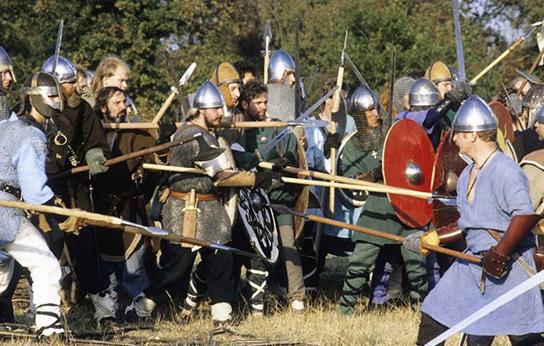
When did the Anglo-Saxons invade Britain?
The Anglo-Saxons first tried invading in the 4th century, but the Roman army were quick to send them home again! Years later – around 450AD – the Ancient Romans left Britain, the Anglo-Saxons seized their chance and this time they were successful!
They left their homes in Germany, the Netherlands and Denmark and sailed over to Britain on wooden boats. Many of them were farmers before they came to Britain and it’s thought they were on the look-out for new land as floodwaters back home had made it almost impossible to farm.

Slide 4
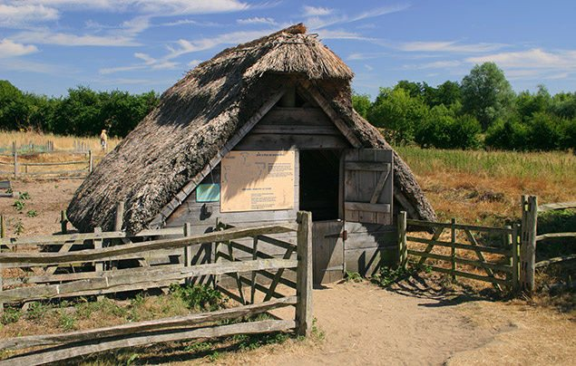
Anglo-Saxon houses
The Anglo-Saxons didn’t like the stone houses and streets left by the Romans, so they built their own villages. They looked for land which had lots of natural resources like food, water and wood to build and heat their homes, and Britain’s forests had everything they needed. They surrounded each village with a high fence to protect cattle from wild animals like foxes and wolves, and to keep out their enemies, too!
We know what Anglo-Saxon houses were like from excavations of Anglo-Saxon villages. They were small wooden huts with a straw roof, and inside was just one room in which the whole family lived, ate, slept and socialised together – much like an ancient version of open-plan living!
The biggest house in the village belonged to the chief, which was large enough to house him and all his warriors – and sometimes even the oxen, too! It was a long hall with a stone fire in the middle, and hunting trophies and battle armour hung from its walls. There were tiny windows and a hole in the roof to allow smoke to escape.

Slide 5
What challenges did they face in establishing settlement?
The challenges the Anglo-Saxons faced were the following:
As there were different tribes, this meant that they fought with each other to establish land.
Each group of Anglo-Saxon settlers had a leader or war-chief. A strong and successful leader became 'cyning', the Anglo-Saxon word for 'king'. Each king ruled a kingdom and led a small army. From time to time, the strongest king would claim to be 'bretwalda', which meant ruler of all Britain.
Tribes would break out into war for land that was rich in nutrients, often this land would be near the coast so it was easier to trade goods.
Anglo-Saxons lived in small villages near rivers, forests and other important resources that gave them everything they needed to care for farm animals, grow crops and make things to sell- so you can see that there would be lots of fighting over land.

Slide 6
Tasks- What challenges did they face in establishing settlement?
Paddling- create a bubble map of all the problems facing the Anglo-Saxons in Britain.
Snorkelling- create a hierarchy pyramid- detailing what each group of people did for the community.
Diving- describe the housing and what the land was used for.
Discuss the physical landscape and why the Saxons preferred land which was located near the rivers.
RPQ- What was the most important reason for migrating to Britain?

Slide 7
Websites
https://www.bbc.co.uk/bitesize/topics/zxsbcdm go onto the website and discuss how the different tribes settled into the UK explain that the people were fighting for land and wanted power.
Also, go onto the website link below:
https://www.bbc.co.uk/bitesize/clips/znjqxnb take a tour around an Anglo-Saxon village.
http://www.primaryhomeworkhelp.co.uk/saxons/houses.htm Ask some of the children to go onto this website to learn about Anglo-Saxon settlements.

