Slide 1
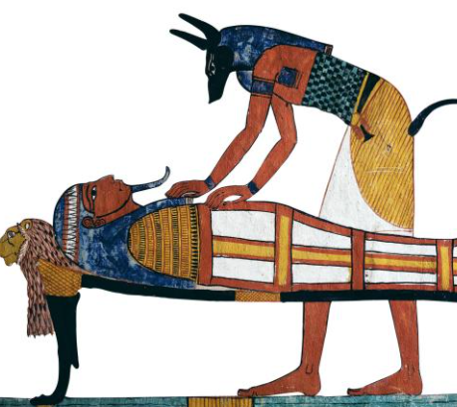
Tuesday 5th January 2021
L.O: To apply key features.
C: Explanation Text
We are going to continue writing an explanation text of how to make a mummy!

Slide 2
Let’s recap the key features of an explanation text….
Try your best to remember the features because we are going to try and spot them in a minute!

Slide 3
These are our key features of an explanation text.
Title​
Opening Paragraph​
Chronological order​
Technical vocabulary​
Diagrams?​
Conclusion​
Time conjunctions​
Cause and effect conjunctions​
Present tense​
​

Slide 4
Let’s look at our model text!
The Mummification Process
Firstly, the body was taken to a place called ‘The Beautiful House’. It was not as beautiful as the name suggests!
Here, the body was cleansed with palm wine and rinsed with water from the River Nile. Sometimes they would use a slatted bed on a slant. This would let the fluids drain off and out of the body.

Slide 5
We are going to continue writing the next few sections today! Let’s look back at your plans…
Remember you can use your plan, conjunction work and model text to help you all lesson!
Dry
-Stuff
-Wrap

Slide 6
Let’s start with Dry- Live Modelling/ Sentence Starters….

Slide 7
Now it is your turn!
Can you write your own drying section?
We will pause to hear a few in a few minutes so try your best to impress everyone and move your name up!

Slide 8
Let’s move to the Stuffing Procedures Live Modelling/ Sentence Starters….

Slide 9
Now it is your turn!
Can you write your own stuffing procedures section?
We will pause to hear a few in a few minutes so try your best to impress everyone and move your name up!

Slide 10
Let’s move to the Wrapping Live Modelling/ Sentence Starters….

Slide 11
Now it is your turn!
Can you write your own wrapping section?
We will pause to hear a few in a few minutes so try your best to impress everyone and move your name up!

