Slide 1
Trading Insults
A | B | C
simpering | mad-headed | dog
wretched | lily-livered | whore-son
insolent | iron-witted | noisem-aker
bawling | languageless | slave
blasphemous | stretch-mouthed | filth
poisonous | glass-gazing | foot-licker
abominable | frosty-spirited | hag-seed
slovenly | foul-spoken | boil
Notes:
The Tempest is a play full of conflicts. How many can pupils think of?
Because of this, many insults are traded. Ask pupils to create their own by choosing a word from column A, one from B and one from C. They will want to share these!
Working with a partner, they should then make up a conversation of insults between Caliban and Prospero.

Slide 2

Lesson 4:
Order and Disorder
Learning Objective
Read and understand Act 1 Scene 1
Examine Shakespeare’s characterisation
Start looking at how contrasts are formed

Slide 3
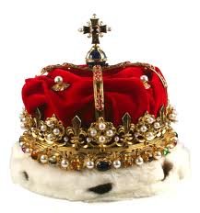
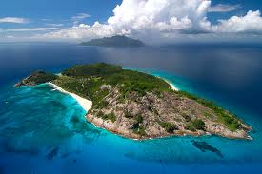
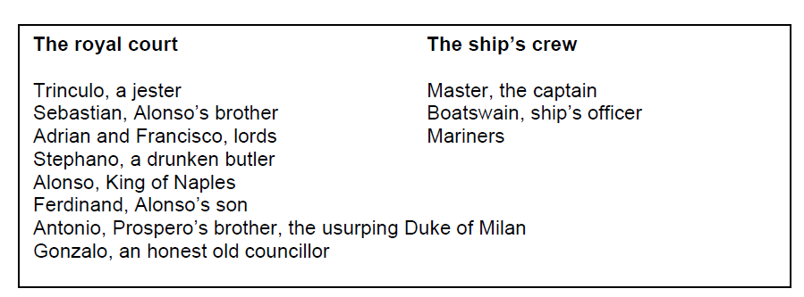
Power, hierarchy and disruption
The Tempest begins with a ship caught up in a sea storm. On the ship
are the following characters, listed in no particular order:
The word hierarchy refers to a ranking system according to status or authority. Shakespeare’s society was strictly hierarchical and a person’s rights and even his or her behaviour and language would be highly regulated according to his/her position in the hierarchy. Rewrite the character list starting with the most important character.

Slide 4
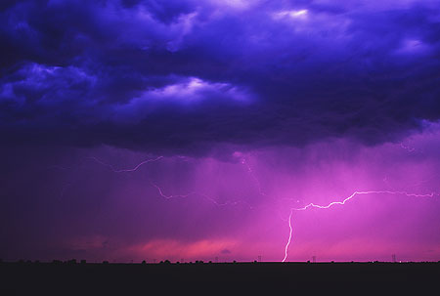
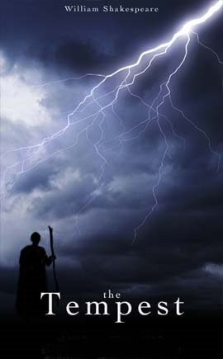
Independent Reading: Act 1 Scene 1
Master:
Boatswain:
Alonso:
Antonio:
Gonzalo:
Sebastian:
Mariners:
Voices off stage:

Slide 5
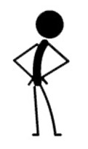
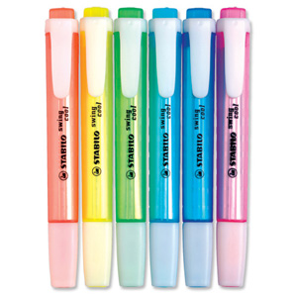
The Characters
On your copy of Act 1, Scene 1 use
different colours to highlight the following:
Orders (imperatives)
Insults
Threats
Curses
Repetition
What characters use these and under the circumstances?

Slide 6

Questions
Given what we studied regarding
hierarchy in Shakespearean times and
what we have just done:
What has your work revealed about particular characters (especially Sebastian and Antonio) and their attitudes and behaviour?
Does their use of language indicate disruption in the hierarchy?

