Slide 1

Lesson 3:
Island Settings

Slide 2
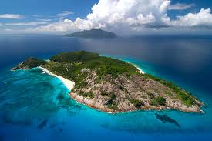
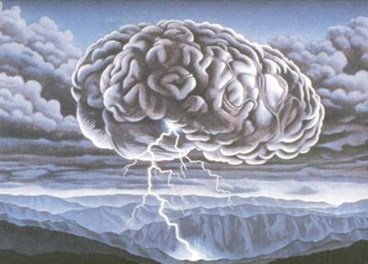
Brainstorm
In Pairs
All the characters in The Tempest find themselves together on an unnamed and otherwise uninhabited island.
Make a list of all the books, plays, films and television programmes that you can think of which are also set on islands.
Why do you think island make such an effective setting in film and literature? Consider the ways in which an island setting would influence the structure, characterisation, language and plot of a text.

Slide 3

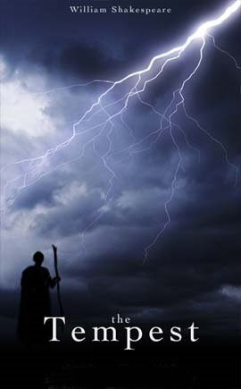
Act 1 Scene 1
Master:
Boatswain:
Alonso:
Antonio:
Gonzalo:
Sebastian:
Mariners:
Voices off stage:
As we go we will be filling in the notes beside the script.

Slide 4
Activities on Act 1 Scene 1
Underline all the words and phrases that show
The strength of the storm
The fears of the crew and passengers

Slide 5

Dramatic Impact of Opening Scene
How does Shakespeare make the opening scene of the play exciting and appealing to
the audience?
Imagine you are a director about to stage the play. Make notes on the sheet provided to plan how you will create a scene that creates a powerful impression to the audience.

Slide 6

Dear Mr Shakespeare
Write the response
I am writing to ask your
advice. I am an aspiring
script writer and have heard
a lot about you. I decided to
do some research into your
work and stumbled across
one of your plays, The
Tempest’. I am interested to
know how you made the play
interesting and dramatic
right from the start.

