Slide 1

Lesson 5:
Contrasts

Slide 2
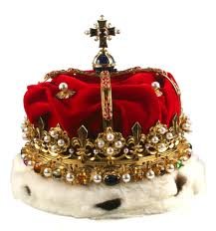
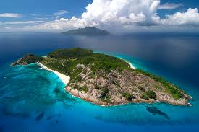
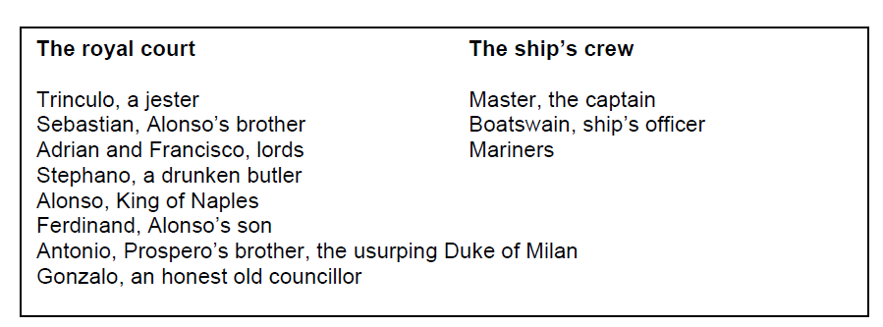
Power, hierarchy and disruption
The Tempest begins with a ship caught up in a sea storm. On the ship
are the following characters, listed in no particular order:
Remember this?

Slide 3
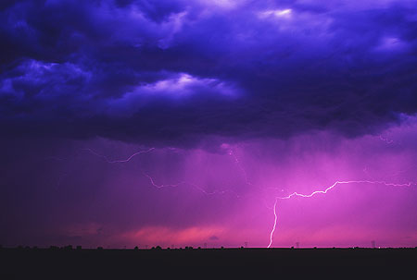
Hierarchy Triangles
Shakespearean England

Slide 4
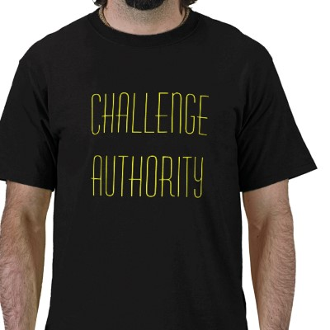
Challenge to Authority
Authority and rebellion and order and disorder are
important themes in The Tempest. What examples
of challenges to authority have you seen so far?

Slide 5
Challenge to Authority
What does this mean?
Why is it important?
What if order is not restored?

