Slide 1

Lesson 2:
Introducing The Tempest

Slide 2

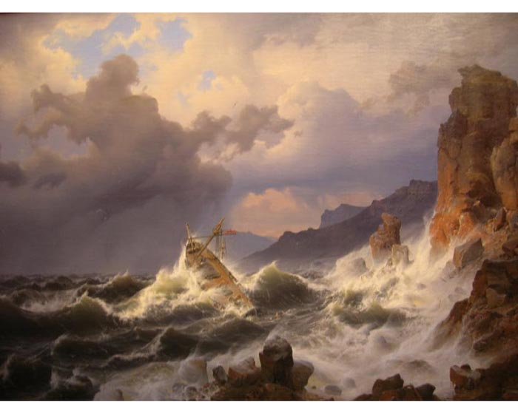
What is a tempest?
1. A violent windstorm, frequently accompanied by rain, snow, or hail.
2. Furious agitation, commotion, or tumult; an uproar:

Slide 3

Notes:
Using this image, taken from a programme, and any prior knowledge of the play that they might have, students should create a brainstorm showing what the expect to find in the play. Eg its possible themes, events, setting, characters, storyline. Emphasise that you are interested in their expectations, not just what they actually know. When new impetus is required, introduce the next image (slide 3) – ask pupils to adapt or develop ideas in the light of it and repeat this process for the third image.

Slide 4


Slide 5
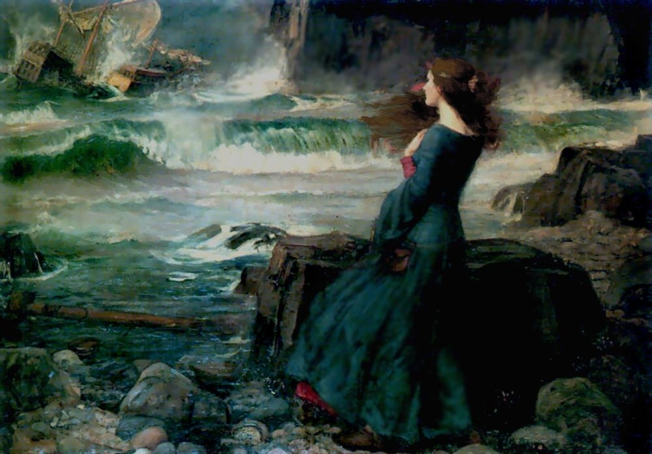
Notes:
Painting – John William Waterhouse (1849 – 1917)

Slide 6

I predict...

