Slide 1

The Tempest

Slide 2
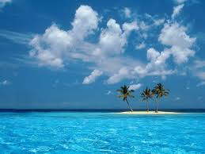
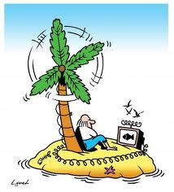
Shipwrecked!
Imagine you are
shipwrecked on an
uninhabited island.
What would your
perfect shipwrecked
island be like?

Slide 6
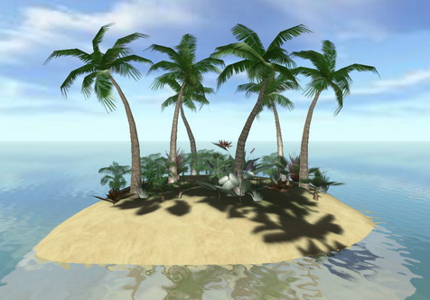
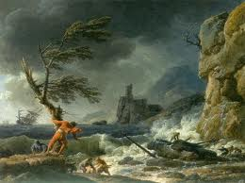
Shipwrecked
What 3 items would you most want to take with you?
What 5 things would you most want to have on the island before your arrival (people and electricity are not allowed) and why?

Slide 7
Shipwrecked
The three items I would take with me are................... I came to these choices because.....
What five things I most want to have on the island before my arrival are............ (You must then explain each item in turn)

