Slide 1

Tuesday 5th January 2021
L.O: To learn and apply new vocabulary.
C: The Iron Man.

Slide 2

Fastest Finger Challenge!
Class Read : p.14-18
Let’s play our fastest finger game!

Slide 3
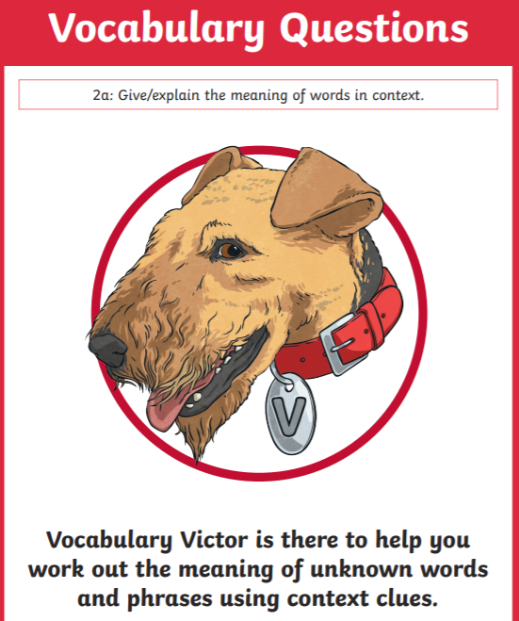
Vocabulary Victor Time!
Today we are going to find some new words and learn what they mean!
We are going to try and use them in context too!

Slide 4
Vocabulary Victor Time!
Today we are going to find some new words and learn what they mean!
We are going to try and use them in context too!
Why should we learn new words?

Slide 5
Vocabulary Victor Time!
Can you draw a table like this in your book?
Word | Meaning | Applied in a sentence

Slide 6
Vocabulary Victor Time!
Paddlers: Define and apply the new words in a sentence.
Snorkelers: Define and apply the new words in a sentence which includes a FANBOYS conjunction.
Divers: Define and apply the new words in a sentence which includes a FANBOYS conjunction and an adverbial phrase.

