Slide 1
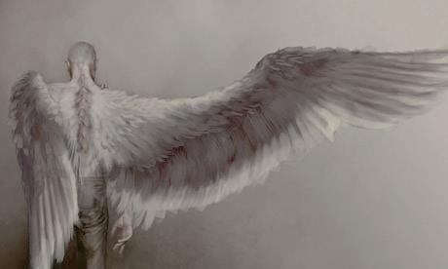
Lesson 2
P.E.E (Point, Evidence and Explain)

Slide 2
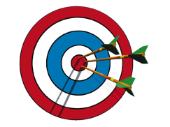
Lesson Focus
Today our learning aims are:
To think in depth about what Michael might be feeling and how we know this from the text.
To explain our ideas using quotes from the story.

Slide 3


Starter
What questions would you ask the creature in the garage?

Slide 4
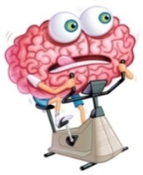
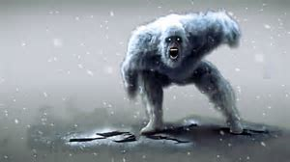
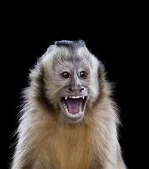
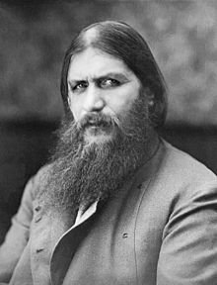
Analysing a quote
“It was strange being at school again. Loads had happened to me, but school stayed just the same. Rasputin still asked us to lift up our hearts and voices and sing out loud in assembly. The Yeti yelled at us to keep left in the corridors. Monkey Mitford went red in the face and stamped his feet when we didn’t know our fractions.
I couldn’t be bothered with it all.”
The Yeti
What does this extract tell you about how Michael is feeling?
Monkey
Rasputin: a self-proclaimed Holy Man

Slide 5
P.E.E
P.E.E
Point Evidence Explain

Slide 6
P.E.E
When you are writing about a text or discussing a text it is very important that you use quotes to back up what you are saying and then explain that quotation.
Using P.E.E. is a way of writing about a text making sure that you include textual evidence and detailed explanations.

Slide 7
P.E.E.
Using P.E.E. will help you get better at writing about what you read, especially when it comes to being critical about a text and being able to analyse it.
Basically it proves you understand and can write about what you have read.

Slide 8
P.E.E
Point – The point/idea you are trying to make/get across to the reader.
Evidence – This is a ‘quote’ taken from the text to prove or support what it is that you are saying.
Explain – This is where you explain what the quotation suggests and how this links back to your point. It is good to include your own personal opinion here and the effect on the reader.
Use the sentence starters to help you!

Slide 9
P.E.E
Let’s look at answering a question together…
How does the man in the garage feel to see Michael again? (page 17)
In the novel it is clear that the man in the garage is not pleased to see Michael again and is feeling annoyed and despondent.
I know this because of the man’s response to Michael, ‘he sighed, like he was sick to death of everything.’(Page 17)
This quotation suggests that by sighing, is a sign that perhaps he is tired of his constant questioning. He probably doesn’t want to answer Michael. Secondly, by exaggerating that he is ‘sick to death’, this could suggest that he is fed up of his situation (being in the garage) and has clearly been in there a long time.

Slide 10
P.E.E
Let’s look at answering a question together…
How does the man in the garage feel to see Michael again? (page 17)
In the novel it is clear that the man in the garage is not pleased to see Michael again and is feeling annoyed and despondent.
I know this because of the man’s response to Michael, ‘he sighed, like he was sick to death of everything.’(Page 17)
This quotation suggests that by sighing, is a sign that perhaps he is tired of his constant questioning. He probably doesn’t want to answer Michael. Secondly, by exaggerating that he is ‘sick to death’, this could suggest that he is fed up of his situation (being in the garage) and has clearly been in there a long time.

Slide 11
P.E.E
How does Michael feel while talking to the man in the garage? Use information from Chapter 7 when you give your answer.
I think Michael is feeling nervous and uncomfortable when talking to the man in the garage.
When asking questions, Michael doesn’t get much response from him. This is shown in the quotation: ‘I chewed my lips and watched him.’
This makes you realise that Michael is trying to think of the right question to ask or words to say. He probably doesn’t want to upset the man and isn’t sure what to do next.

Slide 12
Your Task
Paddling- Colour code the example responses to show the P, E and E sections of the answer.
Snorkelling- Use the table to complete the answers to the questions.
Diving- Answer the questions using P.E.E.

Slide 13
The following slides have a lengthy example of one of the diving problems

Slide 14
10. Why do you think Michael’s dad shows him the parcel of birds? What is he trying to achieve here? Include quotations in your answer. (3)
In Chapter 6, Michael’s dad shows him a parcel of birds he has discovered in the garden. He discusses with his son where he thinks they have come from and makes a big effort to bond with him. This is shown in the quotations: “’Touch it,’ he said. ‘Feel it. Go on, it’s OK.’” and “’Been there so long it’s nearly a fossil.’” These quotations show that Michael’s dad describes what they look like, what has happened to them and even directs Michael to “touch” and “feel” the dead birds to try and interest him in his recent discovery. He may, however, have an ulterior motive here and may try to gain Michael’s interest simply so he can engage in a conversation with and spend time with his son, something they haven’t been doing a lot of recently due to moving house and both parents looking after the poorly baby. Michael’s father may be feeling guilty at the lack of time he has been spending with his son and therefore uses this discovery as his chance to reconnect with his son and strengthen their relationship.

Slide 15
10. Why do you think Michael’s dad shows him the parcel of birds? What is he trying to achieve here? Include quotations in your answer. (3)
In Chapter 6, Michael’s dad shows him a parcel of birds he has discovered in the garden. He discusses with his son where he thinks they have come from and makes a big effort to bond with him. This is shown in the quotations: “’Touch it,’ he said. ‘Feel it. Go on, it’s OK.’” and “’Been there so long it’s nearly a fossil.’” These quotations show that Michael’s dad describes what they look like, what has happened to them and even directs Michael to “touch” and “feel” the dead birds to try and interest him in his recent discovery. He may, however, have an ulterior motive here and may try to gain Michael’s interest simply so he can engage in a conversation with and spend time with his son, something they haven’t been doing a lot of recently due to moving house and both parents looking after the poorly baby. Michael’s father may be feeling guilty at the lack of time he has been spending with his son and therefore uses this discovery as his chance to reconnect with his son and strengthen their relationship.

Slide 16
10. Why do you think Michael’s dad shows him the parcel of birds? What is he trying to achieve here? Include quotations in your answer. (3)
In Chapter 6, Michael’s dad shows him a parcel of birds he has discovered in the garden. He discusses with his son where he thinks they have come from and makes a big effort to bond with him. This is shown in the quotations: “’Touch it,’ he said. ‘Feel it. Go on, it’s OK.’” and “’Been there so long it’s nearly a fossil.’” These quotations show that Michael’s dad describes what they look like, what has happened to them and even directs Michael to “touch” and “feel” the dead birds to try and interest him in his recent discovery. He may, however, have an ulterior motive here and may try to gain Michael’s interest simply so he can engage in a conversation with and spend time with his son, something they haven’t been doing a lot of recently due to moving house and both parents looking after the poorly baby. Michael’s father may be feeling guilty at the lack of time he has been spending with his son and therefore uses this discovery as his chance to reconnect with his son and strengthen their relationship.

Slide 17
10. Why do you think Michael’s dad shows him the parcel of birds? What is he trying to achieve here? Include quotations in your answer. (3)
In Chapter 6, Michael’s dad shows him a parcel of birds he has discovered in the garden. He discusses with his son where he thinks they have come from and makes a big effort to bond with him. This is shown in the quotations: “’Touch it,’ he said. ‘Feel it. Go on, it’s OK.’” and “’Been there so long it’s nearly a fossil.’” These quotations show that Michael’s dad describes what they look like, what has happened to them and even directs Michael to “touch” and “feel” the dead birds to try and interest him in his recent discovery. He may, however, have an ulterior motive here and may try to gain Michael’s interest simply so he can engage in a conversation with and spend time with his son, something they haven’t been doing a lot of recently due to moving house and both parents looking after the poorly baby. Michael’s father may be feeling guilty at the lack of time he has been spending with his son and therefore uses this discovery as his chance to reconnect with his son and strengthen their relationship.

Slide 18
10. Why do you think Michael’s dad shows him the parcel of birds? What is he trying to achieve here? Include quotations in your answer. (3)
In Chapter 6, Michael’s dad shows him a parcel of birds he has discovered in the garden. He discusses with his son where he thinks they have come from and makes a big effort to bond with him. This is shown in the quotations: “’Touch it,’ he said. ‘Feel it. Go on, it’s OK.’” and “’Been there so long it’s nearly a fossil.’” These quotations show that Michael’s dad describes what they look like, what has happened to them and even directs Michael to “touch” and “feel” the dead birds to try and interest him in his recent discovery. He may, however, have an ulterior motive here and may try to gain Michael’s interest simply so he can engage in a conversation with and spend time with his son, something they haven’t been doing a lot of recently due to moving house and both parents looking after the poorly baby. Michael’s father may be feeling guilty at the lack of time he has been spending with his son and therefore uses this discovery as his chance to reconnect with his son and strengthen their relationship.

