Slide 1
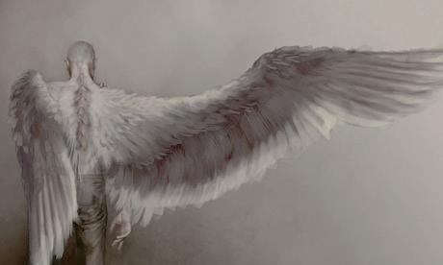
Lesson 1
Michael

Slide 2

True or False?
Statement | True | False
Michael and his family have moved in to a new home.
Michael is excited about the new house.
Michael’s parents are worried about their new born baby.
The garden is overgrown and contains an old dilapidated garage.
Michael misses his friends and his old home.
Michael is close to his parents.
Michael is ignored and overlooked by his parents.
Michael is an introverted and secretive boy.
Michael discovers a dead body in the garage.

Slide 3
True or False?
Statement | True | False
Michael and his family have moved in to a new home.
Michael is excited about the new house.
Michael’s parents are worried about their new born baby.
The garden is overgrown and contains an old dilapidated garage.
Michael misses his friends and his old home.
Michael is close to his parents.
Michael is ignored and overlooked by his parents.
Michael is an introverted and secretive boy.
Michael discovers a dead body in the garage.

Slide 4

Lesson Focus
Today our learning aims are:
To develop our understanding of the novel by reading Chapters 3 and 4
To develop our knowledge and understanding of the character of Michael
Key Words:
Emotion
Introvert
Michael
Description

Slide 5
Lesson Focus
L.O. To understand texts
2d: Make inferences from the text/ explain and justify inferences with evidence from the text.
2f: Identify how narrative content is related and contributes to meaning as a whole
Key Words:
Emotion
Introvert
Michael
Description

Slide 6



Reading
Let’s continue to read the novel.
Turn to Chapter 3.

Slide 7

Secrets…
Why does Michael keep his discovery a secret…?

Slide 8



How is Michael feeling?

Slide 9
Michael’s Diary
Michael’s Diary
Imagine you are Michael. Think about what has happened since you moved house. What would you think and feel about your life in recent weeks?
Write a diary entry as Michael describing what is happening in your life.
Use the key features of effective diary writing:
First person perspective
Personal pronouns
Use imaginative and vivid description
Include the main events of Chapters 1 to 5
Include Michael’s thoughts and feelings

Slide 10
Michael’s Diary
Michael’s Diary
Imagine you are Michael. Think about what has happened since you moved house. What would you think and feel about your life in recent weeks?
Write a diary entry as Michael describing what is happening in your life.
Paddling- use the planning sheet to help you.
Snorkelling- use the book and the success criteria to help you.
Diving as snorkelling, but also use the word dilapidated.

Slide 11
Michael’s Diary
Example Diary
Dear diary,
Everything about my life is stupid. Stupid school, stupid house, stupid baby. I don’t see the point in having moved whatsoever. Why? WHY? My lovely parents never seem to have any time for me now, not since the baby arrived. They don’t even seem to notice that I’m there as they are always looking after the stupid baby or at the hospital.
Recently, I discovered a kind of person in our run-down, dilapidated old garage. Despite my mum’s warnings, I went inside; it’s full of rotting wood and completely covered in thick dust. How on earth could that person/things (whatever it is) be lying there covered in spooky, tattered webs spun so carefully and yet still be alive? I’ve sworn not to tell a single soul, not yet anyway…

Slide 12
Plenary
Read through your diary entry and make sure you’ve ticked your success criteria.
Use your red pen to make any required edits.

