Slide 1

Read Write Inc. Phonics
Y1 & 2 Parents’ Meeting
Notes:
Notes are provided to help you lead the presentation.
Notes in italics are for your attention only.

Slide 2
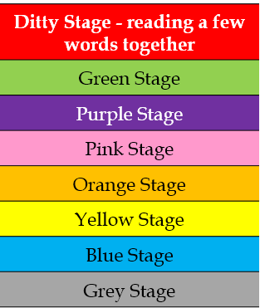
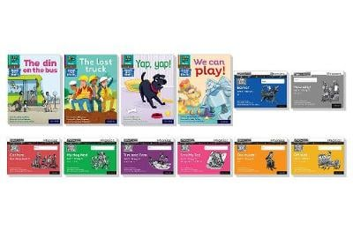

RWI stages – what do the levels mean?
Easter of Yr 1
Notes:
First read – chn to use Fred talk
Second read – chn to use Fred talk and they may have remembered a word from sight
Third read – remember more words and read with fluency
Fourth read – fluent and you could ask questions, focusing on comprehension
By Christmas as many off Y2 off RWI

Slide 3
New vocabulary – The RWI dictionary
Special friends – 2 or 3 letters that make one sound
Fred Talk – sounding out a word c-a-t
Fred in your head – sounding out a word in your head
Green words – words that you sound out
Red words – words that you cannot sound out
My turn your turn - I do it, then you.

Slide 4
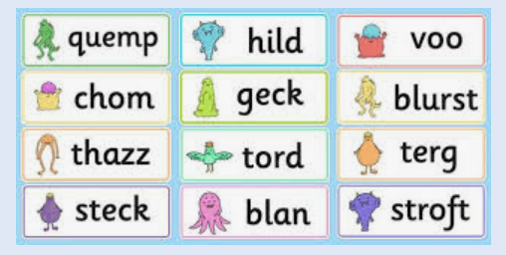
Alien words

Slide 5
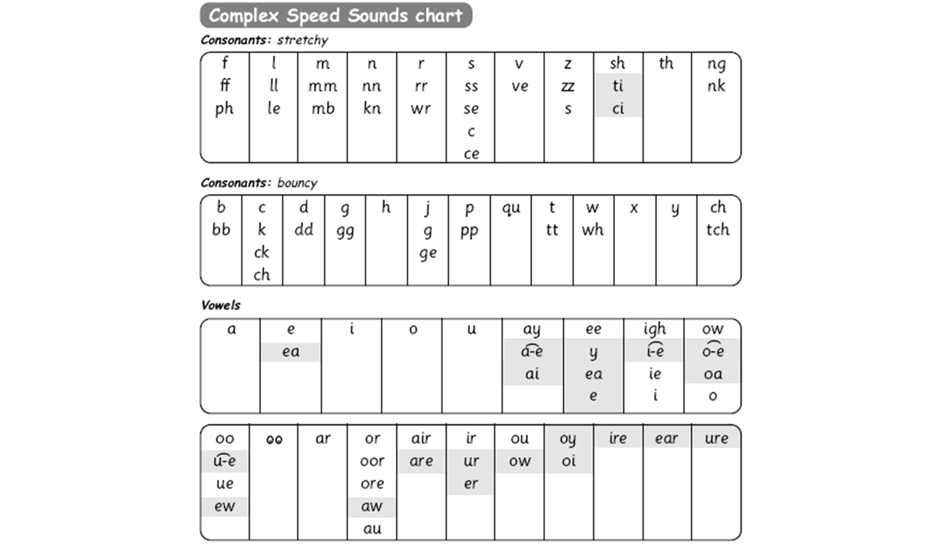
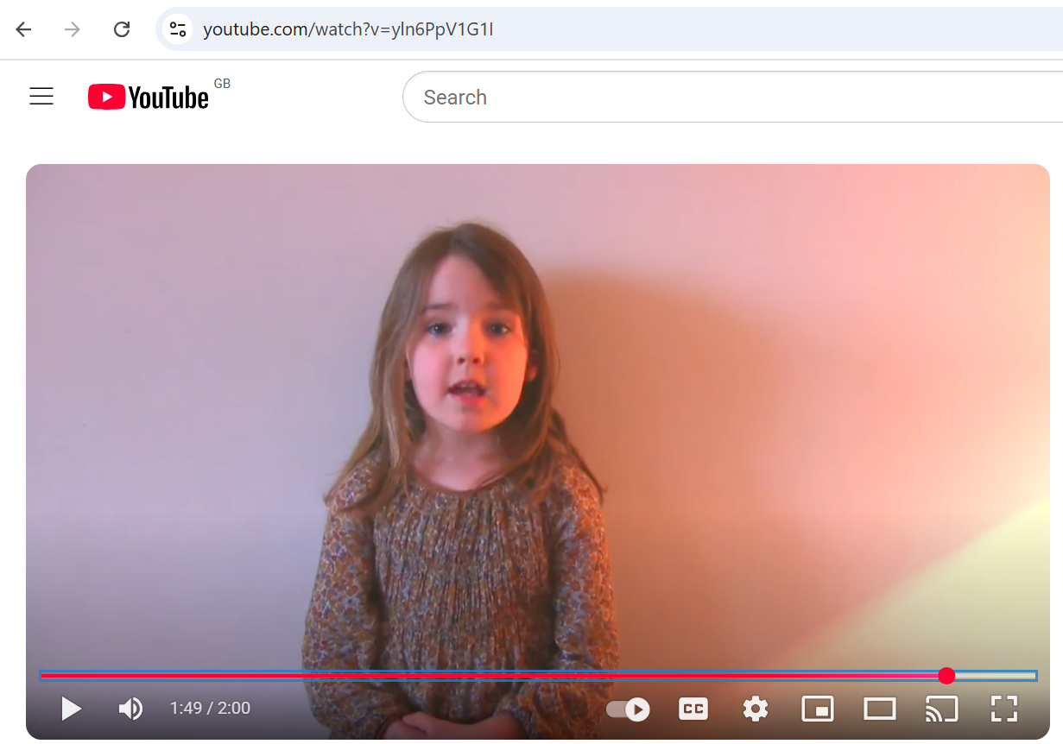
Complex Speed Sounds
Set 2 progressing on to 3
Set 1, 2 and 3 sounds
https://www.youtube.com/watch?v=yln6PpV1G1I
It is important that we use pure sounds, such as ‘s’ not ‘suh’, so that your child will be able to blend the sounds into words.
Notes:
Stretchy and bouncy sounds. Demo.
We use this Speed Sounds chart in Phonics lessons.
It shows the most common graphemes for each sound.
Each box is a sound box showing different ways to read and write the sound. Demo the ‘f’ sound box with examples of words ‘fun’, ‘huff’, ‘photo’ and the ‘or’ sound box with examples of words ‘or’, ‘door’, ‘more’, ‘dawn’, ‘author’.

Slide 6
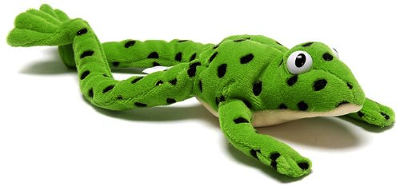

Sounds Lesson Demonstration
Introduce new sounds and recap on previous sounds taught
‘Fred Talk’ progressing on to ‘Fred in your head’
Fred fingers to aid writing
Speed write
Fast paced
Lots of praise!
Notes:
Speed words for fluency
Longer words – use syllables

Slide 7
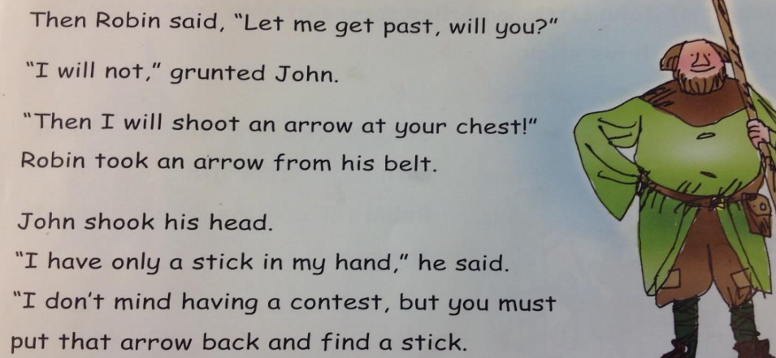
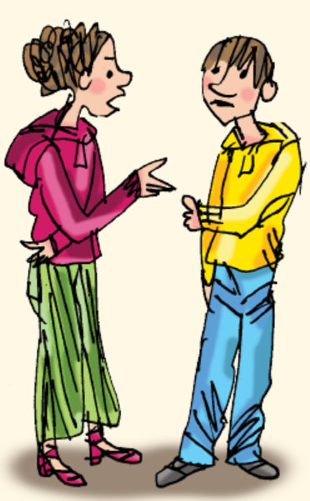
Linking writing to the reading
‘Hold a Sentence’ and ‘Build a Sentence’
Taken from a page in the text
Built as a class before writing independently
Drama can be included to help build sentence and enhance expression.
Notes:
Say sentence, MTYT
Children help to build it
Punctuation finger spaces
Reread to check for sense
Hide and then children have a go at writing.
Build a sentence – use drama, additional pictures/images share ideas (some notes can be taken) but mostly ind. work.
Using letter names instead of sounds from Green up

Slide 8
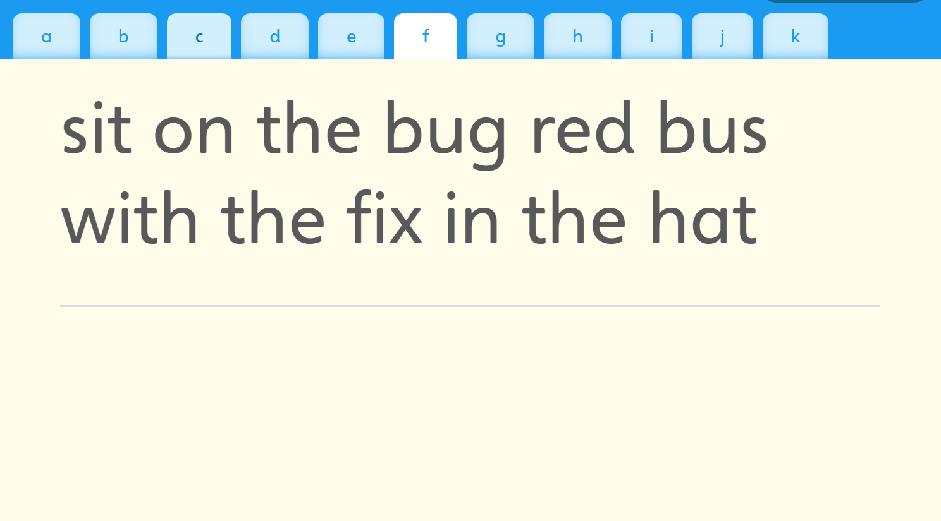
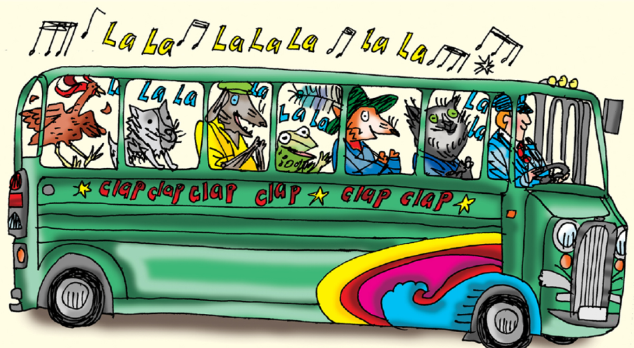
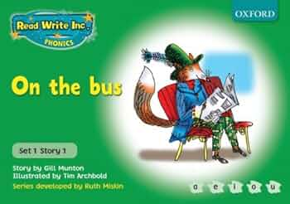
Proof reading and writing about the story
Notes:
Online files sometimes used
Pictures to help gather ideas
Later colours also focus on being able to spell green and red words – little test

Slide 9
How can I help at home?
Notes:
Read question.

Slide 10


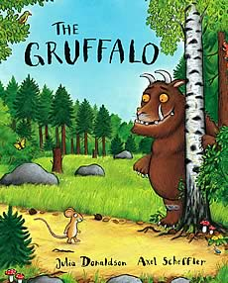

Picture Books And Anything That Interests Them!

Slide 11
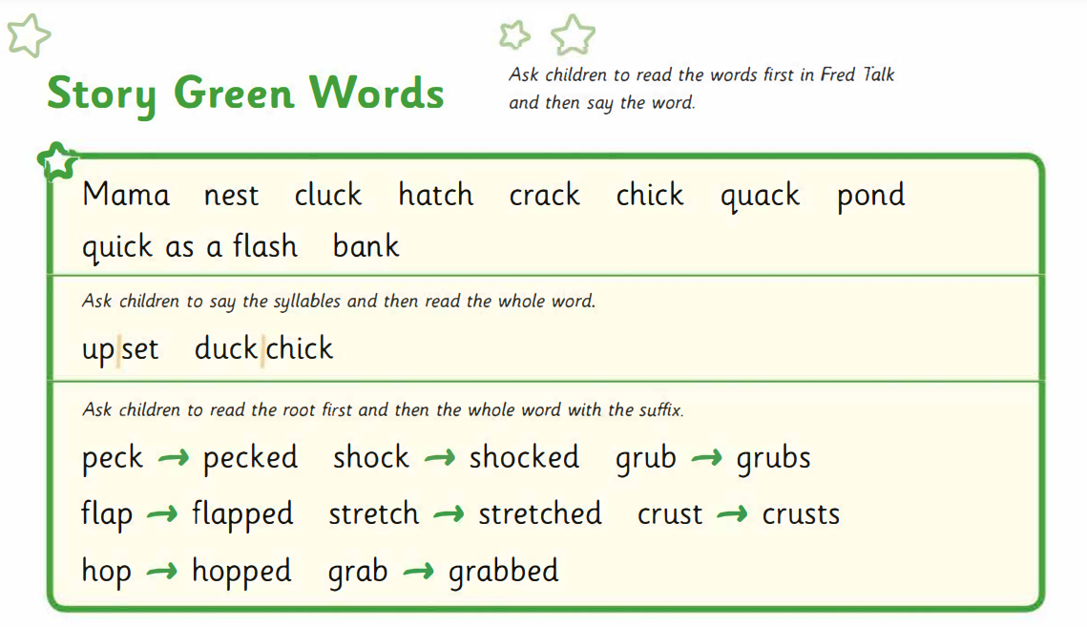
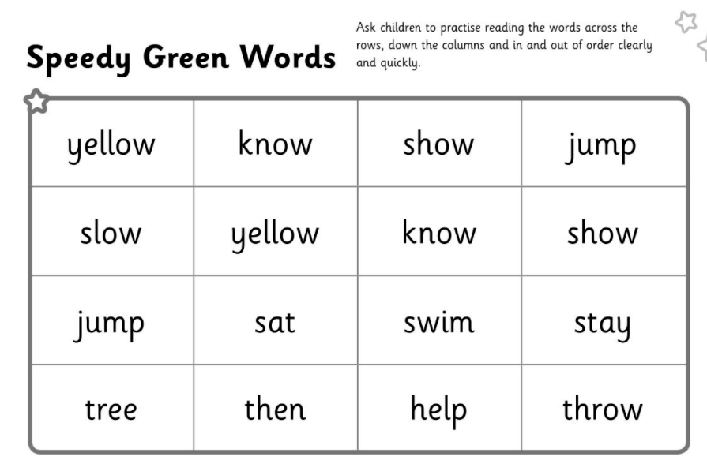
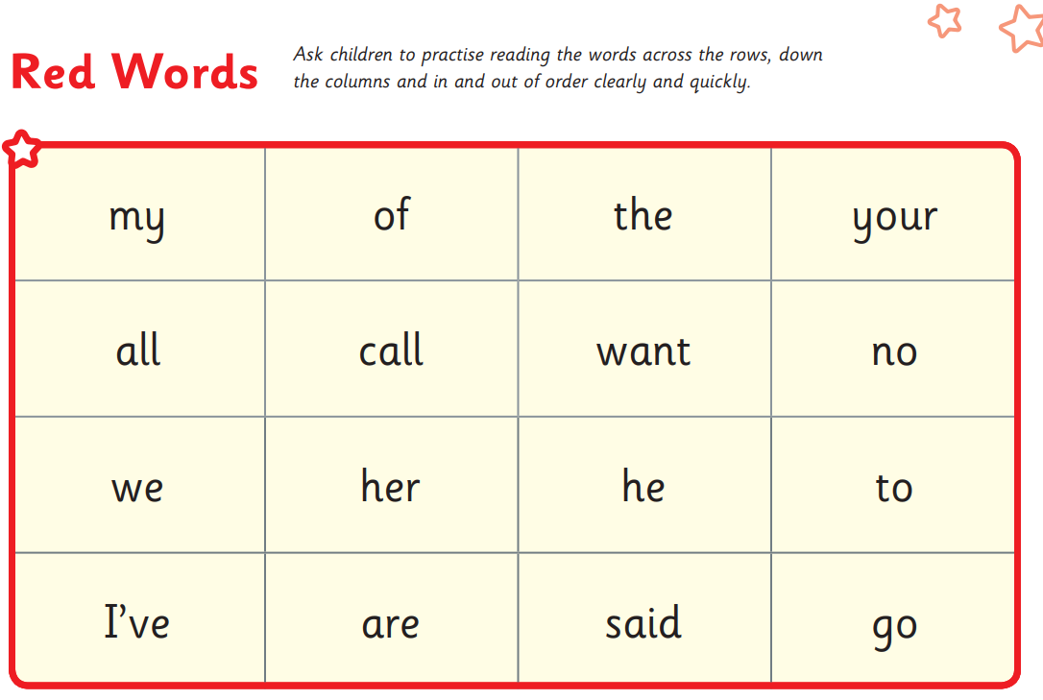
Reading their home reading books.
Notes:
Red Words – match reading level
Explain fluency - link between recognising words and understanding them

Slide 12
Online resources available
Ruth Miskin Parents’ Page:
http://www.ruthmiskin.com/en/parents/
Free e-books for home reading:
http://www.oxfordowl.co.uk/Reading/

Slide 13
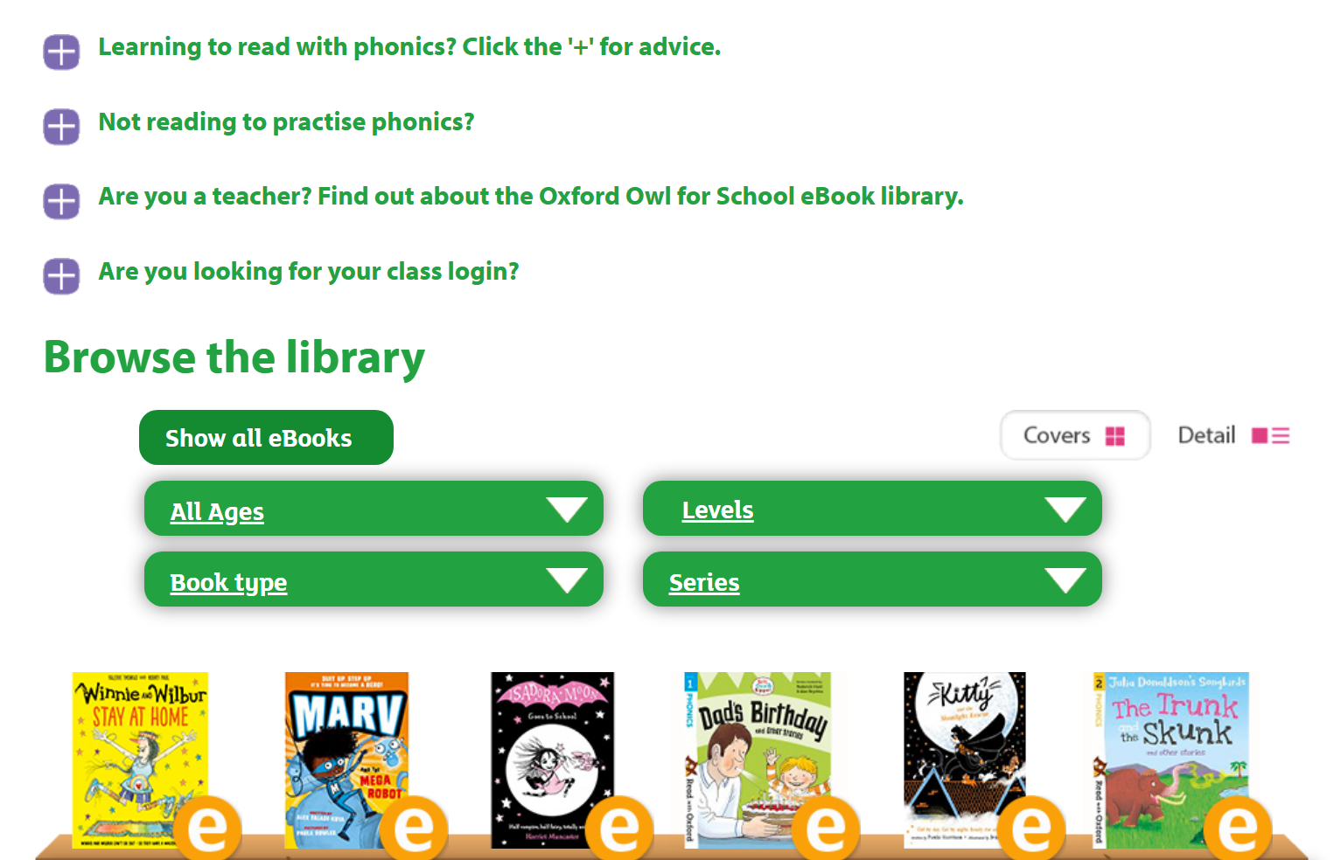
Free ebooks

Slide 14

Any other questions

Slide 15
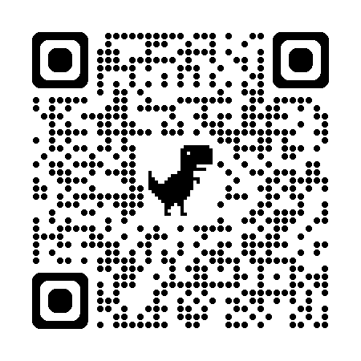
Producing sounds

