Slide 1
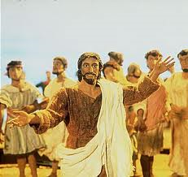
The Easter Story.

Slide 2
To understand beliefs and teachings.
To understand practices and lifestyles.
To understand values.
Now we have explored Palm Sunday, Good Friday and Easter Monday. We are going to explore and research what churches do to celebrate these days.
I have sent you some useful links. These can be found on Teams under the ‘Files’ Tab.

Slide 3
You need to create a poster, leaflet or information guided explaining to others how Christians celebrate the events.
This can be done on the computer or on paper.
Red Pen Question
Paddling Red Pen: Which celebration is your favourite? Why?
Snorkelling Red Pen: Which celebration do you think is the most important to Christians? Why?
Diving Red Pen: Which celebration do you think is the most important to Christians? Explain your reasoning.

