Slide 1

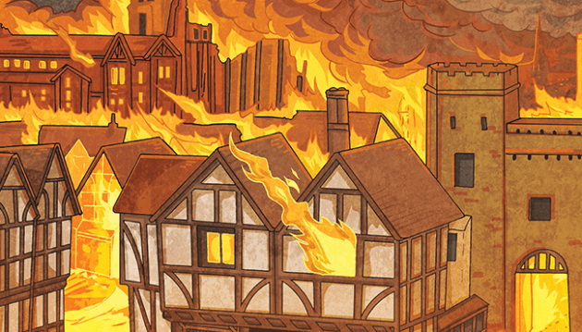
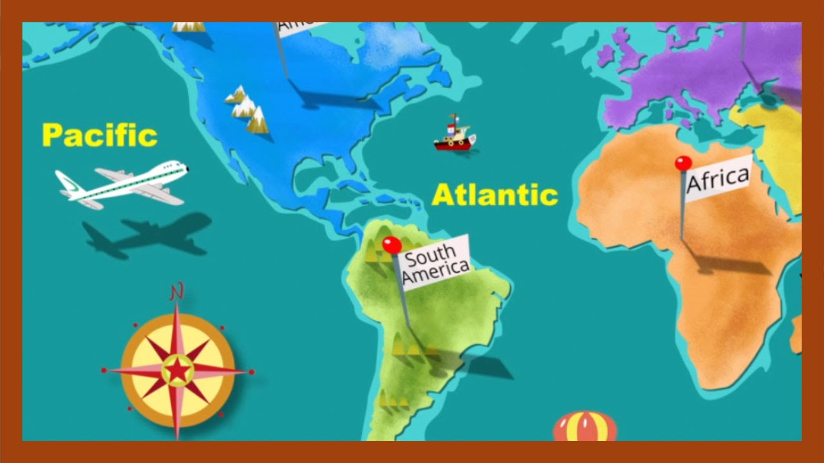
T1 - The Seaside
T2 - The Great Fire of London
T3 - Oceans and Continents

Slide 2

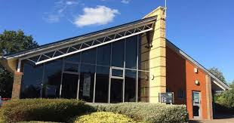
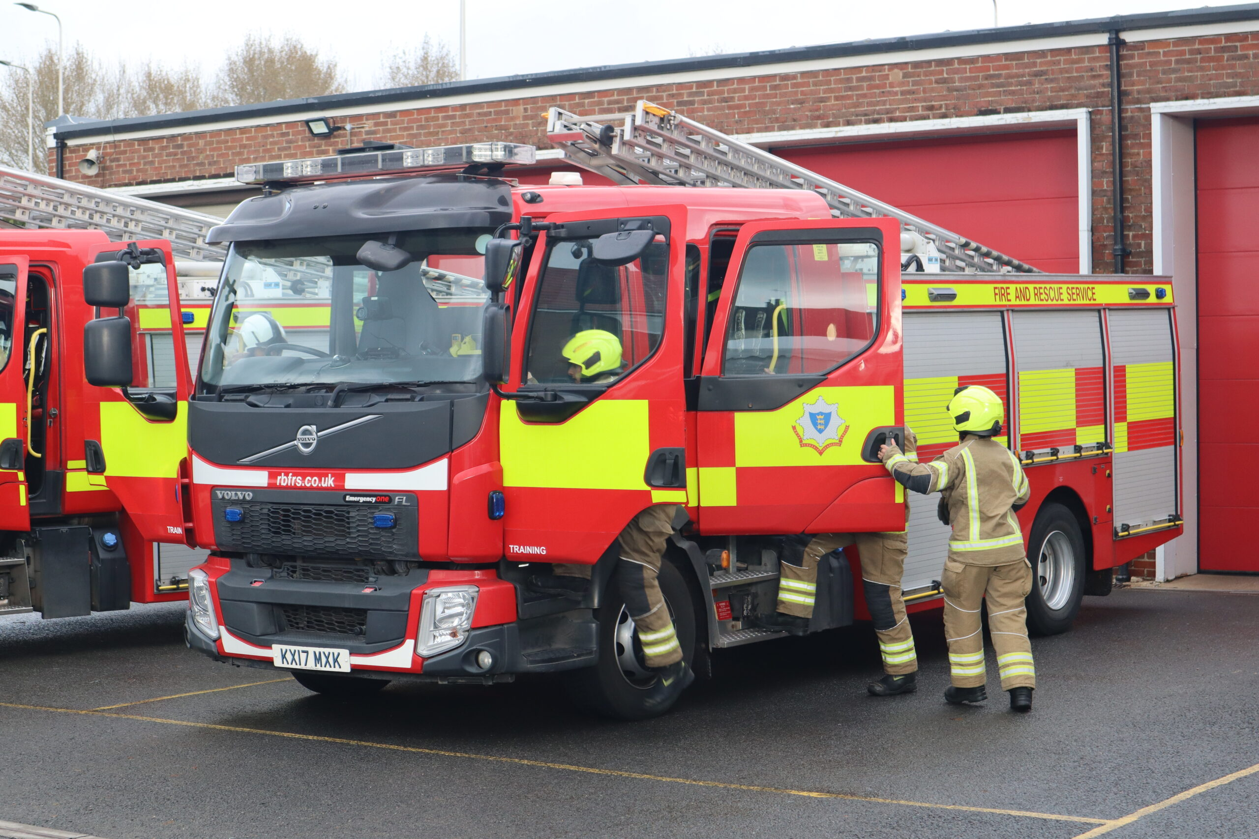
Year 1 highlights
Sports Day
Trip to the library
The Great Fire of London
Visit from the Fire Brigade
Christmas Production
Outdoor learning in the BOLE
Legoland
Swimming
Buddy Time
Enrichment Weeks
Sharing Assembly
AND MUCH MORE!!!

Slide 3

maths
We follow the White Rose Maths Scheme.
Lots of practical work using concrete apparatus (Numicon, number lines, tens frames).
Number Formation.
Focus on numbers 1-20 initially. Keeping the numbers simple allows teaching and comprehension of processes.
A QR sheet is available for you to take home at the end of this session. This will allow you to scan and access a range of different websites and games, to help support your child with their maths skills at home.

Slide 4
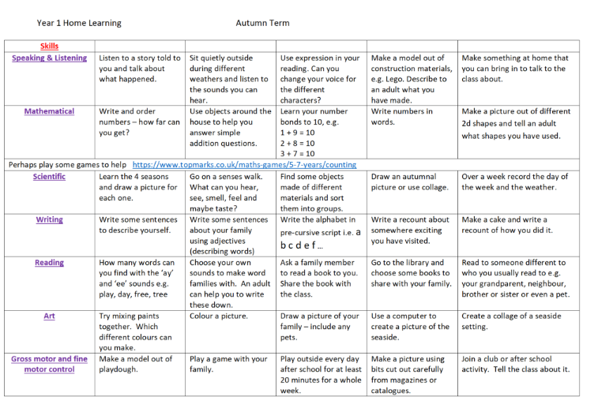
Home learning
Optional home learning – termly in the form of a grid.
Please choose any activity that you think your child would benefit from and enjoy.

Slide 5
Expectations in year 1
We encourage children in year 1 to become more independent and take responsibility for their belongings.
Bringing in their reading folder with their books and reading record every day.
Hanging their belongings on their peg.
Remembering to take home their water bottle and jumper at the end of the day. We will leave a box outside at the end of each day with any jumpers we find with no names.
Learning to tie their ties.
Beginning to remember to go to the toilet at break times (although we will always allow them to go whenever they need to).
Adjusting to spending more time sitting at a table and working with a partner co-operatively.

Slide 6
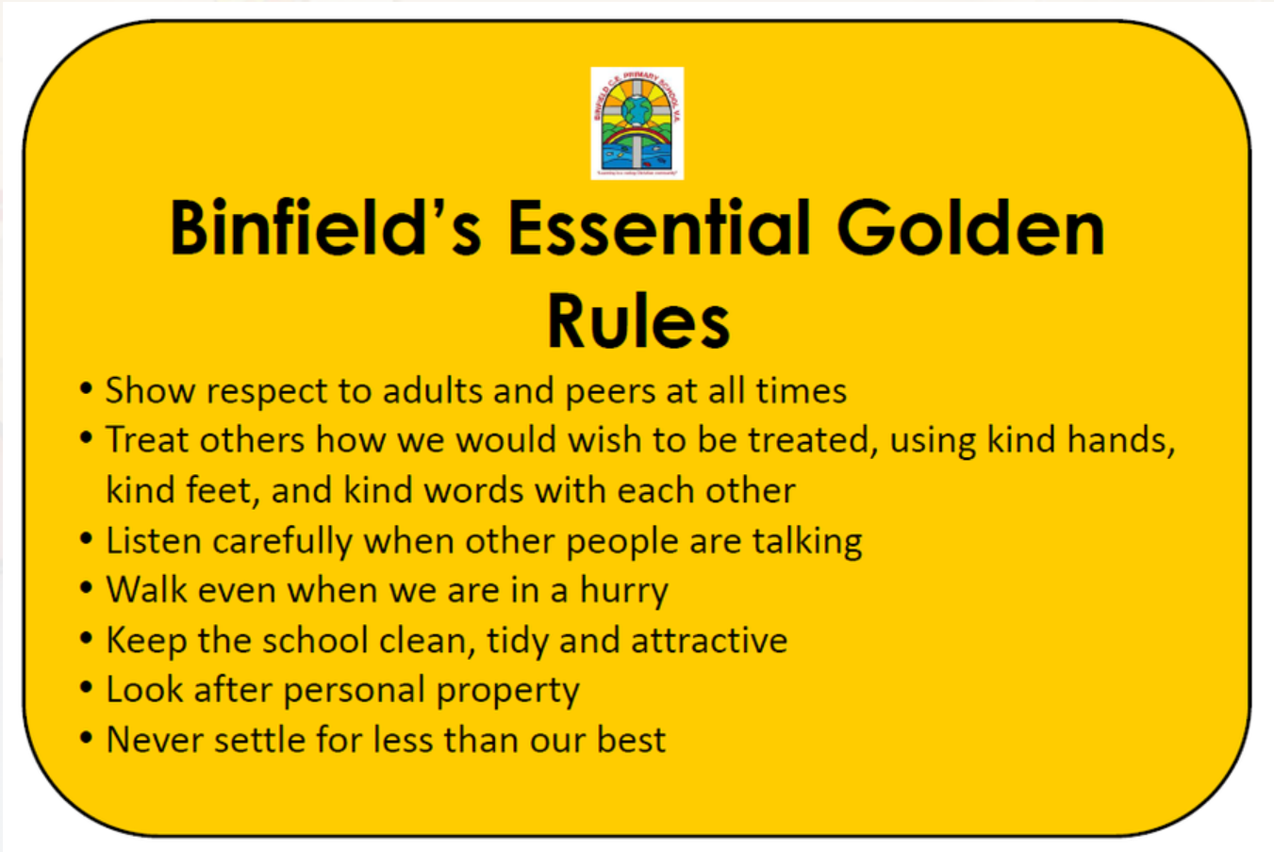
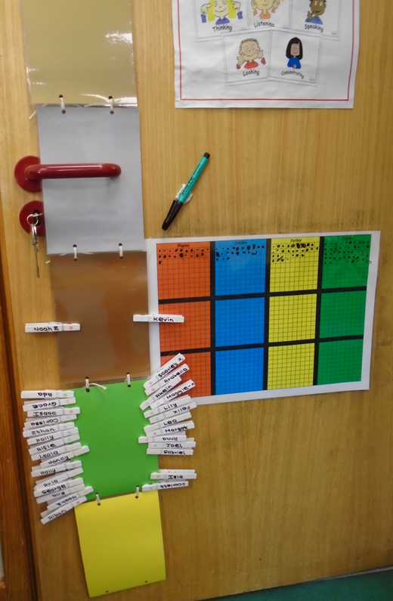
BEHAVIOUR and rewards
Bronze, Silver and Gold Awards​
​
Team points​
​
Pupil of the Week
Every Friday in class up until Christmas. In assembly from January.
​
​
Please return the badge so it can be passed on to the next person. However, if you’d like to keep it, please bring in 50p.

Slide 7

Snack time
We receive fruit from Tesco for the children.
We are going to be allowing children to eat their snack in class before going out to playtime.
If you prefer, you may send your child in with a piece of fruit, vegetable or dried fruit for breaktime.
Please can we ask children do not come in with fruit winders , cheese strings, breadsticks or similar. If your child has this type of snack, we will let them have it the 1st time, but on other occasions, we will have to provide them with our fruit instead.

Slide 8
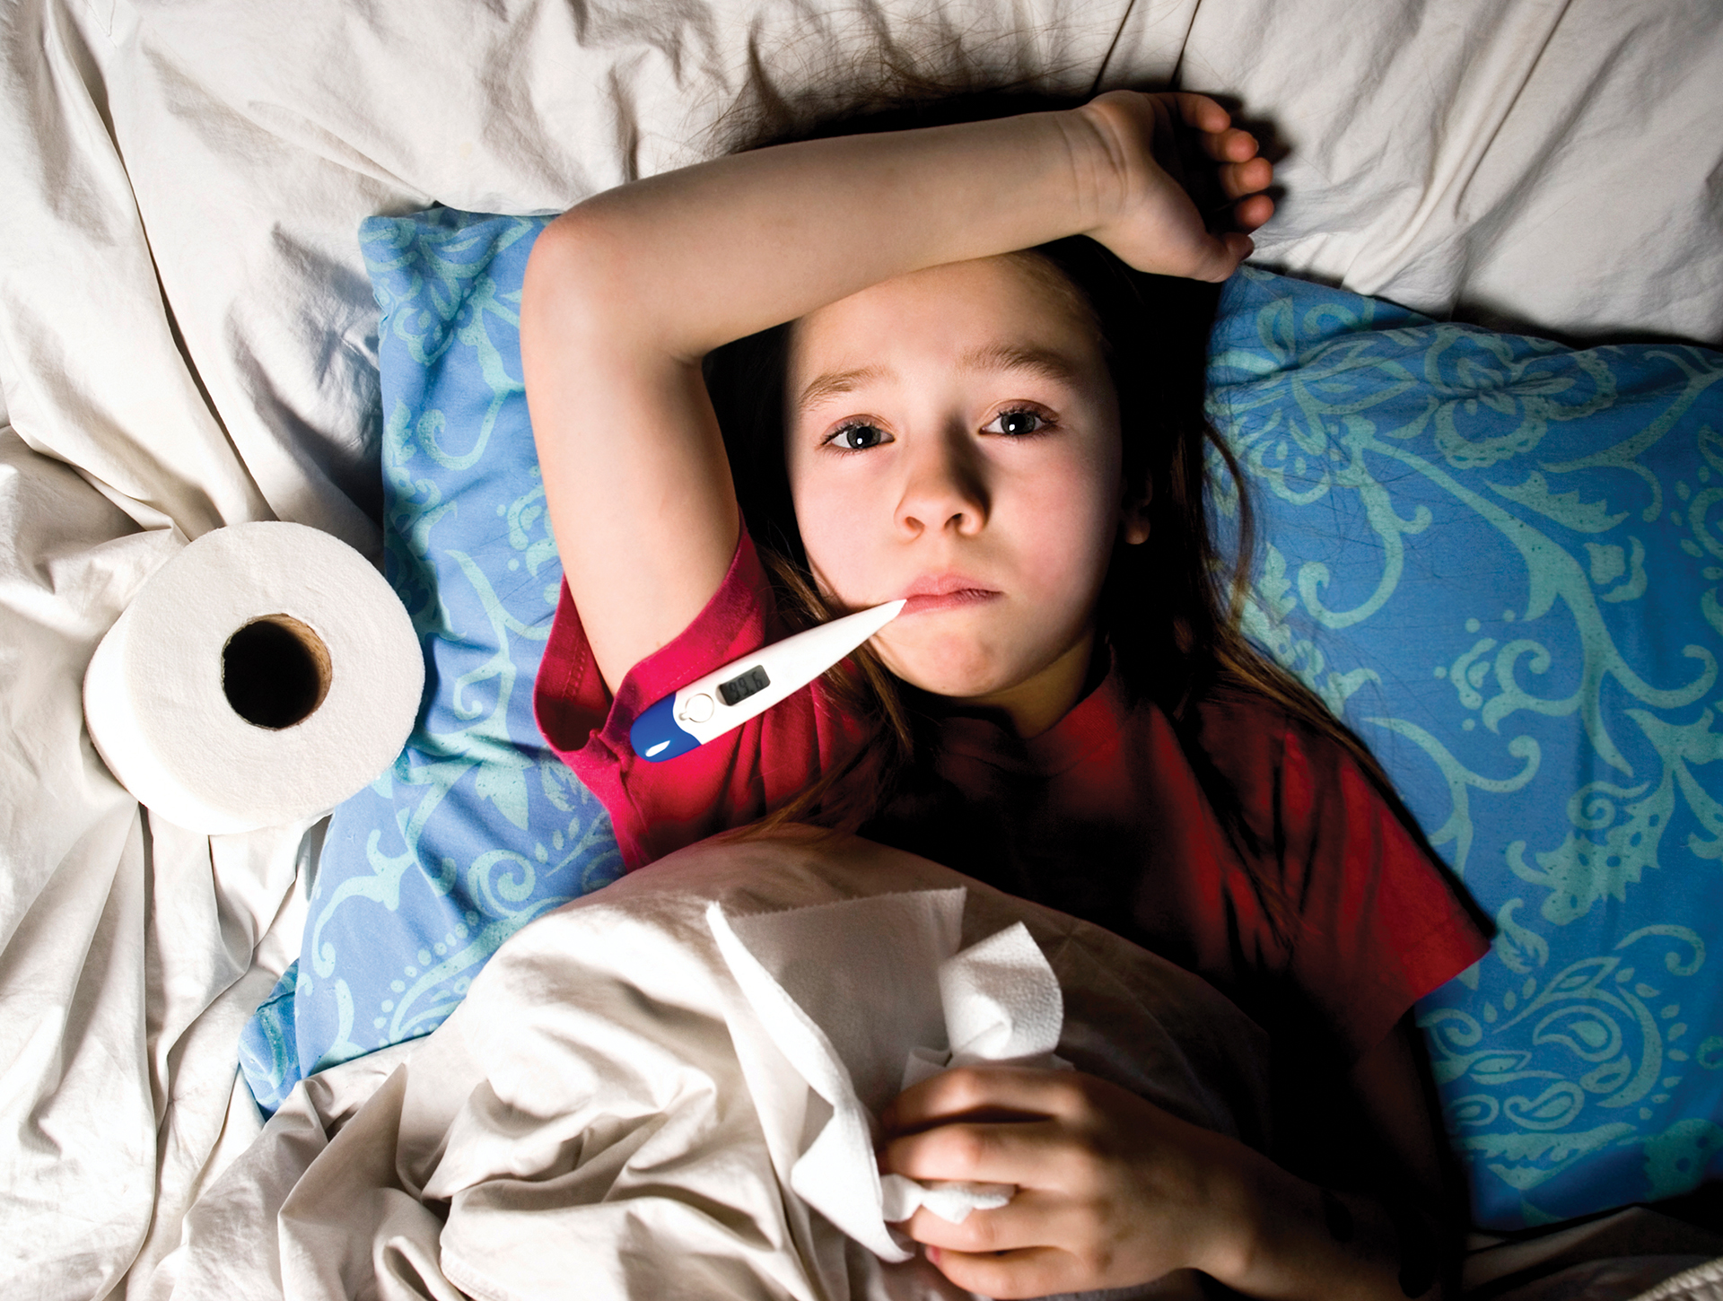
attendance
We work towards 100% attendance for every child.
In the case of illness, please call the office before 8.55am each day.
The staff may ask you for more information regarding an illness - safeguarding.
Diarrhea and/or vomiting - stay off school until your child has not been sick or had diarrhea for at least 2 days.
Temperature – 38 degrees or above, stay off school until temperature is ‘normal’ again without the use of medication.
Any request for leave of absence should be made with at least two weeks' notice using the “Request for Leave of Absence” form, which can be found on the school website or is available from the office.
Where possible, medical appointments should be taken outside of school hours.

Slide 9
Costings and extras
We have a trip to Legoland booked for our Oceans and Continents topic in the Summer Term. The final cost will depend on the price of the coach. It is likely to be in the region of £20-£30.
The date of this trip is TBC, but it is likely to be sometime in May.

