Slide 1
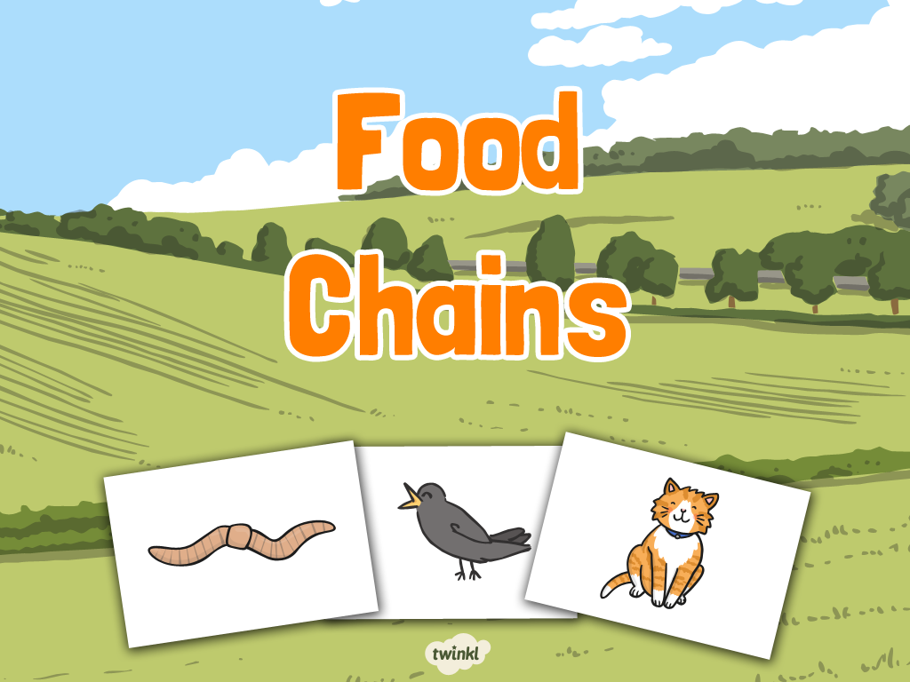

Title slide (themed) here

Slide 2
LO: To investigate living things.
C: To describe how animals obtain their food from plants and other animal, and using the idea of a simple food chain can identify and name different sources of food.
Success Criteria
I can name some sources of food.
I can give examples of carnivores, herbivores and omnivores.
I can order living things in a food chain.

Slide 3
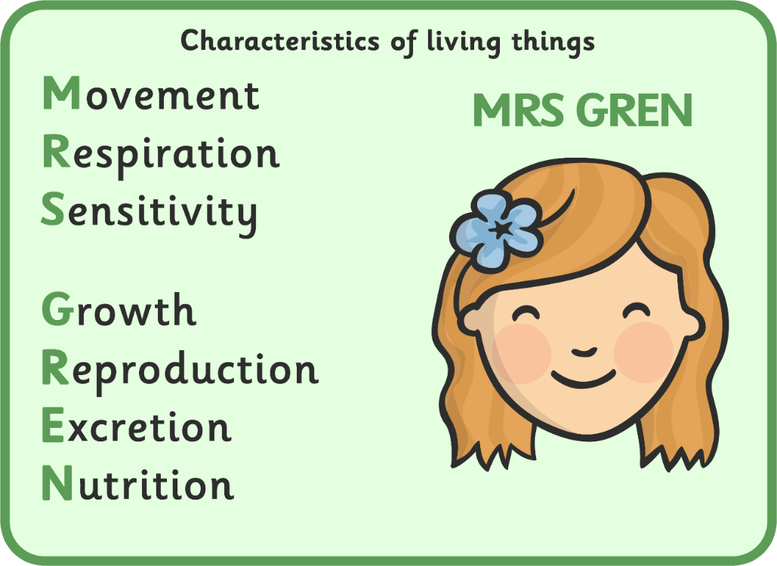
Sources of Food
Do you remember the 7 life processes?
These are the things that all living plants and animals have to do.
These processes tell us if something is alive.
Today we are going to look at nutrition.

Slide 4

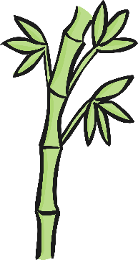
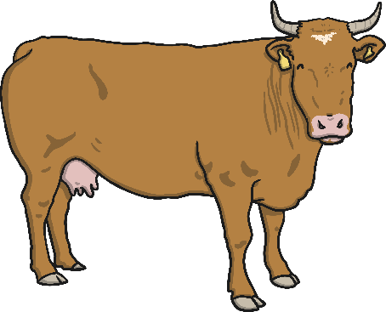



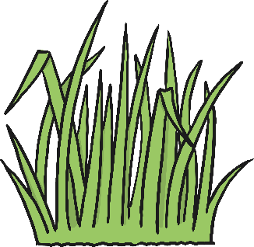
Sources of Food
Some animals get their food from eating plants.
These animals are called herbivores.
Can you think of some herbivores?
Can you think of some of the different things they could eat?

Slide 5


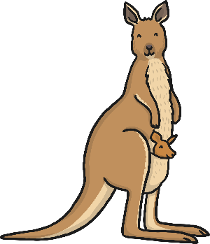

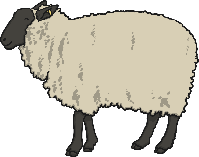
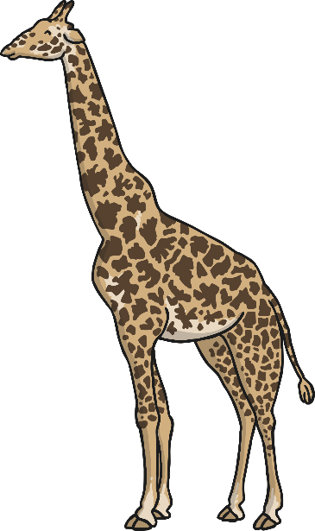
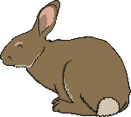


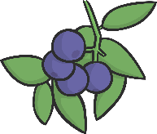
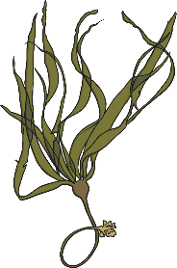

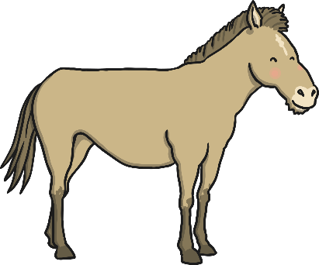


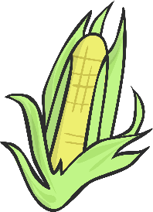

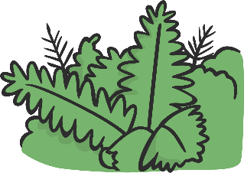

Sources of Food
These animals are herbivores.
They eat plants.

Slide 6
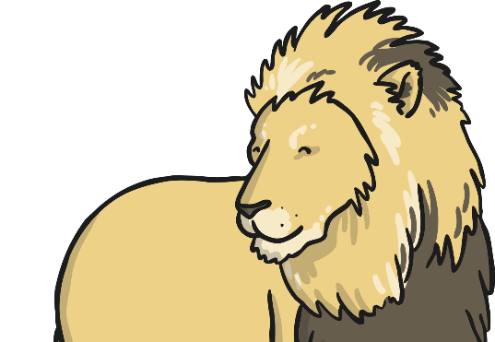
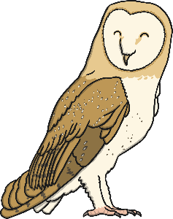

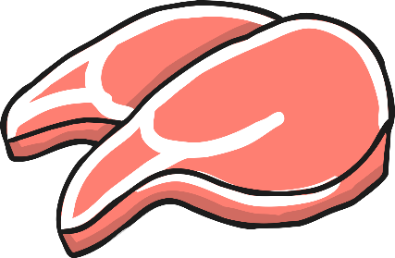
Sources of Food
Some animals get their food from eating other animals.
These animals are called carnivores.
Can you think of some carnivores?
Can you think of some of the different things they could eat?

Slide 7
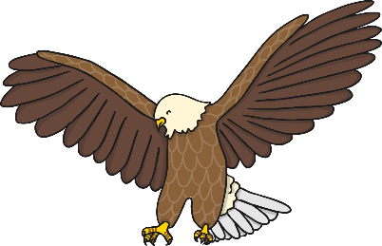
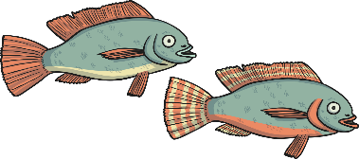
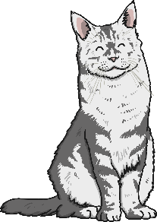

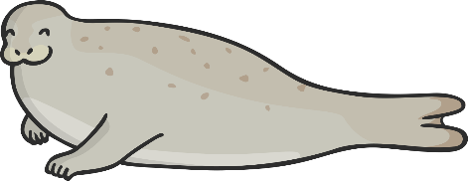
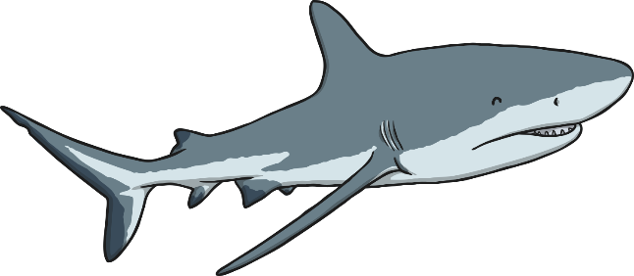

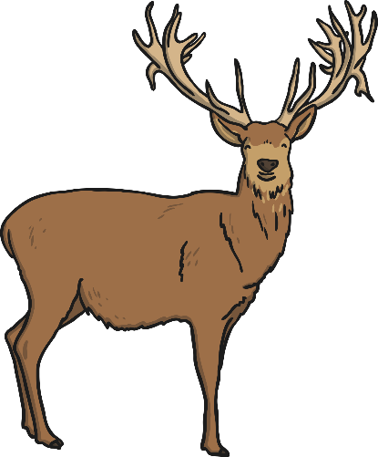

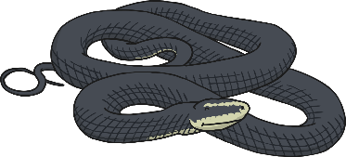
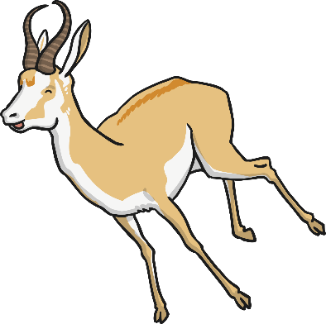
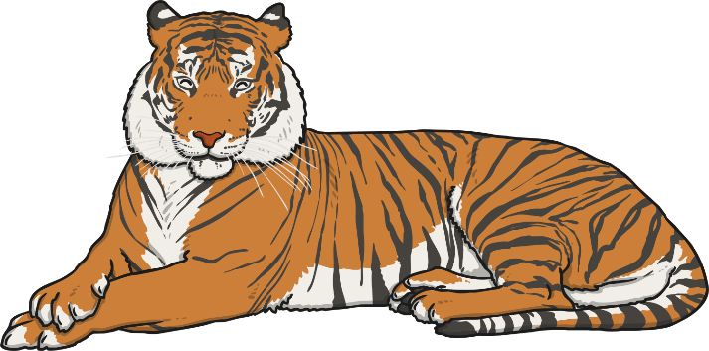
Sources of Food
These animals are carnivores.
They eat animals.

Slide 8
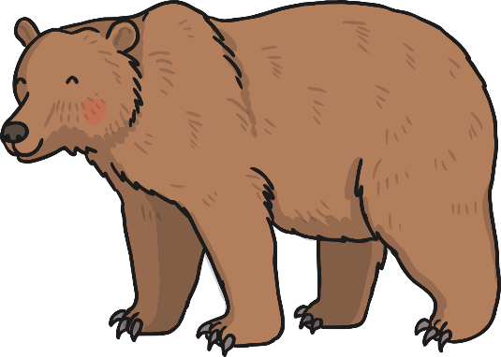
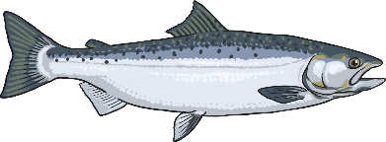
Sources of Food
Some animals get their food from eating some plants and some other animals.
These animals are called omnivores.
Can you think of some omnivores?
Can you think of some of the different things they could eat?

Slide 9
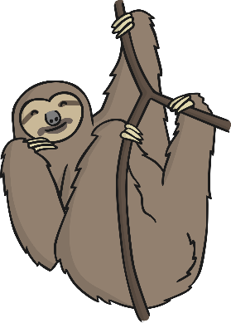
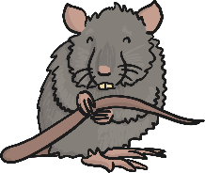
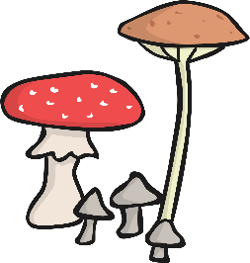
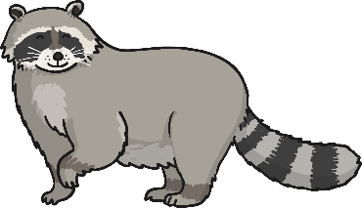
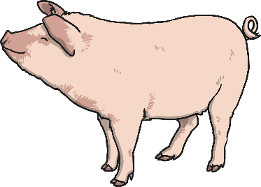
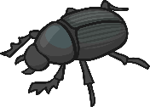
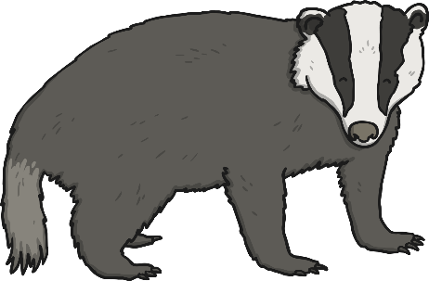
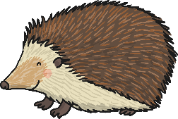

Sources of Food
These animals are omnivores.
They eat plants and animals.

Slide 10
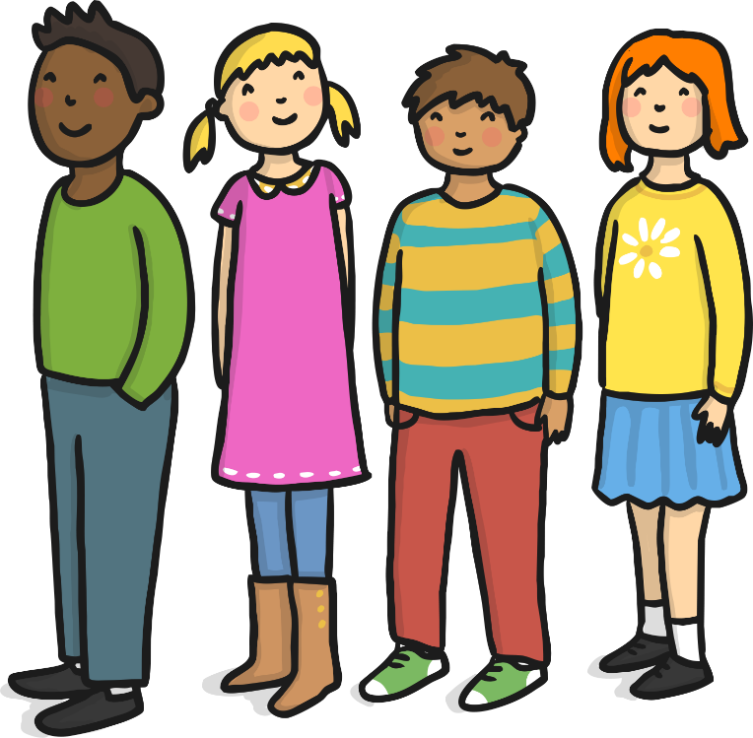
Sources of Food
Are humans herbivores, carnivores or omnivores?
What do we eat?

Slide 11



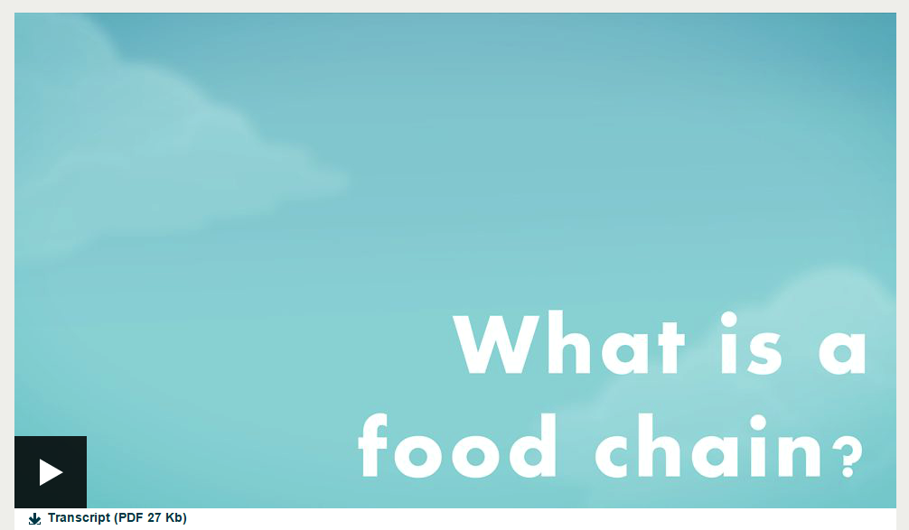
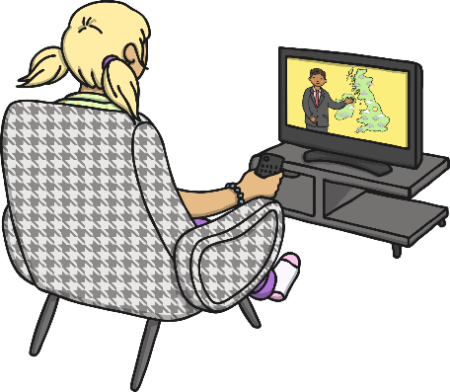
What Is a Food Chain?
A food chain shows how each animal gets its food. Food chains are one of the ways that living things depend on each other to stay alive.
Watch this clip to find out more!

Slide 12
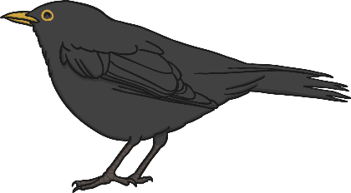

What Is a Food Chain?
Can you name which animal is eating which in the food chain below?
The arrows in a food chain mean ‘is eaten by’.

Slide 13
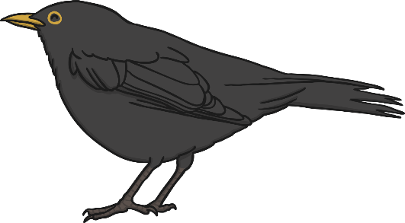

What Is a Food Chain?
Each food chain starts with a green plant.
Green plants are called producers because they produce their own food.
All animals are called consumers because they consume their food by eating plants and other animals.
Animals that eat other animals are called predators. The animals that they eat are called prey.
predator
producer
consumer
prey

Slide 14
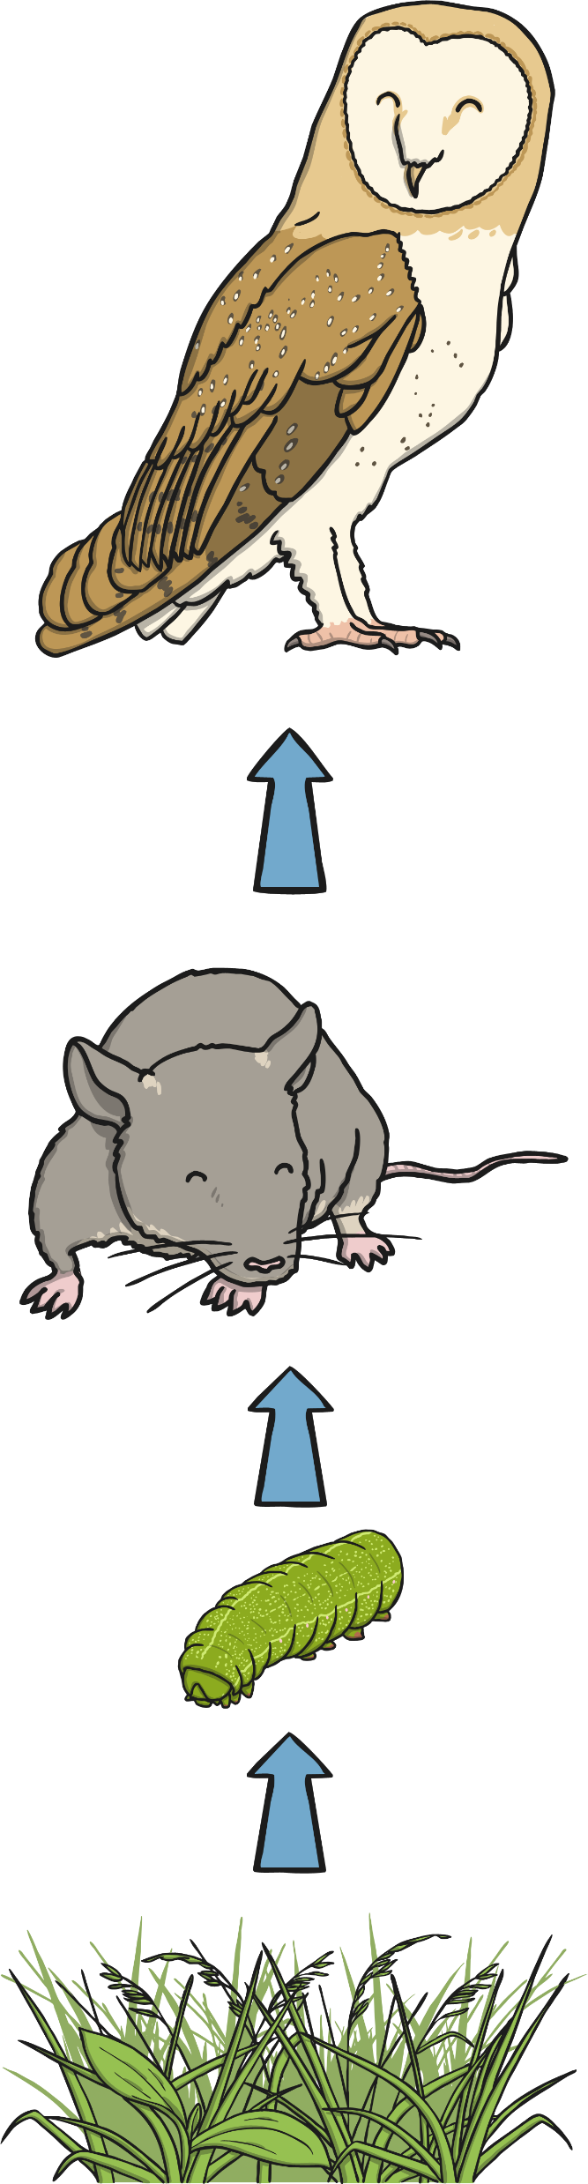



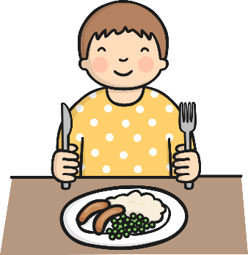

What Is a Food Chain?
There are food chains in all kinds of habitats.

Slide 15


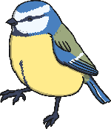

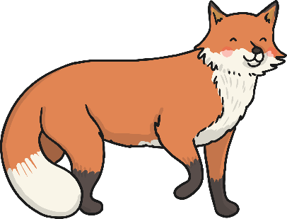

What Is a Food Chain?
Use some of these living things to draw a food chain on your whiteboards.
Remember to draw the arrows to show what eats what!

Slide 16





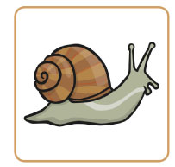
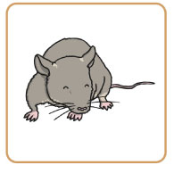
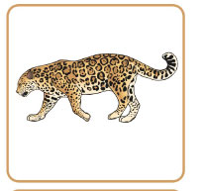
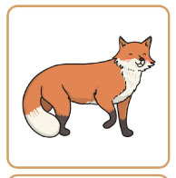

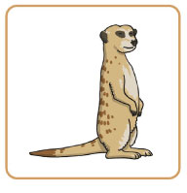
Food Chains Sorting Activity
In your group, arrange the cards into as many food chains as you can.
There are lots of correct answers!

Slide 17


LO: To investigate living things.
C: To describe how animals obtain their food from plants and other animal, and using the idea of a simple food chain can identify and name different sources of food.
Draw and label a 3 stage food chain.
Draw and label 2 different 4 stage food chains.
Make a mini concertina book to show a food chain.
Can you label the producer, the consumer and the predator?

