Slide 1
Tuesday 16th March 2021
L.O: To understand texts- inference
C: Boy

Slide 2
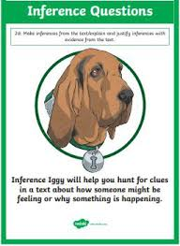
Today we are continuing to explore our new book! We are starting Roald’s school years.
We are going to use our Inference Iggy skills to help us step into Roald’s shoes.

Slide 3
Starter: Thinking Question
What does curious mean? What makes you curious?

Slide 4
Question 1
Class read:
26-34
How much are the Sherbet Suckers? (1 mark)
This is a retrieval question. We need to use a direct quote to get the mark.

Slide 5
Question 2
How do we know the boy is curious? What clues can you find in the text?
(2 marks)
We need to give a reason using evidence from the text.

Slide 6
Question 3
Class read:
26-34
Which sweet would you choose and why? (2 marks)
Make sure you spell the sweet correctly and give evidence. .

Slide 7

Red Pen Challenge:
:
Think back to the questions you wrote last week. Are we any closer to finding out about the mouse or the murder?

