Slide 1
Friday 19th March 2021
L.O: To understand texts- inference skills.
C: Boy

Slide 2
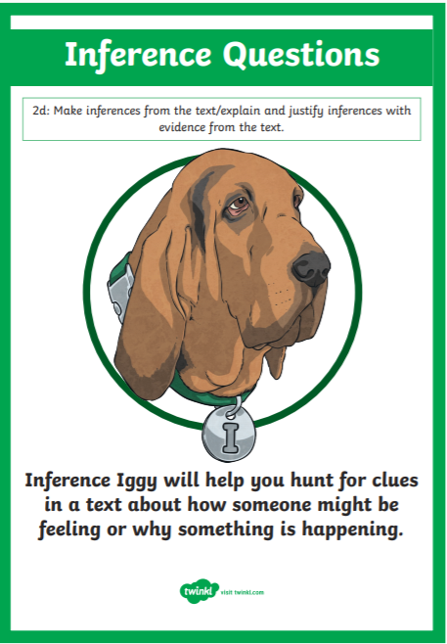
Today we are continuing to explore our new book! We are starting Roald’s school years.
We are going to use our Inference Iggy skills to help us compare and contrast emotions.

Slide 3
Class read p.50-56
While we are reading, I would like you to focus on the character’s thoughts and emotions.

Slide 4
Hotseating!
You are going to ask the main characters questions about their thoughts and emotions.
Roald Dahl
Mrs Pratchett
Head Master

Slide 5
Paddlers: Children to write their own questions
Snorkellers: To use questions to delve deeper into the character’s emotions.
Divers: Children to create sophisticated questions to delve deeper into both their outer and inner emotions.

Slide 6
Let’s hotseat!
We are going to take photos for our books.

Slide 7

Red Pen Challenge:
:
Which character’s emotions are the clearest? How do you know?

