Slide 1
Thursday 18th March 2021
L.O: To understand texts- comparison skills.
C: Boy

Slide 2
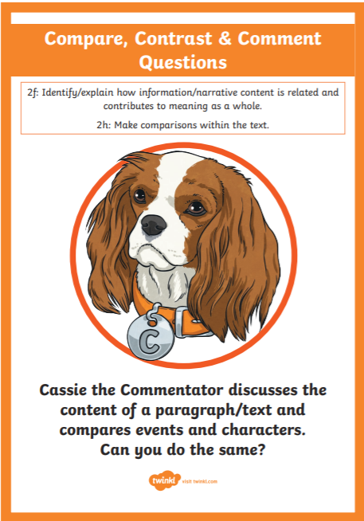
Today we are continuing to explore our new book! We are starting Roald’s school years.
We are going to use our Commentating Cassie skills to help us compare and contrast emotions.

Slide 3
Starter: Emotion Game!
Today, let’s try to come up with 30 different emotions!

Slide 4
Class read: p.42-49
Let’s first read up to page 44.
How do you think Roald is feeling?
Can you write a paragraph with justification?
I will model this.

Slide 5
Class read: p.42-49
I think Roald was feeling…… I know this because the text states….”……..”.

Slide 6
Let’s read up to page 49.
How do you think Roald is feeling now?
Can you write a paragraph with justification?
I will model this.

Slide 7
Class read: p.42-49
I think Roald was feeling…… I know this because the text states….”……..”.

Slide 8

Red Pen Challenge:
:
What do you think was the turning point for Roald Dahl’s emotions in this section?

