Slide 1
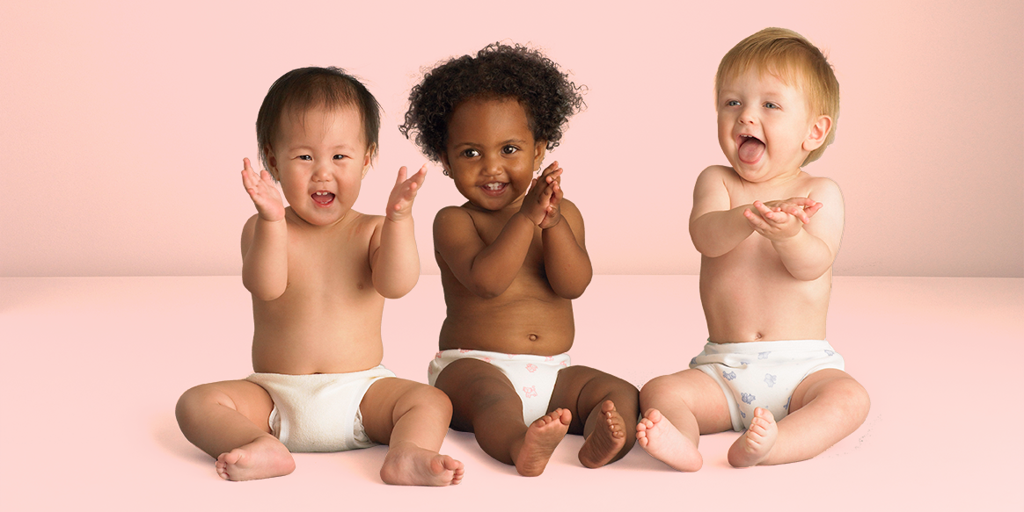
Friday 9th July 2021
L.O: Changing Me- Piece 1
C: How babies grow

Slide 2
How do these pictures make you feel?

Slide 3
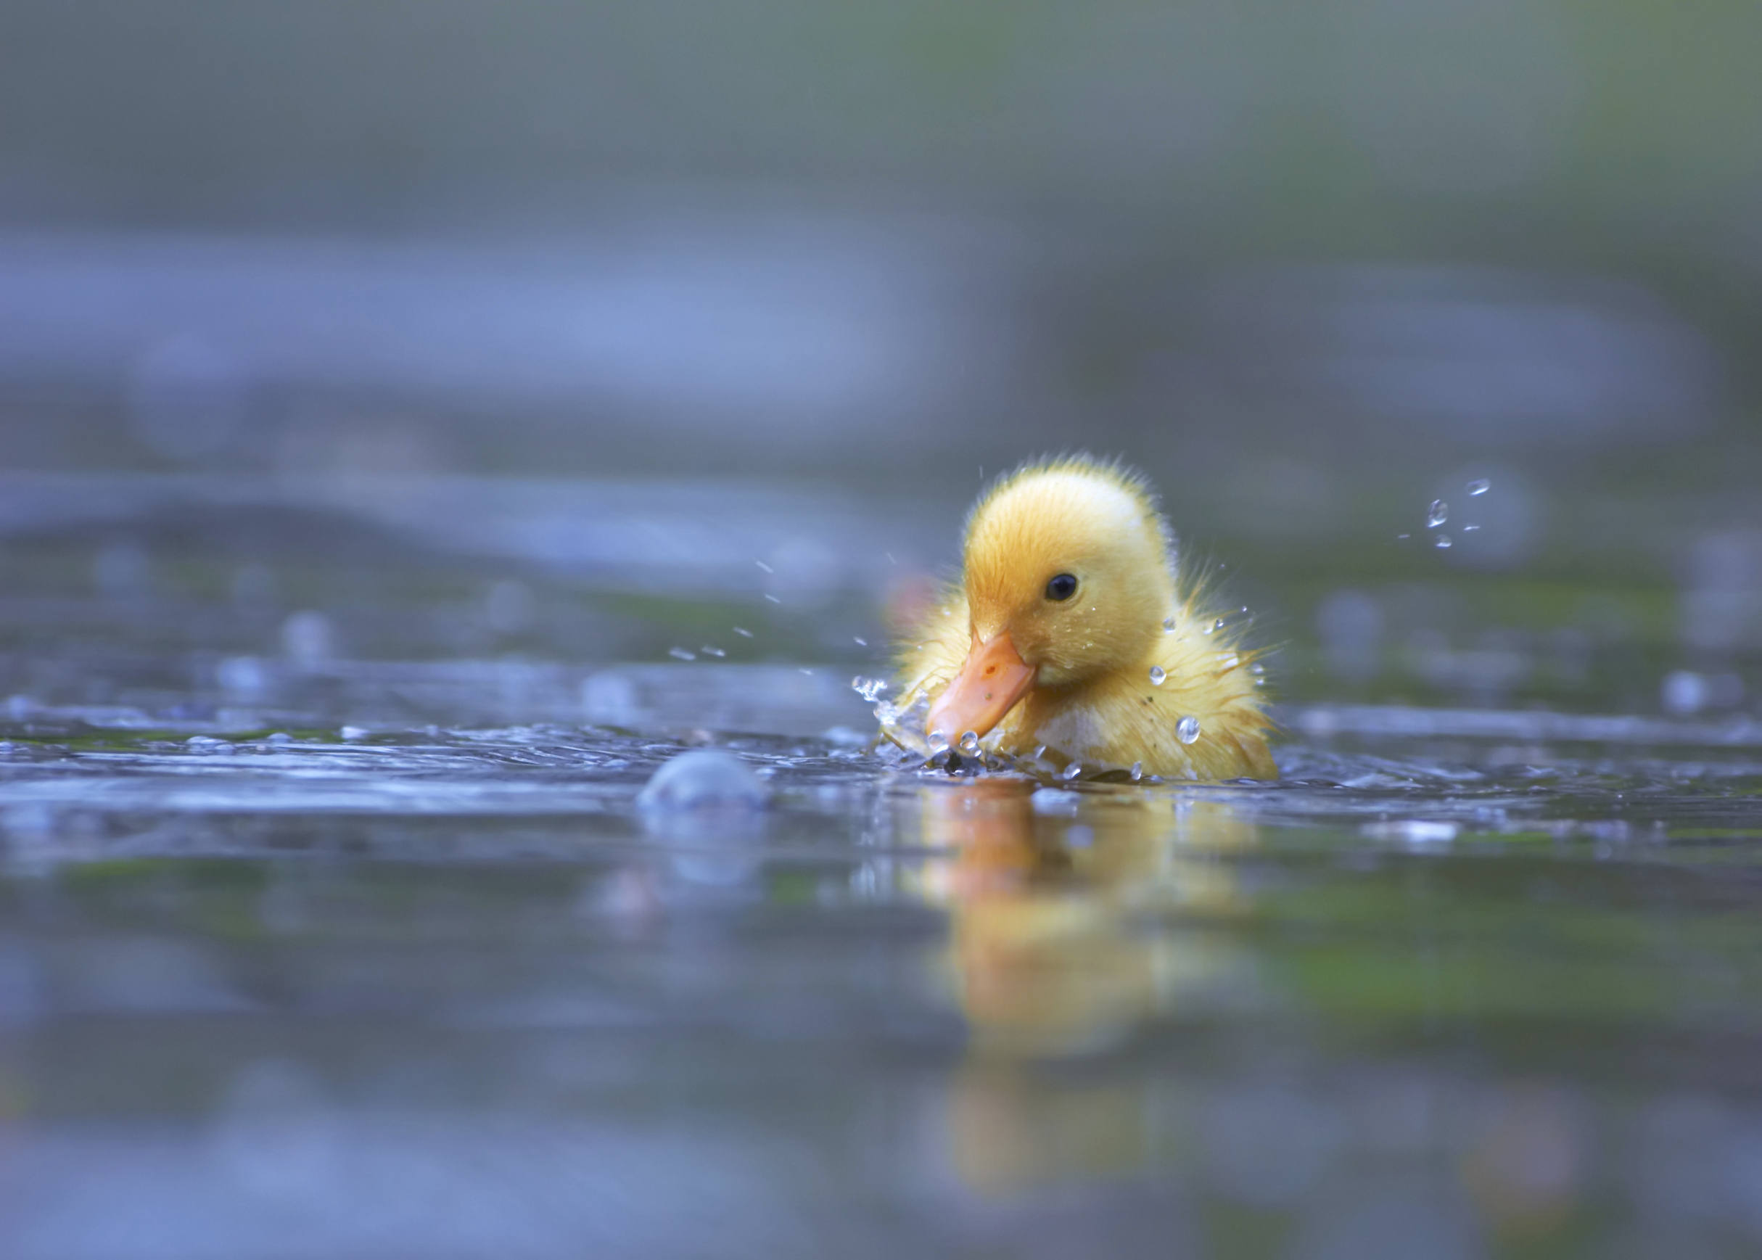

Slide 4
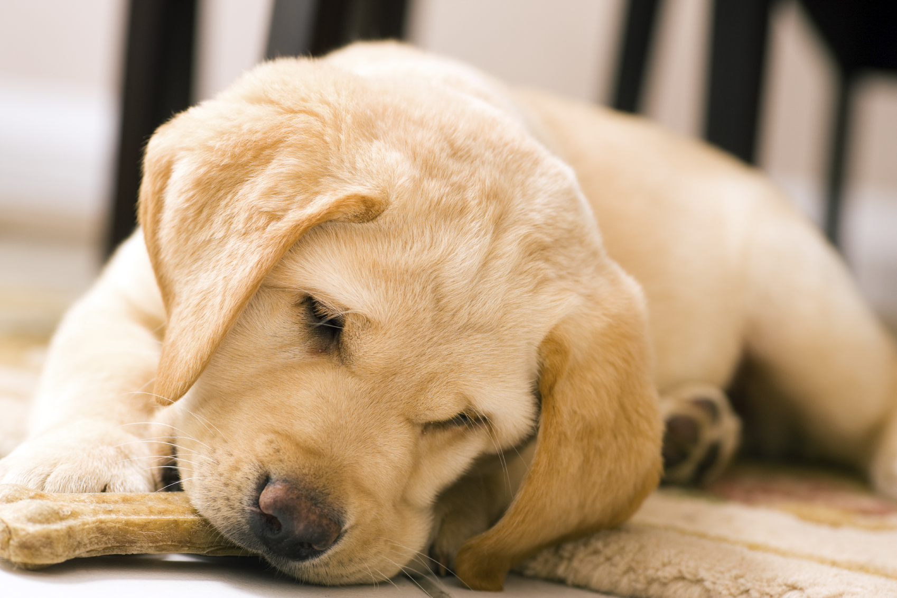

Slide 5
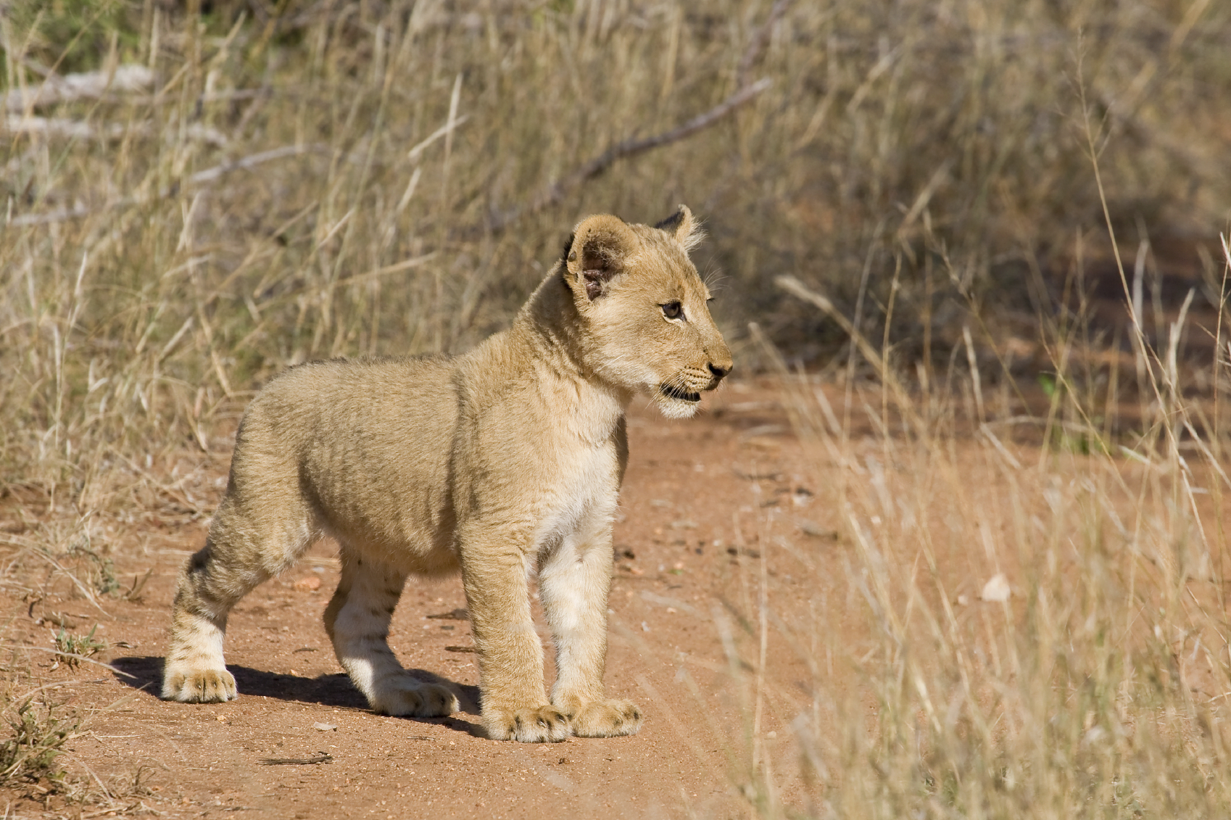

Slide 6
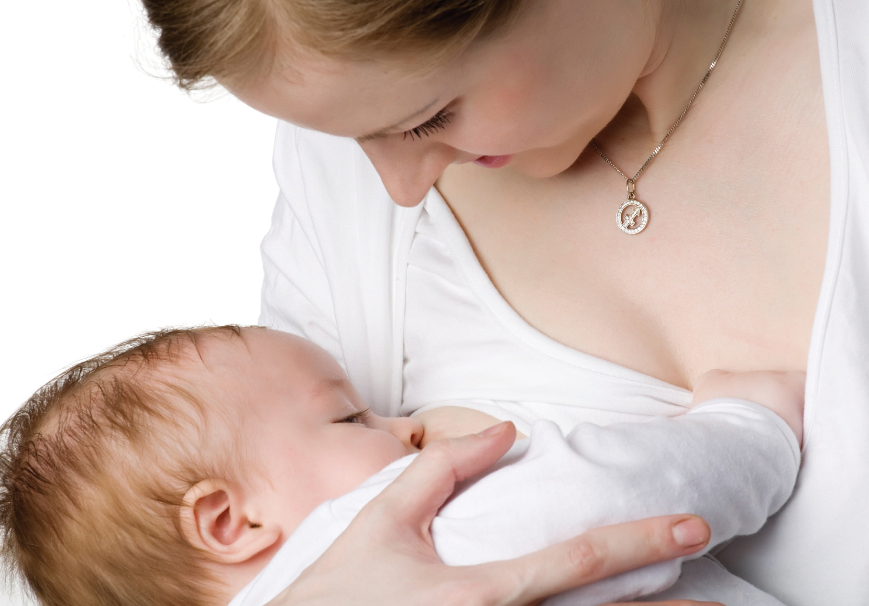

Slide 7
What things can’t a baby do without help?
Let’s make a list of a parent’s responsibilities.

Slide 8
- Next, let’s label these pictures to show changes that occur from birth to adulthood.

