Slide 1
Thursday 8th July 2021
LO: To describe how some of the values held by communities or individuals affect behaviour and actions.
C: What is the best way for a Sikh to show commitment to God?

Slide 2
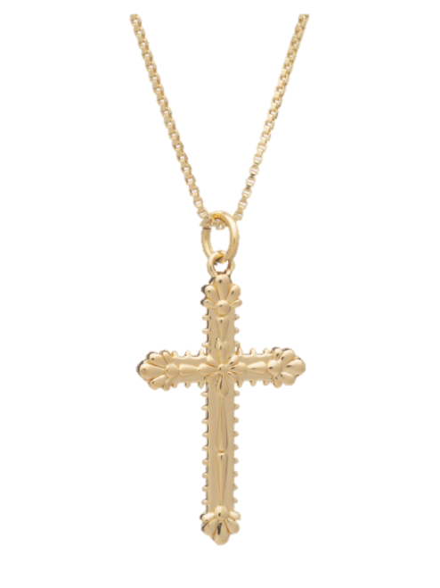

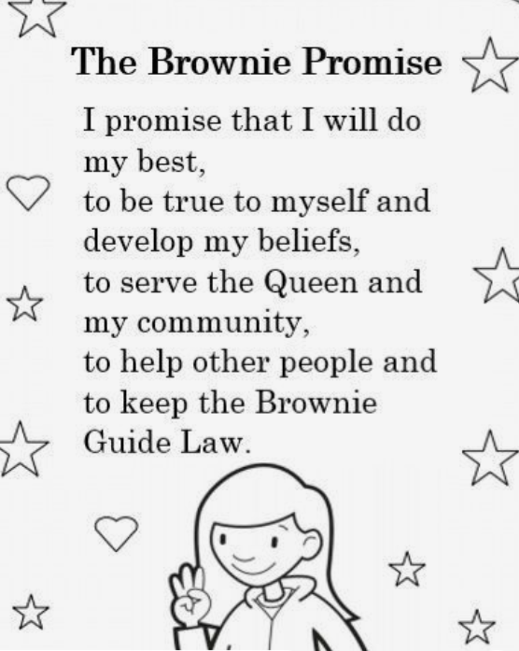
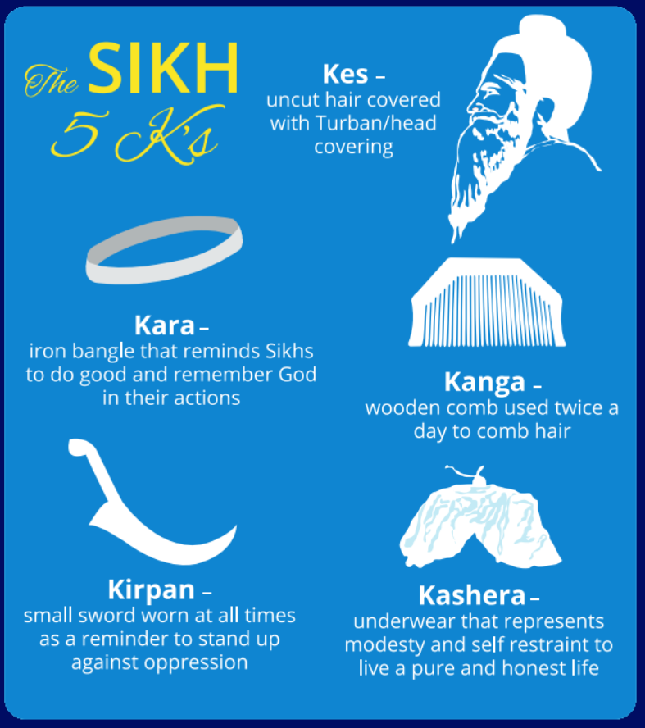
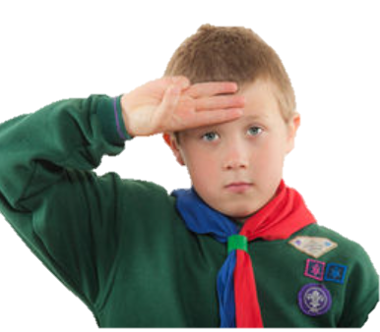

What are all these pictures a sign of?

Slide 3
COMMITMENT

Slide 4
Look at the pictures on the next slide.
What are they committed too?

Slide 5
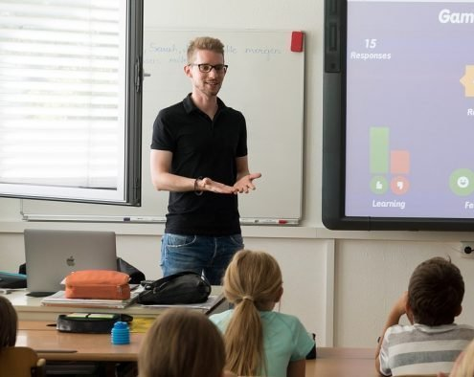
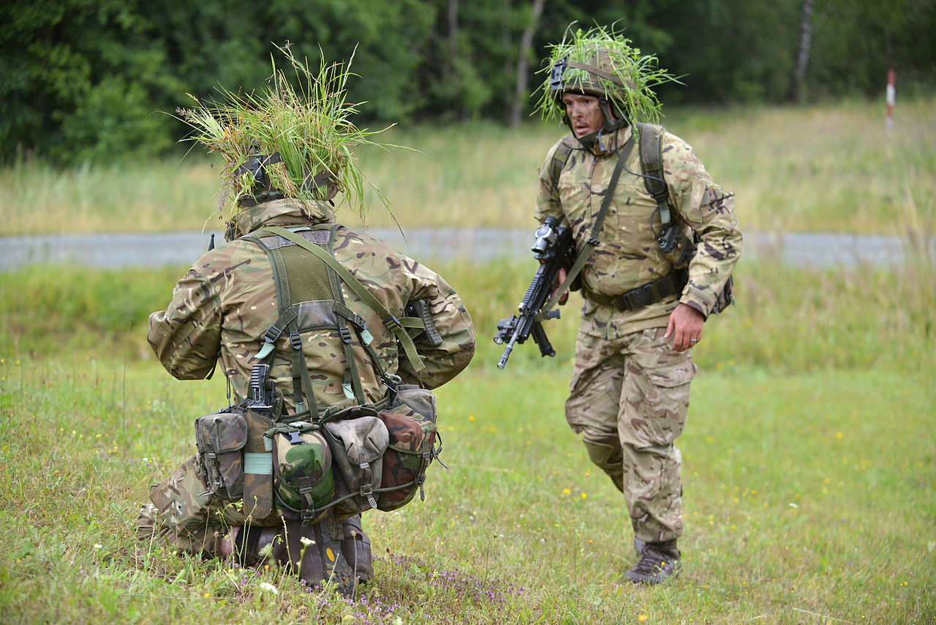
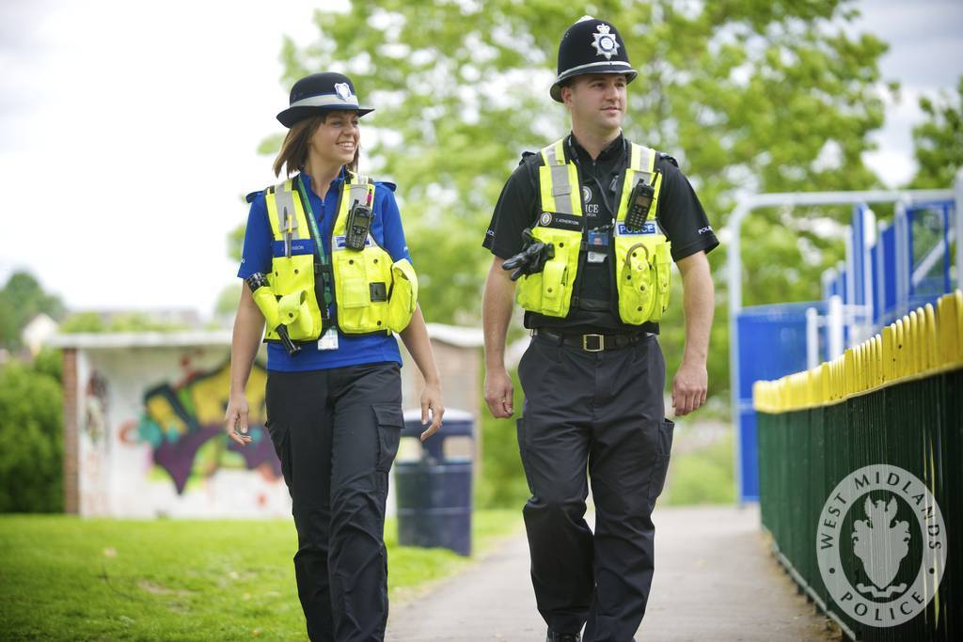
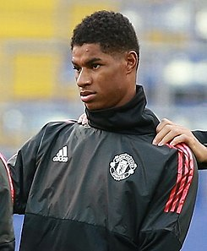



Slide 6
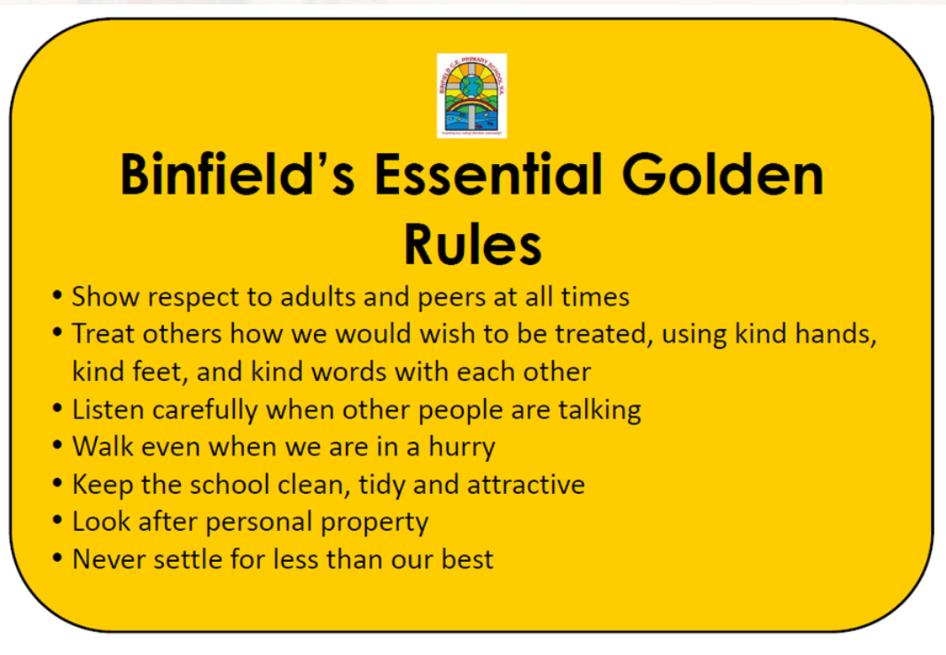
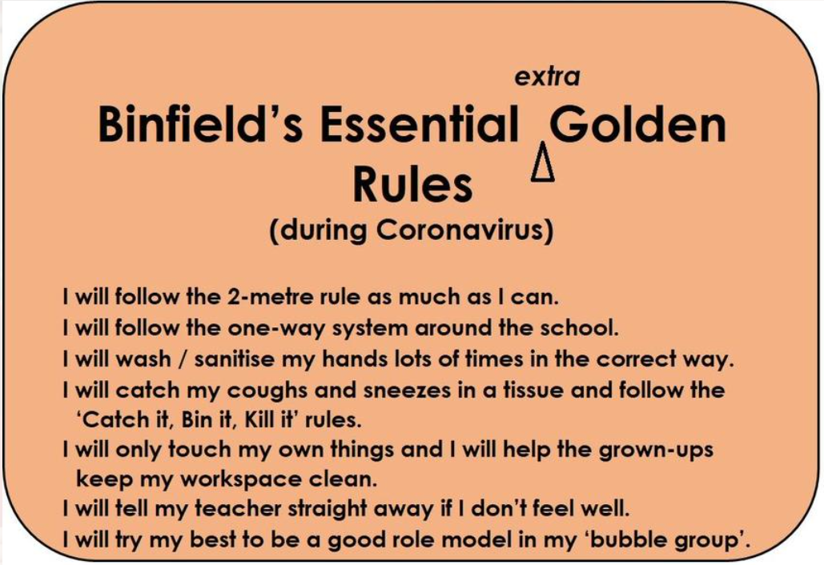
How do we show commitment to our school?

Slide 7

What am I committed to?
How do I show my commitment?
Are there times when showing commitment is difficult?
Is it important to me to show commitment?
Do we show commitment in different ways?

Slide 8
Paddling - Draw something you are committed too and write how you show commitment to this underneath.
Snorkelling - Draw something you are committed to and write how you show commitment to this and if it is sometimes hard to show commitment.
Diving - Draw something you are committed. Underneath, define commitment in your own words. Then, write how you show commitment to this and if it is sometimes hard to show commitment.
RP: Why is showing commitment important?

