Slide 1






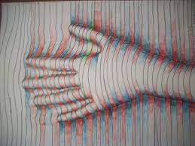
Optical Illusion Art
https://www.youtube.com/watch?v=0teupIUsNXI
https://www.youtube.com/watch?v=YNEXzvnD7mI

Slide 2

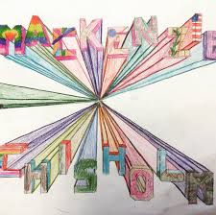





One Point Perspective Art
https://www.youtube.com/watch?v=903BRkOJPBU

Slide 3
Talk Cards in Groups – have a think about these before the Teams call this afternoon.
What is something we did this year that you think you will remember for the rest of your life?
What is something you accomplished this year that you are proud of?
What was the nicest thing someone in our class did for you this year?
What was the most challenging part of this year for you?
Where is your favourite place in our classroom (or school)? Why?
If you could change one thing that happened this year, what would it be?
What are three things you did this year to help your classmates?
What are the three most important things you learned this year?
What is something that was hard for you at the start of the year but is easy now?

