Slide 1
2.7.2021
L.O: To use fractions
C: Subtract Fractions

Slide 3
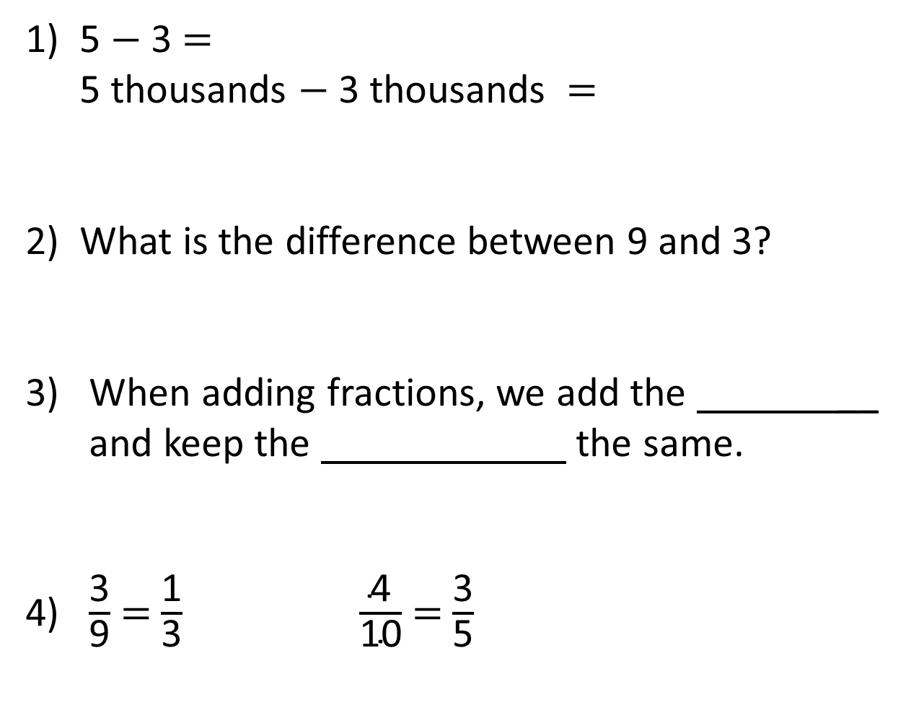
1) 5 $−$ 3 $=$
5 thousands $−$ 3 thousands $=$
2) What is the difference between 9 and 3?
3) When adding fractions, we add the __
and keep the the same.
4) $\frac{\text{3}}{\text{9}}$ $=$ $\frac{\text{1}}{\text{3}}$ $\frac{\text{4}}{\text{10}}$ $=$ $\frac{\text{3}}{\text{5}}$

Slide 4
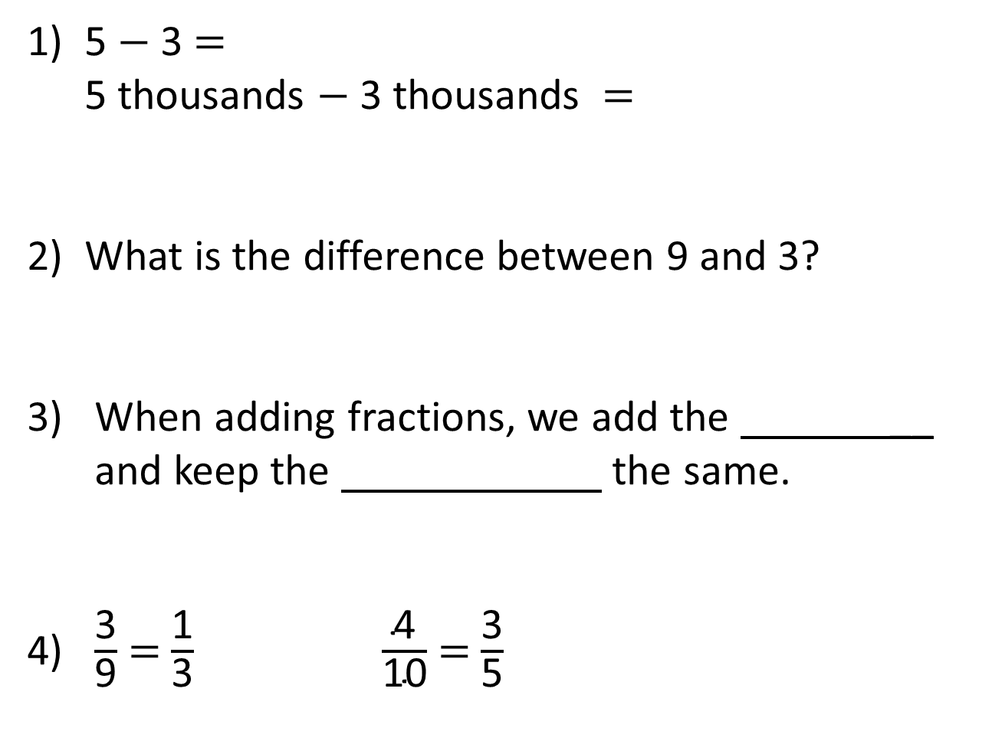
1) 5 $−$ 3 $=$
5 thousands $−$ 3 thousands $=$
2) What is the difference between 9 and 3?
3) When adding fractions, we add the __
and keep the the same.
4) $\frac{\text{3}}{\text{9}}$ $=$ $\frac{\text{1}}{\text{3}}$ $\frac{\text{4}}{\text{10}}$ $=$ $\frac{\text{3}}{\text{5}}$
2
2 thousands
6
numerators
denominators
1
2

Slide 6

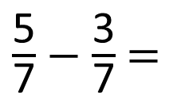
$\frac{\text{5}}{\text{7}}$ $−$ $\frac{\text{3}}{\text{7}}$ $=$
$\frac{\text{2}}{\text{7}}$
When subtracting fractions, we subtract the numerators and keep the denominators the same.
When adding fractions, we add the
numerators and keep the denominators the same.

Slide 7


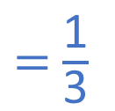


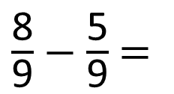


$\frac{\text{8}}{\text{9}}$ $−$ $\frac{\text{5}}{\text{9}}$ $=$
$\frac{\text{3}}{\text{9}}$
$=$ $\frac{\text{1}}{\text{3}}$
Have a think
$\frac{\text{8}}{\text{9}}$
$\frac{\text{5}}{\text{9}}$
$\frac{\text{3}}{\text{9}}$

Slide 8
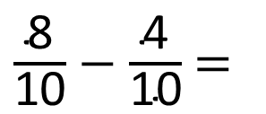
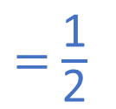
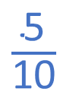
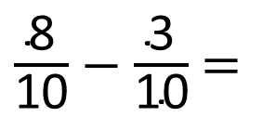
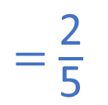
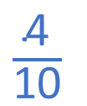
$\frac{\text{8}}{\text{10}}$ $−$ $\frac{\text{3}}{\text{10}}$ $=$
$\frac{\text{5}}{\text{10}}$
$=$ $\frac{\text{1}}{\text{2}}$
$\frac{\text{8}}{\text{10}}$ $−$ $\frac{\text{4}}{\text{10}}$ $=$
$\frac{\text{4}}{\text{10}}$
$=$ $\frac{\text{2}}{\text{5}}$

Slide 9
Have a go at questions 1 – 5 on the worksheet

Slide 10


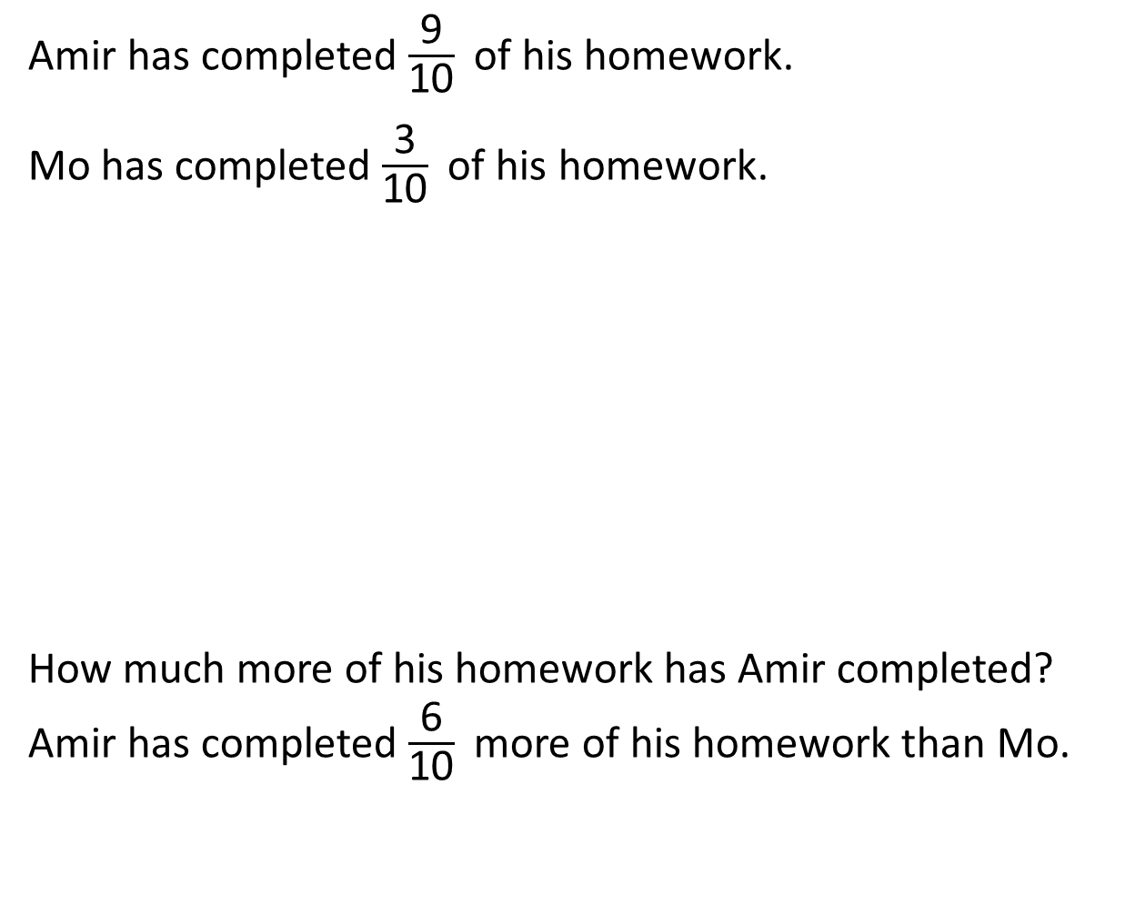
Amir has completed $\frac{\text{9}}{\text{10}}$ of his homework.
Mo has completed $\frac{\text{3}}{\text{10}}$ of his homework.
How much more of his homework has Amir completed?
Amir has completed $\frac{\text{6}}{\text{10}}$ more of his homework than Mo.

Slide 11



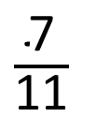
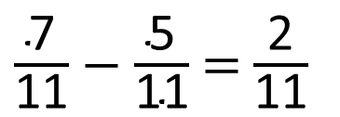
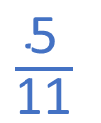
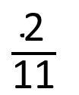
5
$\frac{\text{7}}{\text{11}}$ $−$ $\frac{\text{5}}{\text{11}}$ $=$ $\frac{\text{2}}{\text{11}}$
Have a think
$\frac{\text{7}}{\text{11}}$
$\frac{\text{2}}{\text{11}}$
$\frac{\text{5}}{\text{11}}$

Slide 12
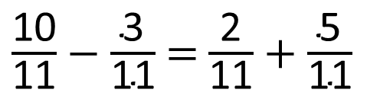
10
$\frac{\text{10}}{\text{11}}$ $−$ $\frac{\text{3}}{\text{11}}$ $=$ $\frac{\text{2}}{\text{11}}$ $+$ $\frac{\text{5}}{\text{11}}$
Have a think

Slide 13
Have a go at the rest of the questions on the worksheet

