Slide 1
Tuesday 29th June 2021
LO: To organise writing appropriately
C: Recount

Slide 2
What is the difference between the past and present tense?
Have a go at the past/present questions

Slide 3
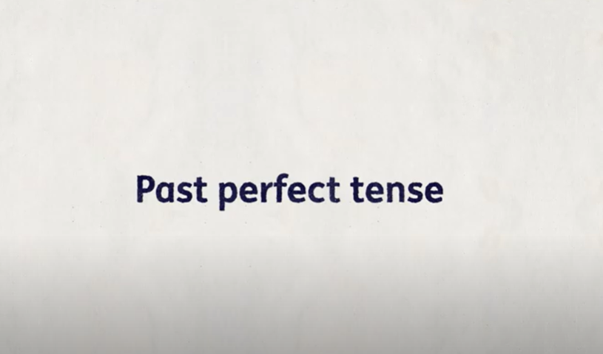
What do you think the past perfect is?
Watch the video from 1m29s
https://www.youtube.com/watch?v=7GAjEdOiNaI

Slide 4
What is the job of the past perfect tense?
We use the past perfect tense to signify an action that was completed before another took place in the past. The form of the past perfect tense is 'had' then the past tense of the verb.
Have a go at the past perfect task

Slide 5
Can you come up with some past perfect sentences which could be used in our diary entry for Bibo?
I had been feeling tired after a day of walking around until I found a new and exciting project.

