Slide 1


Slide 2
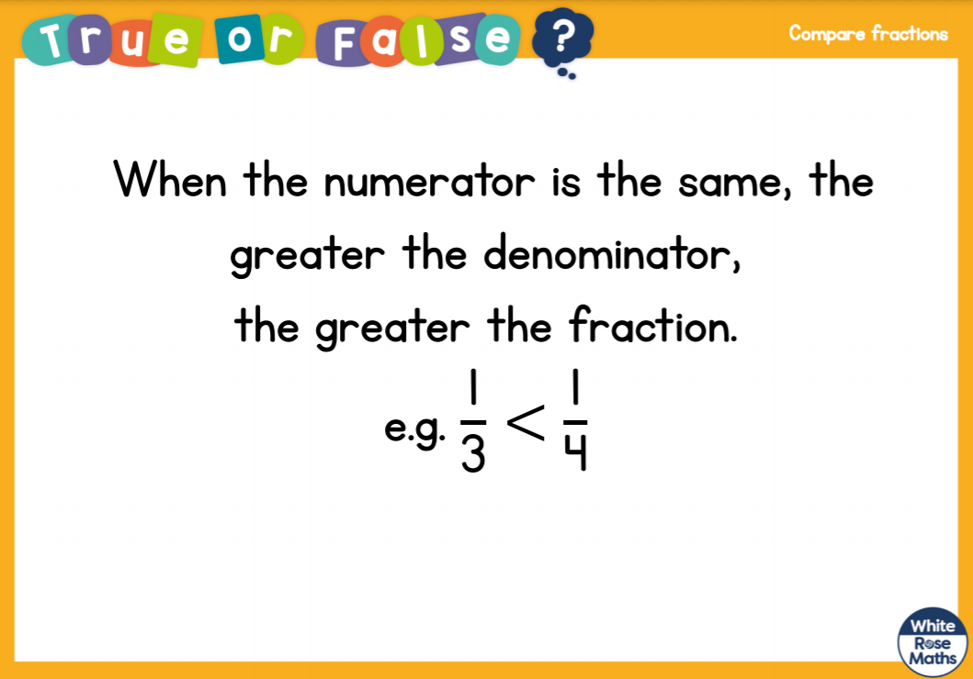

Slide 3
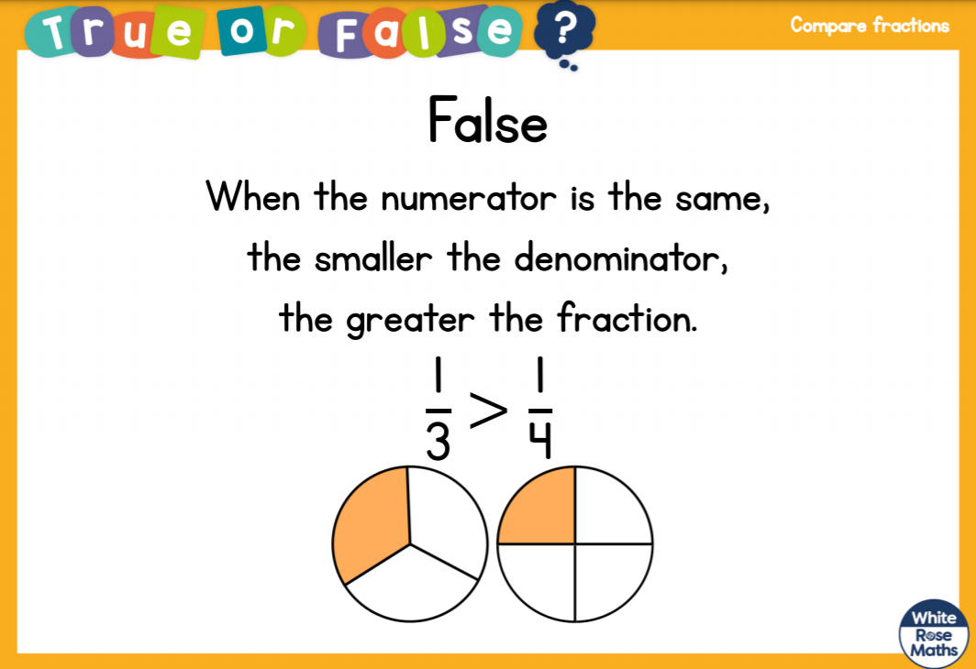

Slide 5



Complete the equivalent fractions
1)
2)
3)
$\frac{\text{1}}{\text{4}}$ $=$ $\frac{\text{2}}{\text{8}}$
$\frac{\text{1}}{\text{4}}$ $=$ $\frac{\text{3}}{\text{12}}$
$\frac{\text{3}}{\text{4}}$ $=$ $\frac{\text{9}}{\text{12}}$

Slide 6
Complete the equivalent fractions
1)
2)
3)
$\frac{\text{1}}{\text{4}}$ $=$ $\frac{\text{2}}{\text{8}}$
$\frac{\text{1}}{\text{4}}$ $=$ $\frac{\text{3}}{\text{12}}$
$\frac{\text{3}}{\text{4}}$ $=$ $\frac{\text{9}}{\text{12}}$

Slide 8


$\frac{\text{6}}{\text{7}}$ $\frac{\text{4}}{\text{7}}$
$$>$$
When the denominators are the same,
the the numerator, the the fraction.
greater
greater
smaller
smaller

Slide 9

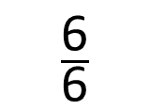
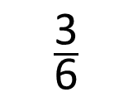
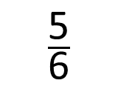
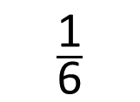
Put the fractions in order from smallest to greatest.
$\frac{\text{5}}{\text{6}}$
$\frac{\text{3}}{\text{6}}$
$\frac{\text{6}}{\text{6}}$
$\frac{\text{1}}{\text{6}}$
When the denominators are the same, the greater the numerator, the greater the fraction.
Have a think

Slide 10
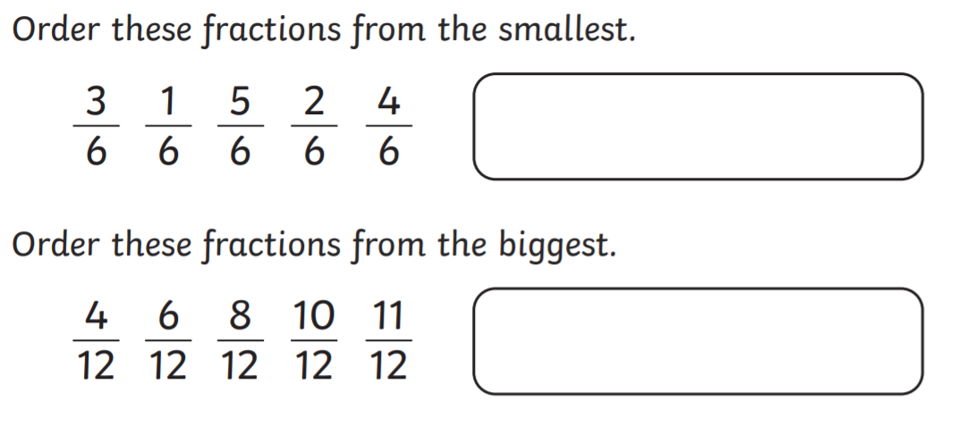

Slide 11
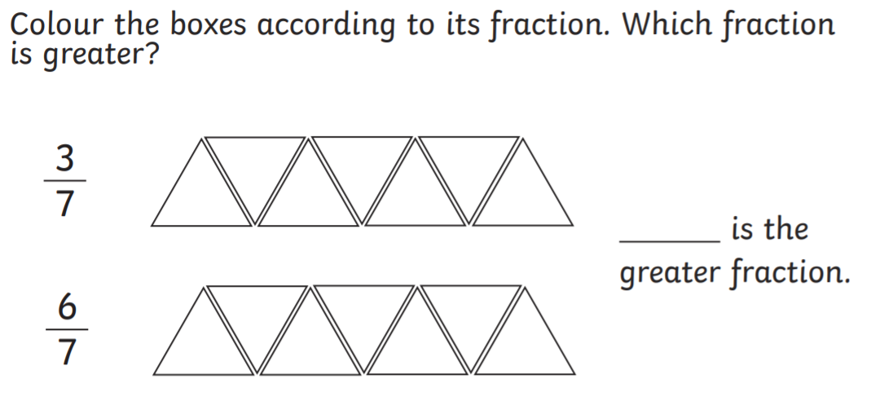

Slide 12


Varied Fluency 1
Complete the missing numerators from these ordered fractions.
3 |  |  |  | 5 |  |  |  | 7
10 |  | 10 |  | 10 |  | 10 |  | 10
© Classroom Secrets Limited 2019

Slide 13
Varied Fluency 1
Complete the missing numerators from these ordered fractions.
3 |  | 4 |  | 5 |  | 6 |  | 7
10 |  | 10 |  | 10 |  | 10 |  | 10
© Classroom Secrets Limited 2019

Slide 14
Varied Fluency 2
Order the fractions in ascending order.
5 |  | 1 |  | 0 |  | 2
5 |  | 5 |  | 5 |  | 5
© Classroom Secrets Limited 2019

Slide 15
Varied Fluency 2
Order the fractions in ascending order.
5 |  | 1 |  | 0 |  | 2
5 |  | 5 |  | 5 |  | 5
0 |  | 1 |  | 2 |  | 5
5 |  | 5 |  | 5 |  | 5
© Classroom Secrets Limited 2019

Slide 16
Varied Fluency 3
Order the fractions in descending order.
5 |  | 7 |  | 1 |  | 3
12 |  | 12 |  | 12 |  | 12
6 |  | 11 |  | 10 |  | 0
12 |  | 12 |  | 12 |  | 12
© Classroom Secrets Limited 2019

Slide 17
Varied Fluency 3
Order the fractions in descending order.
11 |  | 10 |  | 7 |  | 6
12 |  | 12 |  | 12 |  | 12
5 |  | 3 |  | 1 |  | 0
12 |  | 12 |  | 12 |  | 12
© Classroom Secrets Limited 2019

Slide 18
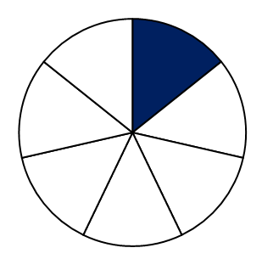
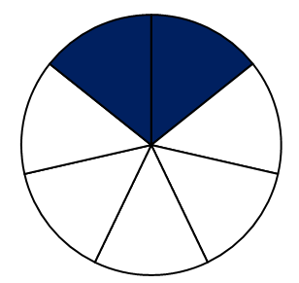
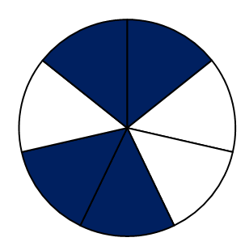
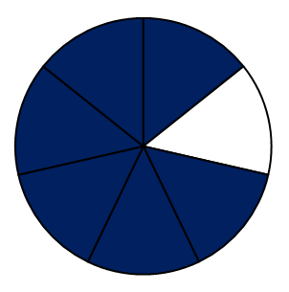

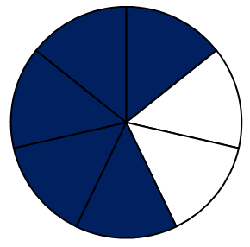
Varied Fluency 4
What is the missing fraction in this sequence?
© Classroom Secrets Limited 2019

Slide 19
Varied Fluency 4
What is the missing fraction in this sequence?
3
7
© Classroom Secrets Limited 2019

Slide 20
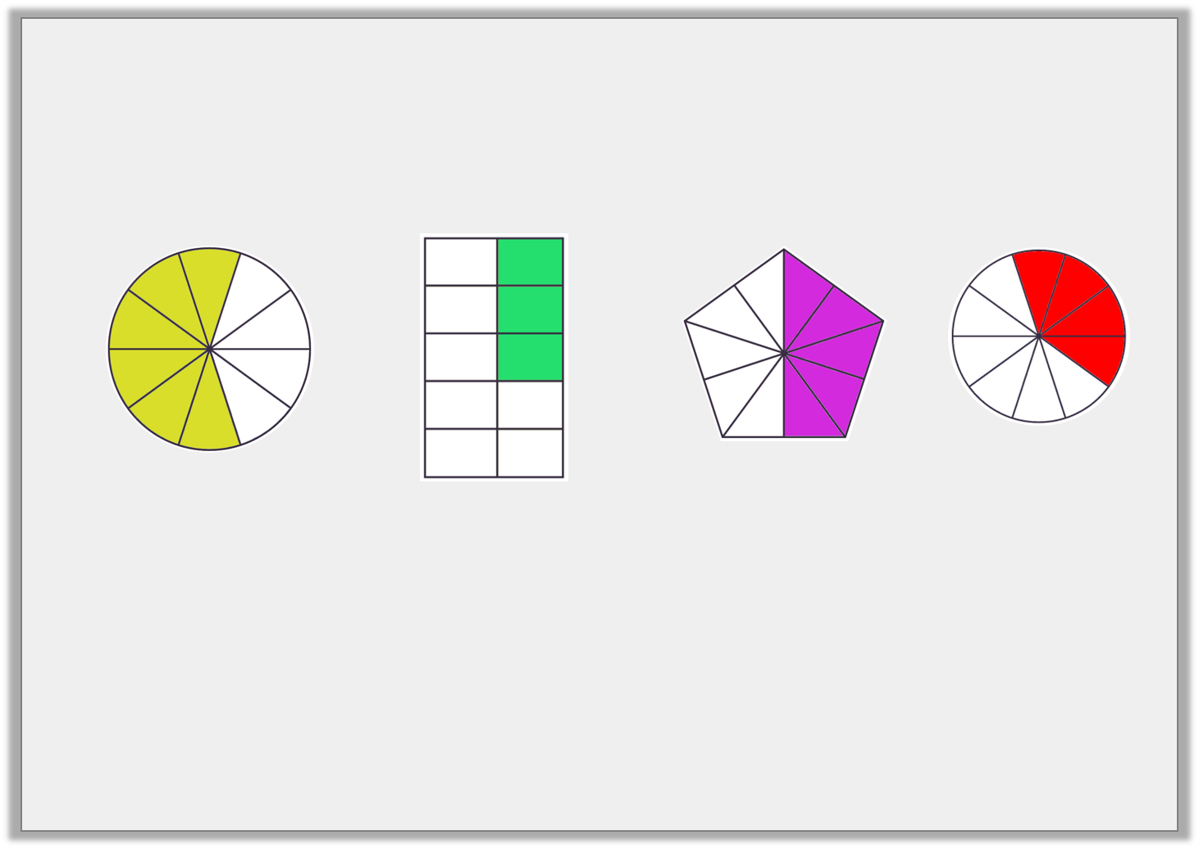
Reasoning 1
Sally has put these fractions in order from smallest to largest. Is she correct?
Explain your answer.
1
2
3
4
© Classroom Secrets Limited 2019

Slide 21
Problem Solving 1
Use the images to help you complete the fractions.
What is the next fraction in this sequence?
© Classroom Secrets Limited 2019

Slide 22
Problem Solving 1
Use the images to help you complete the fractions.
What is the next fraction in this sequence?
6
11
© Classroom Secrets Limited 2019

Slide 23
Problem Solving 2
Which is the incorrect fraction in this sequence?
1
2
3
4
5
© Classroom Secrets Limited 2019

Slide 24
Problem Solving 2
Which is the incorrect fraction in this sequence?
1
2
3
4
5
© Classroom Secrets Limited 2019

