Slide 1

Networks
The school’s network

Slide 2
network
A group or system of interconnected people or things

Slide 3


Slide 4
network
A group or system of interconnected people or things

Slide 5
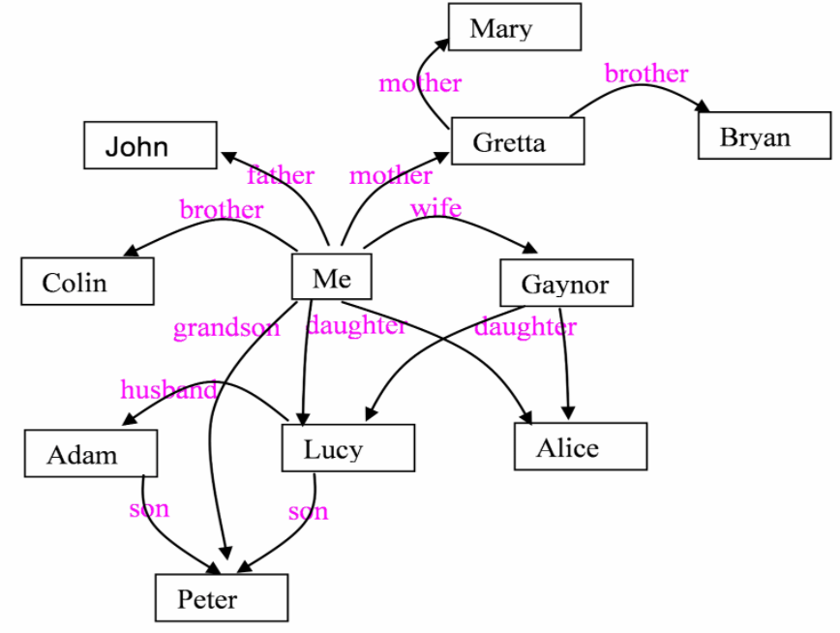
Family network
A group or system of interconnected people or things
Your first task is to draw a family or friends network on your paper. Place yourself in the middle and your network around you

Slide 6
network
A group or system of interconnected people or things

