Slide 1
BIBO
LO: To sequence events
C: Bibo

Slide 2
CAN YOU PUT THESE SENTENCES IN
TIME ORDER?
During lunch
When I woke up
At about ten o’clock in the morning
In the middle of the afternoon
After breakfast
Whilst my Dad cooked dinner
Before bedtime
As the sun was rising

Slide 3
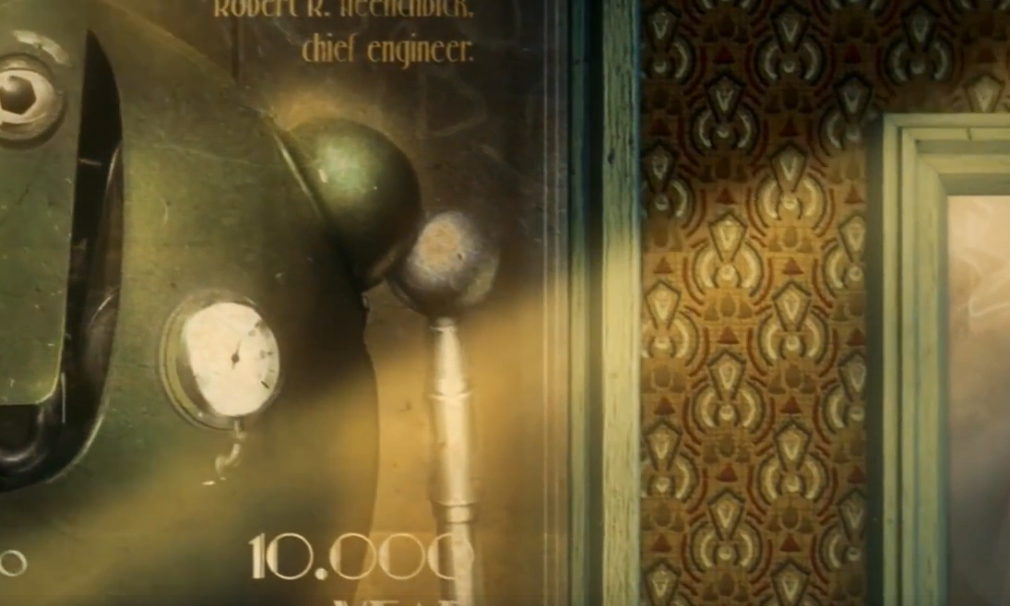
https://www.literacyshed.com/bibo.html

Slide 4
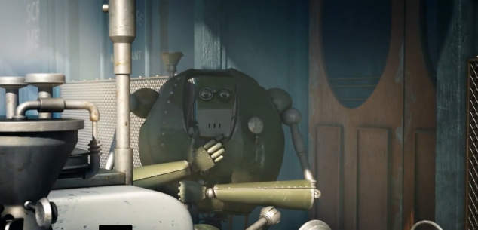
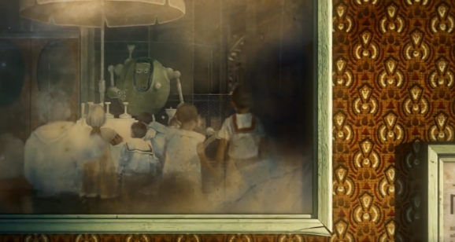
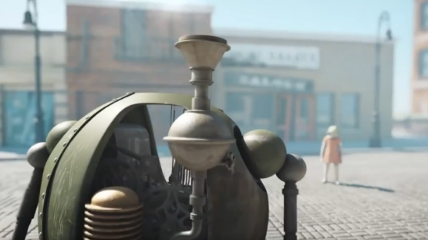
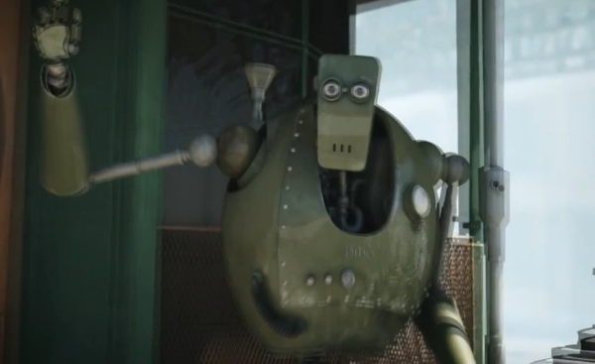
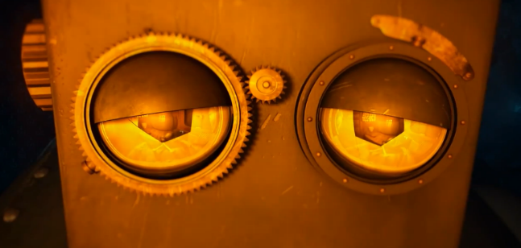
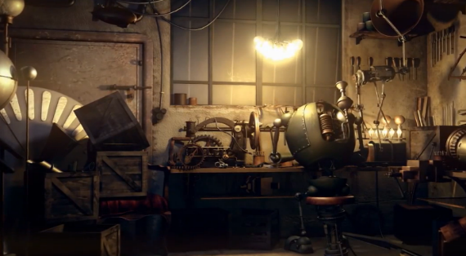
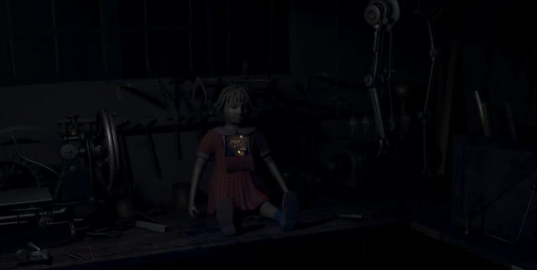
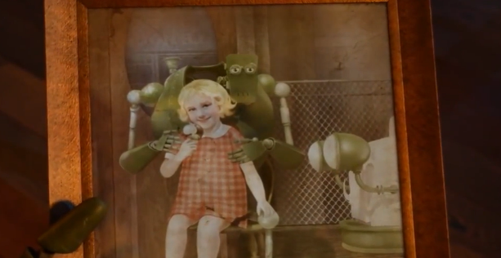
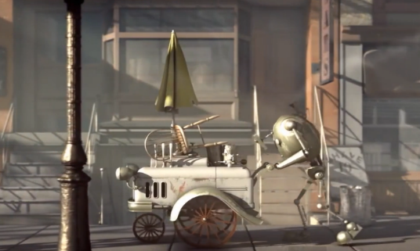
CAN YOU PUT THESE PICTURES IN THE ORDER THEY HAPPENED?

Slide 5



Slide 6
Now you have sequenced the cards,
can you add words to describe Bibo’s emotions?
frustrated
elated
lonely

