Slide 1
Tuesday 22nd June 2021
LO: to understand beliefs and teachings
to understand lifestyles and practices
to understand values
C: Buddhism

Slide 2
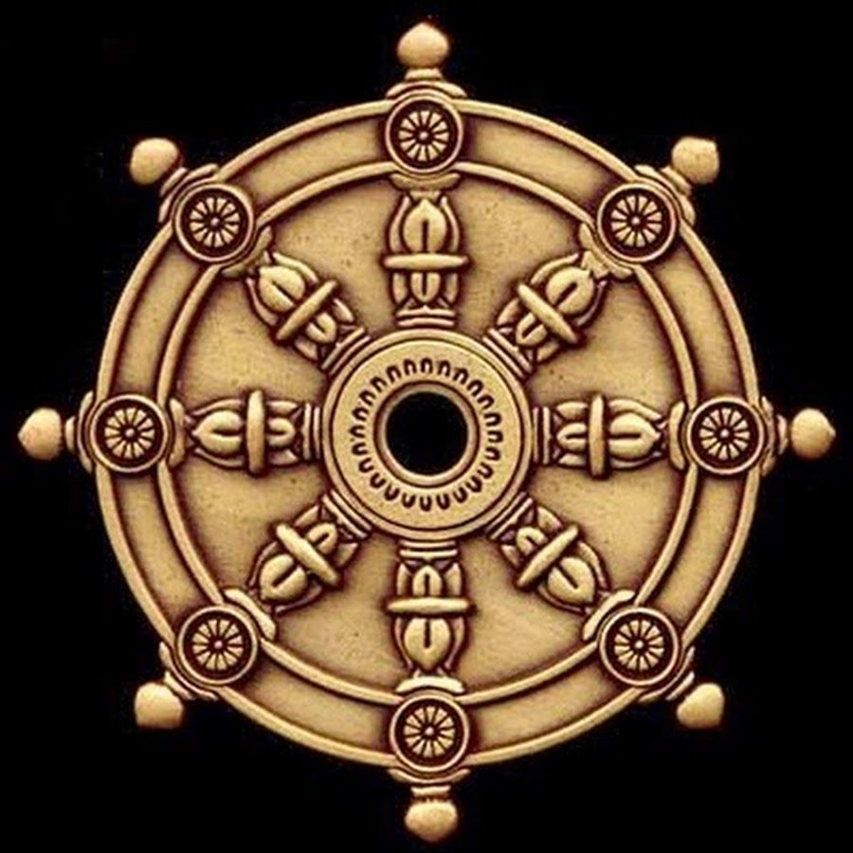
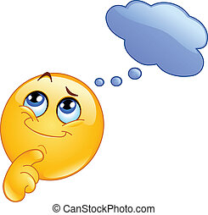
What folds of the Eight-Fold Path did we look at last week?

Slide 3
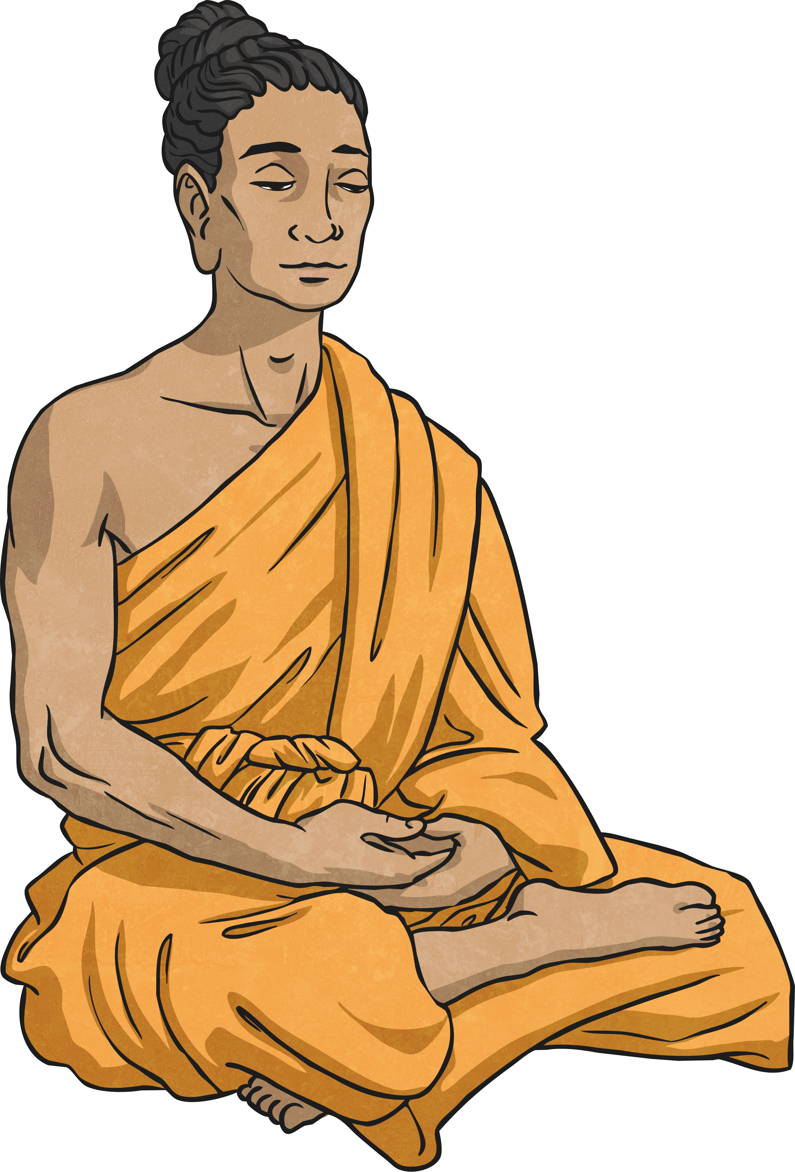
Right Understanding
Having right understanding is when you see the world as it really is and not how you want it to be. Sometimes we try to change things that are outside of our control and we can get upset or not understand things clearly.
Think of a time when you have been upset because you have misunderstood a situation and something seems out of your control. You wanted it to be different to how it really was.

Slide 4
Right Intent
Right Intent means we can commit to a decision or action for the right reasons, once we understand things properly by looking at what is really there and not what we want it to be like.
We need to ask ourselves if we are just being selfish, or are we thinking of others with care and compassion?
Think of a time when you might not have had the right reasons for a decision. What were you trying to gain?

Slide 5
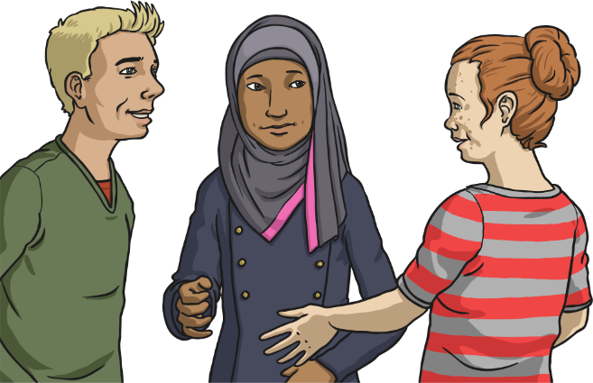
Right Speech
Often things we say in anger or gossip behind people’s backs can cause upset and hurt, and take a long time to sort out. Having Right Speech is deciding never to speak unkindly or in anger.
Have you hurt someone’s feelings by something you have said to them or about them?
Reflect on a time you could have said something differently or not at all.

Slide 6
How many folds can you remember?

Slide 7
This is how I remember the folds:
Right View – point to your eyes
Right Thought – put the palm of your right hand on your heart
Right Speech – point to your mouth
Right Action – raise your hands in front of your and move your fingers
Right Occupation – pretend you are carrying a briefcase
Right Effort – move your hands over your head and lower them all the way down
Right Mindfulness – point to your head
Right Concentration – place your hands in front of you with palms up

Slide 8

Right Action
Right action means behaving in a thoughtful way, considering others and the world we live in. Through our actions, it is a chance to keep the world safe for future generations to live in.
Has there been a time that you have done something that has affected someone else?

Slide 9
Right Action
Behaving in a peaceful, moral way; avoiding acts such as stealing and harming others.
To act in a way that is compassionate and avoids causing harm to all living beings.
Right Action recognises the need to consider others and the world we live in.
This includes not taking what is not given to us, and having respect for the agreements we make in our lives.
This step on the path also includes a whole approach to the environment, with Right Action being taken whenever possible to safeguard the world for future generations.

Slide 10
Buddhist Quote:
We’re engaged in actions all day. Buddhism says that the key to Right Action is intention. Behind every action is a state of mind. If I catch myself in a negative state of mind, I can choose to act differently and so practise Right Action.
What actions do Buddhists take to make sure they follow this fold?

Slide 11
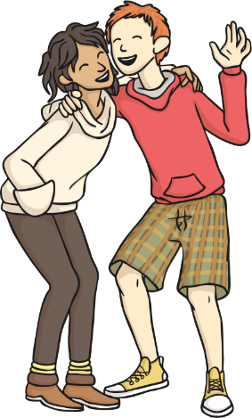
Right Effort
Sometimes we put a lot of effort into the wrong things. Like wanting to be the best, the prettiest or the wealthiest. Right Effort is concerned with developing a positive attitude and cheerful determination in a balanced way. This involves putting effort in to avoid feelings like greed and jealousy, and the right effort into developing feelings of compassion and consideration of others.
Think of something you put a lot of effort into. Is it worthy? Are you encouraging the right sort of feelings and skills?
Are you developing negative feelings with the effort you are putting in?

Slide 12
Right Effort
Putting effort into meditation, in particular, thinking positively and freeing yourself from negative emotions and thoughts.
Right Effort should produce an attitude of steady and cheerful determination.
In order to produce Right Effort, clear and honest thoughts should be welcomed, and feelings of jealousy and anger left behind.
Right Effort equates to positive thinking, followed by focused action.

Slide 13
Buddhist Quote:
I can find myself in different states of mind from one moment to the next. What can I do about this? My states of mind can affect what I do. I need to ask myself through the day: ‘What state am I in?’ Then I can change that by making more effort – I can change how I think and feel. With Right Effort I can develop a more positive and brighter outlook.
What actions do Buddhists take to make sure they follow this fold?

Slide 14
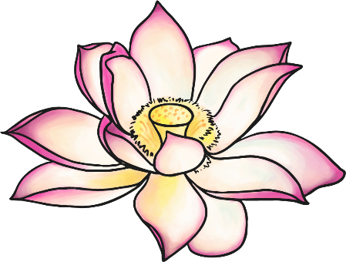
Right Mindfulness
Sometimes we are caught in a moment that takes our breath away, or we get so completely focused on something, we do not notice what is going on around us.
This is an awareness of a moment and our actions in that moment. We suddenly notice old habits that have controlled us and can focus on changing ourselves.
Think about the times you have been completely involved in an activity or moment. Did you suddenly see yourself differently? Did you like what you saw?

Slide 15
Right Mindfulness
To be aware of ones thoughts and actions and be mindful of others.
Becoming fully aware of yourself and the world around you; having a clear sense of your own feelings and thoughts
Right Mindfulness means being aware of the moment, and being focused in that moment. When we travel somewhere, we are hearing noises, seeing buildings, trees, feeling the movement, thinking of those we left behind, thinking of our destination; so it is with most moments of our lives.
Right Mindfulness asks us to be aware of the journey at that moment, and to be clear and undistracted at that moment.
Have you ever done anything where your mind is only with that activity? At that moment, you are mindful.

Slide 16
Buddhist Quote:
Often we are not aware of how we are feeling or what we are doing. If we can become more aware we can live in the present moment and transform our lives. Staying aware is a practice that can lead to happier states of mind. Instead of rushing through a job, I can slow down and even enjoy what I am doing. Right mindfulness makes the most of the present moment.
What actions do Buddhists take to make sure they follow this fold?

Slide 17

Right Concentration
Concentrating is sometimes hard because we allow ourselves to get distracted. The Eightfold Path step of Right Concentration encourages us to focus the mind on something so completely, we see it as it really is and not how we have always thought it is, or been told to see it. This action frees us from being controlled and leads us towards freedom.
Have you managed to concentrate on something so much that you suddenly had a ‘Eureka’ moment and realised something important?

Slide 18
Right Concentration
Developing the mental concentration and focus that is required to meditate.
Right Concentration is turning the mind to focus on an object, such as a flower, or a lit candle, or a concept such as loving compassion.
The benefits of Right Mindfulness and Right Concentration are significant as they teach the mind to see things, not as we are conditioned to seeing them, but as they really are. At the same time, they also lead to a feeling of calm and peace with the world. By being in the moment and being able to concentrate effectively, a sense of joy in the moment is felt. Release from the control of past pains and future mind games takes us closer to freedom from suffering.

Slide 19
Buddhist Quote:
I begin my day with meditation. Why do I meditate? I can only transform myself in all the other steps of the path, if I know myself well. Meditation helps me to develop calm and peaceful states of mind. Then I can begin to see myself more clearly. With the help of meditation, I can gradually progress through ever higher states of mind along the path. I can get nearer and nearer to Enlightenment, even if takes much effort and many lifetimes.
What actions do Buddhists take to make sure they follow this fold?

Slide 20
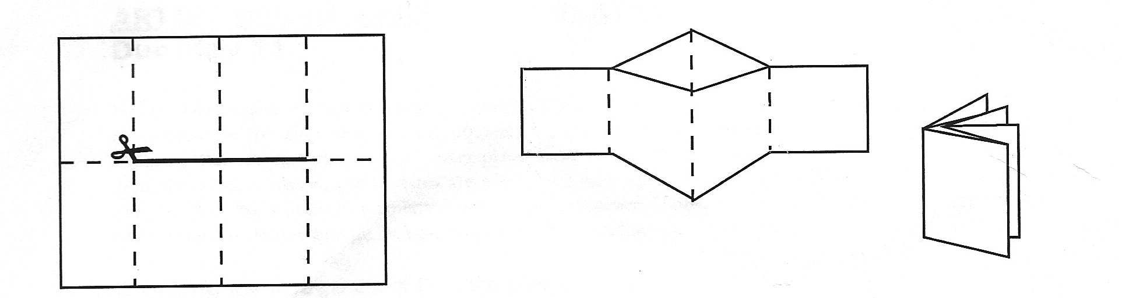
Activity
Return to your concertina book from last lesson.
Illustrate each fold of the Eight-Fold Path that we have covered today.
Snorkelling and Diving: Write a brief description of the folds. What do they mean? What should Buddhists do to follow this fold?
Paddling Red Pen: Do you follow any of the Eight-Fold Path folds in your life? How?
Snorkelling and Diving Red Pen: Consider how your life would be different if you lived it like a Buddhist.

