Slide 1
30.6.2021
L.O: To use fractions
C: Order fractions with different denominators.

Slide 3



Complete the equivalent fractions
1)
2)
3)
$\frac{\text{1}}{\text{4}}$ $=$ $\frac{\text{2}}{\text{8}}$
$\frac{\text{1}}{\text{4}}$ $=$ $\frac{\text{3}}{\text{12}}$
$\frac{\text{3}}{\text{4}}$ $=$ $\frac{\text{9}}{\text{12}}$

Slide 4
Complete the equivalent fractions
1)
2)
3)
$\frac{\text{1}}{\text{4}}$ $=$ $\frac{\text{2}}{\text{8}}$
$\frac{\text{1}}{\text{4}}$ $=$ $\frac{\text{3}}{\text{12}}$
$\frac{\text{3}}{\text{4}}$ $=$ $\frac{\text{9}}{\text{12}}$

Slide 6




$\frac{\text{1}}{\text{2}}$ $\frac{\text{1}}{\text{3}}$
$$>$$
$\frac{\text{1}}{\text{9}}$ $\frac{\text{1}}{\text{5}}$
$$<$$
When the numerators are the same,
the the denominator, the the fraction.
greater
smaller
smaller
greater

Slide 7
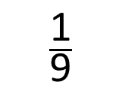
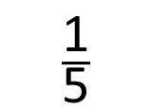
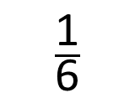
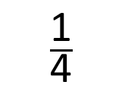
Put the fractions in order from greatest to smallest.
When the numerators are the same, the greater
the denominator, the smaller the fraction.
$\frac{\text{1}}{\text{4}}$
$\frac{\text{1}}{\text{6}}$
$\frac{\text{1}}{\text{5}}$
$\frac{\text{1}}{\text{9}}$

Slide 8
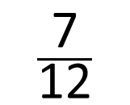
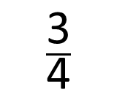
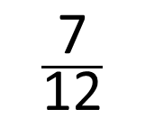
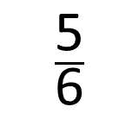
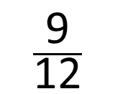
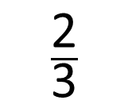
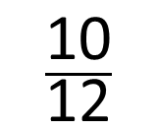
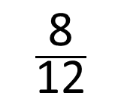
Put the fractions in order from smallest to greatest.
$\frac{\text{2}}{\text{3}}$
$\frac{\text{5}}{\text{6}}$
$\frac{\text{3}}{\text{4}}$
$\frac{\text{7}}{\text{12}}$
$\frac{\text{8}}{\text{12}}$
$\frac{\text{10}}{\text{12}}$
$\frac{\text{9}}{\text{12}}$
$\frac{\text{7}}{\text{12}}$

Slide 9


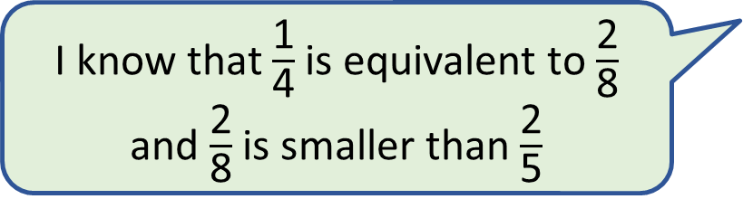
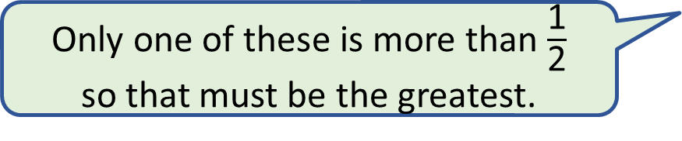
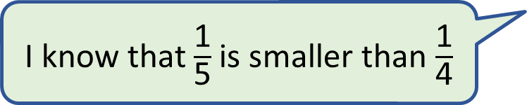
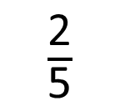
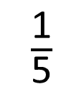
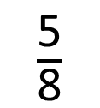
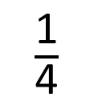

Put the fractions in order from smallest to greatest.
$\frac{\text{2}}{\text{5}}$
$\frac{\text{1}}{\text{4}}$
$\frac{\text{5}}{\text{8}}$
$\frac{\text{1}}{\text{5}}$
I know that $\frac{\text{1}}{\text{4}}$ is equivalent to $\frac{\text{2}}{\text{8}}$ and $\frac{\text{2}}{\text{8}}$ is smaller than $\frac{\text{2}}{\text{5}}$
I know that $\frac{\text{1}}{\text{5}}$ is smaller than $\frac{\text{1}}{\text{4}}$
I can put these in order without using a bar model.
Only one of these is more than $\frac{\text{1}}{\text{2}}$
so that must be the greatest.
When the numerators are the same, the greater
the denominator, the smaller the fraction.
$\frac{\text{2}}{\text{8}}$
Have a think

