Slide 1
Monday 21st June 2021
LO: to write with purpose
C: Persuasive Writing

Slide 2

Persuade
Have you heard this word before?
Do you know what it means?

Slide 3
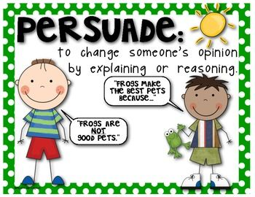
Persuade
to cause (someone) to do something by asking, arguing, or giving reasons.

Slide 4
If I were to write persuasively, what would the purpose of my writing be?
What would I want to achieve?

Slide 5
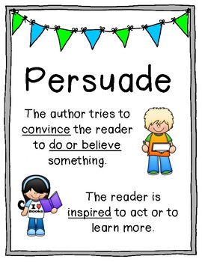
Persuasive writing tries to convince the reader to do something or believe something.
Adverts, reviews, leaflets and letters can all include persuasion.

Slide 6
Look at the examples on the next slides.
What features of persuasive writing can you identify?

Slide 7
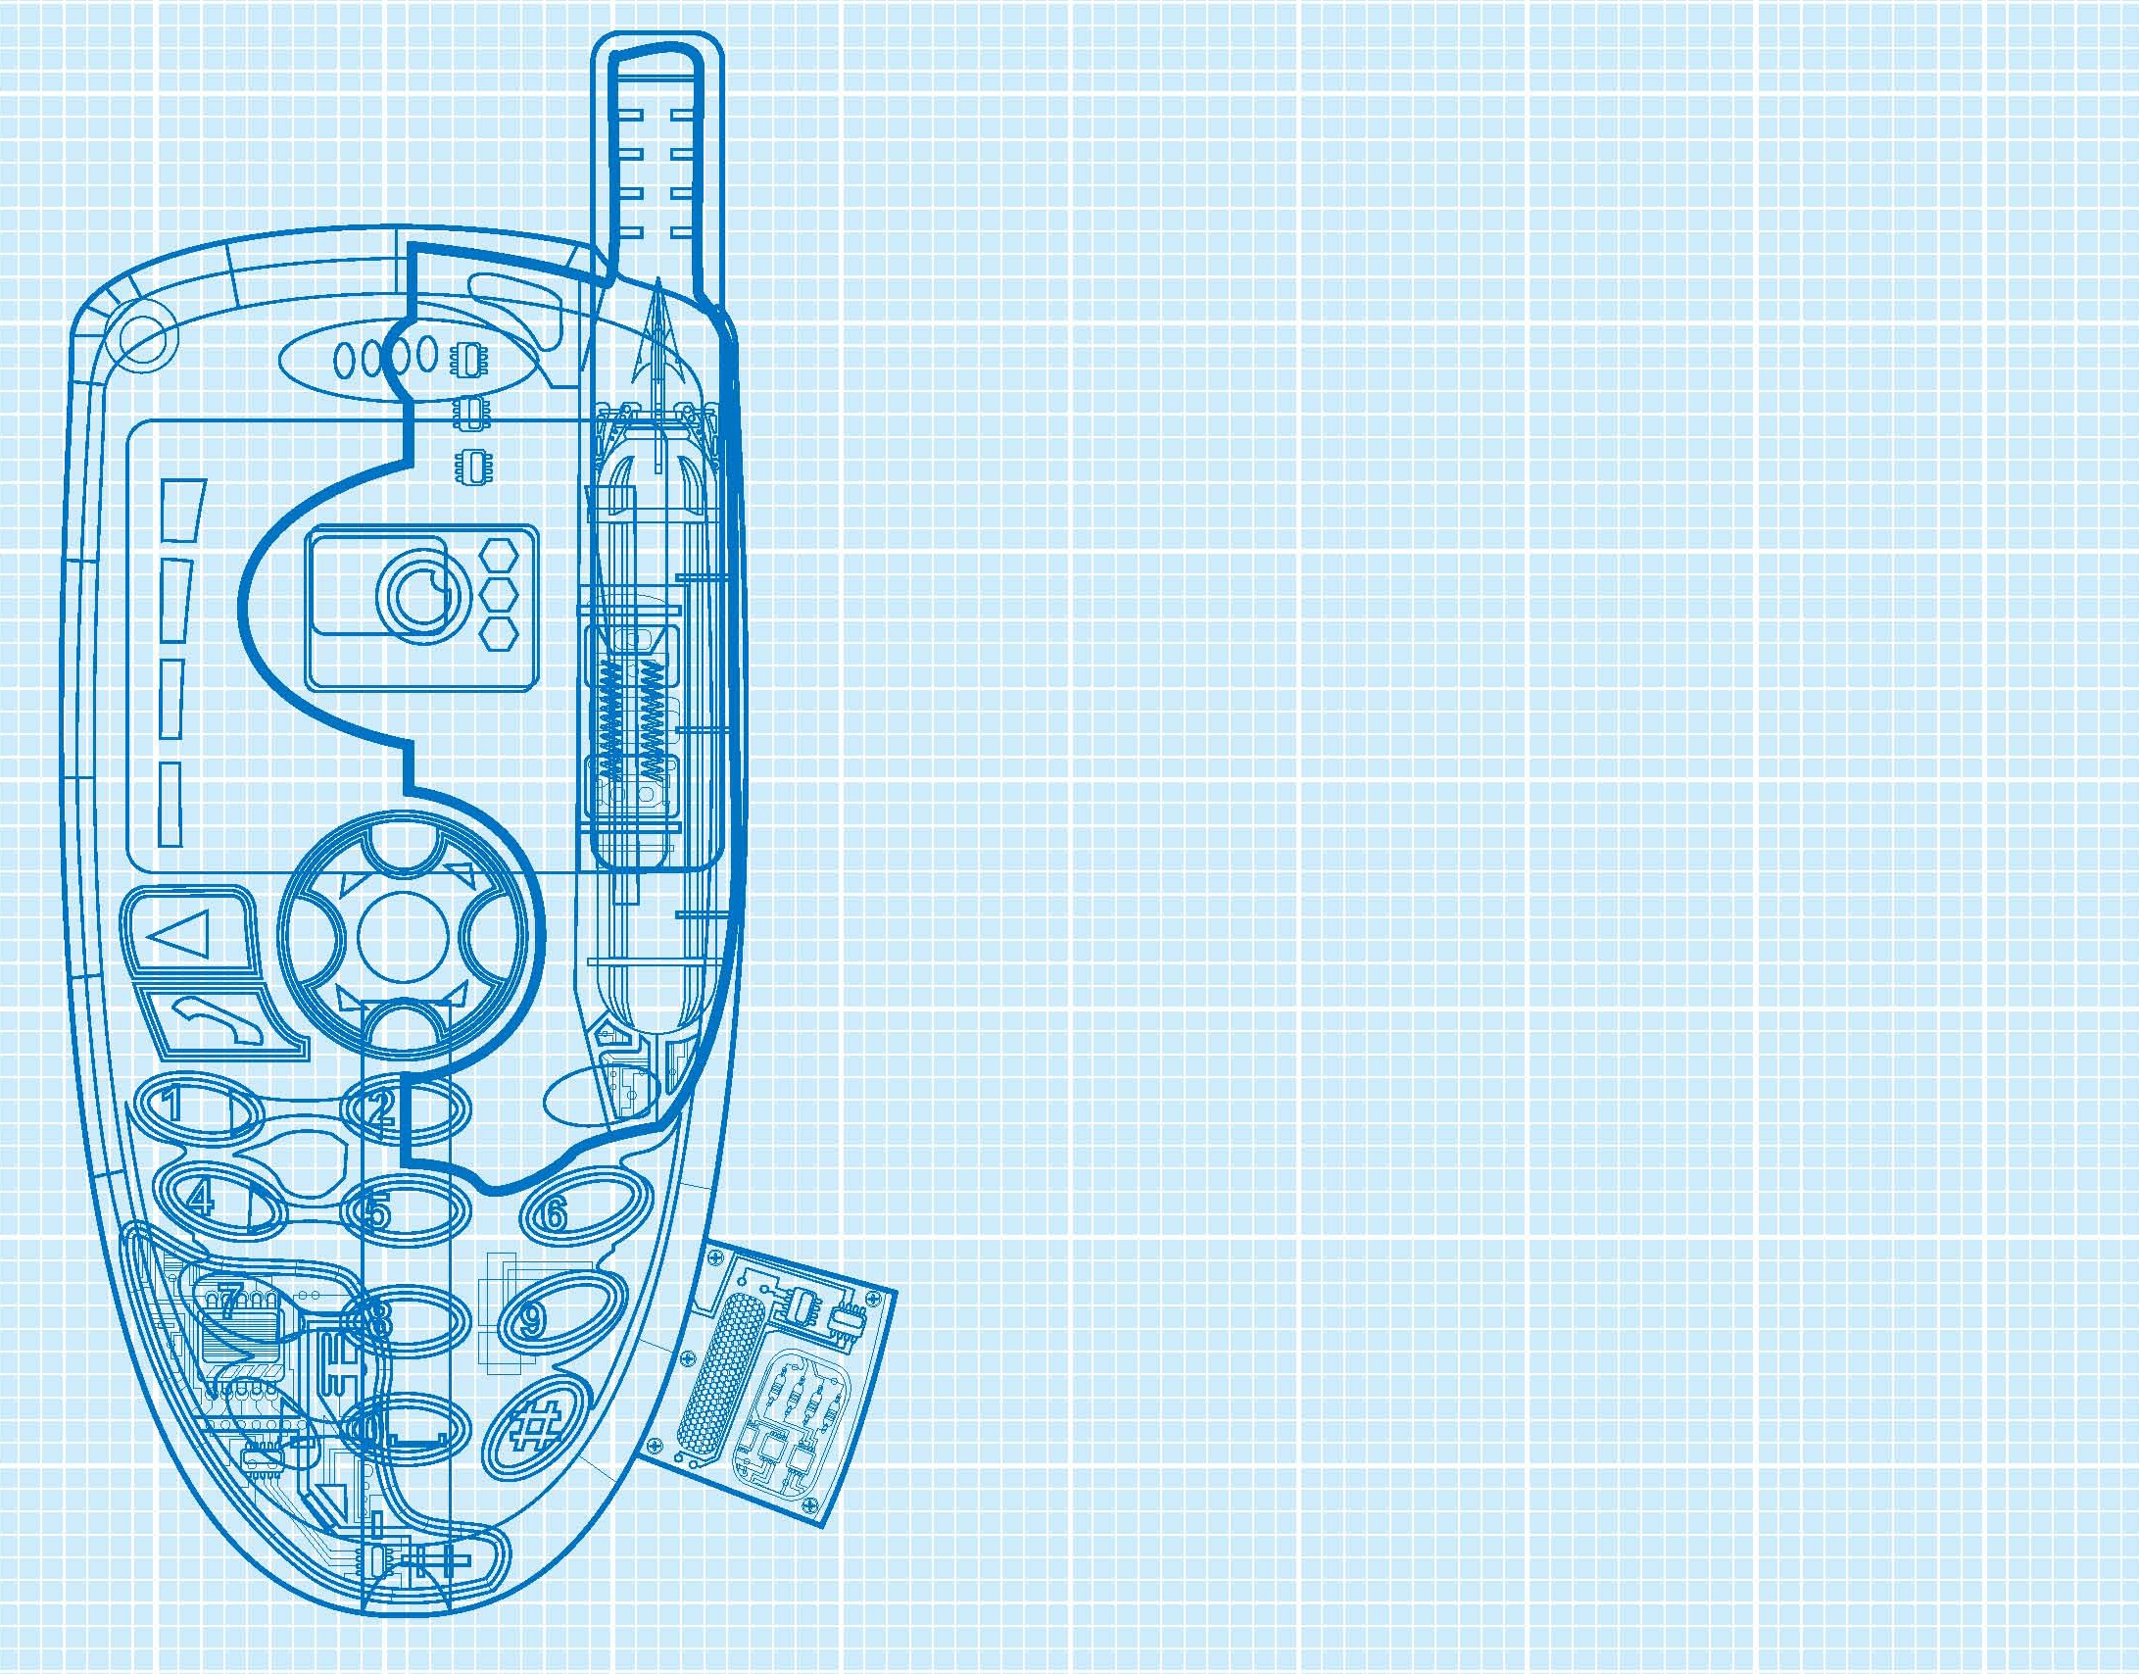
1. Buy now – 'Multifunction Mobile Phone'
Are you about to embark on your first mission as a spy? If so, you will need the Multifunction Mobile Phone. Don't be the only spy on the block left wondering how to phone home!
The Multifunction Mobile Phone is the ideal phone for all spies. It boasts a host of amazing features:
Have worldwide access so that you can always be in contact with those back home;
Make untraceable calls;
Be certain that you cannot be hacked into;
Made of titanium steel so that it works underwater and in space.
Notes:
7
7

Slide 8
This ideal mobile phone has the added bonus of a hidden tranquillizer dart that can be fired through the aerial. Guaranteed to leave your enemies stunned (though with no serious after effects).
Perhaps the most essential reason for purchasing this 'must have' phone is that it can only be used by the owner. Access is made by modern fingerprint recognition!
This phone is recommended by E.T., and comes complete with charger and free leather case. Order now from spygadgetzone.com
Notes:
8
8

Slide 9
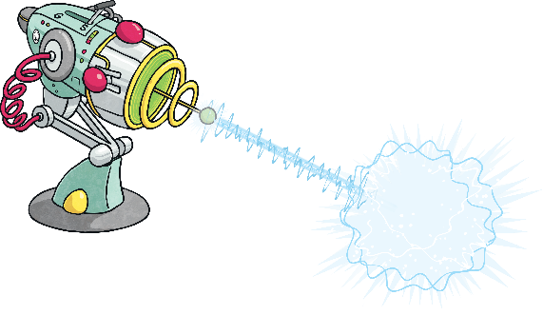
The Zap-Tastic Silencer!
Are your siblings giving you a rough time? Are your friends always bragging about winning at football? Is the neighbour’s cat keeping you awake at night? You need the Zap-Tastic Silencer!
With one press of the smooth-action trigger, you’ll have peace and quiet in no time. Our Zap-Tastic Silencer is filled with astounding alien technology and is available for you to take home today. Say goodbye to irritating sounds and restless nights. Just aim at the irritant, fire the harmless rays and enjoy one hour of complete silence. Yes – it really is that easy!
It’s available for a limited time only so don’t miss out: buy your Zap-Tastic Silencer now!

Slide 10
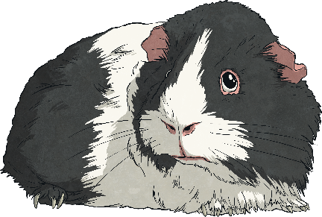
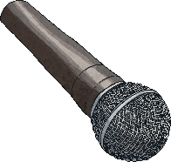
This is an extract from the speech given by Fluffles McSpice during the annual guinea pig meeting at 34 Garden Terrace.
We must not allow ourselves to be treated like this. How many more guinea pigs have to suffer before we say that enough is enough? I have been into next door’s garden and I have seen the food that is available there. Juicy pellets, dried strawberries and delicious dandelion leaves: the kind of food that we should be getting instead of the brown filth and mouldy hay that they try to feed us. No! We want what they’re having. We deserve what they’re having. Stand up for what you believe in, fellow guineas of 34 Garden Terrace, and demand better of our owners!

Slide 11
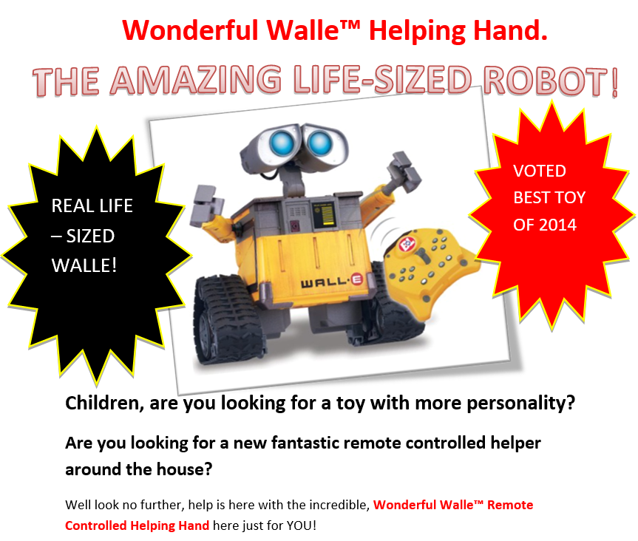
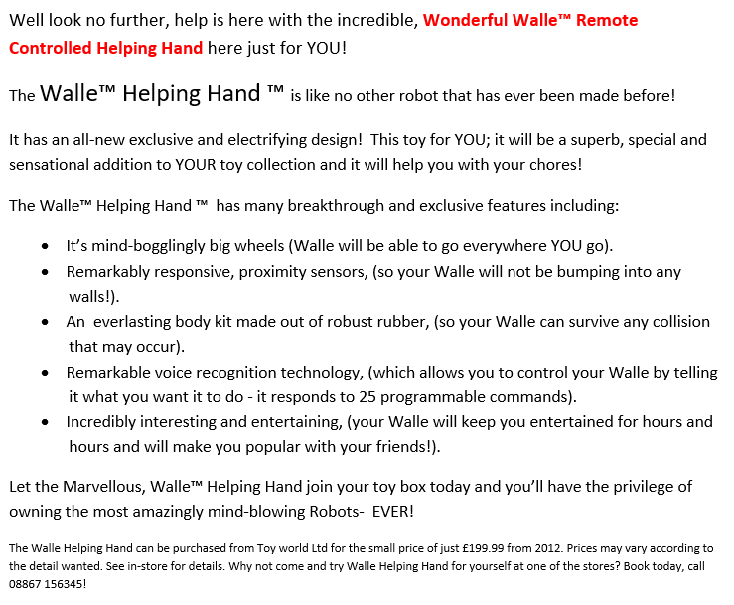

Slide 12

Persuasive Writing Features
A
lliteration
F
acts
O
pinions
R
R
epetition (& hetorical Questions)
E
E
motive Language (& xaggeration)
S
tatistics
T
hree (rule of)
Did you identify all of these features? Did you miss any features?

Slide 13
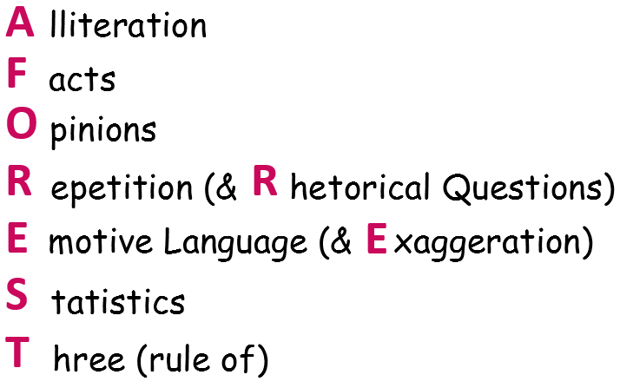
Do you understand what all of these features are?
We will be exploring these features in more detail over the next two weeks!

Slide 14

Look at the examples on the next slides.
Can you find examples of the AFOREST persuasive writing features in these texts?

Slide 15
1. Buy now – 'Multifunction Mobile Phone'
Are you about to embark on your first mission as a spy? If so, you will need the Multifunction Mobile Phone. Don't be the only spy on the block left wondering how to phone home!
The Multifunction Mobile Phone is the ideal phone for all spies. It boasts a host of amazing features:
Have worldwide access so that you can always be in contact with those back home;
Make untraceable calls;
Be certain that you cannot be hacked into;
Made of titanium steel so that it works underwater and in space.
Notes:
15
15

Slide 16
This ideal mobile phone has the added bonus of a hidden tranquillizer dart that can be fired through the aerial. Guaranteed to leave your enemies stunned (though with no serious after effects).
Perhaps the most essential reason for purchasing this 'must have' phone is that it can only be used by the owner. Access is made by modern fingerprint recognition!
This phone is recommended by E.T., and comes complete with charger and free leather case. Order now from spygadgetzone.com
Notes:
16
16

Slide 17
The Zap-Tastic Silencer!
Are your siblings giving you a rough time? Are your friends always bragging about winning at football? Is the neighbour’s cat keeping you awake at night? You need the Zap-Tastic Silencer!
With one press of the smooth-action trigger, you’ll have peace and quiet in no time. Our Zap-Tastic Silencer is filled with astounding alien technology and is available for you to take home today. Say goodbye to irritating sounds and restless nights. Just aim at the irritant, fire the harmless rays and enjoy one hour of complete silence. Yes – it really is that easy!
It’s available for a limited time only so don’t miss out: buy your Zap-Tastic Silencer now!

Slide 19
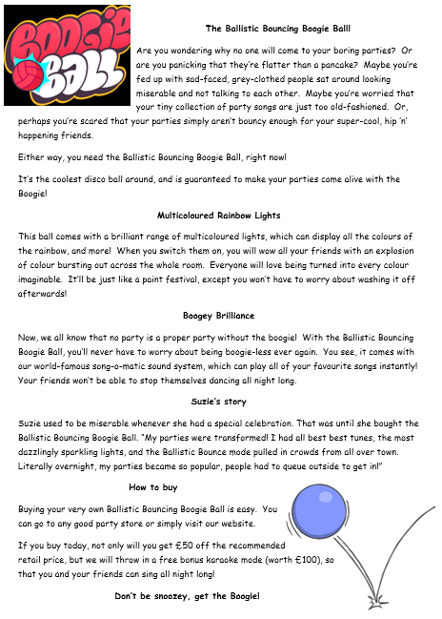
Activity
Look at the persuasive writing text in front of you.
Read through the example and highlight/label examples of persuasive writing features that you can find.
Red Pen: Which feature of persuasive writing do you think is the most effective? Why?
Which feature is the least effective? Why?

Slide 20
Tuesday 22nd June 2021
LO: to write with purpose
C: Persuasive Writing

Slide 21
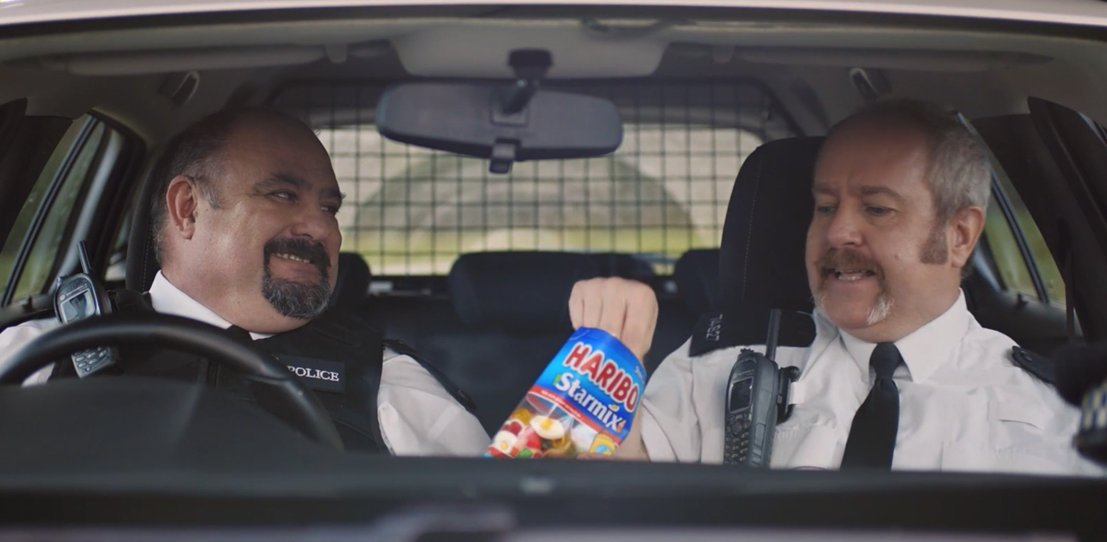
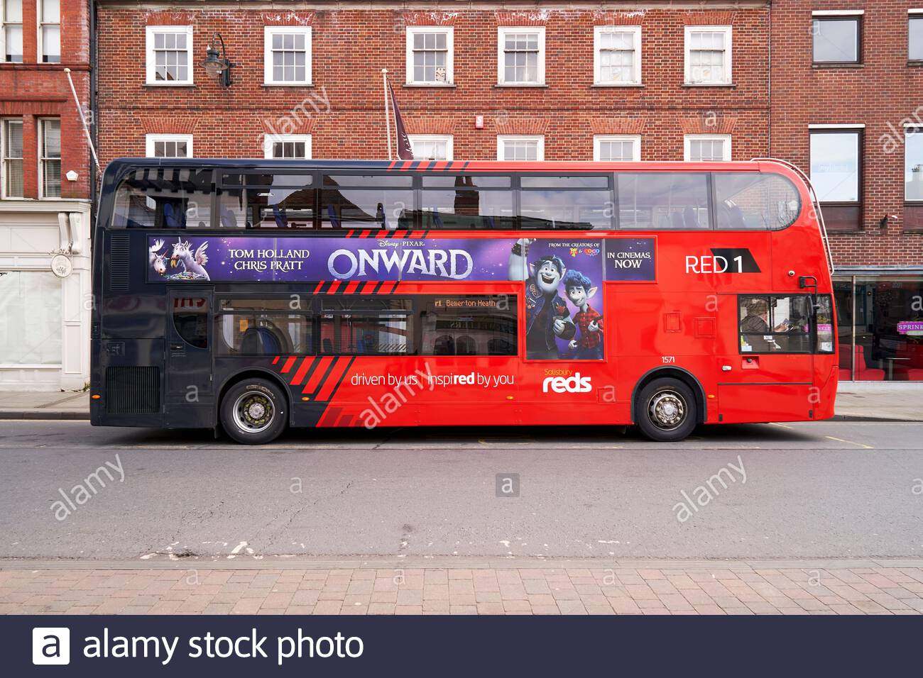
You are going to be creating a state-of-the-art gadget for a spy, or one for school, or even one to use around your house!
You are going to be persuading your reader(s) to buy one – a bit like an advert you might see on TV, in a magazine or even on the side of a bus!

Slide 22

You need to come up with your own gadget.
Here are some ideas you can choose from.
If you have your own idea – go for that!
- a different gadget for a spy, e.g. watch, glasses, car, pen, suitcase
- a gadget for your home, e.g. a bedroom cleaner, chore completer, sister trapper
- a gadget for school, e.g. homework machine, teacher-pleaser, exam-cheater, classroom-tidier

Slide 23
You are going to gather ideas into sections to help us plan using the headings below:
- Who is the gadget for?
- Catchy name for the gadget
- Features of the gadget
- Any bonuses/extras
- Key reason for purchasing
You are also going to draw your invention and label the diagram with the different features it offers.
As you are drawing, you might come up with new ideas that you haven’t thought of yet! You could add these to your plan.

Slide 24
Activity
Draw and label your own invention in your books.
You must give your invention a catchy name and answer the following questions:
- who is the gadget for?
- what are the features of the gadget?
- does the gadget have any bonuses/extras?
- why should the reader purchase your invention?
You might like to create a double page spread for your invention like we have been doing in Geography.

Slide 25
Red Pen: think carefully about the vocabulary you have used for your invention. Remember we want to persuade the reader to buy it! Try to boast about your product, e.g.
- It is the best product.
- It is the ideal gadget.
- It is the finest gadget.
- This essential product.

Slide 26
Wednesday 23rd June 2021
LO: to write with purpose
To use imaginative description
To use sentences appropriately
To punctuate accurately
C: Persuasive Writing

Slide 27
Can you remember the features of persuasive writing?
We are going to be focusing on these persuasive writing features over the next few lessons.

Slide 28
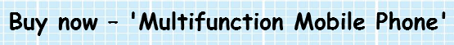
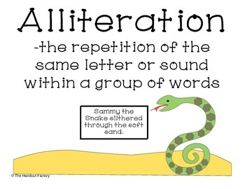
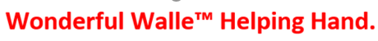
Alliteration
Can you remember what alliteration is?

Slide 29
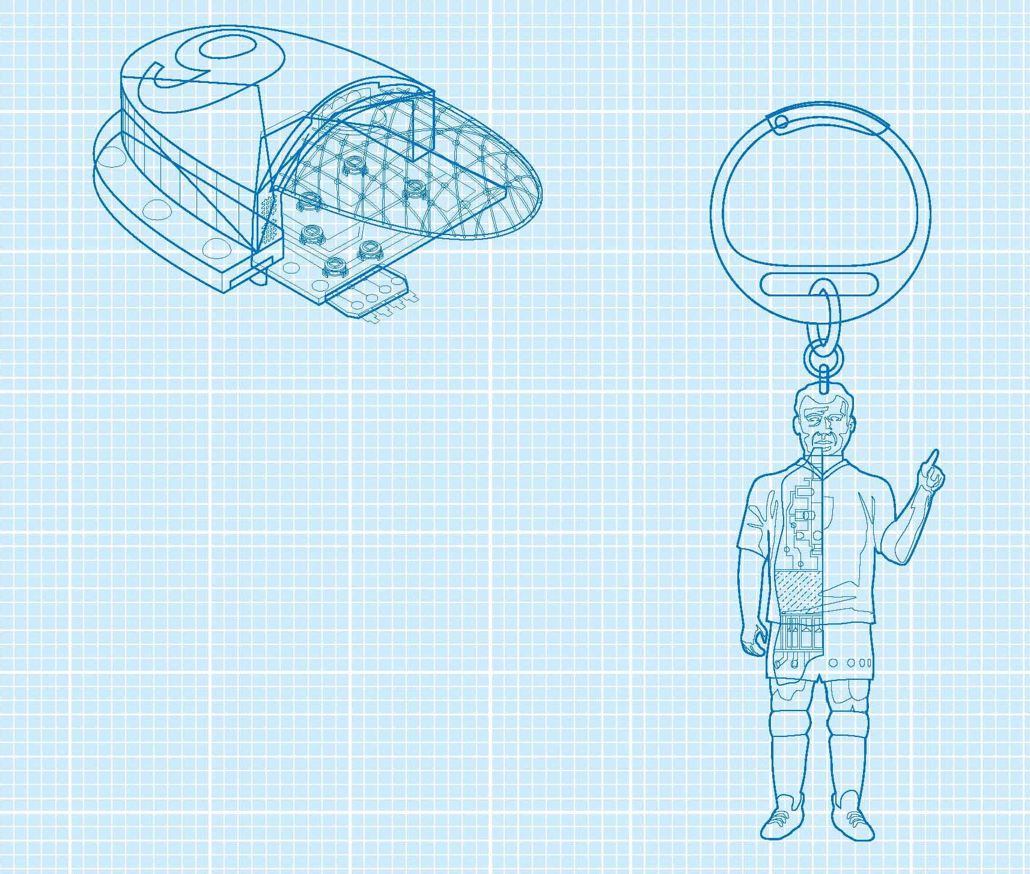
Here is my invention!
It’s a multi-purpose spy key ring!
It has:
- explosive light bursts that stun, but never kill
- laser lights that cut through all known metals
- a bug finder to check that you are not being spied upon
- an amazing listening device

Slide 30
Can you think of any alliterative phrases or sentences for my invention?
Think carefully about your vocabulary choices – you should be boasting about your product!
Is ‘good gadget’ going to make you want to buy the product?

Slide 31
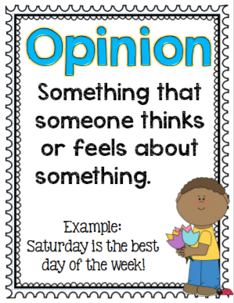
Opinions
What is an opinion?

Slide 32
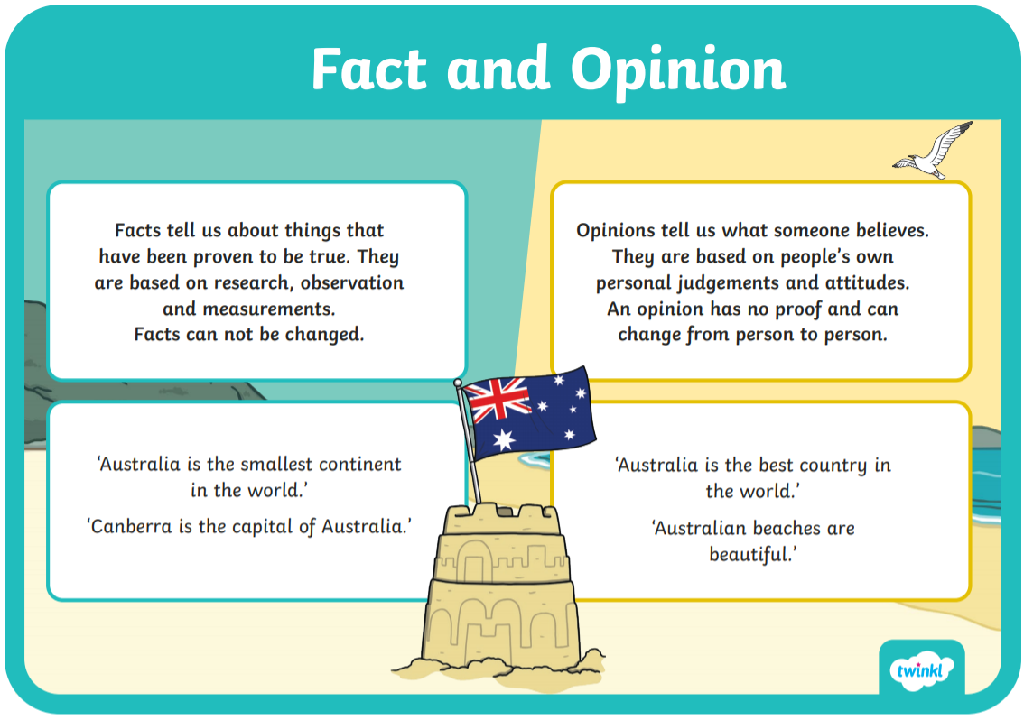
What is the difference between opinion and fact?

Slide 33
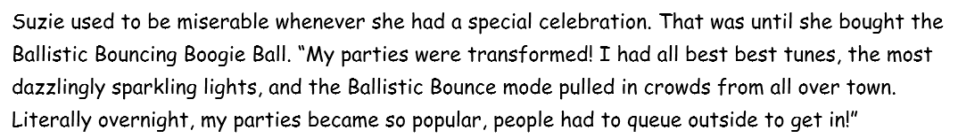
What do you notice about this example?
Can anyone remember how to use inverted commas?

Slide 34
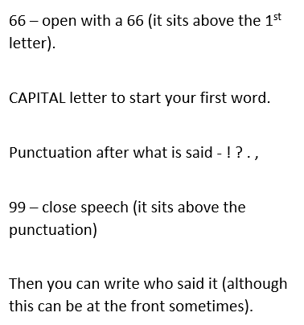
How to use inverted commas:

Slide 35
What might people say about my invention?
How could I write this opinion using inverted commas?

Slide 36
Activity
Experiment with using alliteration and opinions for your own inventions.
You should come up with at least 2 ideas for each feature.
Red Pen: read your partner’s work. Have they persuaded you to buy their product? Why/why not? What do they need to do to persuade you? Are there better, more effective word choices they could have used? Help your partner to improve their ideas!

Slide 37
Thursday 24th June 2021
LO: to write with purpose
C: Persuasive Writing

Slide 38
We are going to continue to look at persuasive writing features today.
What features did we look at yesterday?

Slide 39

R – what does the R stand for?

Slide 40
Repetition and rhetorical questions!
Do you know what these are?
A rhetorical question is one that does not require an answer.
Repetition is when you repeat the same thing more than once.

Slide 41
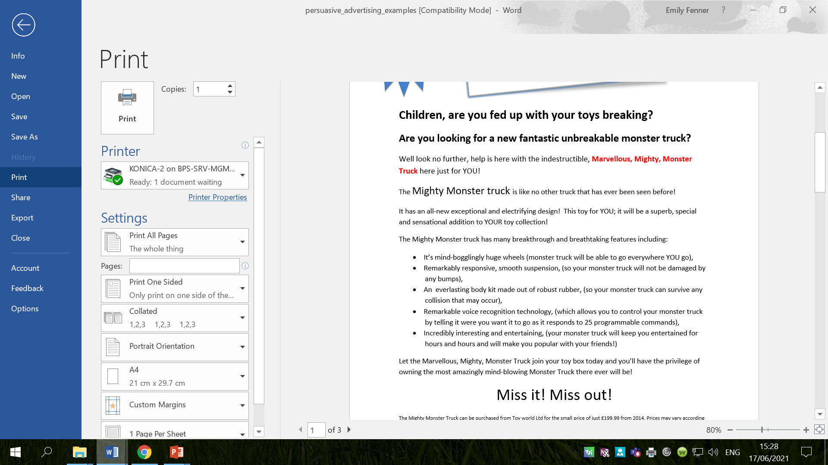
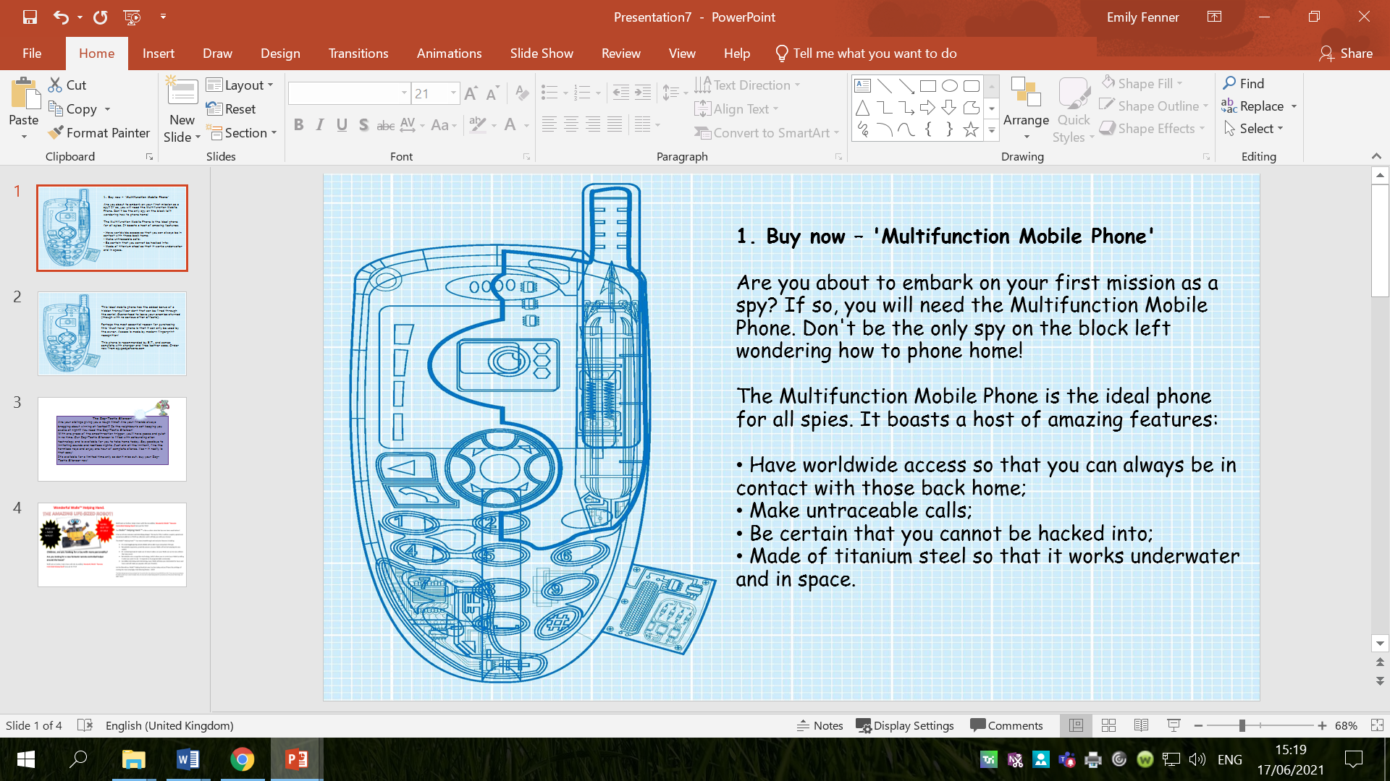
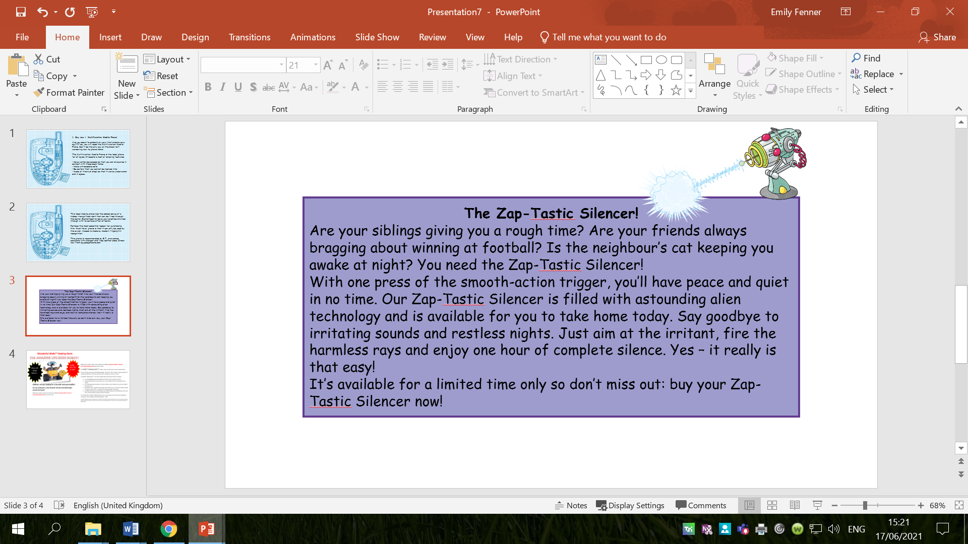
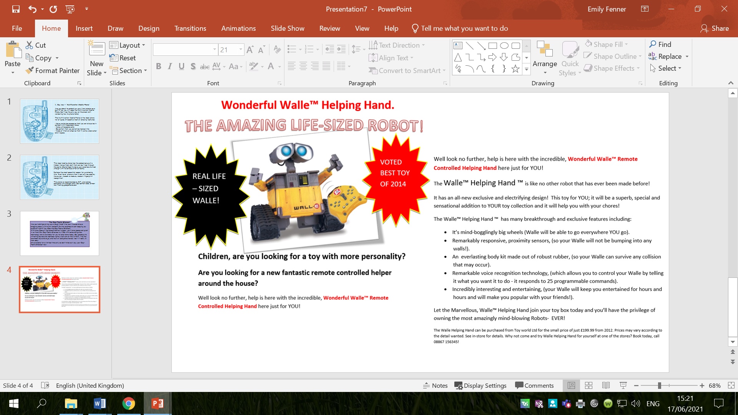

Slide 42
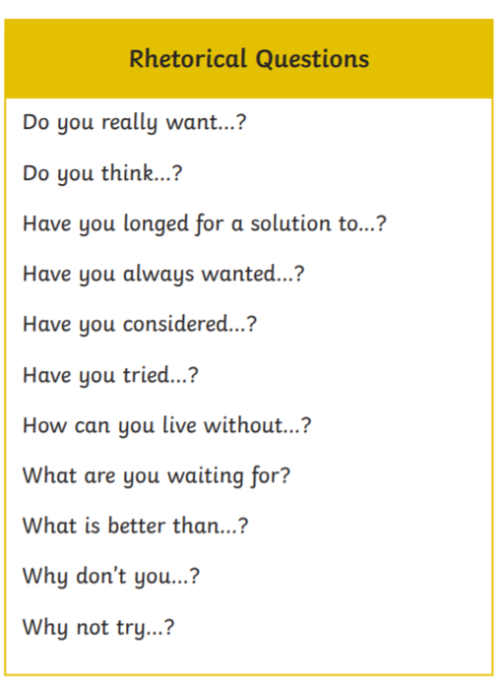
Rhetorical Questions
What rhetorical questions could I use for my invention?

Slide 43
Repetition
Repetition can be used in different ways.
You can repeat the words or sentence in the same way OR the meaning can be kept but stated in a different way using the same words.
For example:
Cats are the best! They make great pets and are very friendly. Cats are the best.
Cats are the best! They make great pets and are very friendly. You should choose a cat because they make the best pets.
How could I use repetition to persuade the reader(s) to buy my gadget?

Slide 44
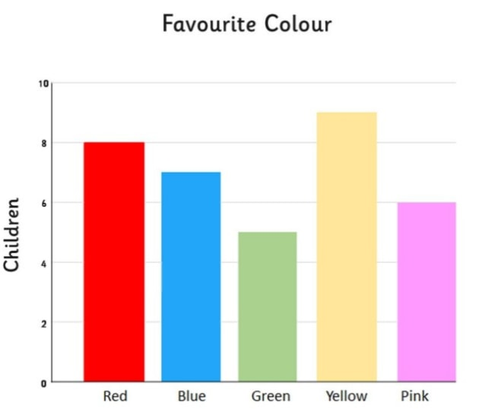
Who can remember what our Maths topic is?

Slide 45
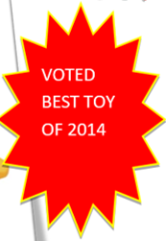
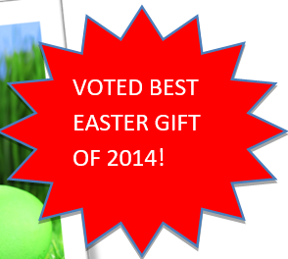
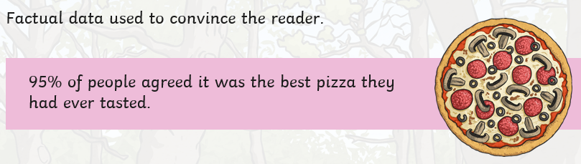
How could we use statistics in our persuasive writing?
Factual data like statistics can be used to convince the reader to buy your product.

Slide 46
What data could we use if we were trying to persuade people to buy my invention?

Slide 47
Activity
Experiment with using repetition, rhetorical questions and statistics for your own inventions.
You should come up with at least 2 ideas for each feature.

Slide 49
Red Pen: read your partner’s work. Have they persuaded you to buy their product? Why/why not? What do they need to do to persuade you? Are there better, more effective word choices they could have used? Help your partner to improve their ideas!

