Slide 1
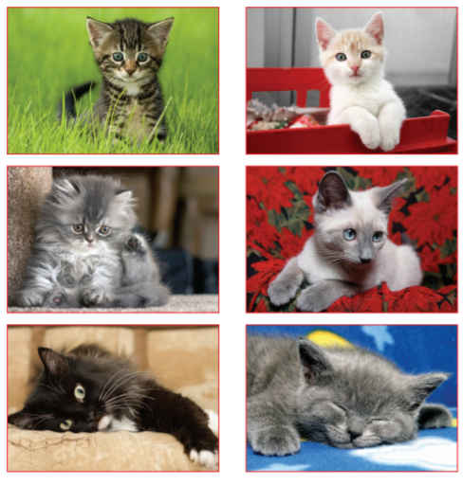
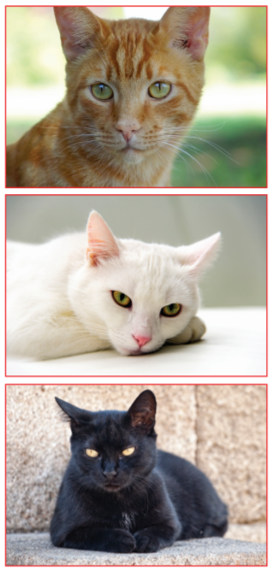
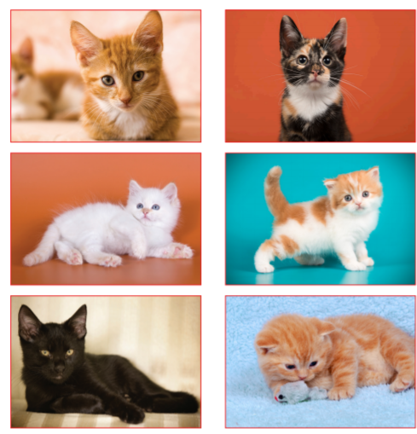
Look at the kitten cards below.
Try to match the kittens to their mother cat.
Why did you choose the mother cat that you did?

Slide 2
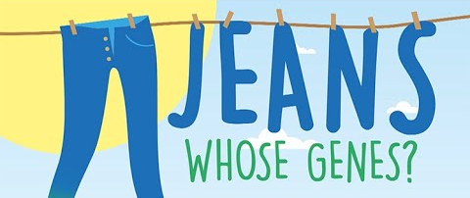
As humans and children, we have some characteristics that are clearly from our parents, but some characteristics that are unique to us.
Our characteristics come from the genes our parents pass on to us!

Slide 3

Genes
Each tiny cell that make up our body contains 25,000 – 35,000 genes.
Our bodies have many trillions of cells.
Genes carry the information that give us our characteristics (traits).
We get half our genes from our birth mther and half our genes from our birth gather.
The father’s genes decide whether the baby will be male or female.

Slide 4

Look at a picture of yourself with your parents:
What characteristics have you inherited?
These may be physical (e.g. eye or hair colour) or may be to do with your personality (e.g. being patient or generous).

Slide 5
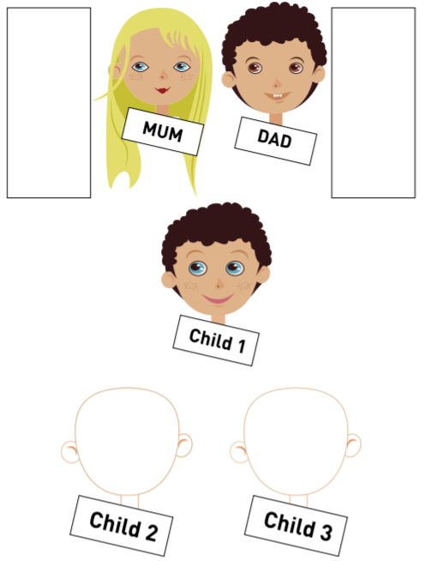
Look at the sheet below.
Write in the box by each parent the characteristics they have (eye colour, hair colour, freckles or not, curly hair or straight hair).
What characteristics has Child 1 inherited from their parents?
Think about what Child 2 and Child 3 might look like if they inherited characteristics from each parent.

Slide 7
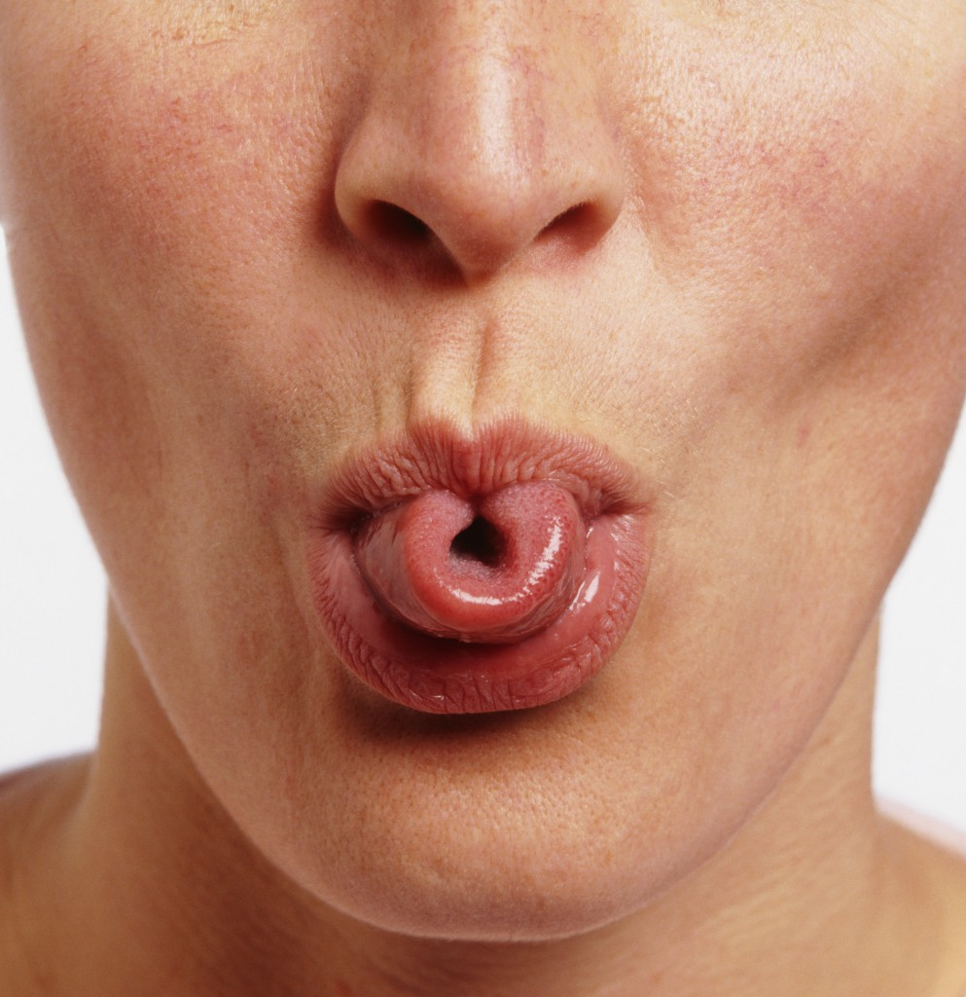
Many of our characteristics are inherited this way from our parents.
Can you roll your tongue into a tube?
This is an ability that is inherited from our parents and it is more common for people to be able to roll their tongue than not.

