Slide 1


Slide 2


What is climate change?
https://www.bbc.co.uk/teach/school-radio/assemblies-ks1-ks2-climate-change-global-warming/zbgxjsg

Slide 3
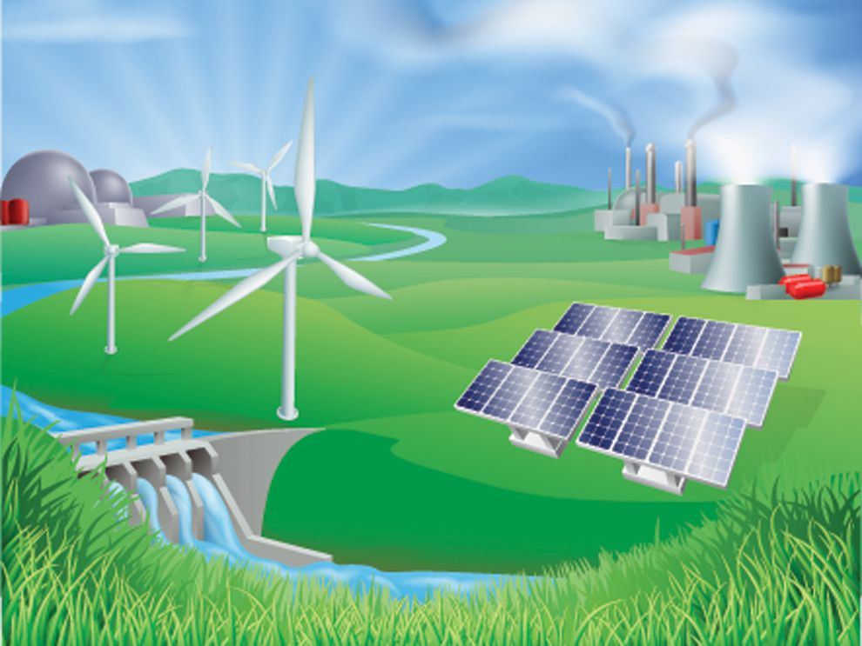
What do you know about renewable energy?
Can you give examples of renewable energy sources?
https://www.bbc.co.uk/bitesize/topics/zp22pv4/articles/ztxwqty

Slide 4
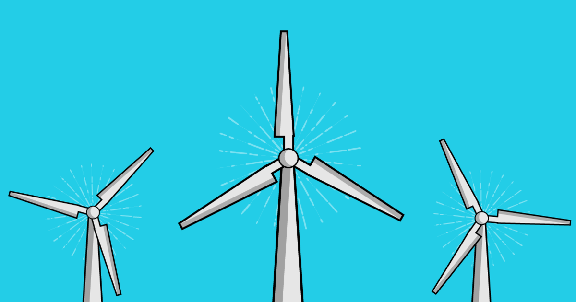
We are going to be focusing on wind power today!
Winds power has been used as a source of renewable energy for centuries and all over the world people are investing in wind technology as one of the main methods for us to generate electricity in the future.

Slide 5


It’s Electrifying!
Wind Energy
© www.sustainablelearning.com

Slide 6
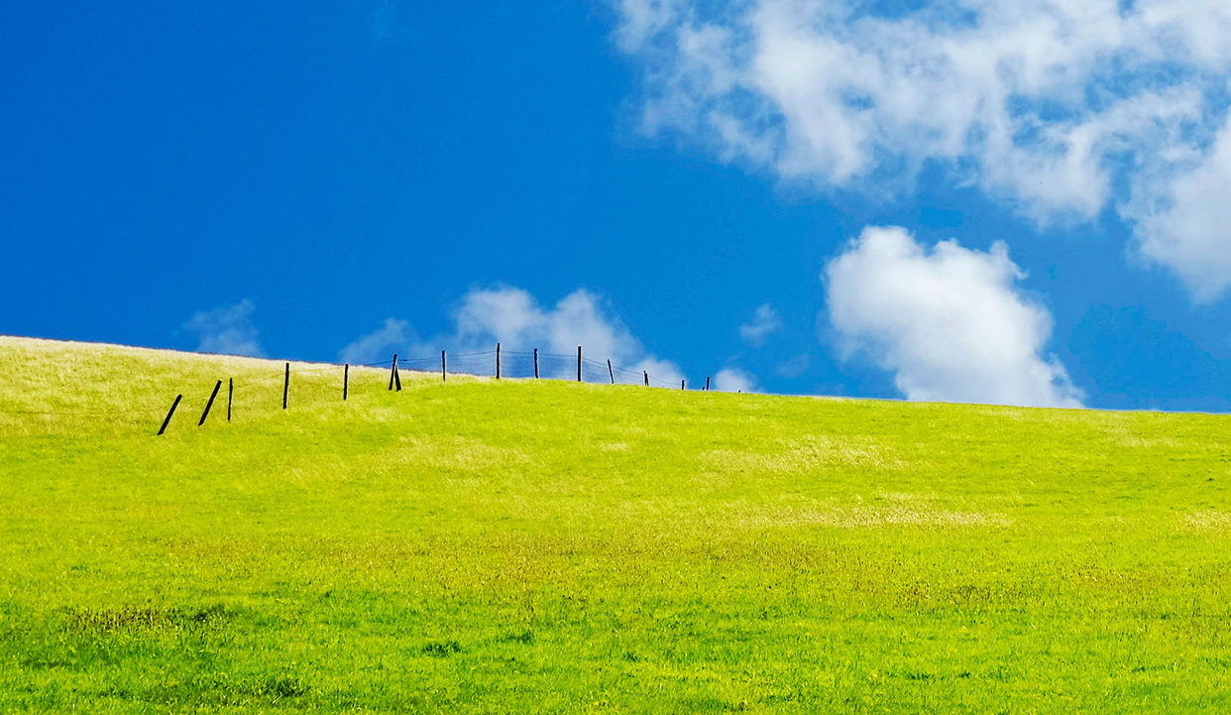
(Almost)
Everything you wanted to know about…
Wind Energy
(Part 1)
Photo by Kumeni CC
Photo by Kumeni CC

Slide 7
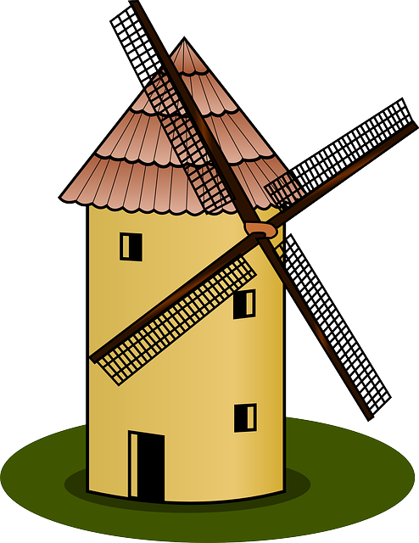

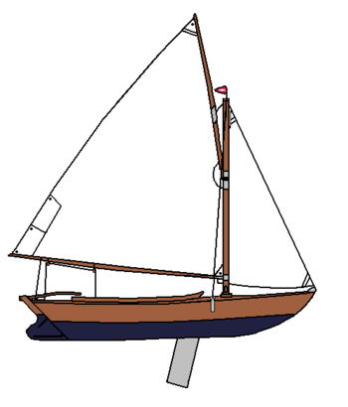
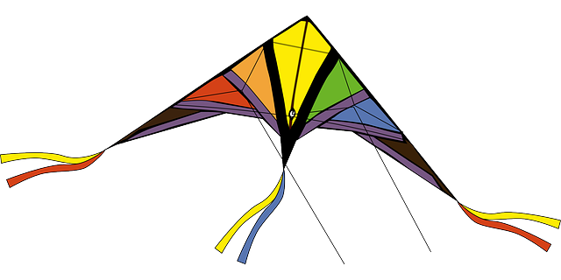
Wind Energy
You might have seen the wind used in lots of different ways.

Slide 8
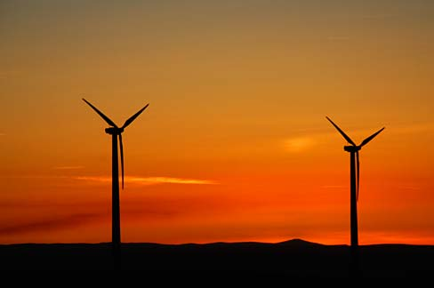
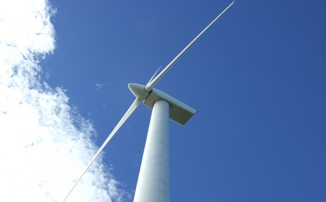
Where Does Wind Come From?
We need to thank the sun.
As the sun warms the ground and sea it also warms the air.
When air gets hotter it rises.
When the hot air rises, the space it leaves is replaced by cold air, which is heavier. This rushing movement of air is the wind.

Slide 9






The hot air rises.
The sun heats the land and the air.
The colder air falls…
WIND
and rushes in to replace the hot air.
WIND FLOW

Slide 10
The hot air rises.
The sun heats the land and the air.
The colder air falls…
WIND
and rushes in to replace the hot air.
WIND FLOW

Slide 11

Wind and tall buildings, hills and mountains
If you have ever climbed a tall building, a hill or a mountain you will know it can be extremely windy at both the top and the bottom.
Do you know why this is?

Slide 12



Up Draft
The diagram shows wind near a skyscraper.
The wind around tall buildings is often strong around the top and the base.
Wind air hits the building and, with nowhere else to go, is pushed up, down and around the sides. The up wind can be called updraft and the down wind can be called down draft.
WIND
WIND
Down Draft

Slide 13
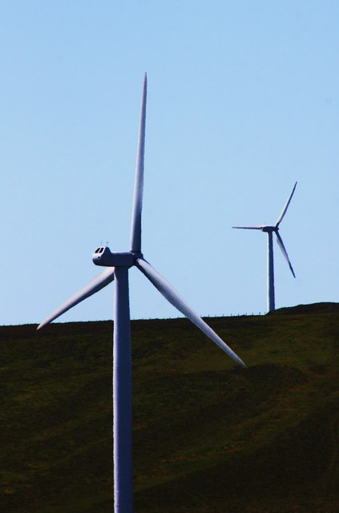
Wind turbines turn kinetic energy (movement) from the wind into electrical power.
Wind provides sustainable energy. It is clean and renewable. It does not pollute the environment or use fossil fuels.

Slide 14

How Can Wind Make Electricity?
When the wind blows, it pushes the blades on the turbine causing them to rotate.
The spinning blades are connected to a shaft which is then connected to a gear box. This gear box helps the blades spin faster.
The gear box is connected to a generator which produces the electricity. The turbines are also fitted with a brake.
blades
Wind
generator
gear box
shaft
brake
Wind

Slide 15

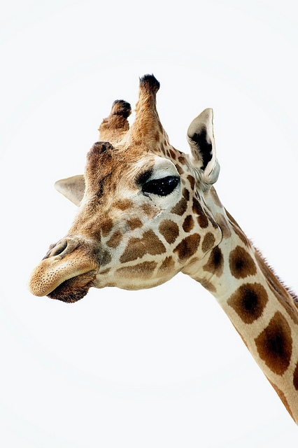
Wow, How Big?!
If you’ve ever seen a wind turbine you will know they are huge!
Wind turbines vary in size and height but a typical turbine is over 100 meters tall.
That’s as tall as a 30-story building.
If 20 giraffes stood on each others heads, they still wouldn’t be able to reach the top.

Slide 16
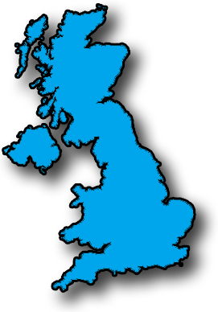
Wind Energy in the UK
The UK is the windiest country in Europe making it the perfect place for wind turbines.
There are 6546 wind turbines in the UK, both on shore and at sea.
We currently have enough wind turbines in the UK to power 8 million homes.

Slide 17

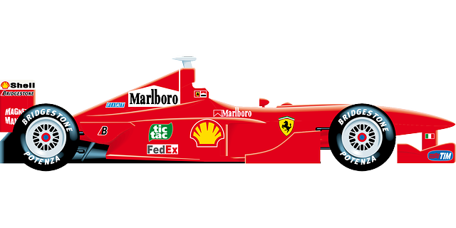
Fact Attack!
One windmill will provide power for over 1,200 homes. That’s enough power to make 180 million cups of tea a year!
A group of turbines together is called a wind farm. These can be built on land or at sea.
Once they are in motion wind turbine blades can turn at speeds of between 45 and 180mph. That’s about as fast as a Formula 1 racing car!

Slide 18

If you were to build wind turbines to generate electricity, where would the best place for the turbines be?
How could you investigate this?
How would you make sure our experiment is a fair test?

Slide 19
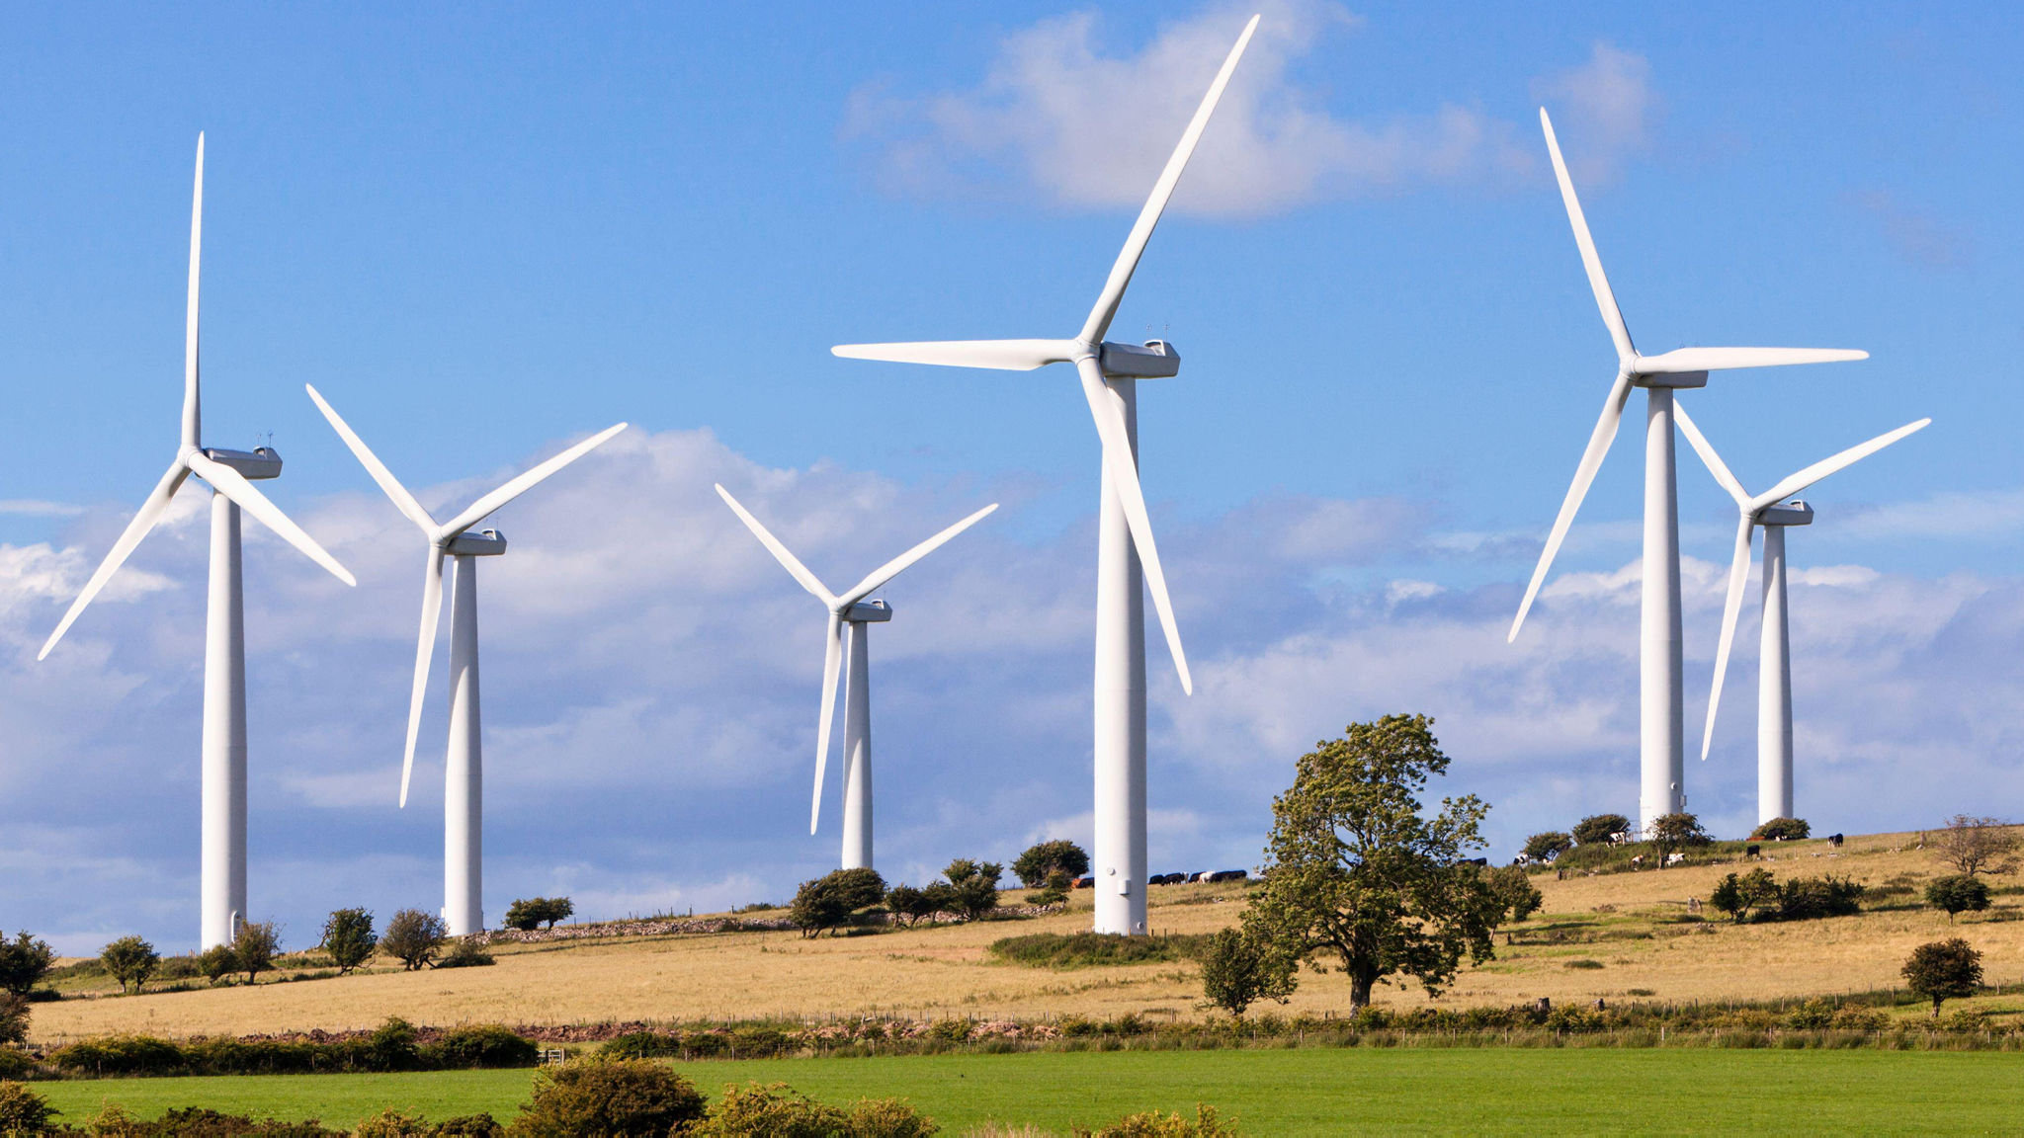
You are going to investigate the windspeeds in 5 different locations around your local areas.
What locations could we choose? We need to try to choose different locations.

Slide 20
How are you going to measure the wind speed?

Slide 21
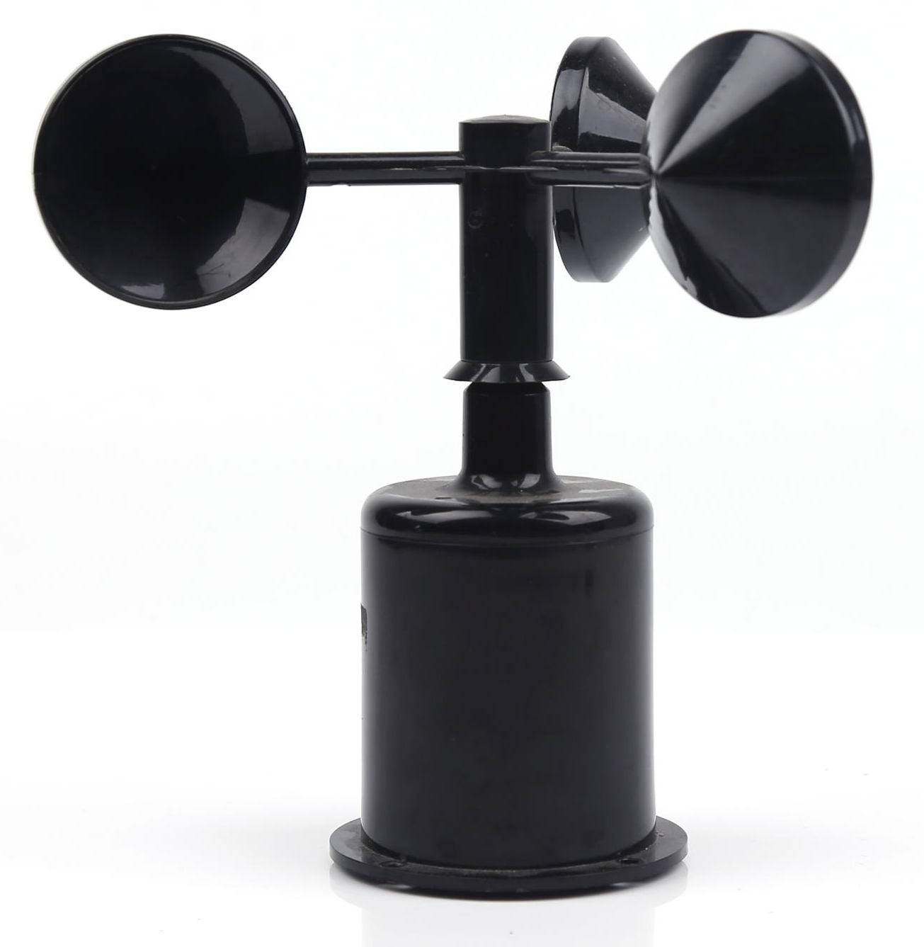
You are going to make an anemometer!
Does you know what an anemometer is?
An anemometer is a device that is used
to measure wind speed.
https://www.bbc.co.uk/programmes/p0114lsp

Slide 22
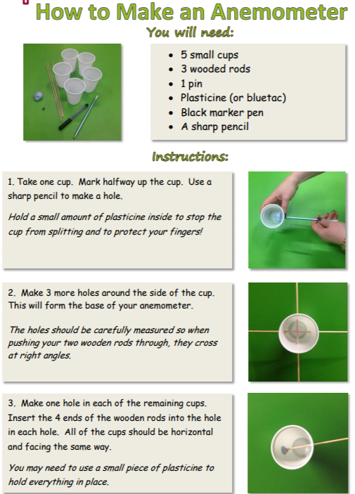
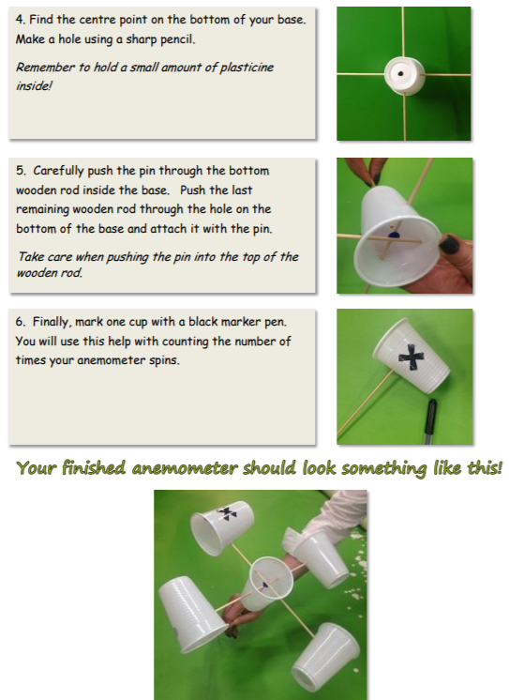

Slide 23


