Slide 1
Tuesday 15th June 2021
LO: to understand beliefs and teachings
to understand lifestyles and practices
to understand values

Slide 2

Can you remember what this represents?

Slide 3
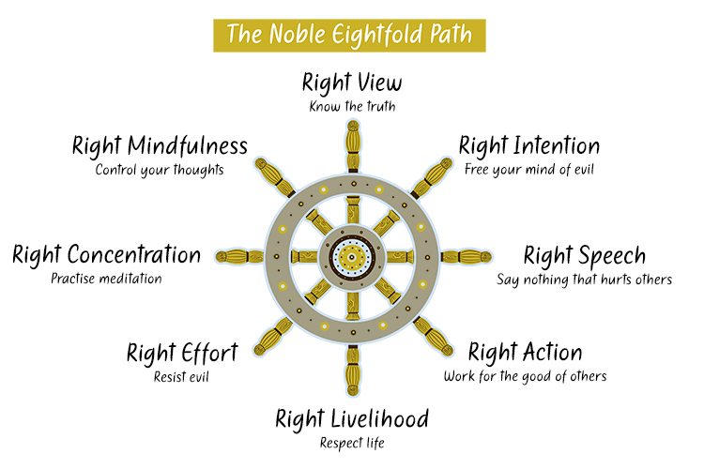
The Eight-Fold Path
The Buddha says there are 8 things people can do to help them lead good lives which would make the world better for everybody and everything.
The Eight-Fold Path helps people know which decisions/choices are good, i.e. decisions that will be thoughtful and bring no harm to any living thing.

Slide 4
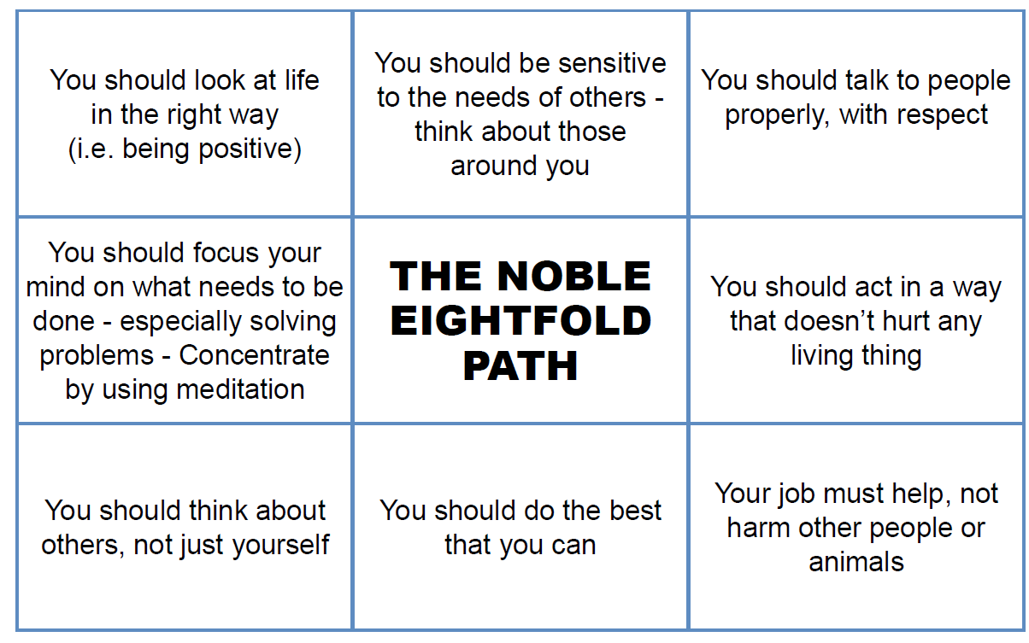
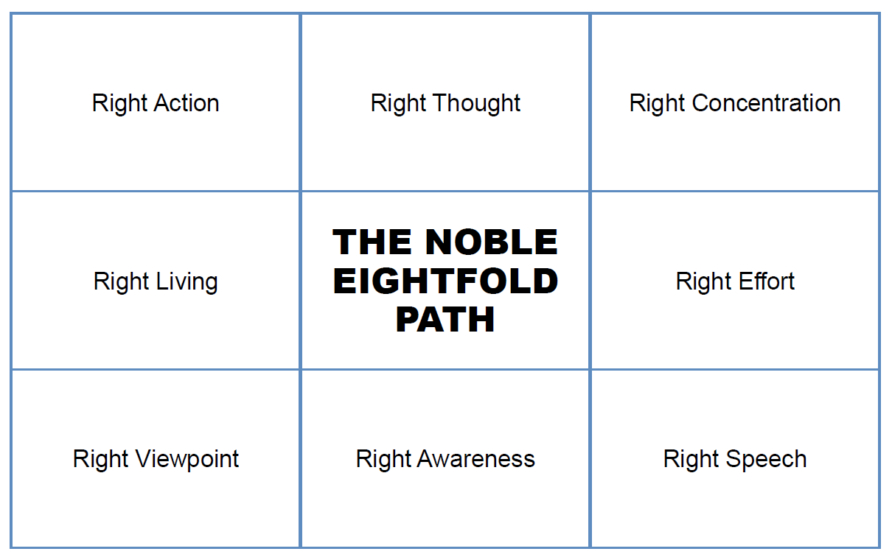
Quick Activity
Complete the Eight-Fold Path sheet: match the definitions to the different folds.
Right Intent
Right Livelihood
Right Understanding
Right Mindfulness

Slide 5
Answers:
Right Action | You should act in a way that doesn’t hurt any living thing.
Right Livelihood | Your job must help, not harm other people or animals.
Right Understanding | You should look at life in the right way (i.e. being positive).
Right Intent | You should be sensitive to the needs of others – think about those around you.
Right Concentration | You should focus your mind on what needs to be done – especially solving problems – concentrate by using meditation.
Right Effort | You should do the best you can.
Right Mindfulness | You should think about others, not just yourself.
Right Speech | You should talk to people properly, with respect.

Slide 6
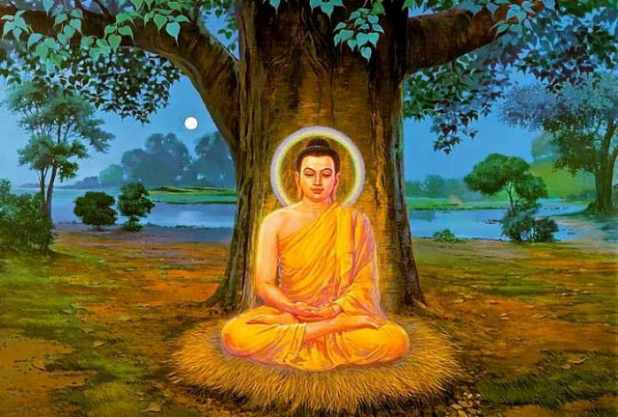
The main aim underneath the Buddha’ teaching of the Eight-Fold Path is to not bring harm to any living thing.

Slide 7
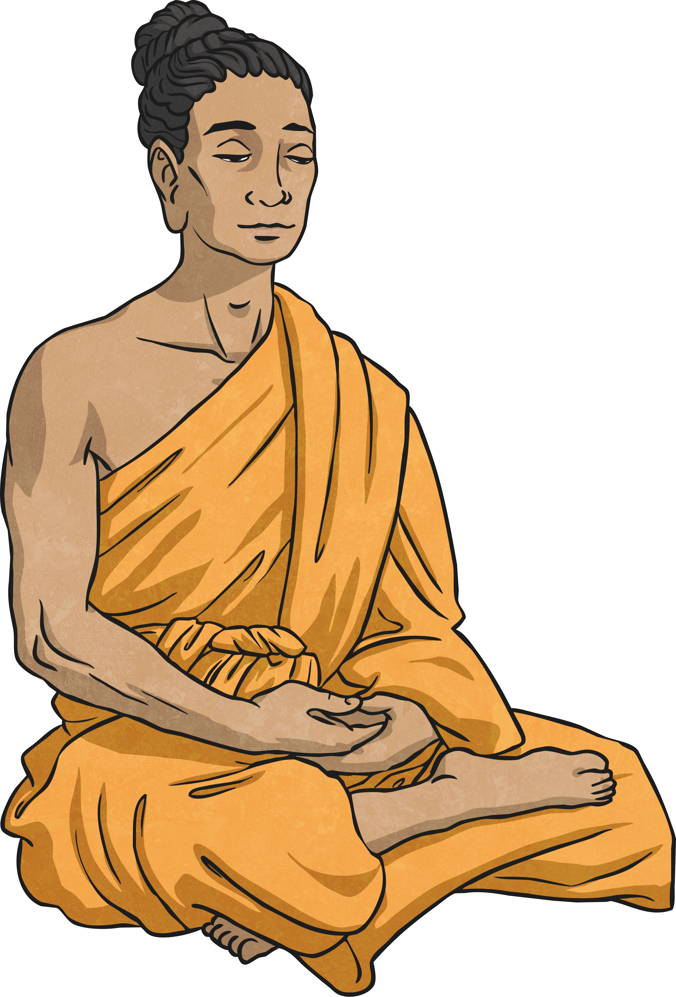
Right Understanding
Having right understanding is when you see the world as it really is and not how you want it to be. Sometimes we try to change things that are outside of our control and we can get upset or not understand things clearly.
Think of a time when you have been upset because you have misunderstood a situation and something seems out of your control. You wanted it to be different to how it really was.

Slide 8
Right Understanding
This is a significant step on the path as it relates to seeing the world and everything in it as it really is, not as we believe it to be or want it to be.
To see the world as it really is.
To understand the teachings of the Buddha.

Slide 9
Buddhist Quote:
Before I can practise Buddhism at all, I have to have some idea that there’s something to work toward. When I look at the Buddha image I remember that I too can be like that. I can become happier, wiser and more compassionate. I too want to gain Enlightenment. That’s my goal, my vision.
What actions do Buddhists take to make sure they follow this fold?

Slide 10
Right Intent
Right Intent means we can commit to a decision or action for the right reasons, once we understand things properly by looking at what is really there and not what we want it to be like.
We need to ask ourselves if we are just being selfish, or are we thinking of others with care and compassion?
Think of a time when you might not have had the right reasons for a decision. What were you trying to gain?

Slide 11
Right Intent
Having the right approach and outlook to following the Eightfold Path; being determined to follow the Buddhist path with a genuine, honest attitude.
This is the step where Buddhists become committed to the path.
Right Intent urges us to decide what our heart wants.
Right Intent must come from the heart and involves recognising the equality of all life and compassion for all that life, beginning with yourself.

Slide 12
Buddhist Quote
It’s no good wanting Enlightenment in my head, if in my heart, I can’t be bothered. One way I can motivate myself is by meditating. I can also inspire myself by reading some of the Dharma books.
What actions do Buddhists take to make sure they follow this fold?

Slide 13

Right Speech
Often things we say in anger or gossip behind people’s backs can cause upset and hurt, and take a long time to sort out. Having Right Speech is deciding never to speak unkindly or in anger.
Have you hurt someone’s feelings by something you have said to them or about them?
Reflect on a time you could have said something differently or not at all.

Slide 14
Right Speech
To speak well.
To say things which are kind and compassionate.
To refrain from speaking harmful or hurtful things.
Speaking truthfully in a helpful, positive way; avoiding lying or gossiping about others.
We tend to underestimate the power of the spoken word, and often regret words said in haste. Each of us has experienced the disappointment associated with criticism, and we also are likely to have felt good when kind words encouraged us.
Right speech involves recognising the truth, and being aware of the impact of gossip and of repeating rumours. Communicating thoughtfully helps to unite others, and can heal disagreement. By resolving never to speak unkindly, or in anger, a spirit of consideration grows which moves us closer to everyday compassionate living.

Slide 15
Buddhist Quotes
We have a strong effect on others through our speech and communication. I need to speak kindly and truthfully. If I tell the truth, especially when it isn’t easy, I can develop honesty and fearlessness. By being truthful, I do myself honour. What a challenge it is to be really honest and always kind.
What actions do Buddhists take to make sure they follow this fold?

Slide 16
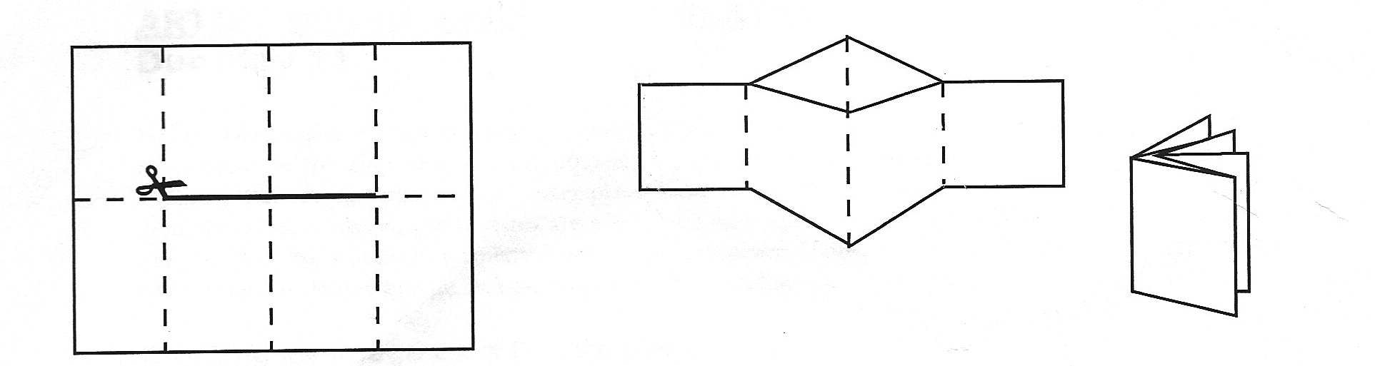
Activity
Make a concertina book by folding your piece of paper so that it has 8 sections.
Illustrate each fold of the Eight-Fold Path that we have covered today.
Snorkelling and Diving: Write a brief description of the folds. What do they mean? What should Buddhists do to follow this fold?
Paddling Red Pen: Do you follow any of the Eight-Fold Path folds in your life? How?
Snorkelling and Diving Red Pen: Consider how your life would be different if you lived it like a Buddhist.

