Slide 1
Thursday 1st July 2021
L.O: Understand movement, forces and magnets
C: Working Scientifically

Slide 2
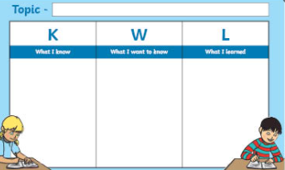
Let’s start by thinking about what we already know about magnets.

Slide 3
Now let’s stick in our knowledge organisers and spend 10 minutes exploring and experimenting with the magnets.
Write down any observations you make on your whiteboards, so we can share our findings in 10 minutes.

Slide 4
Now let’s watch a video and play some games to find out a bit more!
https://www.bbc.co.uk/bitesize/topics/zyttyrd/articles/zpvcrdm

Slide 5
Your task is to work in small groups and create a fun video for Newsround, explaining what magnets are and how they work.
We will watch these in 30 minutes. You can use posters and props to help you.

Slide 6
Let’s watch the videos!
Red Pen Question:
You will be asked to write a star and a wish for another team. So make sure you are listening.

