Slide 1
Monday 14th June 2021
LO: to write with purpose.
to punctuate accurately
to spell correctly
C: Biographies

Slide 2
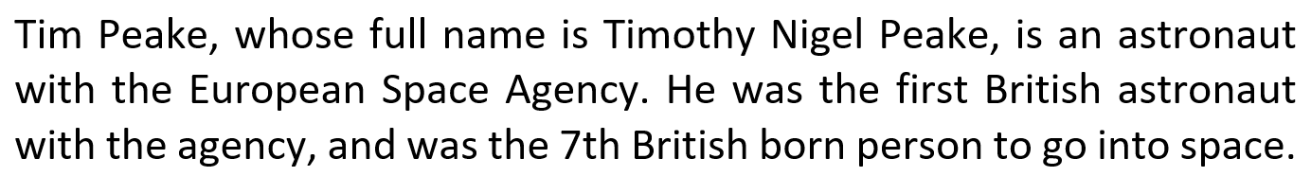
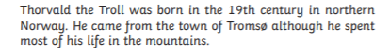
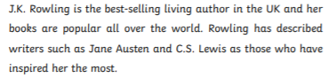
Starter
What are these?
What are the features of introductions?

Slide 3

Biographies need to have an attention grabbing introduction that summarises the main events of the person’s life and makes the audience want to read on.

Slide 4
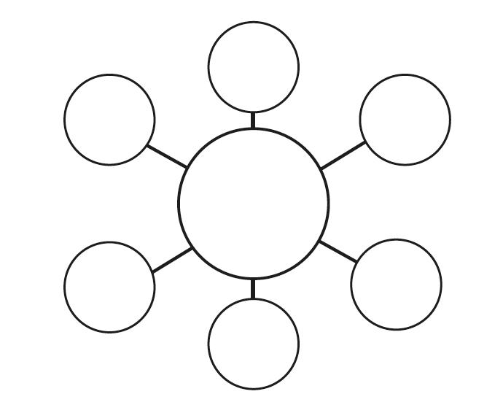
Create a bubble map of all the things you will need to include in your introduction for your David Attenborough biography.

Slide 5
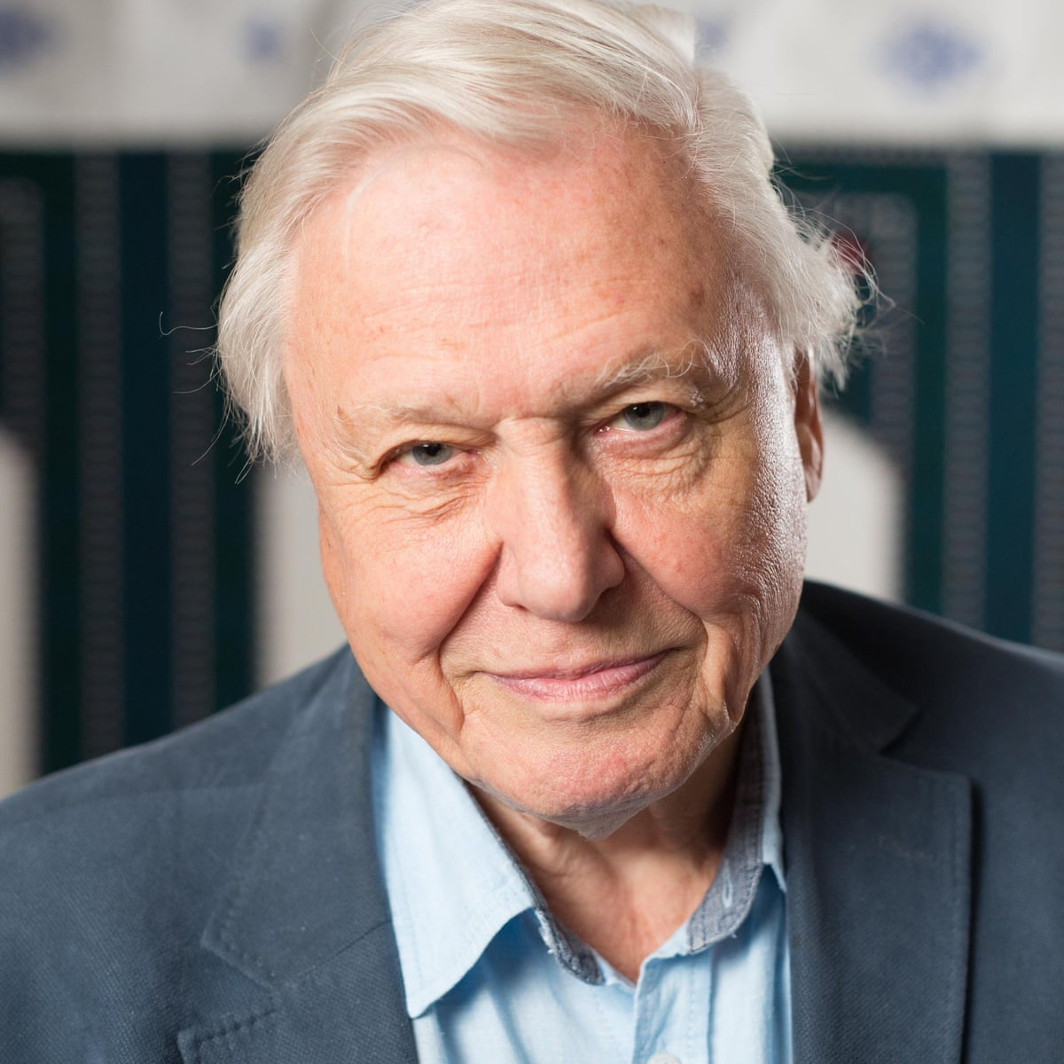
You are going to write an introduction for our David Attenborough biography together.

Slide 6
Tuesday 15th June 2021
LO: to write with purpose
to organise writing appropriately
to use paragraphs
to spell correctly
to punctuate accurately
C: Biographies

Slide 7
Starter
Timothy Nigel ‘Tim’ Peake was born in Chichester, West Sussex, England on 7th April 1972. He grew up in a nearby village with his sister Fiona, his mother Angela and his father Nigel. Tim’s mother worked as a midwife and his father was a journalist. His father had always been interested in historic aircraft, so he took Tim to air shows from an early age. This is what fuelled Tim’s fascination with flying and his passion began. When he was 13 years old, Tim joined a military program through his school. Through this program, he learned to fly with their air force section on weekends. By the time he was 16, Peake had decided to become a pilot in the army. He studied at the Chichester High School for boys and left in 1990 to enrol at the Royal Military Academy in Sandhurst.
Can you identify all of the features of biographies I have used?
What do you like about my example?
Are there any words or phrases you would like to magpie? Write these on your whiteboards!
Is there anything that could be improved?

Slide 8
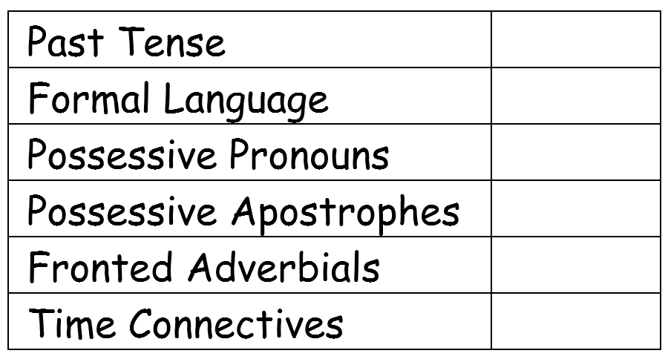
Biography Checklist
Do we know what every item is on the checklist?
Can you give an example of each?
Remember: you should be using all of these features in your writing over the next few days.

Slide 9
Activity
You are going to begin to write your biographies today.
You are only going to write about David Attenborough’s early life events and achievements.
Red Pen: look at your biography checklist. Have you included everything on the checklist? Is there anything missing? Add in a sentence or two to make sure every item on the checklist is ticked off!

Slide 10
Wednesday 16th June 2021
LO: to write with purpose
to organise writing appropriately
to use paragraphs
to spell correctly
to punctuate accurately
C: Biographies

Slide 11

Starter
Have a look back at the highlighting and marking comments from your work last lesson.
What did you do well yesterday?
What do you need to include in your work today?
What do you need to improve today?

Slide 12
After his graduation from the Royal Military Academy, Tim Peake became an officer in the British Army Air Corps. In the army, he flew in Germany, Northern Ireland, Kenya, Canada, and the Balkans. Peake also served as a flight instructor and a platoon commander. He retired from the British military in 2009, after completing over 3000 flying hours. In 2008, Tim saw an advert from the European Space Agency announcing it was accepting applications for new astronauts, so he decided to apply. In 2009, Tim was offered one of the six available places to train to be an astronaut with the European Astronaut Corps in Cologne, Germany. On the 15th December 2015, Tim Peake, Yuri Malenchenko and Tim Kopra launched. They reached their destination at 5:33pm and Tim was welcomed onboard the International Space Station. He became the first British astronaut to inhabit the ISS. Tim spent six months living and working in space. During his stay on the ISS, Peake researched new medical cures and completed the first spacewalk by a British astronaut. He returned to Earth on 18th June 2016. He travelled in the Soyuz capsule at 25 times the speed of sound, and landed in Kazakhstan at 9:15am. During his mission, Tim had made 3000 orbits of Earth, covering about 125km.
Can you identify all of the features of biographies I have used?
What do you like about my example?
Are there any words or phrases you would like to magpie? Write these on your whiteboards!
Is there anything that could be improved?

Slide 13
Biography Checklist
Remember: you should be using all of these features in your writing over the next few days.

Slide 14
Activity
You are going to continue to write your biographies today.
You are only going to write about David Attenborough’s later life events and achievements.
Red Pen: look at your biography checklist. Have you included everything on the checklist? Is there anything missing? Add in a sentence or two to make sure every item on the checklist is ticked off!

Slide 15
Thursday 17th June 2021
LO: to write with purpose
to organise writing appropriately
to use paragraphs
to spell correctly
to punctuate accurately
C: Biographies

Slide 16
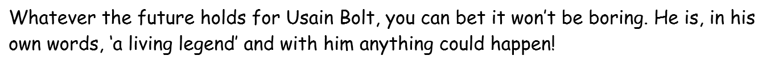
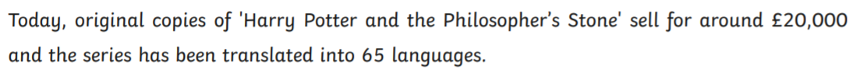
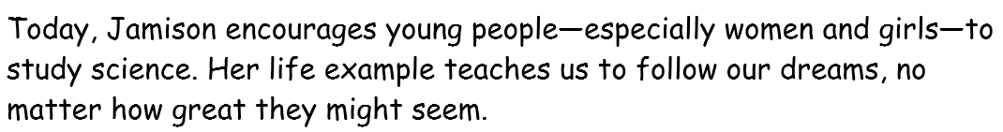
Starter
What are these?
What are the features of conclusions?

Slide 17

Biographies should conclude with what they are doing now, or how they are/will be remembered.

Slide 18
Activity 1:
You have 10-15 minutes to write your own conclusions in your books.
Use the sentence starters below to help you:
Today…
His life example teaches us…
David Attenborough will be remembered for…

Slide 19
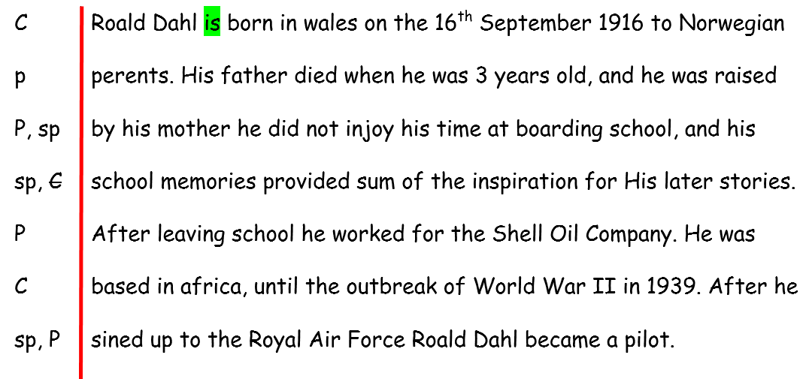
Can you edit and improve this example?
Can you identify and correct all of the mistakes that have been made?
Can you add in a sentence or two to tick off another item on the checklist?

Slide 20
Look back at the highlighting and marking comments from your biography.
What have you done well?
What do you need to correct or improve?
Is there anything on the checklist you have missed off? How can you make sure this item gets ticked off today?

Slide 21
Activity 2:
You are going to be using the highlighting and marking comments to edit and improve your work today.
Red Pen: If someone was to write your biography, what would they include? Write some sentences about your life using the items on the checklist!

