Slide 1
Monday 10th May 2021
LO: To understand electrical circuits
C: Electricity.

Slide 2
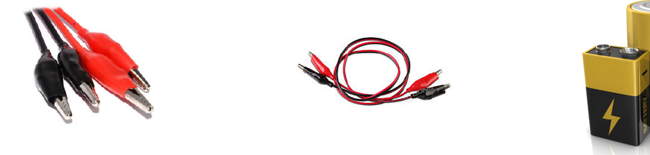
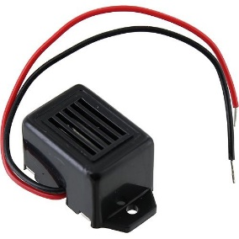
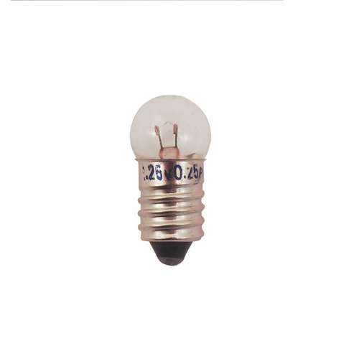
Which of these pictures shows:
A wire
Crocodile clip
Bulb
Buzzer
Cell

Slide 3
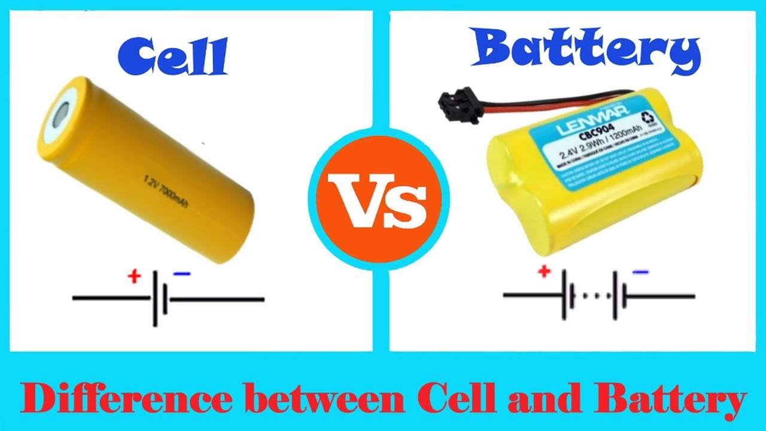
The difference between a cell and a battery is that a cell is a single unit that converts chemical energy into electrical energy, and a battery is a collection of cells.

Slide 4
Watch: http://www.bbc.co.uk/bitesize/ks3/science/energy_electricity_forces/electric_current_voltage/revision/3/

Slide 5

What is important when you are building circuits?
How will you make my circuit work?
Using this website: https://learningcircuits.co.uk/circuit_builder
Can you build a circuit to make the bulb light up?
The cell converts the chemical energy stored within it, into electrical energy which, in turn, makes the bulb light up.

Slide 6
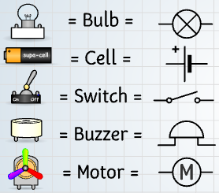
Go to: https://www.andythelwell.com/blobz/guide.html
Read the information under ‘Section 1 – What makes circuits work?’
Your challenge:
Can you draw a circuit to show how you would make a buzzer or a motor work?
What will you need in your circuit?
Use the key to help you.

Slide 7
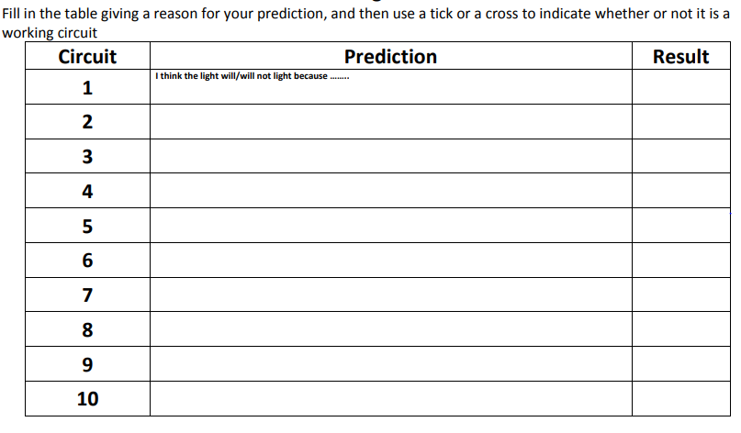
Your activity…
Use scientific language!
Use the simple circuit cards on the website and predict whether or not the circuits will work using your knowledge of circuits.
First you need to explain why you think it will or will not work.
Then you need to construct the circuit to test your prediction using the website below..
Go to: https://phet.colorado.edu/sims/html/circuit-construction-kit-dc/latest/circuit-construction-kit-dc_en.html and click ‘lab.’
Paddling: complete at least 3 circuits.
Snorkelling: complete at least 5 circuits.
Diving: complete at least 7 circuits.

Slide 8


