Slide 1
Tuesday 11th May 2021
LO: to understand beliefs
To understand practices and lifestyles
To understand values
C: Buddhism

Slide 2
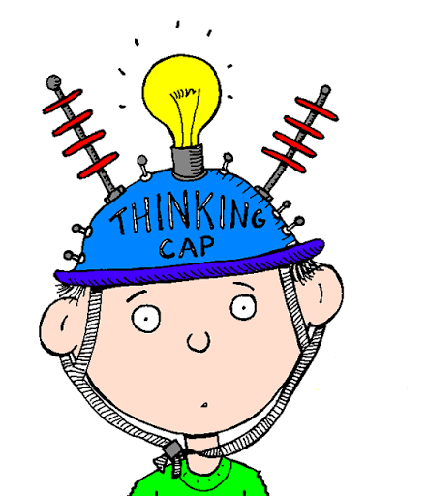
What is suffering?
What is selfishness?

Slide 3
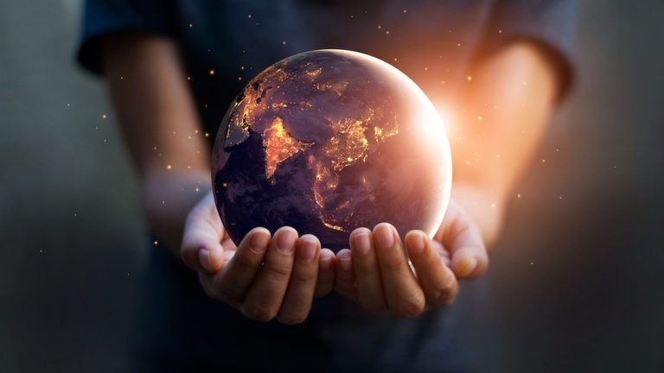
Suffering: the state of undergoing pain, distress, or hardship.
Selfishness: placing concern with oneself or one's own interests above the well-being or interests of others.
Buddhists believe that there is suffering in this world and that suffering is caused by greed and selfishness.

Slide 4
How might someone be greedy?
In groups, think about ways that being greedy might cause yourselves or somebody else to suffer.

Slide 5
How might somebody be selfish?
How might this cause suffering to yourselves and others?

Slide 6
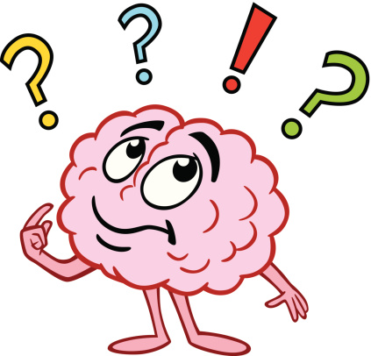
What did the Buddha teach about not being greedy or selfish?

Slide 7
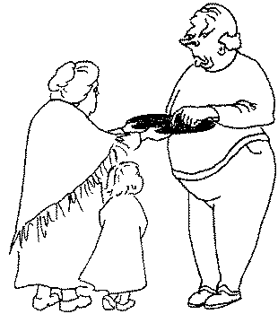
The Golden Plate
Once upon a time in a place called Seri, there were two salesmen of pots and pans and handmade trinkets. They agreed to divide the town between them. They also said that after one had gone through his area, it was all right for the other to try and sell where the first had already been.
One day, while one of them was coming down a street, a poor little girl saw him and asked her grandmother to buy her a bracelet. The old grandmother replied, "How can we poor people buy bracelets?" The little girl said, "Since we don't have any money, we can give our black sooty old plate." The old woman agreed to give it a try, so she invited the dealer inside.

Slide 8
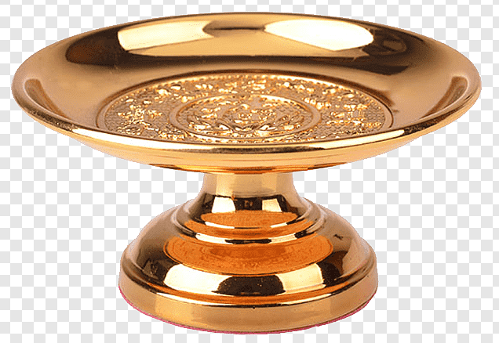
The salesman saw that these people were very poor and innocent, so he didn't want to waste his time with them. Even though the old woman pleaded with him, he said he had no bracelet that she could afford to buy. Then she asked, "We have an old plate that is useless to us, can we trade it for a bracelet?" The man took it and, while examining it, happened to scratch the bottom of it. To his surprise, he saw that underneath the black soot, it was a golden plate! But he didn't let on that he had noticed it. Instead he decided to deceive these poor people so he could get the plate for next to nothing. He said, "This is not worth even one bracelet. There's no value in this. I don't want it!" He left, thinking he would return later when they would accept even less for the plate.

Slide 9
Meanwhile the other salesman, after finishing in his part of town, followed after the first as they had agreed. He ended up at the same house. Again the poor little girl begged her grandmother to trade the old plate for a bracelet. The woman saw that this was a nice tender looking merchant and thought, "He's a good man, not like the rough-talking first salesman." So she invited him in and offered to trade the same black sooty old plate for one bracelet. When he examined it, he too saw that it was pure gold under the grime. He said to the old woman, "All my goods and all my money together are not worth as much as this rich golden plate!"

Slide 10
Of course the woman was shocked at this discovery, but now she knew that he was indeed a good and honest fellow. So she said she would be glad to accept whatever he could trade for it. The salesman said, "I'll give you all my pots and pans and trinkets, plus all my money, if you will let me keep just eight coins and my balancing scale, with its cover to put the golden plate in." They made the trade. He went down to the river, where he paid the eight coins to the ferry man to take him across.

Slide 11
By then the greedy salesman had returned, already adding up huge imaginary profits in his head. When he met the little girl and her grandmother again, he said he had changed his mind and was willing to offer a few cents, but not one of his bracelets, for the useless black sooty old plate. The old woman then calmly told him of the trade she had just made with the honest salesman, and said, "Sir, you lied to us."
The greedy salesman was not ashamed of his lies, but he was saddened as he thought, "I've lost the golden plate that must be worth a hundred thousand." So he asked the woman, "Which way did he go?" She told him the direction. He left all his things right there at her door and ran down to the river, thinking, "He robbed me! He robbed me! He won't make a fool out of me!"

Slide 12
From the riverside he saw the honest salesman still crossing over on the ferry boat. He shouted to the ferry man, "Come back!" But the good merchant told him to keep on going to the other side, and that's what he did.
Seeing that he could do nothing, the greedy salesman exploded with rage. He jumped up and down, beating his chest. He became so filled with hatred towards the honest man, who had won the golden plate, that he made himself cough up blood. He had a heart attack and died on the spot!

Slide 13

What happened in the story?
Now, what do you think the Buddha taught about not being greedy or selfish?

Slide 14
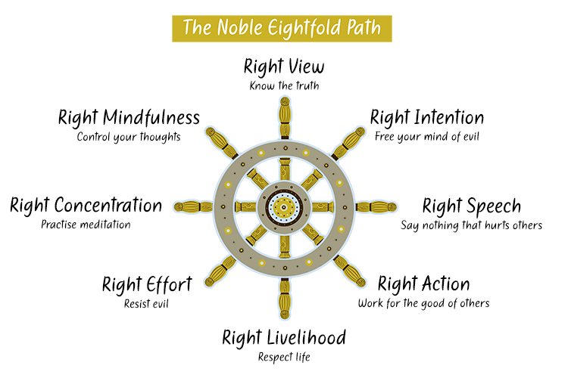
The Buddha believed greed and selfishness could be stopped.
He taught that to live a good life without being selfish or greedy would make the world a better place.
To help people know what to do and not to do, he gave them the eight-fold path.

Slide 15

Your life is made up of paths – every decision you make means that you have to choose and follow a path.
But how do you know which path to take?
When you make a decision, you have to choose one that will be the best in the end.
The teachings of the Buddha say that the best path you can take is the eight-fold path.

Slide 16
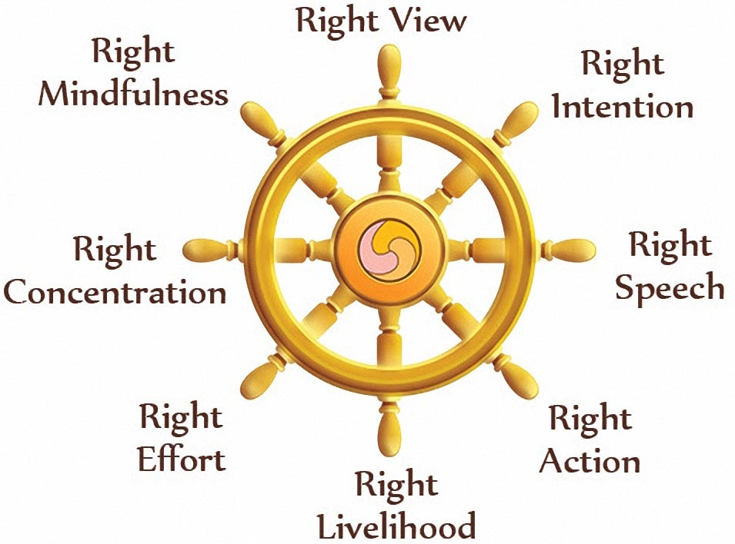
The eight-fold path is the path to ending suffering and achieving self-awakening.
Being self-awakened means that you have become completely wholesome, wise, free and understand everything.
If it is followed correctly, the eight-fold path can end suffering.
Buddhists believe that the eight-fold path is the path to the end of suffering.

Slide 17
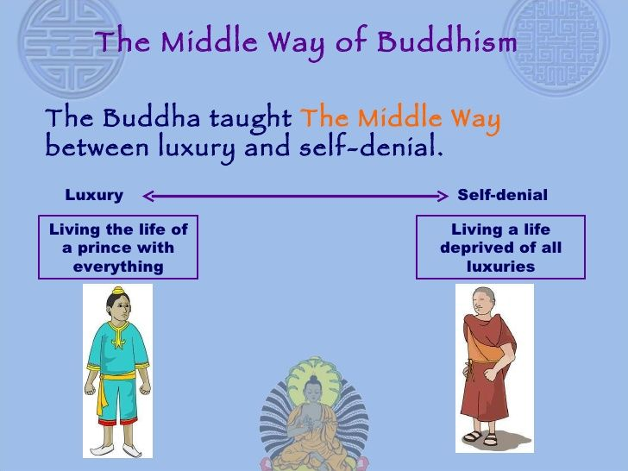
The path is sometimes called The Middle Way; it is a middle way between extremes.
The buddha had once lives a life of luxury as a prince.
He had also tried a life of extreme hardship – the sparing life.
He taught that following the Noble Eightfold Path, a middle way, leads to happiness and freedom from suffering.

Slide 18
Can you think of any other religions which may give their followers rules or tell them how(not) to live their lives?

Slide 19
Activity
Read the information PowerPoint about the eight-fold path.
Choose one of the folds and draw a picture to represent it.
Red Pen: would the Buddha’s teaching about your fold of the eight-fold path make the world a better place if most/all people tried their best to do this? Explain your reasoning.

