Slide 1
LO: TO understand Chronology.
C: Ancient Mayans

Slide 2
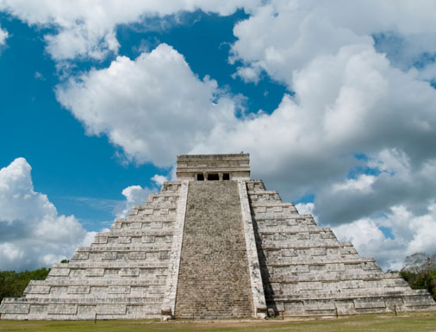
How long do you think the Mayans were around for?

Slide 3
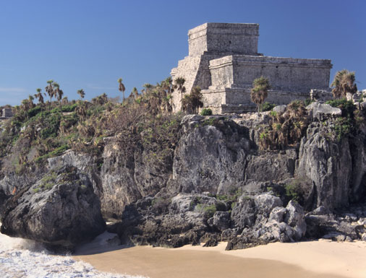
They were actually around for more than 3000 years.
Pre-classic Period (2000 BC to 250 AD)
The Pre-classic Period covers from the start
of the Maya civilization to 250 AD when the
Maya civilization began its golden age. A lot of development
took place during this period. The major cities during this
period were El Mirador and Kaminaljuyu.
Classic Period (250 AD to 900 AD)
The Classic Period is considered the golden age
of the Maya city-states. Most of the artistic and
cultural achievements of the Maya civilization took place
during this period.

Slide 4
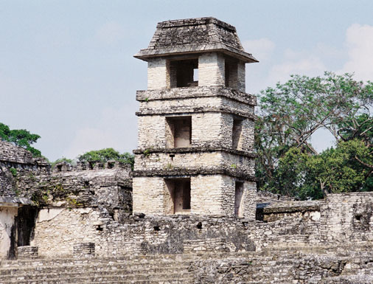
Post-classic Period (900 AD to 1500 AD)
Although the southern city-states collapsed, the Mayan cities
in the northern part of the Yucatan Peninsula continued to
thrive for the next several hundred years during the
Post-classic period.
Colonial Period (1500 AD)
Many of the Maya city-states are conquered by the Spanish.

Slide 5
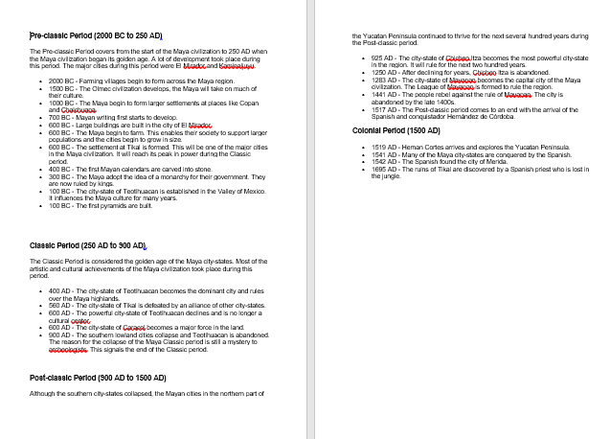
Look at the timeline sheets that are on the webpage and read through them.

Slide 6
BC and AD
BC refers to before Christ (Jesus) was born. The years count down towards zero.
AD refers to the latin phrase ‘anno domini’ – this means ‘In the year of the Lord.’ this means from AD when Jesus was born. So the numbers then count upwards. We’re in the Year 2021.
So the Mayans were around both before and after Jesus’ birth.

Slide 7
Your Task
You are going to make a timeline for The Mayans. Draw and plot the your timeline.
Once you’ve done that, use Maths and post it notes to plot any
- Decades (10 years).
-Century's (100 years).
-Millennium (1000 years).

