Slide 1
LO:
To explore and decompose an existing game.
To modify a game.
C: Helicopter game.

Slide 2
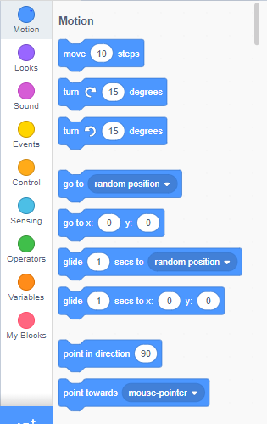
Recap…
What can you remember from our last computing lesson?
What is a continuous loop?
What was the aim of the helicopter game?
What do you think modify means?

Slide 3
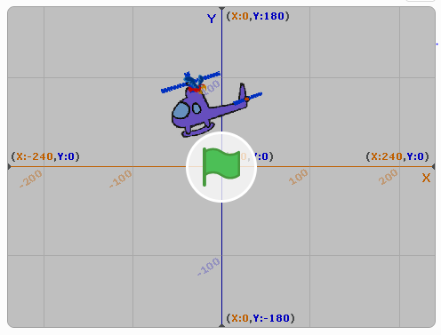
https://scratch.mit.edu/projects/316961043/
Spend the first 10 minutes familiarising yourself with the game.

Slide 4
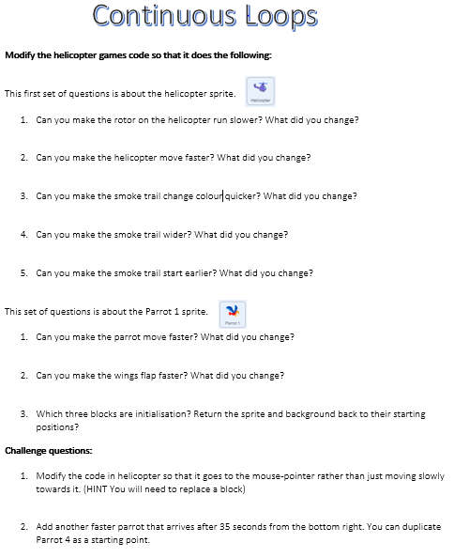
Your activity
Today you are going to complete the questions about the parrot sprite and the challenge questions.

