Slide 1
Monday 10th May 2021
LO: to write with purpose
C: Non-Chronological Reports

Slide 2
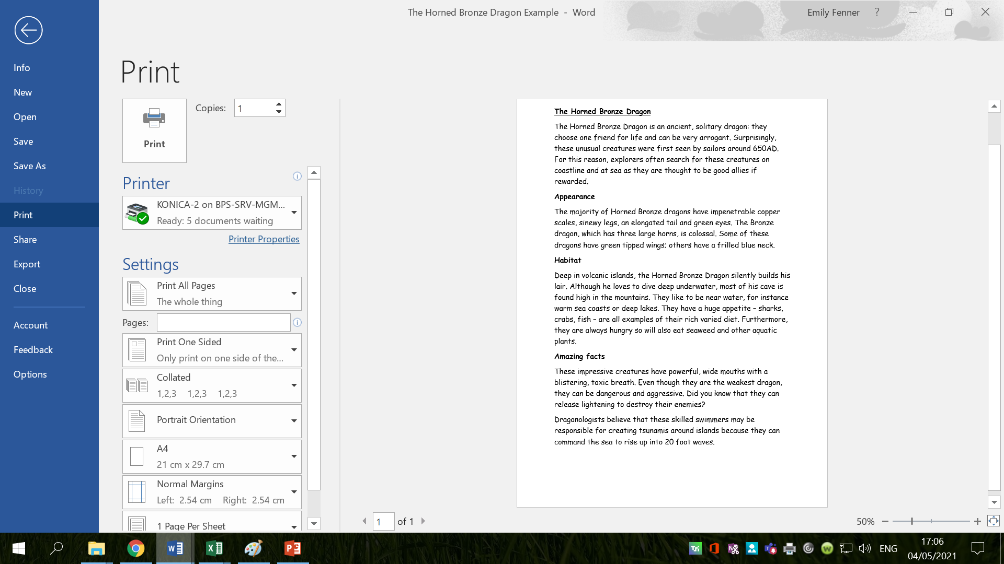
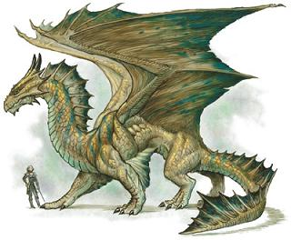
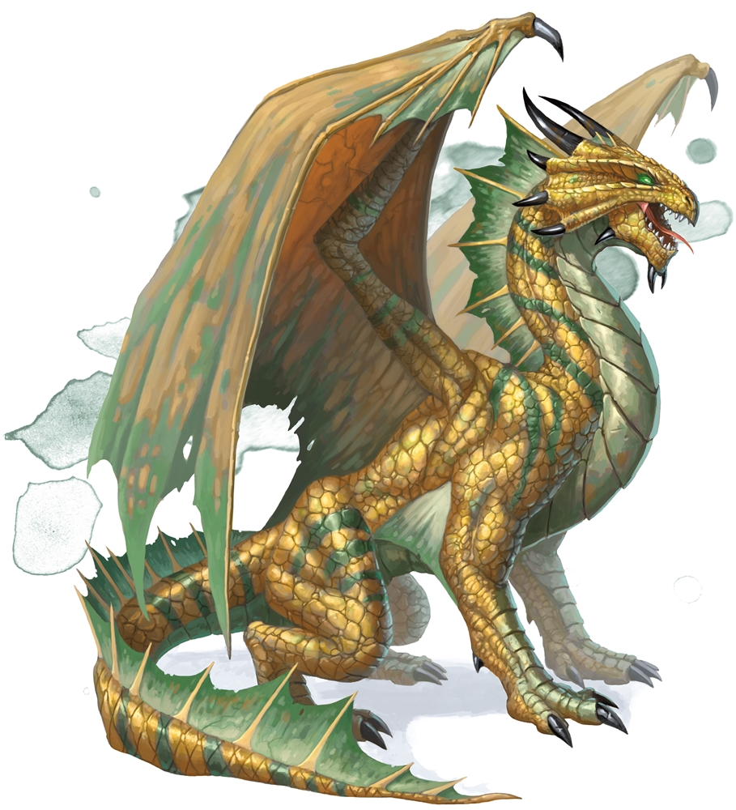

Slide 3
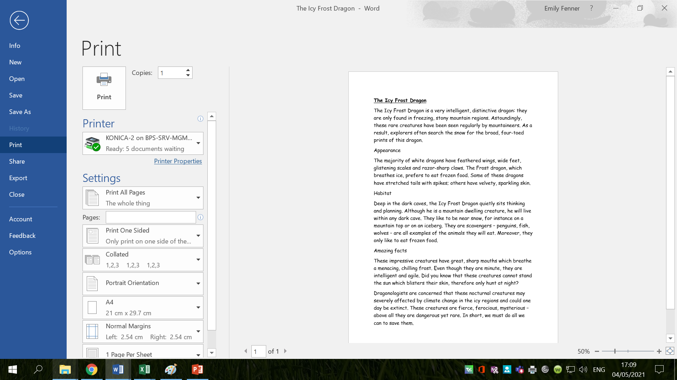
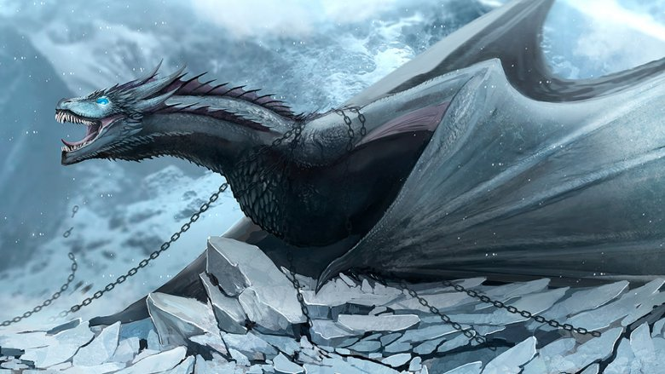
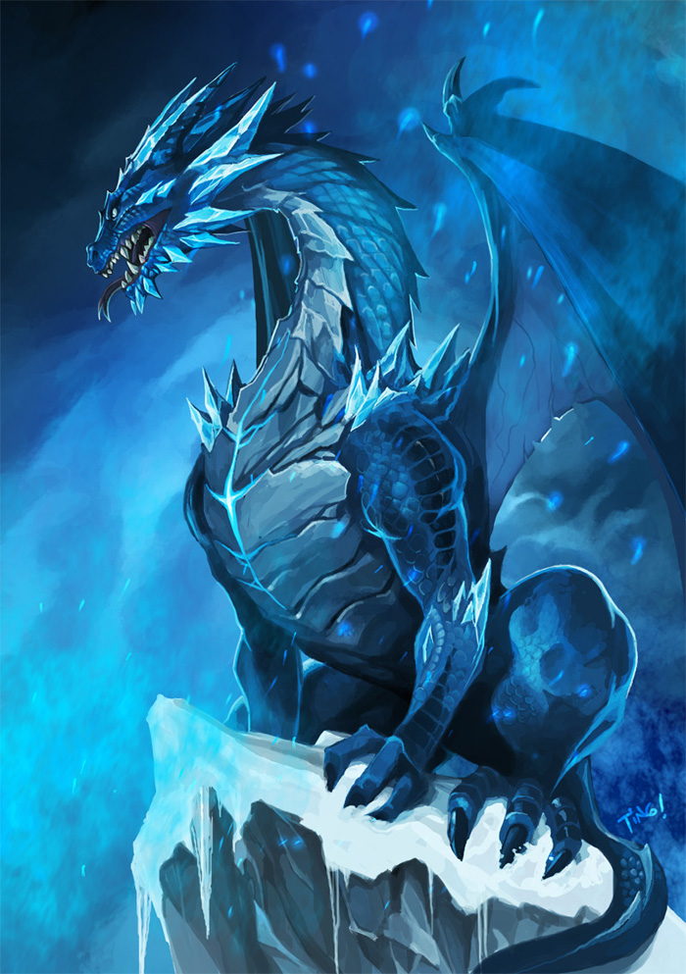

Slide 4

What type of writing is this?

Slide 5

A non-chronological report is a text which isn’t written in time order.
They are normally non-fiction texts which give information on a particular subject or event, without referring to the order in which things happen.

Slide 6

What do you think the features of non-chronological reports are?
Read the texts again and identify the key features.

Slide 9
Features of non-chronological reports
- a topic title which covers the whole subject
- a brief introductory paragraph which gives a who/what/where overview
- information grouped into paragraphs, with sub-headings
- individual points supported by extra detail and examples or evidence
- written in the present tense, unless the report is historical
- written in the third person
- formal tone

Slide 10
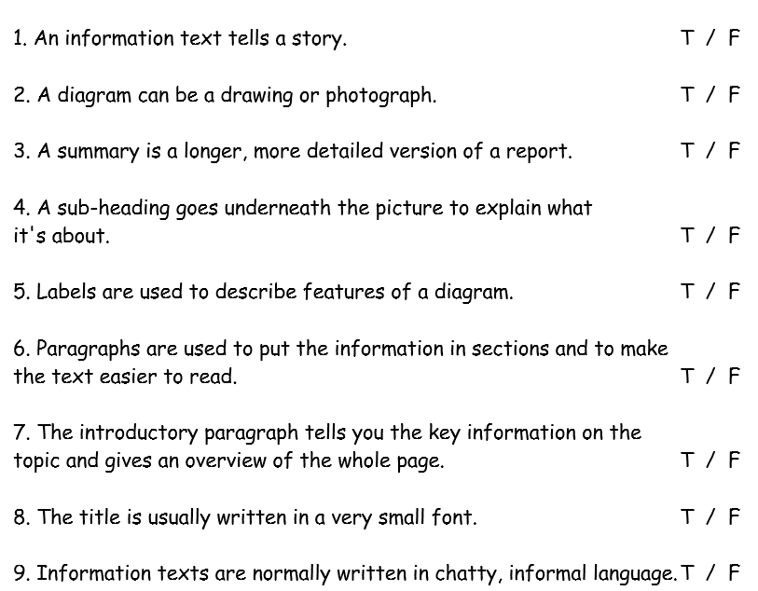
Activity:
Complete the non-chronological report true or false quiz!
Red Pen: what do you think the benefits (positives) of non-chronological reports are? Are there any weaknesses (negatives) you can think of?

Slide 11
Tuesday 11th May 2021
LO: to use imaginative description
C: Non-Chronological Reports

Slide 12
Vocabulary Matching Game
Match the simple language with more complex words.
tough | leathery | impenetrable | robust | resilient
ugly | grotesque | monstrous | hideous | repulsive
quick | agile | nimble | rapid | swift
big | immense | vast | cumbersome | colossal
sharp | jagged | spikey | razor-sharp | pointed
hot | scorching | fiery | scalding | boiling
poisonous | toxic | venomous | lethal | noxious
powerful | mighty | formidable | sinewy | robust

Slide 13
Call my Bluff
Decide from the set of definitions below which one is the correct meaning.
Grotesque
a) Powerful and strong
b) Ugly and twisted
c) Colourful and bright
d) Very hot
Sinister
a) Large
b) Poisonous
c) Invisible
d) Threatening
Malicious
a) Bright and shiny
b) Nasty and harmful
c) Hard and strong
d) Bad smell
Impenetrable
a) Jagged and sharp
b) Multi-coloured
c) Impossible to pierce
d) Very tall and thin

Slide 14
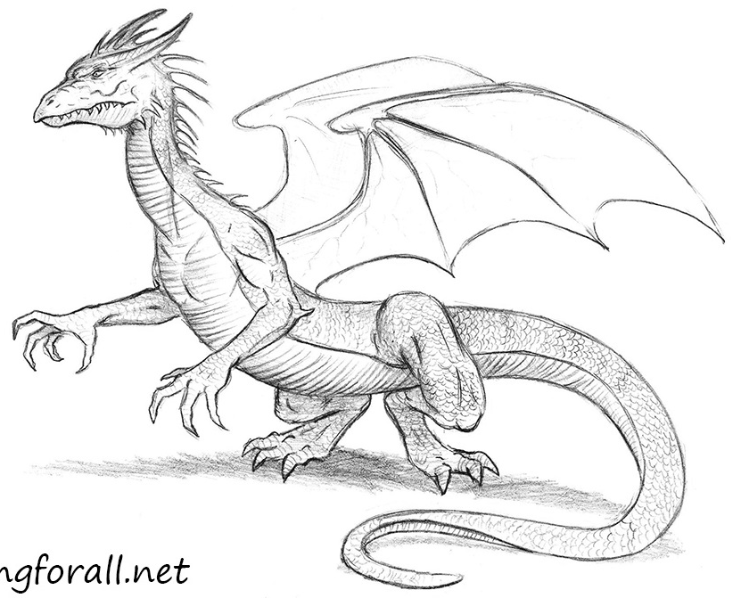
You are going to be writing your own non-chronological reports over the next couple of weeks about your very own dragon!
First, you need to create your own dragon and draw it!
It is very important to consider what parts of your dragon you’re going to describe before you draw.

Slide 15
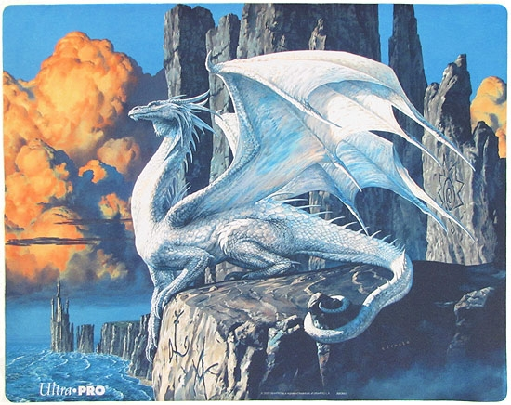
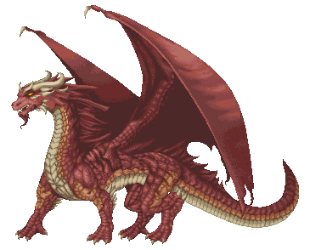
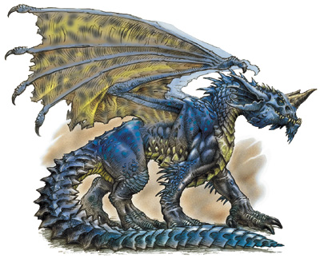
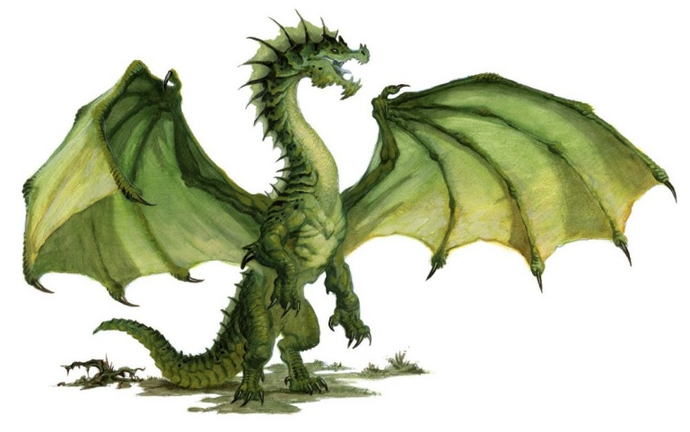
Look at these dragon pictures.
Think of some expanded noun phrases to describe their features.

Slide 16
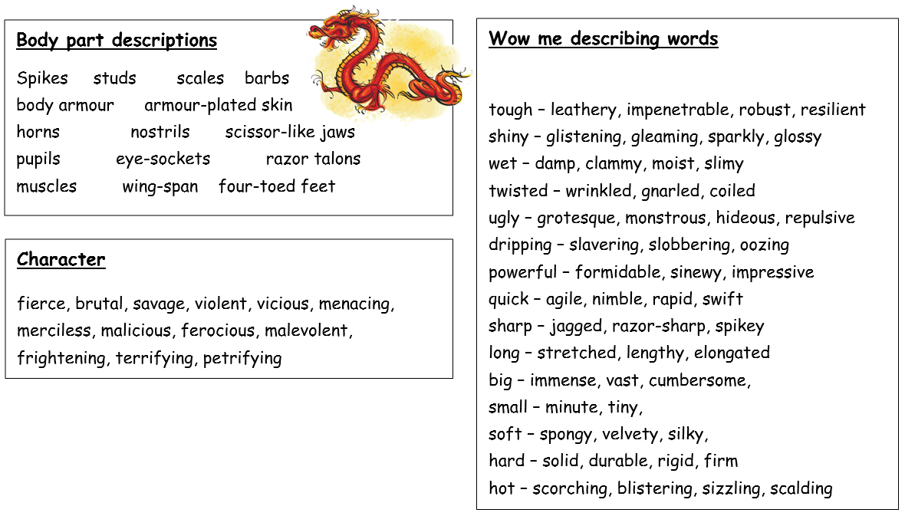
What is your dragon going to look like?
What features will your dragon have?
What expanded noun phrases will you use to describe your dragon?

Slide 17
Try to use impressive vocabulary to describe your dragon.
Can you use alliteration, similes and metaphors to describe your dragon in detail?

Slide 18
Activity:
Paddling: Draw a picture of your dragon. Label your dragon’s features using expanded noun phrases. | Snorkelling: Draw a picture of your dragon. Label your dragon’s features using expanded noun phrases and alliteration. | Diving: Draw a picture of your dragon. Label your dragon’s features using expanded noun phrases, alliteration, similes and metaphors.
Red Pen: using the sentence starters below, write some sentences about your dragon’s appearance using conjunctions.
The majority of…
Some dragons…
The … dragon …

Slide 20
Wednesday 12th May 2021
LO: to write with purpose
to use sentences appropriately
C: Non-Chronological Reports

Slide 21
Starter
What can you remember about simple, compound and complex sentences?

Slide 22
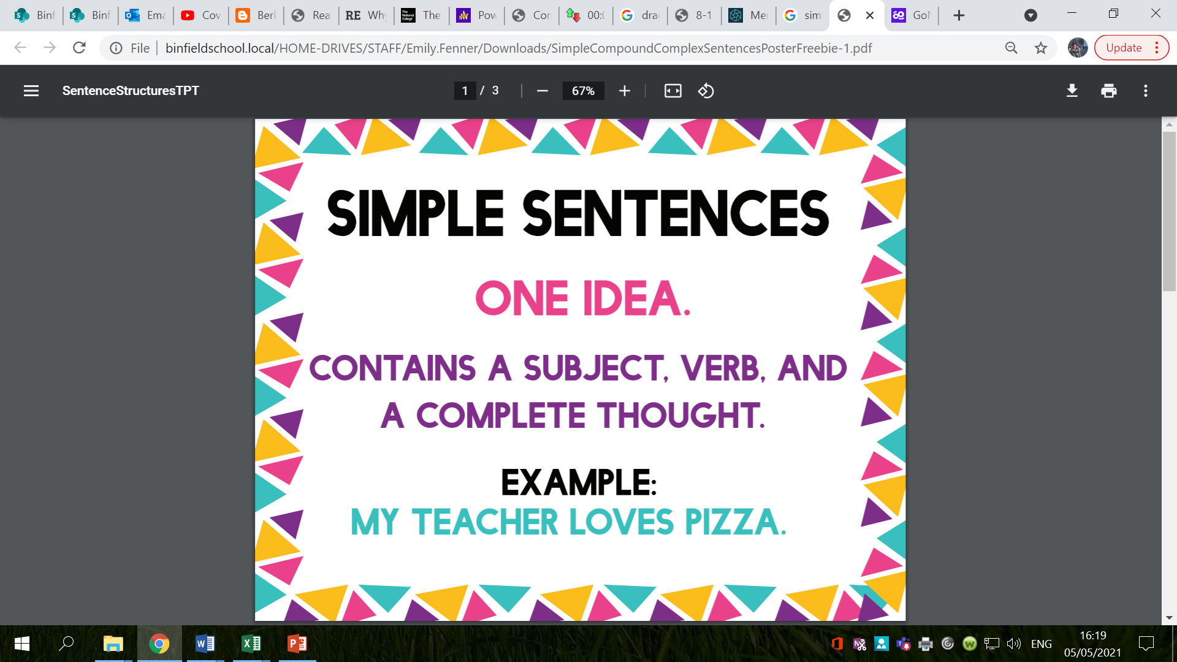

Slide 23
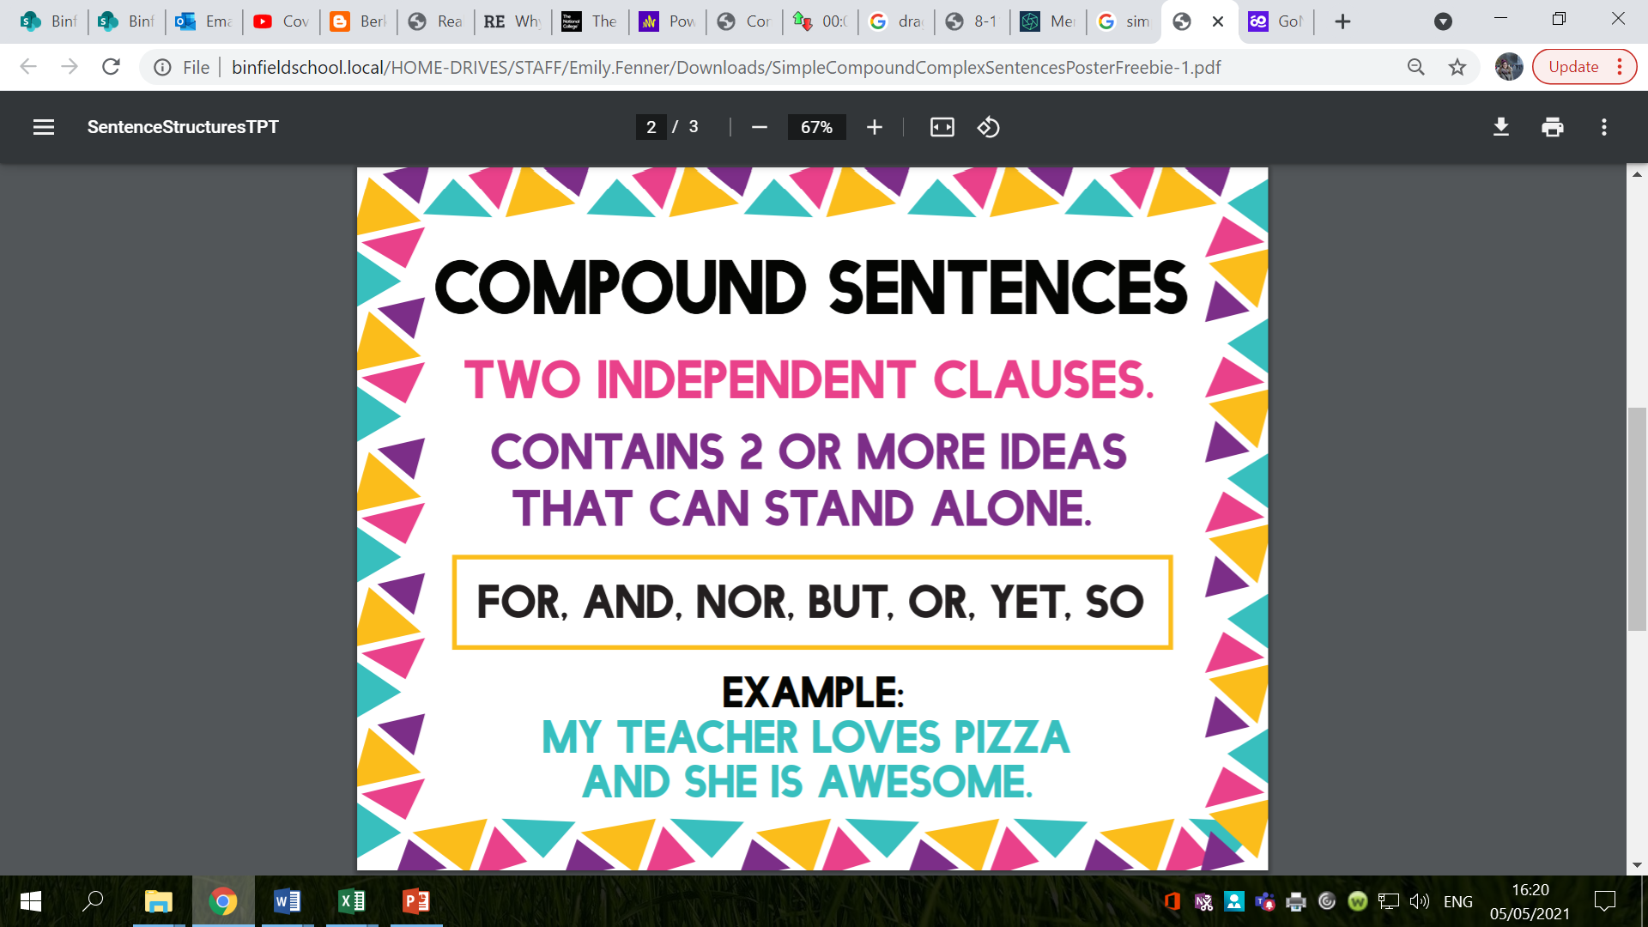

Slide 24
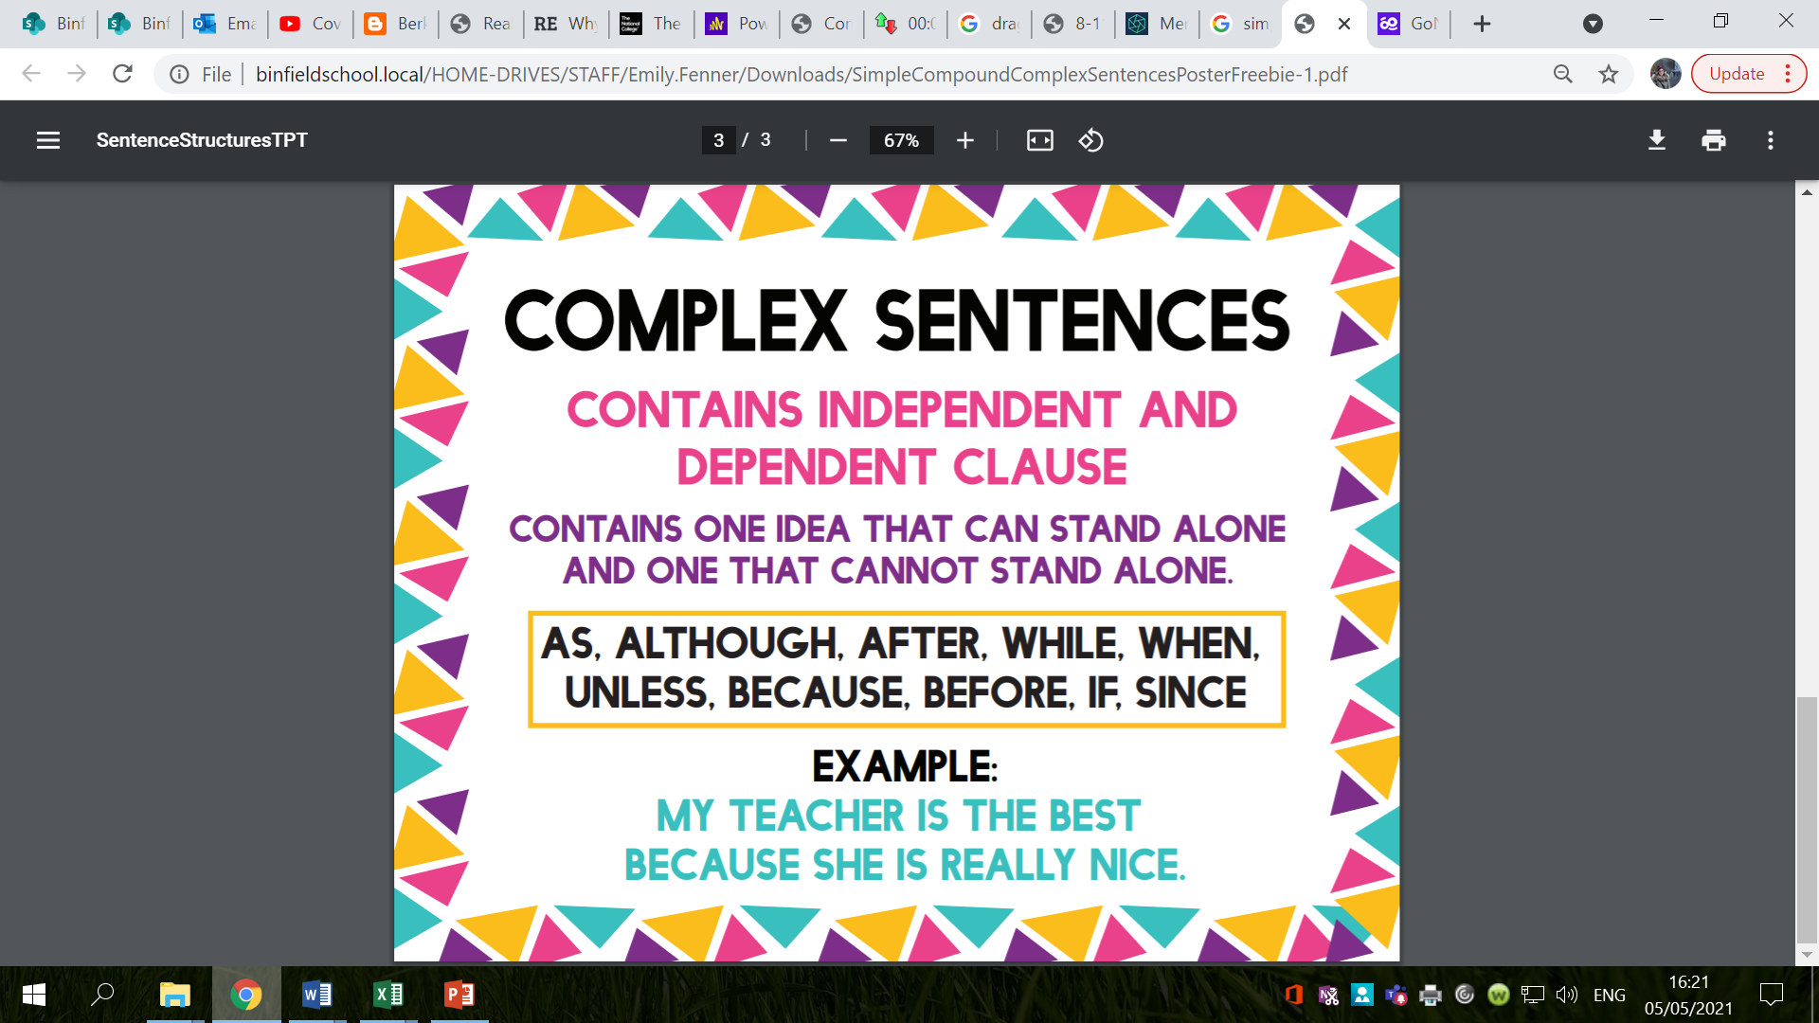

Slide 25
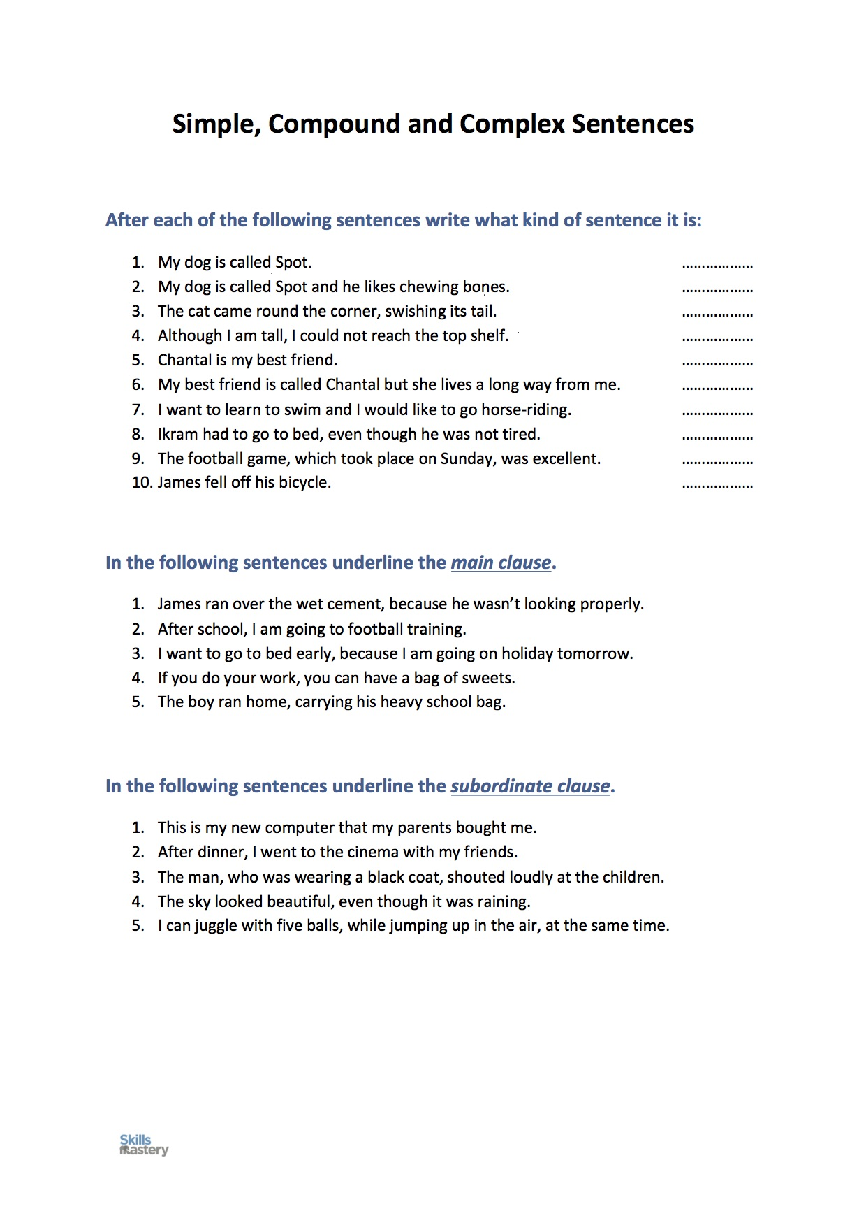

Slide 28
What things might we want to tell people about our dragons?
What questions might our readers want us to answer in our non-chronological report?
E.g. physical appearance, diet, habitat and additional information.

Slide 29
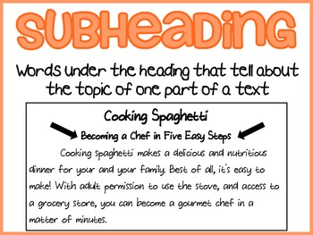
Create a list of sub-headings for your dragon non-chronological report.

Slide 30
Choose one of the sub-headings.
What could you write about your own dragon for this sub-heading?
Remember to use expanded noun phrases to describe.

Slide 31
Activity
Choose 3 sub-headings for your non-chronological report.
Create a bubble map of ideas for each of your chosen sub-headings.
Red Pen: write some sentences for one of your sub-headings using descriptive vocabulary and conjunctions.

Slide 32
Thursday 13th May 2021
LO: to write with purpose
to use imaginative description
to use paragraphs
C: Non-Chronological Reports

Slide 33
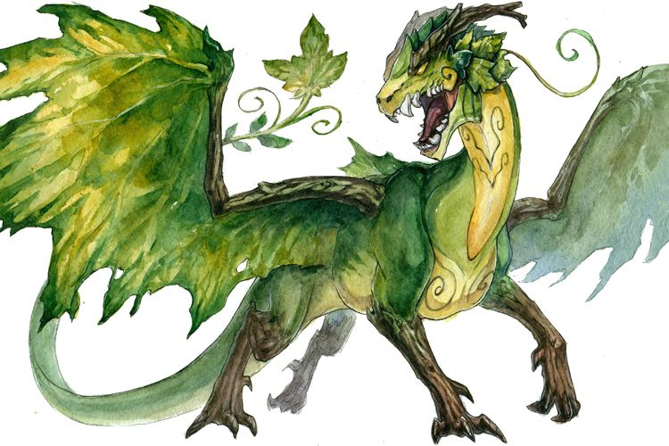
Example
What features can you see in the paragraph?
What words or phrases could you magpie in your writing today?
Forest dragons are easy to identify, as they are the smallest dragon in the British Isles. They are the size of a house cat and are covered in shiny, brittle scales. Since the adult Forest Dragon is a dark green colour, it is able to stay camouflaged in the trees and tall grass. However, juveniles are born with a yellowish tinge. They have a strip of short, yellow spikes which run along its back. Furthermore, Forest Dragons have a slightly spiked tail in order to protect them from predators.

Slide 34
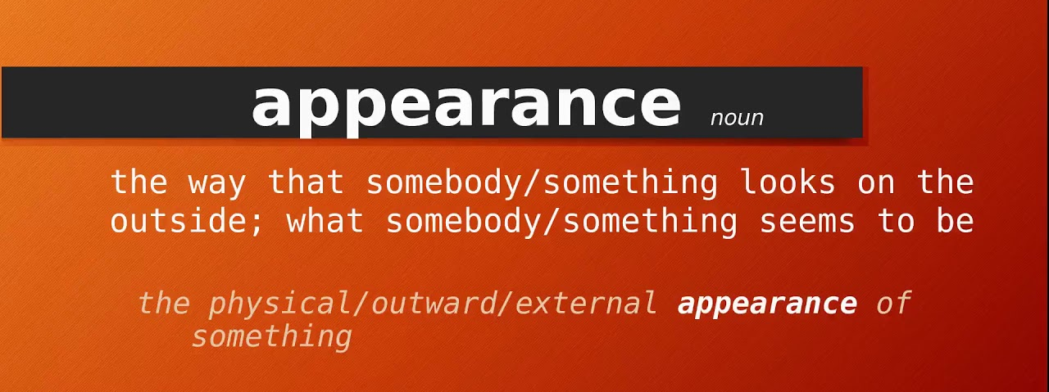
Activity:
Using the sentence prompts on the next slide, write a paragraph about your dragon’s appearance for your non-chronological report.

Slide 35

Sentence 1: Why is your dragon easy to identify?
Sentence 2: What size is your dragon?
Sentence 3: What is their skin/scales like? Does this prevent them from attack? Why?
Sentence 4: Where is your dragon’s weak spot? Where are they weakest?
Sentence 5: What is your dragon species like as a baby? How does your dragon species change as it grows older? Is your dragon easy or hard to spot? Why?
Sentence 6: What can’t your dragon do? Why?
Sentence 7: How does your dragon move on land?
Sentence 8: What are your dragon’s teeth like? What can they do?

