Slide 1
1.7.2021
L.O: To use fractions
C: Add fractions

Slide 3
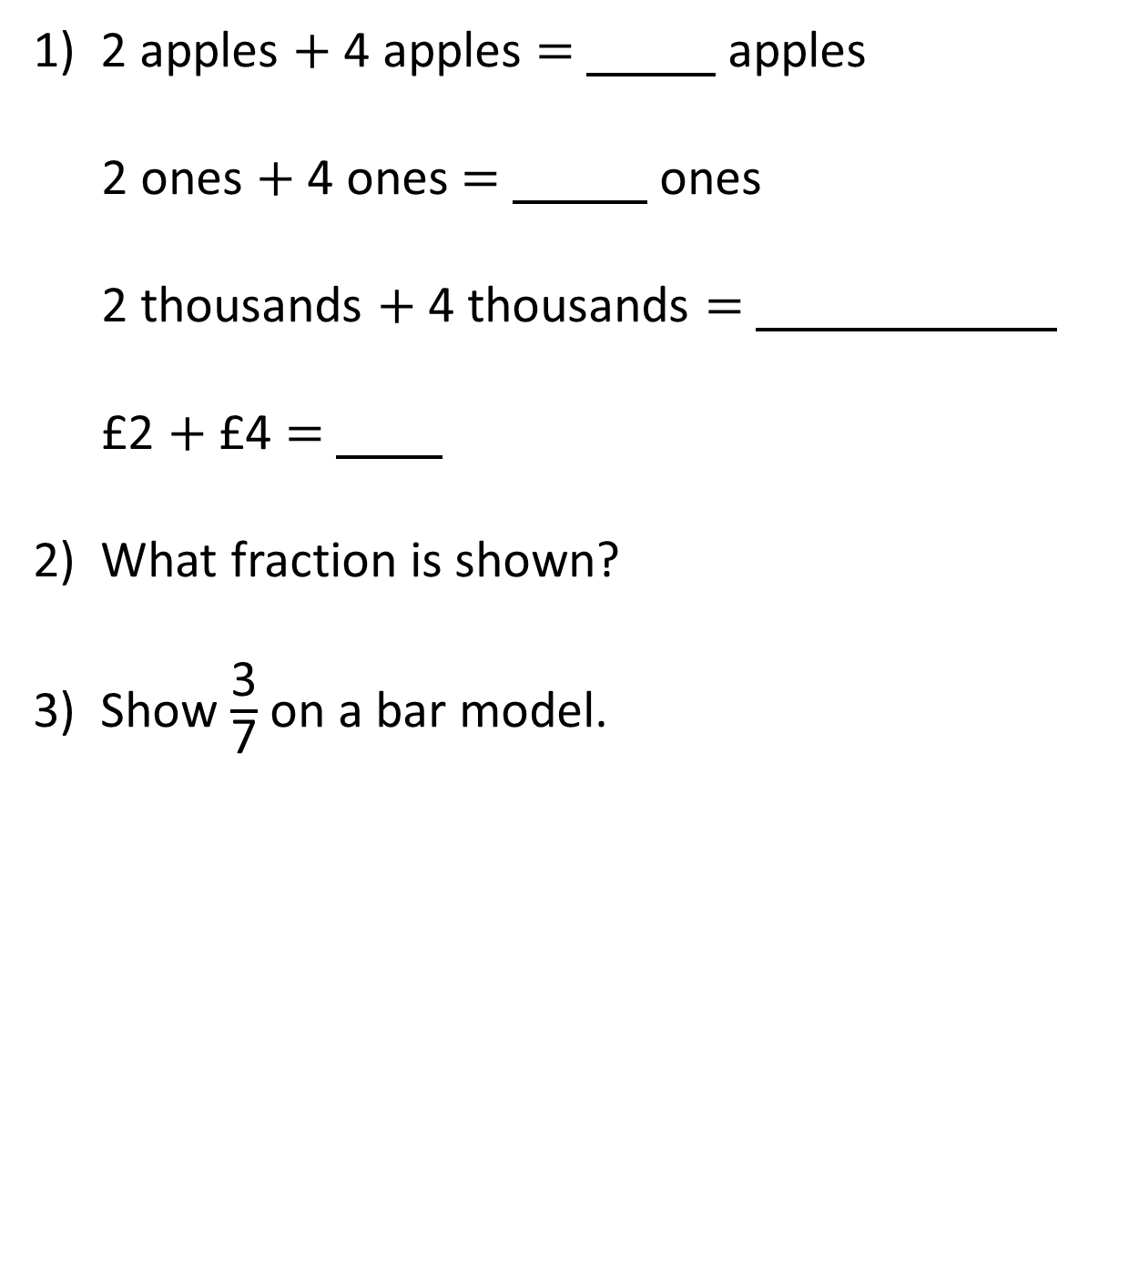
2 apples $+$ 4 apples $=$ apples
2 ones $+$ 4 ones $=$ ones
2 thousands $+$ 4 thousands $=$
£2 $+$ £4 $=$
What fraction is shown?
Show $\frac{\text{3}}{\text{7}}$ on a bar model.

Slide 4

6
2 apples $+$ 4 apples $=$ apples
2 ones $+$ 4 ones $=$ ones
2 thousands $+$ 4 thousands $=$
£2 $+$ £4 $=$
What fraction is shown?
Show $\frac{\text{3}}{\text{7}}$ on a bar model.
6
6 thousands
£6
$\frac{\text{4}}{\text{5}}$

Slide 6


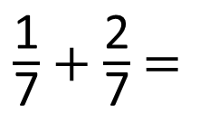
$\frac{\text{1}}{\text{7}}$ $+$ $\frac{\text{2}}{\text{7}}$ $=$
$\frac{\text{3}}{\text{7}}$
one seventh $+$ two sevenths $=$ three sevenths

Slide 7


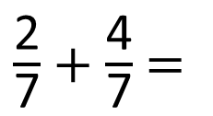
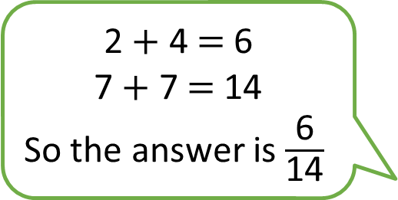
$\frac{\text{2}}{\text{7}}$ $+$ $\frac{\text{4}}{\text{7}}$ $=$
2 $+$ 4 $=$ 6
7 $+$ 7 $=$ 14
So the answer is $\frac{\text{6}}{\text{14}}$
Do you agree with Tiny?
Have a think

Slide 8


$\frac{\text{2}}{\text{7}}$ $+$ $\frac{\text{4}}{\text{7}}$ $=$
$\frac{\text{6}}{\text{7}}$
2 $+$ 4 $=$ 6
7 $+$ 7 $=$ 14
So the answer is $\frac{\text{6}}{\text{14}}$
Oh wait! I see now it’s $\frac{\text{6}}{\text{7}}$

Slide 9


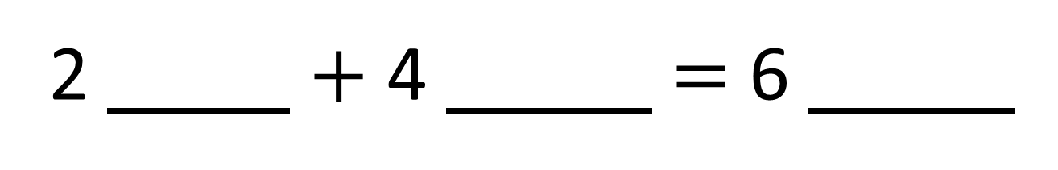
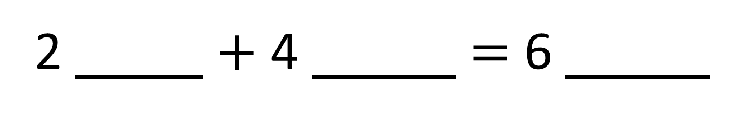
2 $+$ 4 $=$ 6
2 $+$ 4 $=$ 6

Slide 10



2 $+$ 4 $=$ 6
2 $+$ 4 $=$ 6
sevenths
sevenths
hundreds
hundreds
hundreds
sevenths
$$\frac{\text{6}}{\text{7}}$$
$\frac{\text{2}}{\text{7}}$ $+$ $\frac{\text{4}}{\text{7}}$ $=$

Slide 11



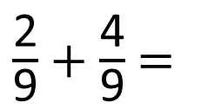


$\frac{\text{2}}{\text{9}}$ $+$ $\frac{\text{4}}{\text{9}}$ $=$
$\frac{\text{6}}{\text{9}}$
Have a think
$\frac{\text{6}}{\text{9}}$
$\frac{\text{2}}{\text{9}}$
$\frac{\text{4}}{\text{9}}$

Slide 12
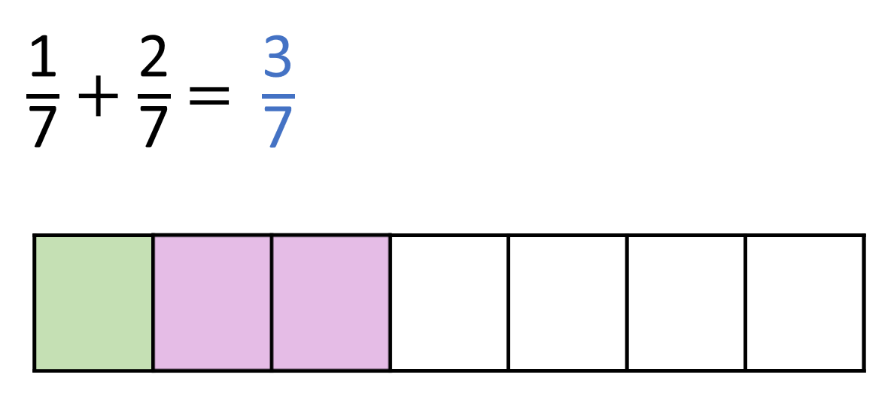
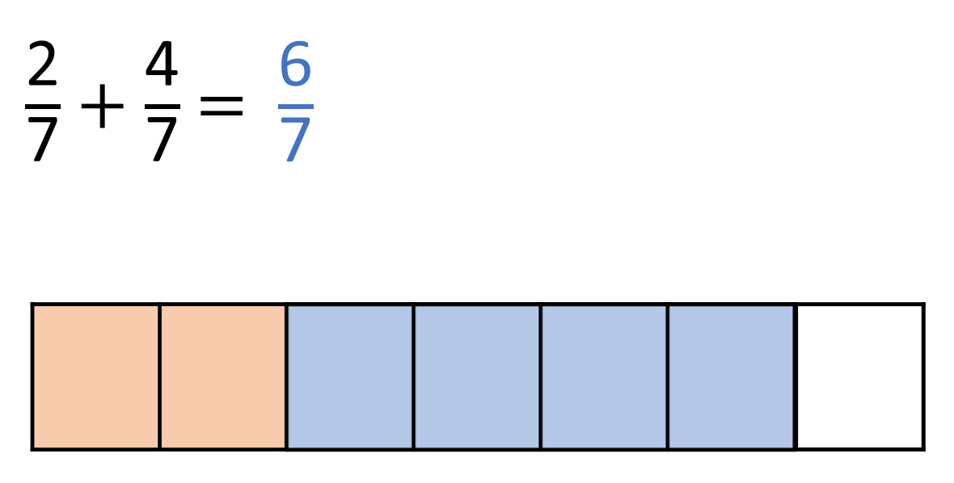
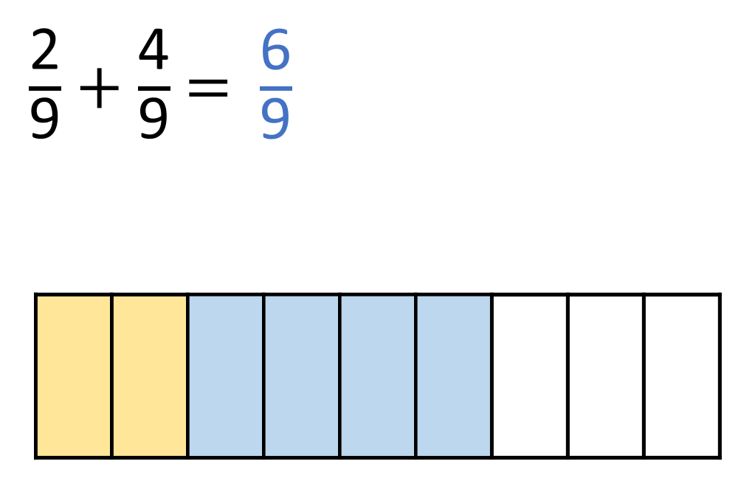
What do you notice?
Have a think
Add the numerators
Keep the denominators
the same

Slide 13
Have a go at questions 1 – 3 on the worksheet

Slide 14
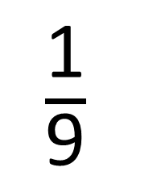
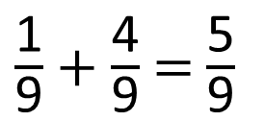
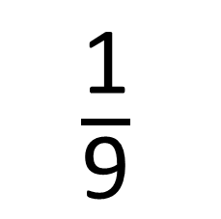
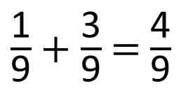
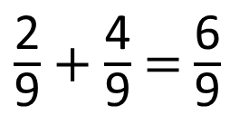
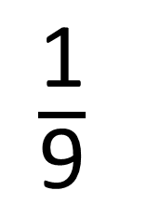
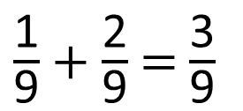
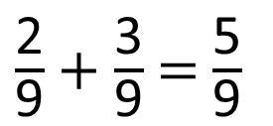


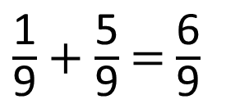
1
2
3
4
5
6
$\frac{\text{1}}{\text{9}}$
$\frac{\text{1}}{\text{9}}$
$\frac{\text{1}}{\text{9}}$
$+$
$=$
You can use each digit card once per solution.
How many solutions can you find?
$\frac{\text{1}}{\text{9}}$ $+$ $\frac{\text{2}}{\text{9}}$ $=$ $\frac{\text{3}}{\text{9}}$
$\frac{\text{1}}{\text{9}}$ $+$ $\frac{\text{3}}{\text{9}}$ $=$ $\frac{\text{4}}{\text{9}}$
$\frac{\text{1}}{\text{9}}$ $+$ $\frac{\text{4}}{\text{9}}$ $=$ $\frac{\text{5}}{\text{9}}$
Have a think
$\frac{\text{1}}{\text{9}}$ $+$ $\frac{\text{5}}{\text{9}}$ $=$ $\frac{\text{6}}{\text{9}}$
$\frac{\text{2}}{\text{9}}$ $+$ $\frac{\text{3}}{\text{9}}$ $=$ $\frac{\text{5}}{\text{9}}$
$\frac{\text{2}}{\text{9}}$ $+$ $\frac{\text{4}}{\text{9}}$ $=$ $\frac{\text{6}}{\text{9}}$

Slide 15
Have a go at the rest of the questions on the worksheet

