Slide 1



Slide 2





Slide 3



Slide 4

Buddhists believe…
The real source of happiness lies within our minds.

Slide 5
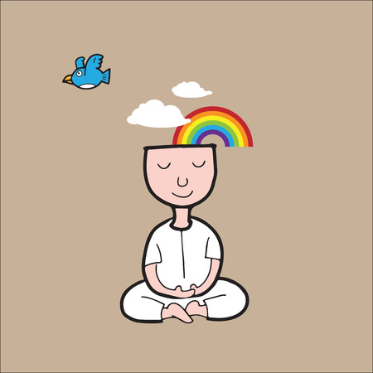
A pure and peaceful mind = happiness.

Slide 6


Slide 7

Getting what you want does not guarantee you happiness.
Wanting things stops us from being happy.

Slide 8

Buddhists believe…
Unhappiness will end when we stop wanting things for our selves.
When selfish wanting is removed, there will be no more suffering.
We will be happy, always.

Slide 9
Activity:
List three things that you have really wanted, then answer the following questions from a Buddhist’s point of view:
- Did you ever have any of the things you wanted so much?
- Did having any of them make you happy?
- If so, how long did the feelings of happiness last?
Red Pen Challenge: Do you think the source of happiness lies in your mind or in the things that you have, such as family, friends, possessions etc.? Explain your reasoning.

