Slide 1
To investigate places.
To communicate geographically.
To build an overview of world history.
C: Pompeii

Slide 3
Key Words
Active volcano A volcano that has had at least one eruption during the past 10,000 years.
Dormant volcano Volcanoes that are quiet, but might possibly erupt again.
Extinct volcano Volcanoes that have not had an eruption for at least 10,000 years and are not expected to erupt again.
Plinian eruption Eruptions named after the Roman writer, Pliny the Younger who wrote the only eye witness account of his uncle, Pliny the Elder, who witnessed the 79AD eruption.
Pyroclastic flow Very hot ash, lava fragments, and gases that come from a volcano, typically flowing at great speed.
Stratovolcano A volcano built up of layers of lava and ash.
Viscous A thick, sticky consistency between solid and liquid.

Slide 4
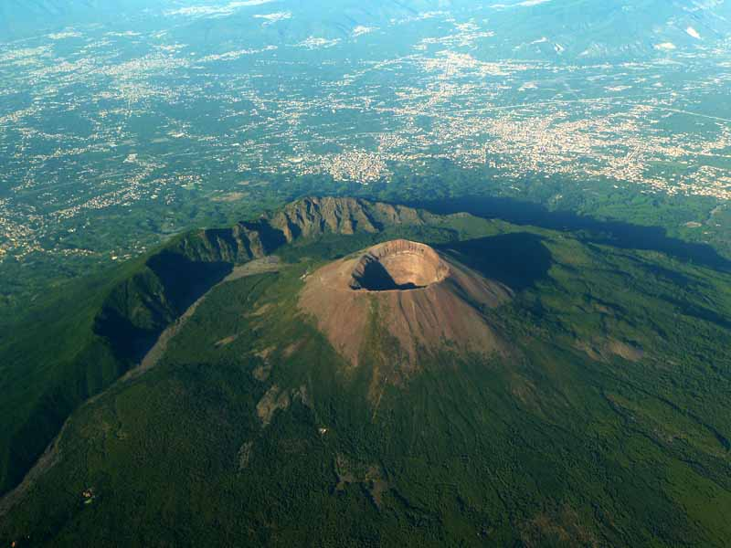
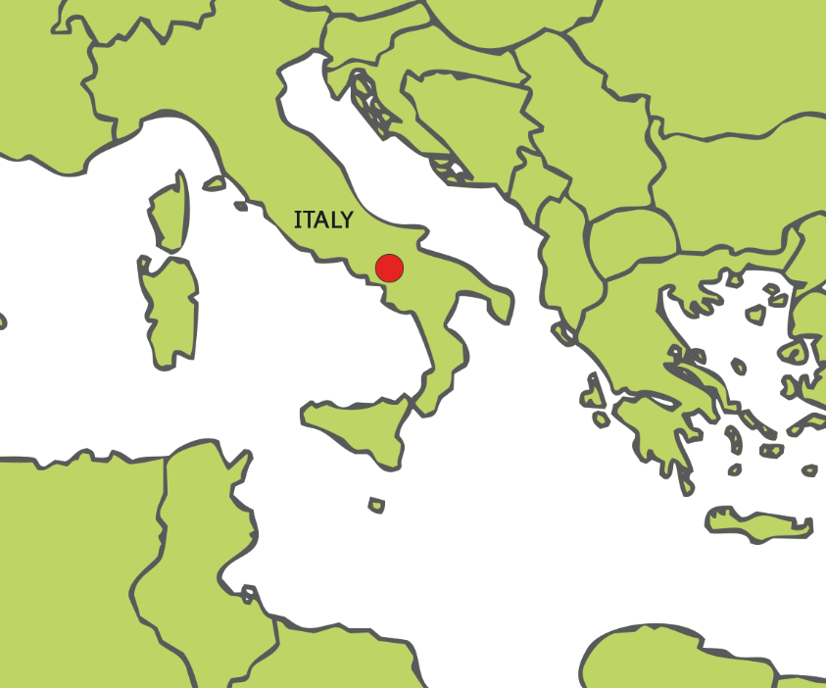
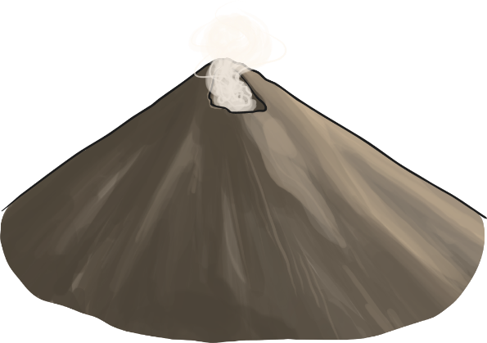
Mount Vesuvius is located on the Gulf of Naples, in Italy.
It is close to the coast and lies around 9km from the city of Naples.
Despite being the only active volcano on mainland Europe, and one of the most dangerous volcanoes, almost 3 million people live in the immediate area.
Did you know..?
Mount Vesuvius last erupted in 1944.
Photo courtesy of Ross Elliot(@flickr.com) - granted under creative commons licence – attribution

Slide 5
Mount Vesuvius is one of a number of volcanoes that form the Campanian volcanic arc. This is a series of volcanoes that are active, dormant or extinct.
Mount Vesuvius is actually a volcano within a volcano. Mount Somma is the remain of a large volcano, out of which Mount Vesuvius has grown.
Campi Flegrei
Vesuvius
Vulcano
Stromboli
Panarea
Etna
Campi Flegrei del Mar di Sicilia
Did you know..?
Mount Vesuvius is 1,281m high.
Mount Etna is another volcano in the Campanian arc. It is Europe’s most active volcano.

Slide 6
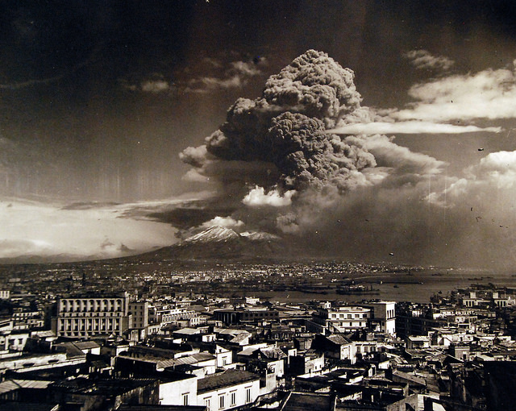

Mount Vesuvius last erupted in 1944. This was during the Second World War and the eruption caused great problems for the newly arrived Allied forces.
Aircraft were destroyed, an airbase was evacuated and 26 people died. Three villages were also destroyed.
1944 was the last recorded eruption but scientists continue to monitor activity as Mount Vesuvius is especially dangerous.
Did you know..?
During the 1944 eruption, the lava flow stopped at the steps of the local church in the village of San Giorgio a Cremano. The villagers call this a miracle!
Photo courtesy of National Museum of the U.S. Navy(@flickr.com) - granted under creative commons licence – attribution

Slide 7
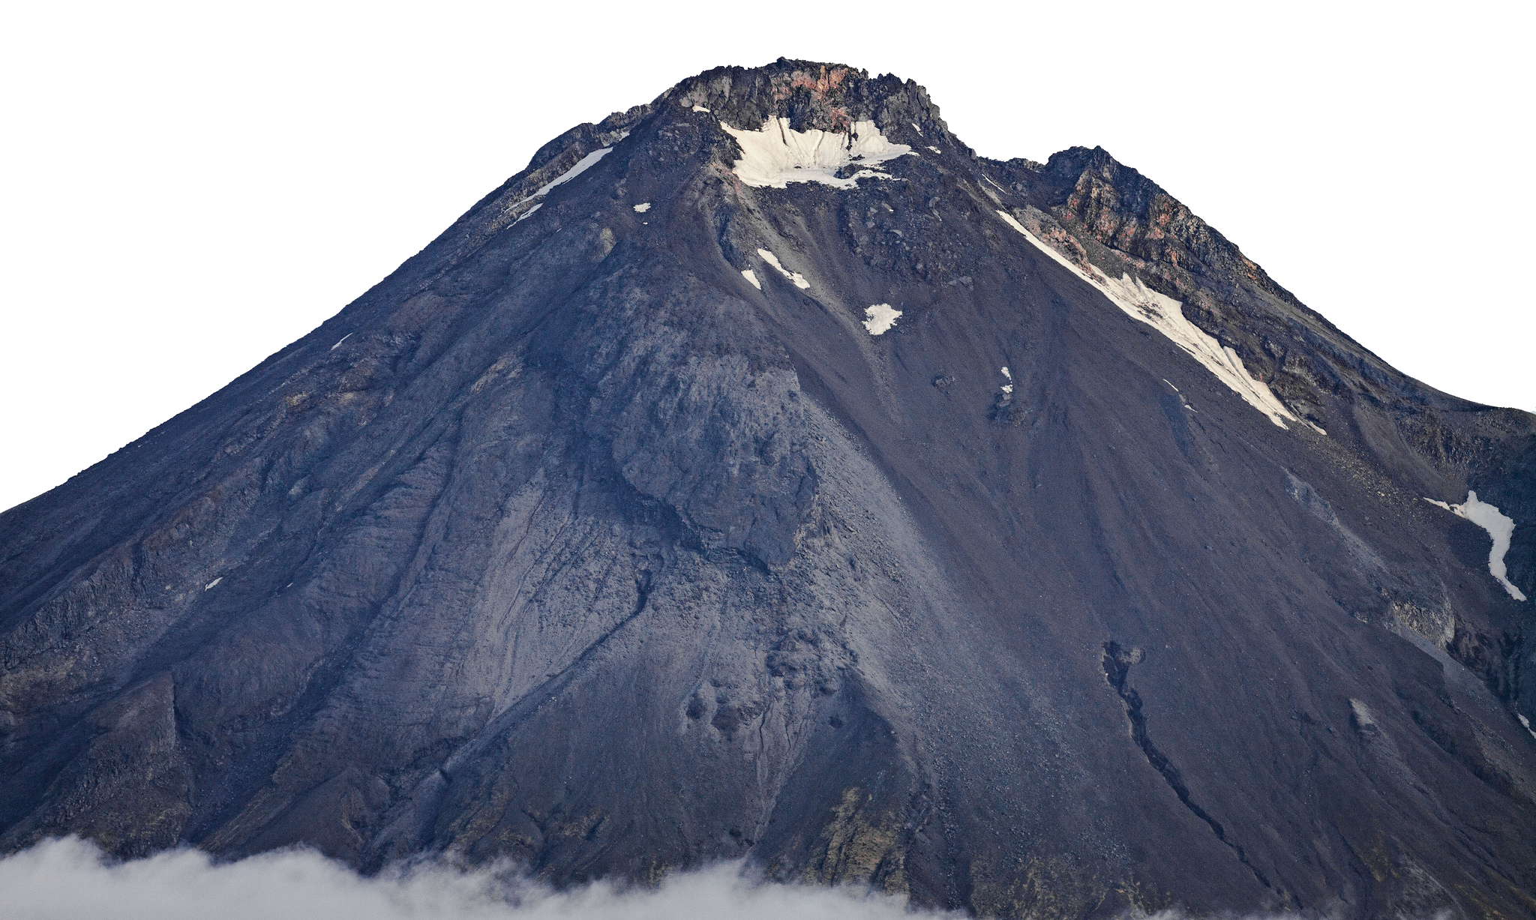
Mount Vesuvius is a stratovolcano.
Tall, conical shape.
Steep profile.
Explosive eruptions.
Composed of a layer of hardened lava and volcanic ash, which creates a danger of mud slides during eruptions.
Lava is highly viscous. This makes it cool and harden before it gets far.
Stratovolcanoes are the most common volcano type.
Causes more casualties than other volcano types.
Photo courtesy of Dave Young(@flickr.com) - granted under creative commons licence – attribution

Slide 8
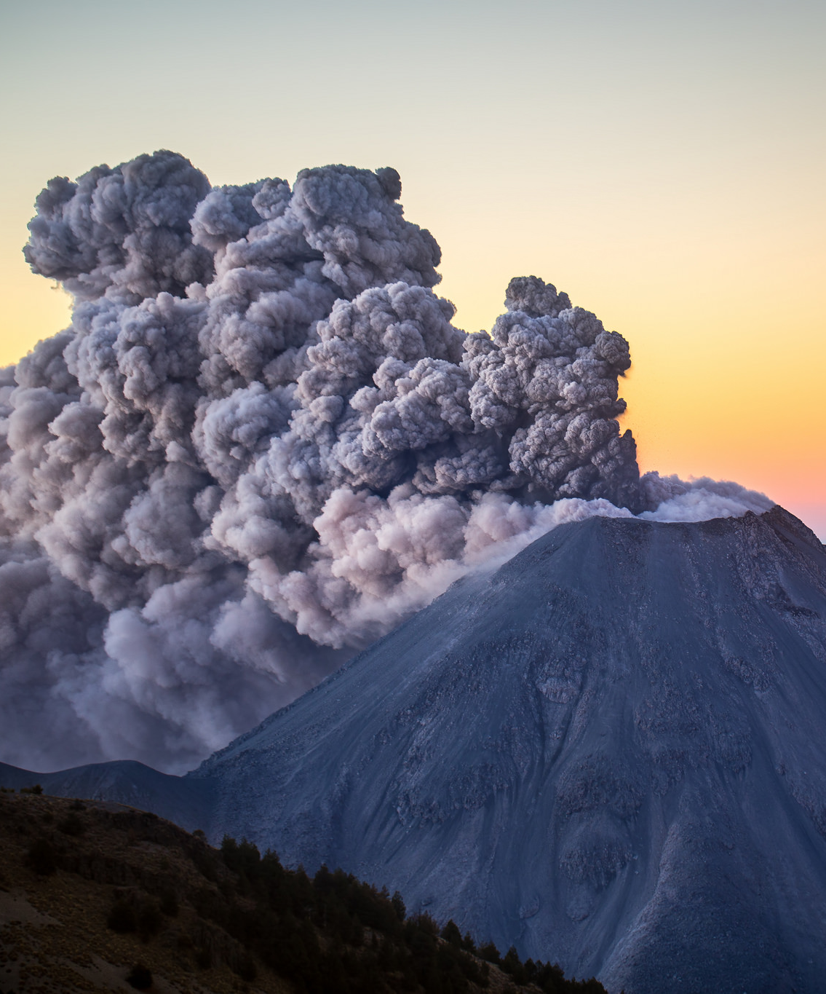
Although Mount Vesuvius has been relatively quiet since 1944, volcanologists believe it is a matter of when, not if, the volcano will erupt again.
While the city of Naples lies around 9km away, volcanologists have predicted that in the event of an eruption, the pyroclastic flow containing hot ash, gas and rock, would take just less than 3 minutes to reach the city.
Photo courtesy of Christian Villicana(@flickr.com) - granted under creative commons licence – attribution

Slide 9
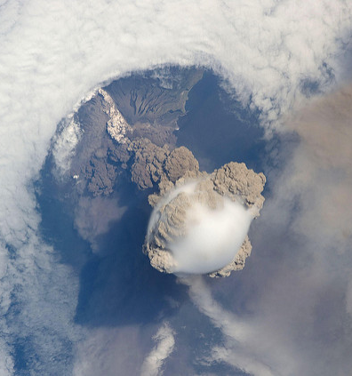
Plinian eruptions are huge explosions that create columns of gas, ash and rock that rises dozens of kilometres into the atmosphere. Because of this, the effects of a Plinian eruption have a greater reach.
The gas, ash and rock are known as pyroclastic flows and travel great distances at speeds of up to 100 miles per hour.
Clouds of hot ash, gas and rock as seen from space.
Photo courtesy of NASA Goddard Space Flight Center(@flickr.com) - granted under creative commons licence – attribution

Slide 10
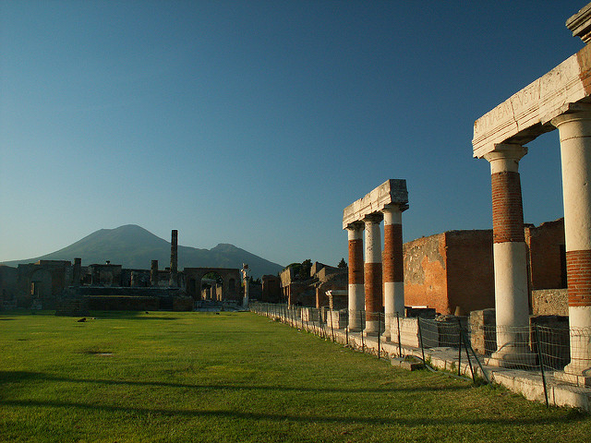
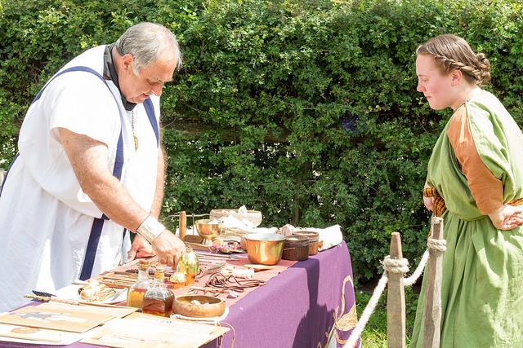
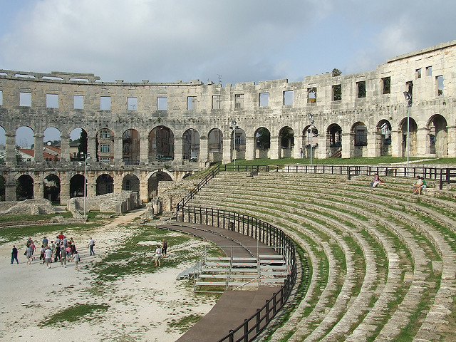
Mount Vesuvius is probably most famous for the 79 AD eruption that destroyed the Roman towns of Pompeii and Herculaneum.
Pompeii was a bustling Roman city, with grand stone buildings, temples and a forum. The streets were paved and even had the luxury of running water.
On the 24th August 79AD, the streets would have been bustling with people shopping, trading and going about their everyday routines.
Photo courtesy of Hardo Muller, Hans Splinter, Chris Yunker(@flickr.com) - granted under creative commons licence – attribution

Slide 11
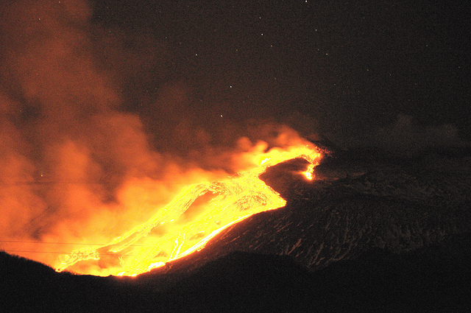
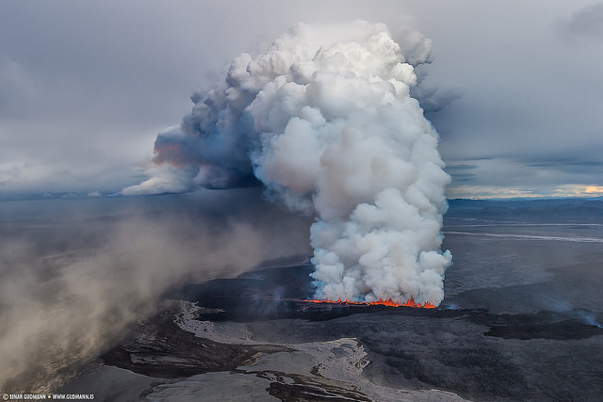
Mount Vesuvius had not erupted for hundreds of years - many people were unaware it was even a volcano.
People chose to live right on the mountain because of the rich, fertile soils on the slopes of the mountain. This was good to grown crops in and gave farmers work.
The first sign of trouble came in the afternoon with a huge explosion. Rocks, ash and lava were hurled into the air.
Lava began to flow down the slopes but people were not immediately concerned, believing they were safe in the city.
Photo courtesy of gnuckx, Sparkle Motion(@flickr.com) - granted under creative commons licence – attribution

Slide 12
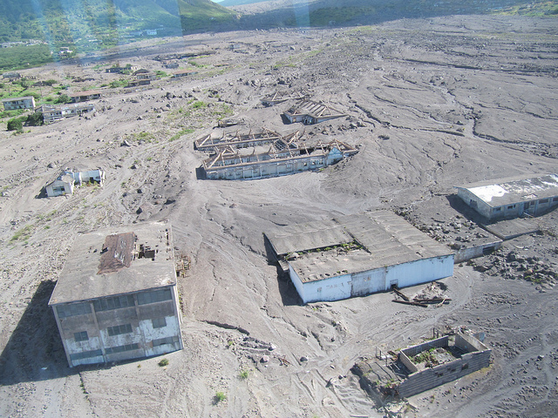
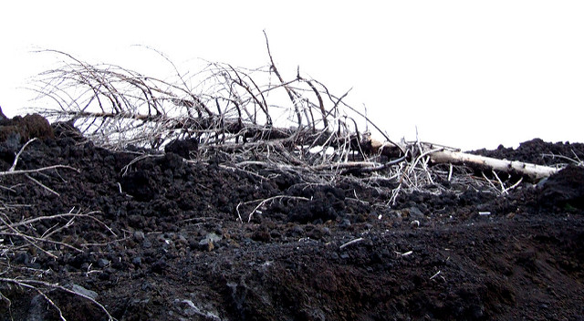
Eighteen hours after the first eruption, there was another. This time the eruption had such force, one side of the mountain blew up. A huge cloud of rock, ash and gas hurtled down the slopes towards Pompeii.
The citizens tried to flee. But it was too late.
The citizens were buried in seconds where they stood, in a layer of ash around 9m thick.
Photo courtesy of Leonora (Ellie) Enking, gnuckx(@flickr.com) - granted under creative commons licence – attribution

Slide 13
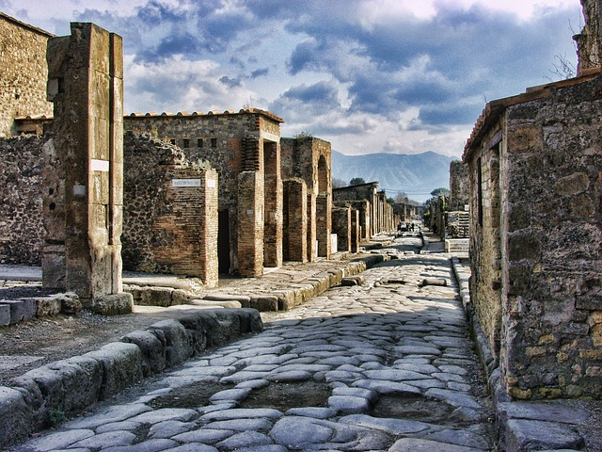
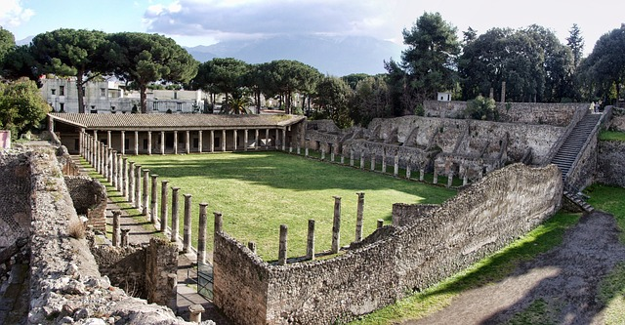
Because the area around Mount Vesuvius remained uninhabitable, the towns of Pompeii and Herculaneum were undiscovered until 1748.
Nearly 2000 years later in 1997, the whole city of Pompeii was finally uncovered.
Today you can walk the paved streets of the Roman towns and marvel at the stone and concrete structures that were preserved in the volcanic ash.
Photo courtesy of Graham-H(@pixabay.com) - granted under creative commons licence – attribution

Slide 14
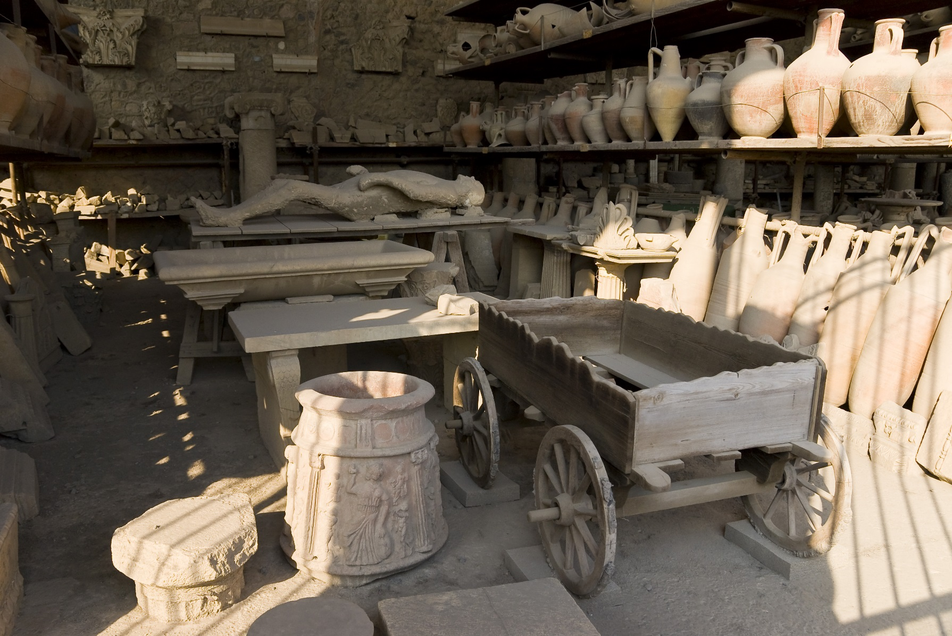
When Mount Vesuvius erupted, the people who were left in Pompeii were buried by volcanic ash. When the bodies decayed, a gap was left in the ash, which archaeologists filled with plaster to create copies of people who lived in Pompeii.
Vases and human plaster casts store
Photo courtesy of Akash_Kurdekar (@flickr.com) - granted under creative commons licence – attribution

Slide 15
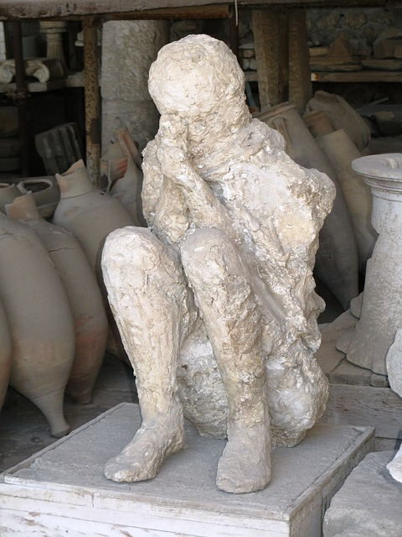
A

Slide 16
Task
Paddling | Snorkeling | Diving
Explain what you know about Mount Vesuvius and Pompeii – why did people chose to live there? -Did they know it was a volcano? Why not? Explain how the archaeologists preserved the evidence that people were buried in ash. | Explain what you know about Mount Vesuvius and Pompeii. Use geographical and Historical language such as: Past Roman times 79AD Fertile soil Stratovolacano Eruption Write 3 questions you would want to ask the people of Pompeii. | Explain in detail what you know about Mount Vesuvius and Pompeii. Use geographical and Historical language such as: Past Roman times 79AD Fertile soil Stratovolacano Eruption Pyroclastic flow In your opinion, do you think it was sensible to set up home under a volcano? Think about what they knew of the volcano.

