Slide 1
PSHCE

Slide 2
Notice how trees change through seasons.
This is a change that the trees can’t control – it just happens.
Sometimes we go through changes that we have no control over too.

Slide 3
Many people can find change difficult, especially when the change is something unpleasant or unwanted.
We can do things to help us manage change, so that we cope with the change better.
Read Sofia and Levi’s story and see if you can identify what happened in the story to manage the change and help the children cope.

Slide 4
Notes:
One day after school, Sofia and Levi were called into the kitchen by their Dad who wanted a chat. Their Dad said he had met a new girlfriend and he wanted to get married to her. Their mum had left when they were little, so Dad had always looked after them on his own. Dad said his girlfriend was called Maria and she also had two children, so they would be one big happy family. Levi and Sofia weren’t so sure. They liked having Dad to themselves. Dad said he didn’t want to rush anything and said for now he just wanted them to get used to the idea and think about it for a while.

Slide 5
Notes:
A week or two went by and Dad asked the children how they were feeling about Maria and her children. He asked if they were ready to meet them. Levi and Sofia thought they may as well get it over with and decided to say yes. Dad asked where they would like to go for a special day out, and suggested a theme park. Later that day Sofia said to Levi at least they would get to go somewhere cool even if Maria was going to be there.

Slide 6
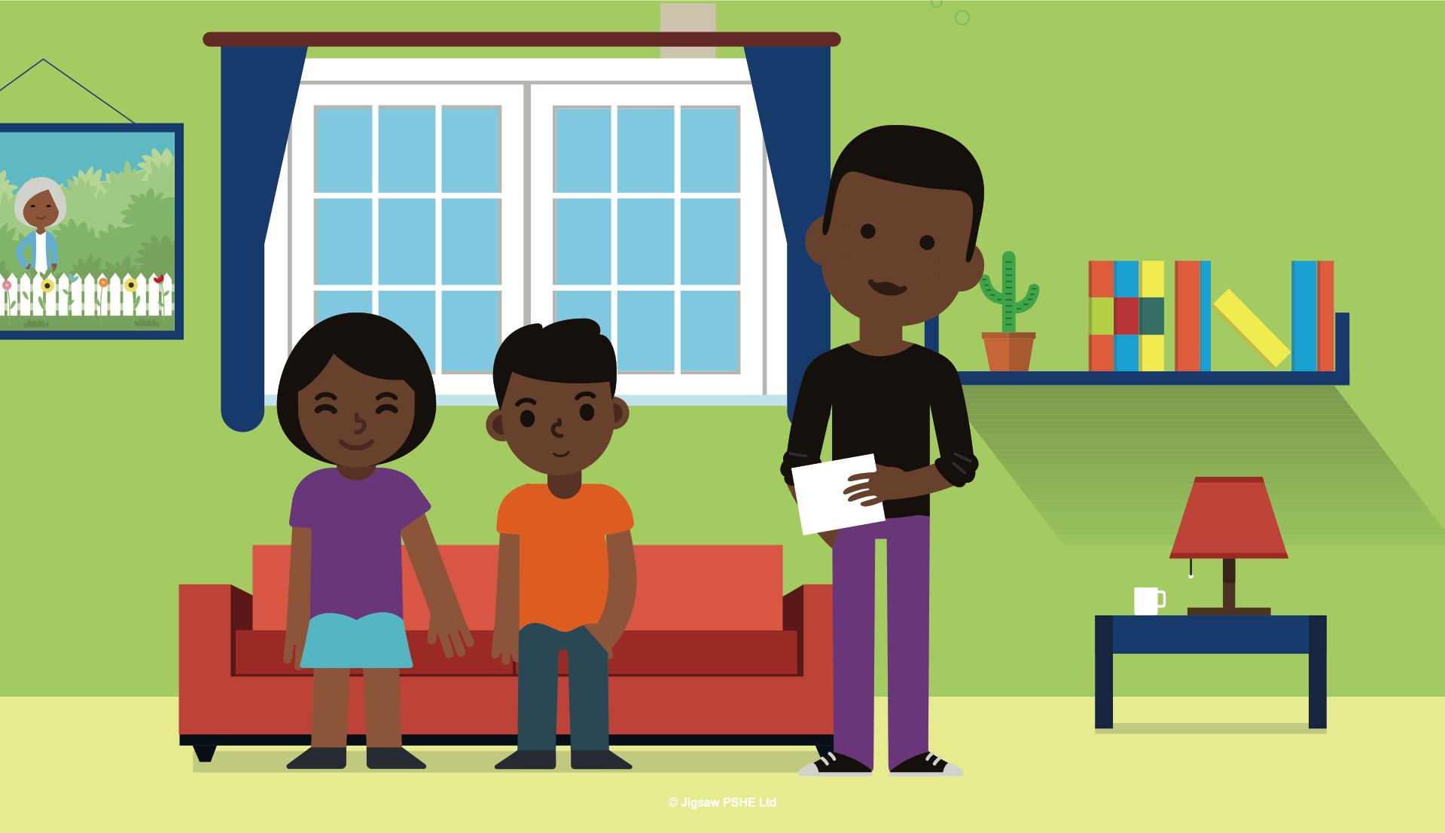
Notes:
Two days before the trip, Dad sat down with Levi and Sofia and showed them some photographs of Maria and her children. He talked about them a lot so that Levi and Sofia were prepared before the trip. Sofia thought that Maria seemed kind, and they were both pleased to be getting an older brother and sister who were fun and caring.

Slide 7
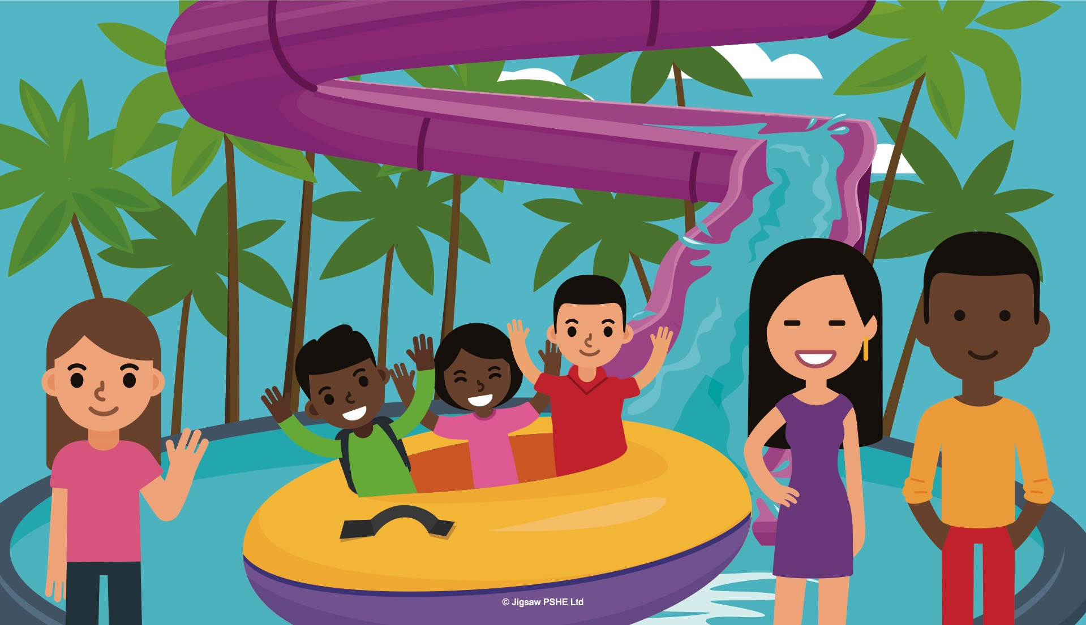
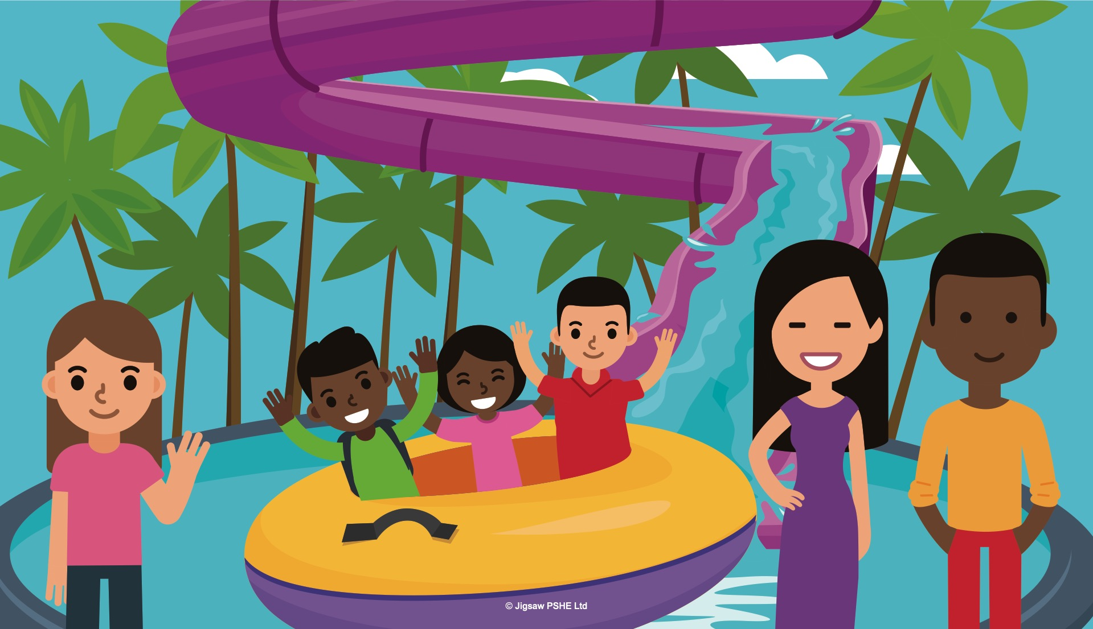
Notes:
The day of the trip arrived. The families met up. Maria and her children were very nice. Maria’s teenage children who were called Sam and Olivia, enjoyed taking Levi and Sofia on the scarier rides that their parents didn’t want to go on. Sam said that when they moved into the same house, he would teach Levi how to play basketball. Olivia said she was really looking forward to having a younger sister to share things with. Olivia was a blackbelt in Karate and she asked Sofia if she would like to start coming to classes with her. Sofia thought that would be great.

Slide 8
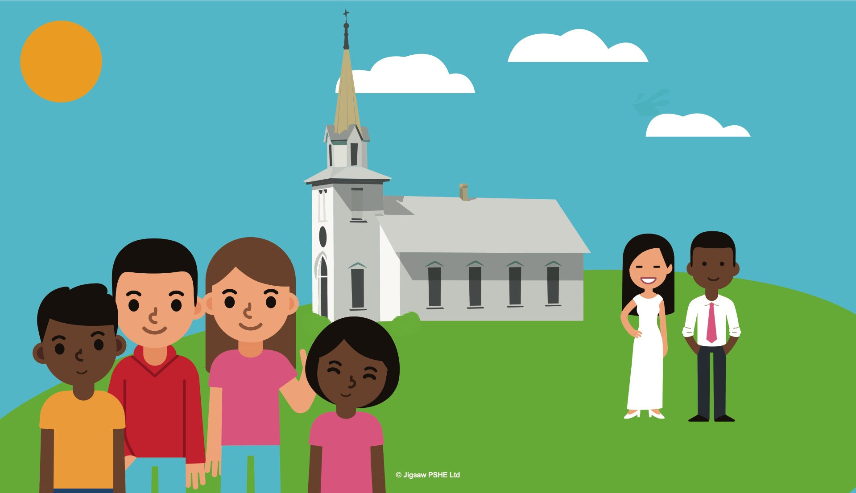
Notes:
Over the next few weeks the two families met every weekend and slowly they began to change into one family. By the time of the wedding, it didn’t seem to Sofia and Levi at all strange their family had changed, and even though they sometimes felt a little nervous about having a new Mum, it didn’t seem anywhere near as scary compared to when their Dad had first told them.

Slide 9
Using the Circle of Change template,
Make your own Circle of Change
using a split pin and an arrow.
Think of a change you would
like to make in school during
the next academic year
and think this through using
the Circle of Change model.

