Slide 1
Tuesday 6th July 2021
LO: to understand beliefs and teachings
to understand lifestyles and practices
to understand values
C: Buddhism

Slide 2
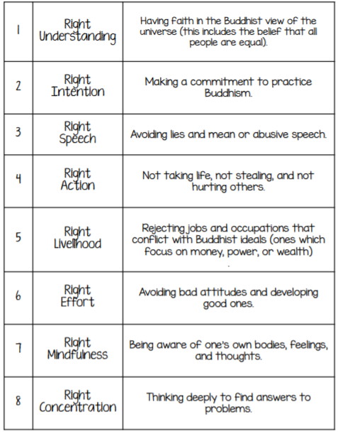
Starter
Remind yourself of the Eight-Fold Path and then have a look at the scenarios on the website.
Read the scenarios and decide if any of the folds of the Eight-Fold Path are not being followed.
Identify which stage it is and write down why it is not being followed.

Slide 3
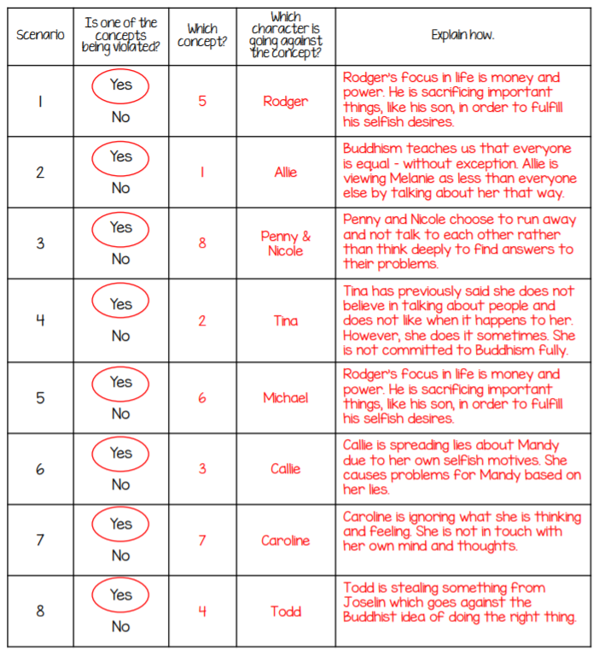
Answers

Slide 4
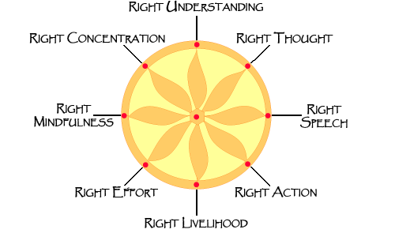
The main aim underneath the Buddha’s teaching of the Eight-Fold Path is to not bring harm to any living thing.
This means not killing/harming: people, animals and the earth!
It means not destroying the natural world around us.
Harm might not just mean physical harm, but also emotional harm too, e.g. upsetting others/hurting someone’s feelings etc.

Slide 5
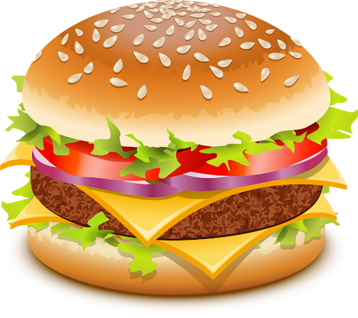

What do you think a Buddhist would say about…
Eating meat?
What would a Buddhist tell you to do instead of this action?

Slide 6
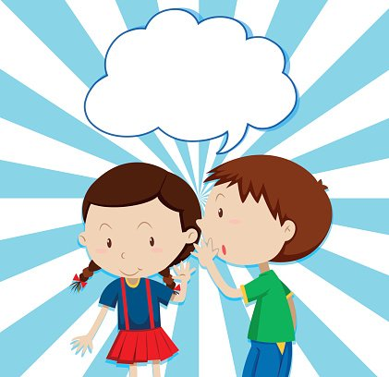
What do you think a Buddhist would say about…
Telling someone what the strange person over there did today?
What would a Buddhist tell you to do instead of this action?

Slide 7
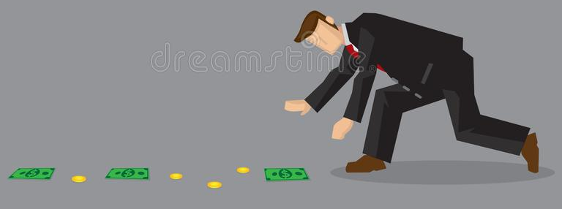
What do you think a Buddhist would say about…
Picking up a £10 note you spot in the corridor?
What would a Buddhist tell you to do instead of this action?

Slide 8
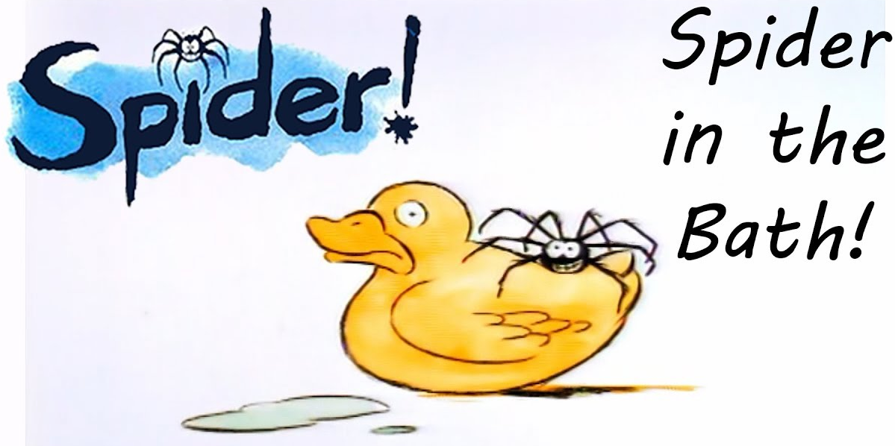
What do you think a Buddhist would say about…
Squashing a spider in the bathtub?
What would a Buddhist tell you to do instead of this action?

Slide 9
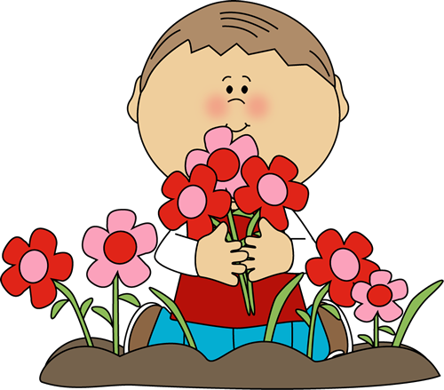
What do you think a Buddhist would say about…
Picking flowers in the garden?
What would a Buddhist tell you to do instead of this action?

Slide 10
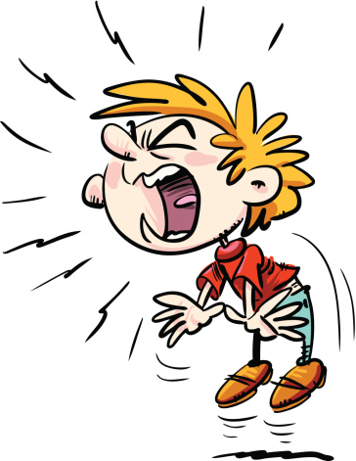
What do you think a Buddhist would say about…
Shouting at a friend who upset you?
What would a Buddhist tell you to do instead of this action?

Slide 11
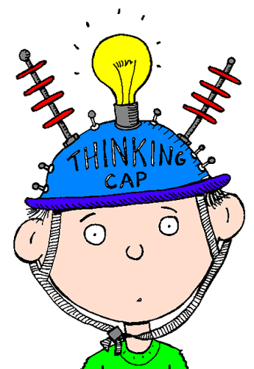
Think about a time when you were responsible for hurting another living creature.
Who or what did you hurt? How did it hurt it/them?
What would a Buddhist say you should have done?

Slide 12
Activity
Fold your page in half.
In one half – draw and illustrate a time when you were responsible for hurting another living creature.
Who/what did you hurt?
How did you hurt it/them?
In the other half – draw and illustrate what a Buddhist would have done instead.
Snorkelling and Diving: explain why you think they would have acted differently.

Slide 13
Red Pen
How difficult is it each day to make sure you never harm anyone or anything?

